Slide 1
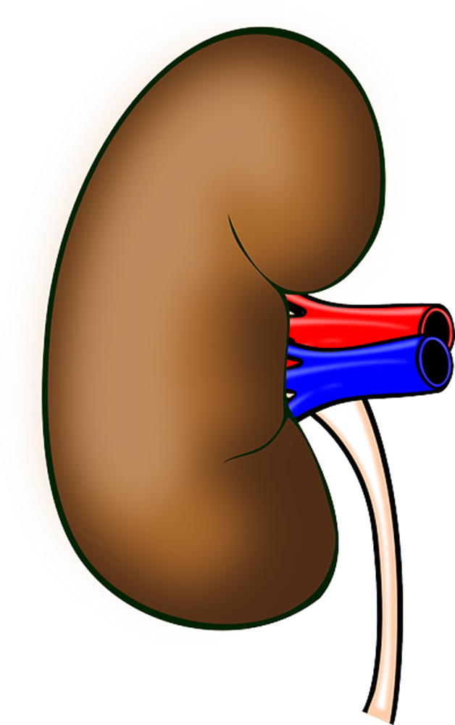
Acute Kidney Injury
To navigate through the programme use the arrows on your keyboard
http://pixabay.com/en/anatomy-kidney-organ-human-body-158998/
Katie Fielding, Professional Development Advisor, RDU
Lindsay Chesterton, Renal Consultant
Rachel Cooper, Professional Development Advisor, MAU

Slide 2
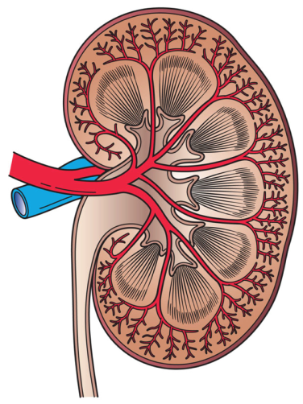
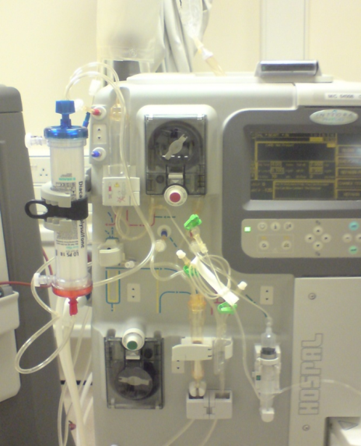
What does Acute Kidney Injury (AKI) mean?
Rapid deterioration in kidney function over days/weeks
  Used to be known as acute renal failure
Often reversible, but requires prompt action
If not resolved promptly, can lead to permanent damage to the kidneys (chronic kidney disease)
Prompt treatments and correction of AKI has a direct link with improved patient outcomes
http://commons.wikimedia.org/wiki/File:Kidney_Cross_Section.png
Further Reading if interested:
NCEPOD (2009) ‘Adding Insult to Injury’ - http://www.ncepod.org.uk/2009aki.htm
Only 50% of patients with AKI receive good medical care
Notes:
What is AKI?
U&Es shows stage / severity of AKI – can’t really tell if got it any other way
Other bloods help
Pts with AKI have poorer mortality and outcomes.

Slide 3
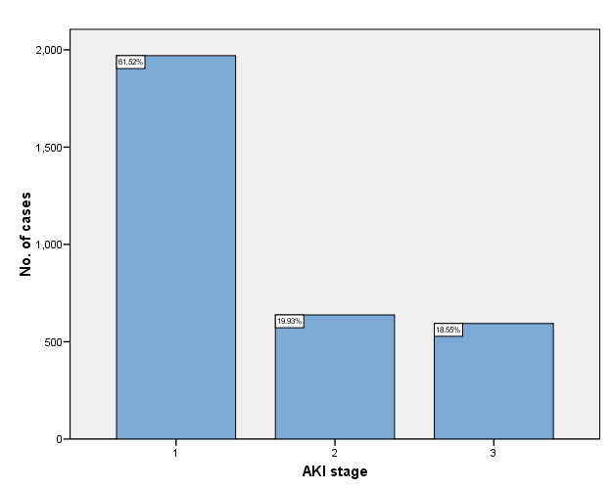
AKI is common
In one year there will be
4,269 episodes
of AKI at RDH
60% AKI present on admission
40% AKI acquired in hospital
Hospital acquired AKI can occur due to illness or as a side effect of medical treatment
(i.e. drugs; operations etc.)
Data from Jun 2010 – Feb 2011
At least 14% of AKI is preventable (NCEPOD, 2009)
That’s a lot of cases!!
Notes:
Incidence (per hospital admission): 23.7 episodes per 1000 admissions
Hospital does things to cause AKI – operations, drugs other pathologies
For MAU 60% of AKI be walking through the door.

Slide 4
AKIN Stages
AKI is diagnosed from a rise in creatinine
  Normally rises exponentially from baseline, dependant on severity
This can occur with reduction of urine output
AKI is diagnosed via AKIN stages (as below)
Stage | Serum Creatinine | Urine Output
1 | Increase of > 26.4 µmol/l (0.3mg/dl) OR to 150-200% of baseline (1.5-2.0 fold) | <0.5 ml/kg/hr for >6hrs
2 | Increase to >200-300% of baseline (>2-3 fold) | <0.5 ml/kg/hr for >12hrs
3a | Increase to >300% of baseline (>3 fold) or serum creatinine greater than > 354 µmol/l (4mg/dl) with an acute rise of at least 44 µmol/l (0.5mg/dl) | <0.3ml/kg/hr for 24hrs OR anuria for 12 hrs
Note: Stage 1 does not require a large change in creatinine or prolonged drop in urine output – AKI can occur rapidly and subtly
AKI will progress through the stages until the cause is corrected / treated
U&E results on iCM now include the stage of AKI
Notes:
How judge AKI stage – worse AKI stage is, harder it is to resolve, longer it will take and less chance of resolution.
Based on urine output and creatinine and how prolonged reduced urine output is – exponential and quick
Check what AKIN stands for and how widely used

Slide 5
Diagnosis of AKI
Blood test is the only way to know
  U&E
Detects rise in creatinine
Only differential diagnosis of AKI is creatinine rise
Other Useful Information
Additional bloods
  FBC, Bicarbonate, Phosphate, Calcium, LFTs, Arterial Blood Gas
Fluid balance & urine output
Urinalysis
Bladder scan / renal ultrasound
Medication list
You will see the significance of these tests as you work through the programme

Slide 6
Management of AKI
AKI management falls into 2 categories:
Treatment / Correction of Cause of AKI
Management of Complications
We will explore these aspects further ….
Notes:
6
Management of AKI falls into 2 boxes
First is about treatment of cause
- need to know what has caused it
- how to diagnose it
- how to correct it

Slide 7
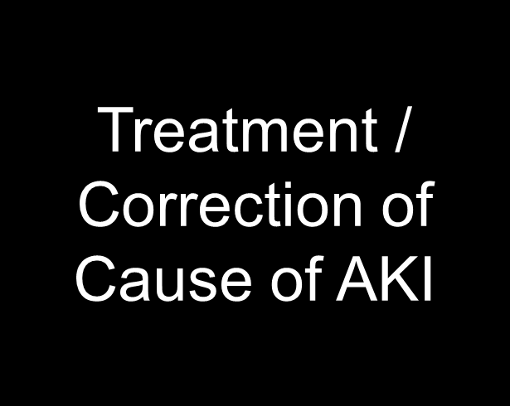
How we treat AKI depends on the cause
This cause can be related to the kidneys or secondary to something else in the body
We often talk about …
‘is it kidneys 1st. or kidneys 2nd?’
i.e. is the problem with the kidneys or is it elsewhere in the body

Slide 8
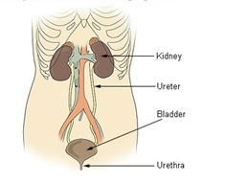
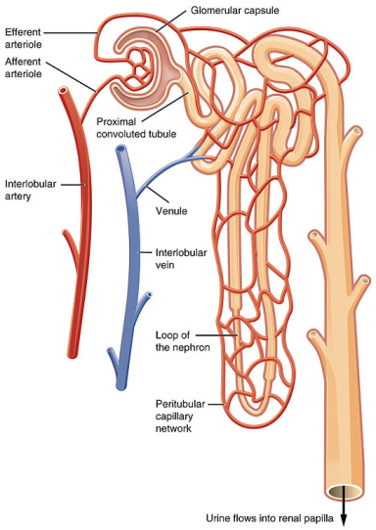
What causes AKI?
This can be grouped into 3 categories:
Pre Renal
Intrinsic / Renal
Post Renal
http://en.wikipedia.org/wiki/Urinary_bladder_disease
Is it kidneys 1st or kidneys 2nd?
http://commons.wikimedia.org/wiki/File:2611_Blood_Flow_in_the_Nephron.jpg
Notes:
3 types of AKI – dependant on part of kidney affected – all critical to function
Where it is will affect the treatment
One of most important things is determining cause of AKI

Slide 9

Pre Renal AKI
The filtration unit of the kidneys is the nephron
The nephrons perform the regulatory functions of the kidneys
  Excrete waste products of metabolism
  Regulate electrolytes
  Manage fluid balance
  Manage acid produced by metabolism
This requires an adequate blood supply to manage these aspects
If the blood supply to the nephrons is inadequate, it suspends the filtration function of the nephrons, causing AKI
In pre-renal AKI, the kidneys are not receiving the blood supply they need to function
The Nephron
This is kidneys 2nd. – the kidneys are not yet damaged, they are only failing due to lack of blood supply.
If you can correct the blood supply to the kidneys, AKI will resolve.
If you don’t the kidneys become ischaemic and damaged and you develop intrinsic AKI.
Notes:
3 types of AKI – dependant on part of kidney affected – all critical to function
Where it is will affect the treatment
One of most important things is determining cause of AKI

Slide 10
Common Causes of AKI – Pre-Renal
Approx. 65% of AKI is pre-renal –
the most common form of AKI
Dehydration is the most common cause of pre-renal AKI, which if corrected rapidly resolves the AKI
Prerenal (Kidneys 2nd)
Dehydration Heart failure Septic shock GI bleeds etc Often multiple insults
An accurate fluid balance and assessment can help the renal team identify whether dehydration could be an issue
An adequate BP is required to maintain blood flow / perfusion to the nephrons,
aim for systolic BP > 100mmHg
If you correct all causes of pre-renal AKI rapidly, the AKI will resolve

Slide 11
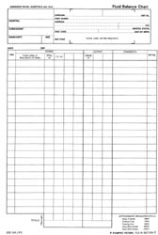
Measuring Fluid Balance
Tips for completing a fluid balance chart:
Be inclusive
  Include all fluid input and output
  Input = Oral intake, IV infusions, IV drugs, flushes, ice cubes, liquid feeds, fortisips
  Output = Urine output, diarrhoea, vomiting, NG aspirate, ileostomy / colostomy output
Be accurate
  Measure as much as you can
  Ask your patient / relatives to help
  Weigh bedpans / vomit bowls / sheets (1g = 1ml)
  Everyone in the team can help
Consider insensible loss = loss from sweating and breathing
  Difficult to estimate – can be anything from 400mls-1l a day
  Weighing wet sheets from excess sweating & comparing to dry sheets can provide an indication
Are you aiming for a net loss or gain?
  Total regularly and consider your aim e.g. if your patient is dehydrated and you are giving fluid to correct this, you would expect a net gain at the end of the day
Notes:
Totting up – are you looking at differences – are considering if this is correct.
Assess your patient as a whole – look at signs not just one aspect
Fluid balance provides another part of the picture for the renal team – along with weight and urine dipstick.

Slide 12
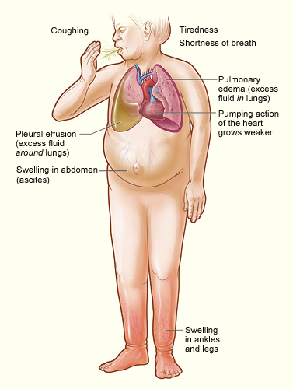
Fluid Assessment Skills
Assessment of your patient, also gives an indication of fluid status
Aspects to consider include:
BP & pulse
Daily weight
  Fluctuations are normally related to fluid
Signs of oedema
  Peripheral oedema
    Swollen ankles or legs
    Could be swollen around abdomen / buttocks / thighs if laid flat
    Fluid accumulates at lowest point
  Pulmonary oedema
    Shortness of breath; white frothy sputum; inability to lie flat
  The fluid balance chart totals will contribute to this assessment
https://en.wikipedia.org/wiki/Heart_failure

Slide 13


Intrinsic / Renal AKI
In this form of AKI, damage has occurred to the cells of the nephron
The kidneys are unable to perform their functions as the nephrons are not working due to damage
This is kidneys 1st. – there is direct damage to the kidneys.
All types of AKI will eventually lead to intrinsic AKI if not corrected rapidly.

Slide 14
Common Causes of AKI
These patients will often have to be managed on Ward 407
 | Renal (Kidneys 1st)
 | Acute tubular necrosis Glomerular injury Drugs/Toxins Tubular injury
This it the most complex and hardest form of AKI to correct
This is the form of AKI
associated with the poorest outcomes
There are often lots of weird and wonderful causes of intrinsic / renal AKI
Remember:
All AKI will eventually become intrinsic unless corrected promptly

Slide 15
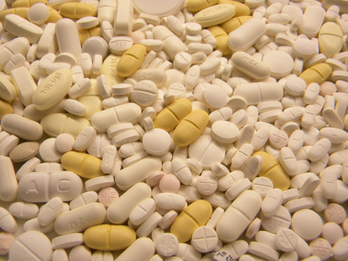
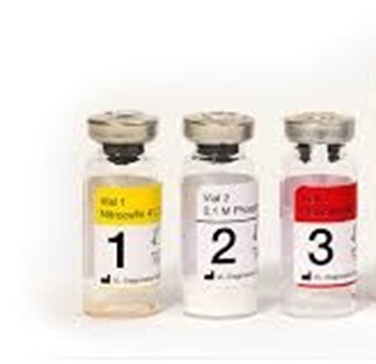
Common Drugs Causing AKI
Many drugs cause damage to the kidneys.
The most common offenders you may need to consider are hi-lighted below:
http://commons.wikimedia.org/wiki/File:Tablets_pills_medicine_medical_waste.jpg
Gentamicin and Vancomycin
Non-Steroidal Anti-Inflammatory Drugs
ACE Inhibitors
IV Contrast
Even if they are not directly the cause, you will want to minimise their use, as they could make the AKI worse
Notes:
A lot of drugs contribute to / cause AKI
Like liver, kidneys involved in excretion of drugs
These are main offenders – given regularly and nephrotoxic

Slide 16
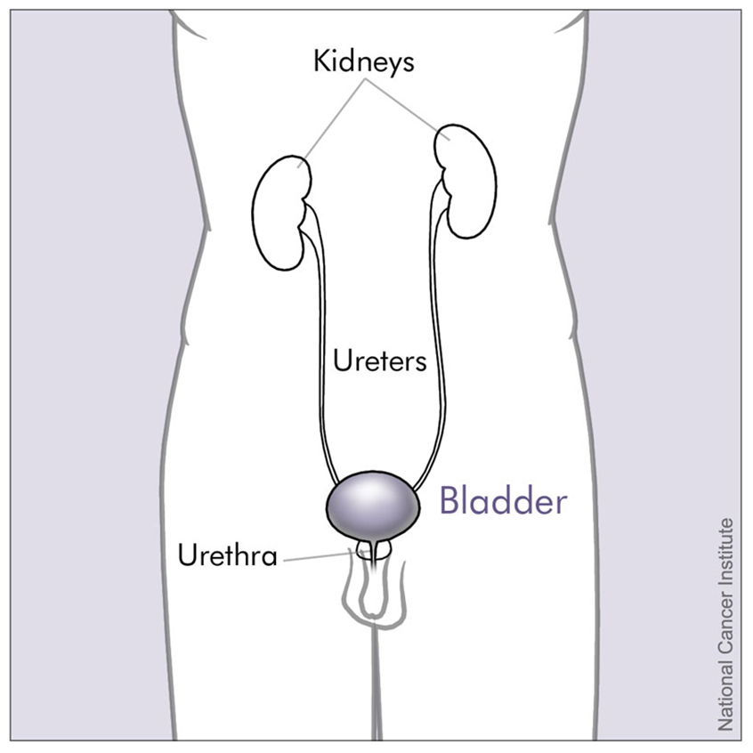
Post Renal AKI
This form of AKI is caused by the drainage of urine out of the kidneys, once it is formed
Initially the kidneys are working, urine is formed but the patient is not passing that urine
The build up of urine causes back pressure, causing hydronephrosis
The kidneys then start to fail, if this pressure is not relieved
http://commons.wikimedia.org/wiki/File:Bladder_and_nearby_organs_(male).jpg

Slide 17

Post Renal AKI
The blockage can occur in 2 areas:
In the ureters
  The bladder will not fill with urine
Below the bladder
  - The bladder is full but the patient is unable to empty the bladder

Slide 18

Common Causes of AKI
Inserting urostomy tubes or a catheter can bypass the blockage, the pressure is relieved and the AKI resolves
This it the simplest and easiest form of AKI to correct, if managed promptly
 |  | Postrenal (Kidneys 2nd)
 |  | Obstruction Tumours Kidney stones Enlarged prostrate
This is kidneys 2nd., however this will rapidly turn into intrinsic AKI if not corrected promptly
A bladder scan will only detect an problem below the bladder. A renal ultrasound scan is needed to detect a problem above the bladder

Slide 19

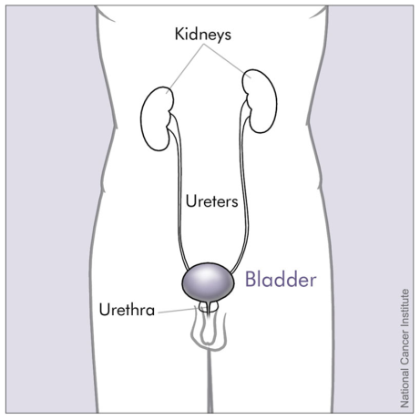
Review – The Common Causes of AKI
Prerenal (Kidneys 2nd) | Renal (Kidneys 1st) | Postrenal (Kidneys 2nd)
Dehydration Heart failure Septic shock GI bleeds etc Often multiple insults | Acute tubular necrosis Glomerular injury Drugs/Toxins Tubular injury | Obstruction Tumours Kidney stones Enlarged prostrate

Slide 20
Why is awareness of the causes of AKI important?
Identifying the cause of the AKI, allows us to identify the best action to correct it
If we can correct the AKI promptly and accurately, the AKI has a better chance of resolving
Awareness of other causes of AKI, help us avoid these ‘stressors’ reducing the burden on a recovering kidney
This improves outcomes for the patient, reduces the chance of chronic kidney disease and the patient is more likely to return to a normal life

Slide 21
Why is the urinalysis so important?
This can help us determine whether it is Kidneys 1st. or Kidneys 2nd
This will affect the overall management of the AKI
It is vital information for the renal team!
Blood and protein get into the urine when the filtration system of the nephrons is not working properly.
This indicates damage to the kidneys = Kidneys 1st.
If this is absent the kidneys are unlikely to be damaged
= Kidneys 2nd.
Urine
Blood / Protein
Kidneys 1st
No Abnormalities
Detected
Kidneys 2nd
Nitrites/leucocytes
(not relevant unless
UTI symptoms or septic)
Nitrites and leucocytes only have clinical significance if the patient also has symptoms of a UTI.
Notes:
What does your dipstick mean?
Difficult if the patient does not produce urine
Lidney sieve ensures that no blood or protein gets in the urine – if present, sign sieve is not working properly.

Slide 22
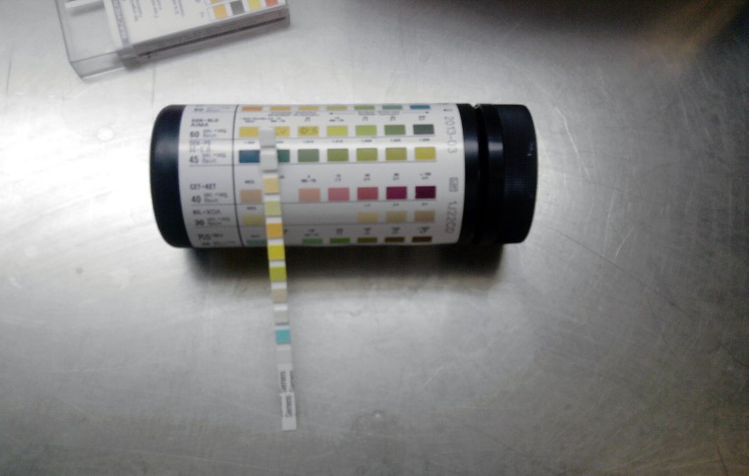
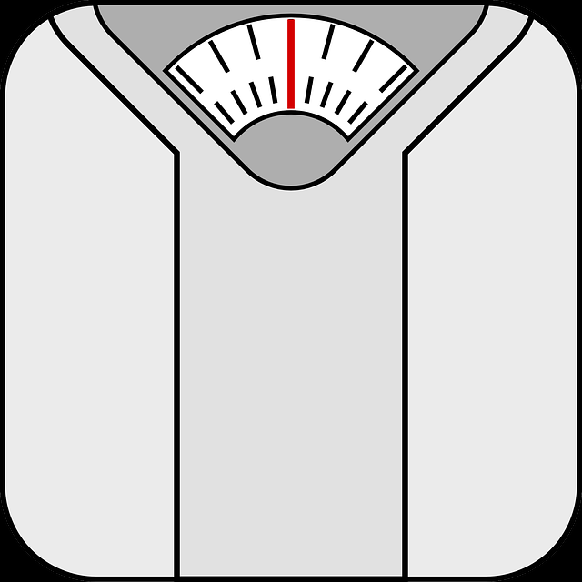
Invaluable information
Dip
Chart
Weigh
https://en.wikipedia.org/wiki/Urine_test_strip
Hopefully, you can now see why these aspects are so important for managing patients with AKI!
https://pixabay.com/en/scale-machine-weight-weighing-37772/
Notes:
Chart obs and fluid balance
Weighing – daily alterations are fluid – gives us a baseline – helps further management

Slide 23
Guidelines and Bundles
There are few clinical guidelines in place in the hospital, that will help with the management of AKI.
AKI Guidelines
AKI Care Bundle
Hyperkalaemia Bundle
They:
Summarise the care the AKI patient requires
Provide simple guidance
As we work through these, you will be able to identify how some simple steps help correct and prevent some of the causes of AKI discussed

Slide 24
AKI Guidelines are available on the hospital intranet
The key to these is ‘AUDITS’
Notes:
Dehydration
Obstructions
Nephrotoxins
Urine
Think
Once done simple interventions is about diagnostic tests (renal US), monitoring (U&Es) and escalation
(renal team)

Slide 25
AUDITS
Assess history and examine
  Fluid status
  Clinical history
  Drug history
Urine Dipstick
Diagnosis
  What is the cause
Investigations
  Renal Ultrasound if obstruction suspected
Treatment
  Fluid
  Stop nephrotoxins
  Treat underlying cause
Seek advice
  AKI stage 3
  Intrinsic AKI
  Complications e.g. hyperkalaemia

Slide 26
A simple approach to AKI Management
Correct dehydration
  IV 0.9% Saline in most situations
Maintain BP
  Systolic BP above 100mmHg
  To maintain blood supply to kidneys
Take away the cause of AKI
  Involves diagnosis too
Recovery time
  Reduce burden on kidneys, by eliminating other sources of ‘stress’ for the kidneys i.e. nephrotoxins; dehydration etc.
The vast majority of your patients with AKI will improve with this approach
If they don’t, CALL RENAL
Notes:
Treatment of AKI – this approach works with all pts – is simple.

Slide 27
Your role is important
Good nursing care is essential
Medical decisions are made upon the information you provide
You can make the difference to the quality of care the patient receives
…hydration…
…treat sepsis…
…medicines management…
Notes:
AKI not a diagnosis – will be a cause
Need team work to identify cause and treat
Hydration, treat sepsis and medicines – important care

Slide 28
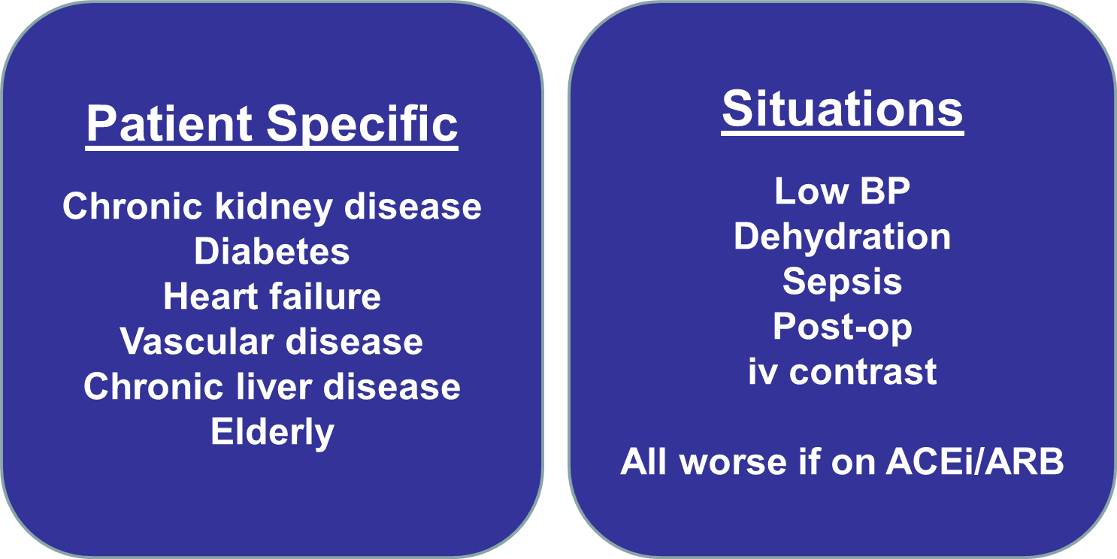
Recognise the Risk
All patients are at risk of developing AKI whilst in hospital
Don’t just think about those diagnosed with AKI, think about those who could be at risk
Notes:
In reality this is what it means
Hydration – maintain BP
Medications – discuss in another slide
Monitoring – talked about in first session – nurses role

Slide 29
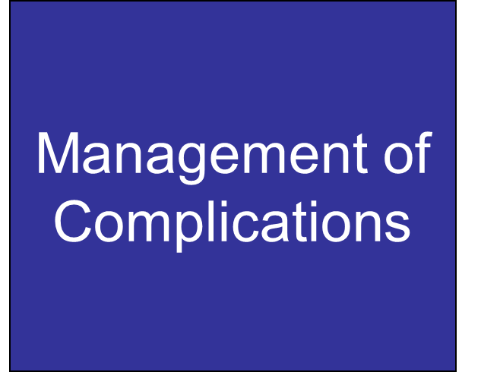
Next Section ….
AKI comes with a number of complications that occur as the kidneys are not doing the job they normally do for the body
As well as managing the cause of AKI, we also need to manage the complications
Some of these can be life threatening and all can be serious, if not managed appropriately

Slide 30
The kidneys are involved in managing the aspects outlined below and if they don’t, complications can occur:
Fluid Balance
  AKI increases risk of fluid overload, as the body cannot excrete excess fluid adequately
Electrolyte management
  Excess potassium is the main risk in AKI
Acid base balance
  Metabolic acidosis is a risk, as the waste acid builds up in the body
Build up of waste products
  Urea is the main risk in AKI
Production of red blood cells
  Anaemia can occur due to suppression of erythropoeitin release caused by AKI and destruction of RBC by high urea levels

Slide 31
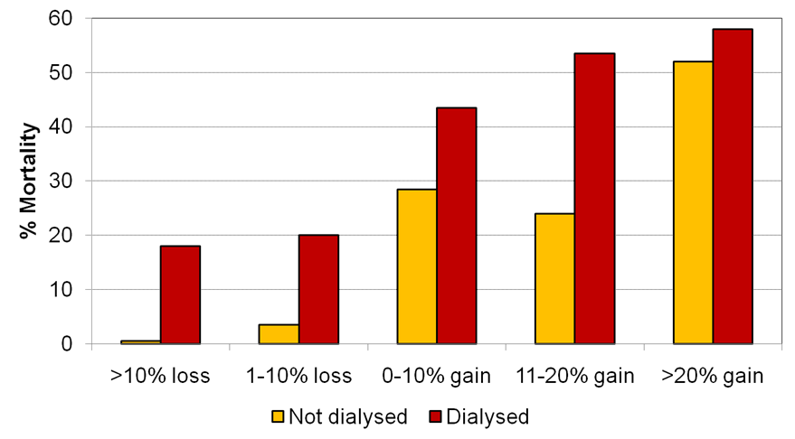
Fluid Overload
Fluid can easily build up to dangerous levels in the body
This has to be balanced with the need to give fluid to correct dehydration
The balance is difficult, but you need to be careful you don’t over-do it!
Adapted from Bouchard et al, Kidney Int 2009.
Adjusted odds ratio for death associated with fluid overload at dialysis initiation = 2.07
Notes:
More fluid you give and more overloaded the pt – the higher their mortality.
31

Slide 32
Fluid balance tips…
Don’t…
Do…
Use fluid boluses to resuscitate hypotensive pts
Go back and regularly review patient
Use 0.9% saline for majority of cases
Use daily weights to monitor fluid balance
Prescribe ‘maintenance’ fluids
Prescribe a 24hr regime to an oliguric patient
Give too much fluid unnecessarily
Use Hartmann’s if K⁺ high
Notes:
Advice we give to drs about fluid – good context for nurses to know
32

Slide 33
Medical Management of Hyperkalaemia
Step 1
  ECG, cardiac monitoring and stabilize myocardium
  Calcium gluconate will help stabilise the heart muscle
  It reduces it’s sensitivity to a raised potassium
Step 2
  Buy time
  Insulin will move the potassium into the cells, where it won’t affect the heart
  Dextrose is needed concurrently to correct the hypoglycaemia caused by the insulin
Step 3
  Ensure kidneys get rid of K – get them working again!
  Remember: The effects of insulin and calcium gluconate are temporary – if the kidneys don’t start excreting potassium, hyperkalaemia will return.
Notes:
Insulin and dextrose will work if don’t need dx – can use and get kidneys working which when it returns it will excrete potassium

Slide 34
Can you see the trends?
Cardiac
  ECG changes
  Monitor
  Calcium gluconate
Excretion
  Fluid
  Diuretics
Buy time
  Insulin & dextrose
  Not long term solution (i.e.>2-4 hrs), unless excretion improves
Reassess & referral
Notes:
Says what we just said

Slide 35
Analgesia & AKI
Problem
Some analgesia is nephrotoxic
  Increases burden and damage to the kidneys
  NSAID – avoid! (i.e. ibuprofen, diclofenac)
Some analgesia is excreted by the kidneys
  Retention of drug in AKI
  Be wary of opiates
  Avoid long acting opiates and PCA’s
Use:
Paracetamol
Nefopam
  30mg tds prn
Morphine
  Low dose and monitor for side effects
Ask the renal team
Ask the pain team
  More unusual pain relief can be OK in AKI e.g. amitriptyline, gabapentin
Notes:
Analgesia problematic
2 probs – nephrotoxic and lack of excretion

Slide 36
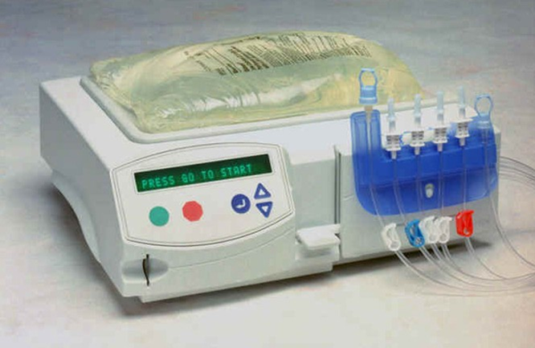

Dialysis & AKI
Can be used to correct life threatening complications:
Hyperkalaemia
Fluid overload
Acidosis
With AKI or CKD:
  Kidneys are not working
  Dialysis is the only way to correct
  Dialysis is only available on RDU, 407 and ITU
Get them transferred asap – don’t wait for the patient to stabilise, as they won’t until they have dialysis

Slide 37
Hyperkalaemia & Dialysis
Dialysis can only remove potassium from blood
Do use Calcium gluconate: cardio-protect
Don’t use insulin & dextrose / salbutamol – moves potassium into cells
  Dialysis then can’t remove potassium
Unless the kidneys are working, dialysis is the most effective way to remove potassium
Notes:
37
Only use dialysis when needed – if can correct without we will – dialysis damaging to kidneys
Few things need to consider if have hyperkalaemic patient who needs dx

Slide 38
Summary
AKI requires prompt recognition and correction, to prevent long term damage to the kidneys
Nursing staff have an important role is diagnosing, monitoring and treating AKI
Life-threatening complications occur in the body whilst the kidneys are not working properly
Whilst the majority of management is simple, dialysis complicates things
Use the renal team’s expertise

Slide 39
Thank you for taking the time to complete this presentation
If you have any queries, please feel free to contact Katie
Please take time to complete the Multiple Choice Questions

Slide 40
MCQ Questions - AKI
Please note down your answers on a piece of paper – the answers are available at the end.

Slide 41
1) What percentage of Acute Kidney Injury is acquired whilst patients are in hospital?
  a)10%
  b) 60%
  c) 40%
  d) 25.5%

Slide 42
2) Which of these tests is most accurate in assessing the severity of AKI?
  a) U&E blood test
  b) Kidney biopsy
  c) Dialysis
  d) CT scan

Slide 43
3) Why is a urine dipstick most important for a patient with AKI?
  a) To help diagnose infection
  b) To detect diabetic ketoacidosis
  c) To ascertain if there is damage to the kidneys
  d) To keep the renal consultants happy

Slide 44
4) Dehydration is a priority to correct with AKI as:
  It makes the patient uncomfortable
  It reduces the blood flow to kidneys, exacerbating / causing AKI
  It helps dilute the electrolytes in the blood, reducing the creatinine
  It’s not a priority, we don’t want to risk giving the patient fluid overload

Slide 45
5) Which of these conditions exacerbates / causes AKI:
  Cardiac failure
  GI bleed
  Vascular disease
  All of the above

Slide 46
6) A patient’s whose weight increases daily, indicates:
  They are eating too much
  Accumulation of fluid potentially leading to fluid overload
  Constipation
  Inaccurate scales

Slide 47
7) Which of these drugs will cause damage to the kidney and exacerbate / cause AKI:
  Gentamicin and vancomycin
  Paracetamol and morphine
  Digoxin and adenosine
  Lansoprazole and gaviscon

Slide 48
8) For a patient with AKI, we aim to keep their systolic BP above:
  80mmHg
  90mmHg
  100mmHg
  110mmHg

Slide 49
9) Which of these analgesics can you give to a patient with AKI:
  Diclofenac
  Codeine
  Co-codamol
  Nefopam

Slide 50
10) Post renal AKI leads to no urine output as:
a) The kidneys are unable to produce urine
b) The urine produced is unable to drain out of the kidneys
c) The patient is dehydrated
d) The filtration system in the kidneys is leaking

Slide 51
11) Which of the list below are complications of AKI (i.e. occur as the kidneys are not working properly):
  Hyperkalaemia
  Fluid overload
  Anaemia
  Immunosuppression
  Metabolic acidosis
  All of the above

Slide 52
12) Which of these might indicate fluid overload of a patient with AKI:
  No urine output with no other symptoms
  Tachycardia and low BP
  SOB, ankle oedema and positive fluid balance
  880mls in bladder (from scan) with no urine output

Slide 53
13) A patient becomes unstable who has AKI, potassium is 8.4 and no urine output. They have been prescribed haemodialysis. What is the most important thing you can do for that patient:
  Administer calcium resonium
  Start insulin and dextrose infusion
  Contact their next-of-kin
  Transfer to renal ward asap

Slide 54
14) Nursing care of AKI is important because:
  Good nursing care is linked to good patient outcomes
  Renal consultants make decisions based on the information provided by nurses
  Because nurses are special
  All of the above

Slide 55
15) For a patient with AKI, the main priority for medical care is:
  Hydration, monitoring, diagnosis and treatment of cause
  Strict fluid restriction, monitoring, diagnosis and treatment of cause
  Strict fluid restriction and transferring to renal ward
  Hydration and transferring to renal ward

Slide 56
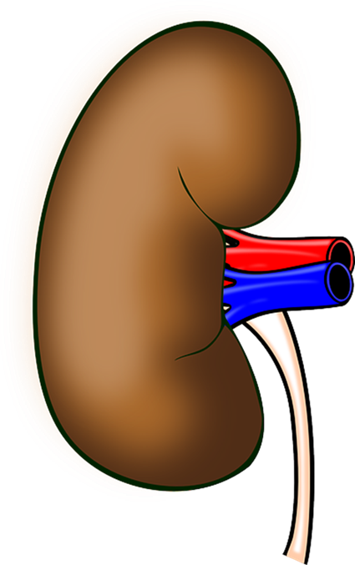
Thank you for completing the quiz.
Please implement what you have learnt into practice!!

Slide 57
Answers
The answers to the quiz are:
c
a
c
b
d
b
a
c
b
b
f
c
d
d
a

