Slide 1
Facilitator Guidance Notes.

Slide 2
Suggested Timetable

Slide 3
Guidance Notes:
Each scenario should be set up in 3 rooms; preferably with a mannequin and equipment such as stethoscope to encourage the candidates to actively demonstrate their A-E assessments.
If possible the candidates should be split into 3 groups.
Observations Charts, Prescription Charts and Fluid Balance Charts should be available for the candidates to view and interpret.
Each scenario should last for around 20 minutes this should include time for introduction, discussion and closure.
It is up to the faculty to determine which candidates lead the scenarios or whether this could be completed as a group discussion.
For each scenario the candidates should be able to stage the AKI, identify the possibly underlying diagnosis and formulate a management plan – detail of which may differ depending on the experience of the candidates.
The scenarios may be adapted to fit the background of the candidates but the essential discussion points should not be altered.

Slide 4
Guidance notes for Scenarios.
Scenario 1 Keith Kidney
Scenario 2 Natalie Nephron
Scenario 3 Paul Potassium

Slide 6
Total input: 3100mls
Total output: 90mls
In 4 hours
Weight: 70kg
Notes:
The patient is critically unwell.
Has received 3000mls of fluid with deteriorating observations.
May still require more fluid at this stage but would require senior level input.
Urine output remains poor for his weight.
Likely to require invasive monitoring in HDU/ITU with possible medications to support blood pressure and possible haemofiltration.

Slide 7
Observations completed 2 hourly by HCA.
Apyrexial
Worsening tachycardia
Worsening hypotension
Respiratory Rate labile
Sa02 92%
Decreased conscious level.
Notes:
Observations completed by HCA – patients who are sick should have at least hourly observations completed manually (where possible) and by a registered Nurse.
Patient is critically unwell here.
Key with observations is the trend is more important than specific numbers.

Slide 8
Notes:
Points for discussion:
How much fluid is too much?
What fluid should be used in fluid resuscitation?
Complications of fluid resuscitation?
Signs of hypo/hypervolaemia.

Slide 10
Observations completed hourly.
Pyrexial 39.3
Worsening Tachycardia
Hypotension
Reduced conscious level
EWS 10

Slide 11
Total Input: 100mls
Total Output: 85mls
Over 6 hours.
Weight: 110kg
Notes:
Discuss when to escalate for medical review concerning fluid balance?
Discuss residual volume and this can be misconstrood as adequate urine output.

Slide 12
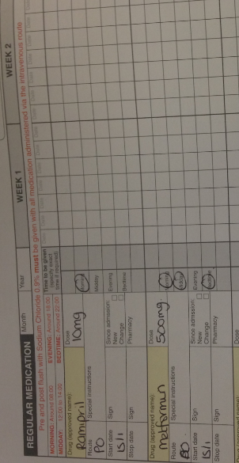
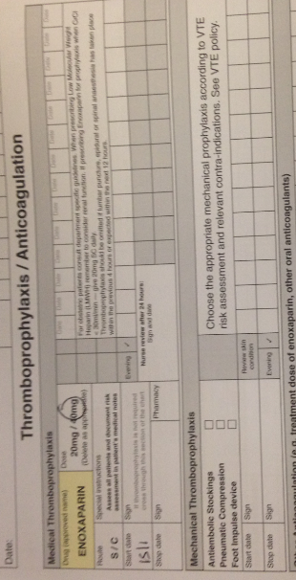
Notes:
Medications should always be reviewed in patients who are admitted to hospital.
Flucloxacillin – wrong dose.
Enoxaparin – Should renal dose be given and why?
Ramipril & Metformin should be omitted unwell improving – Why?

Slide 14
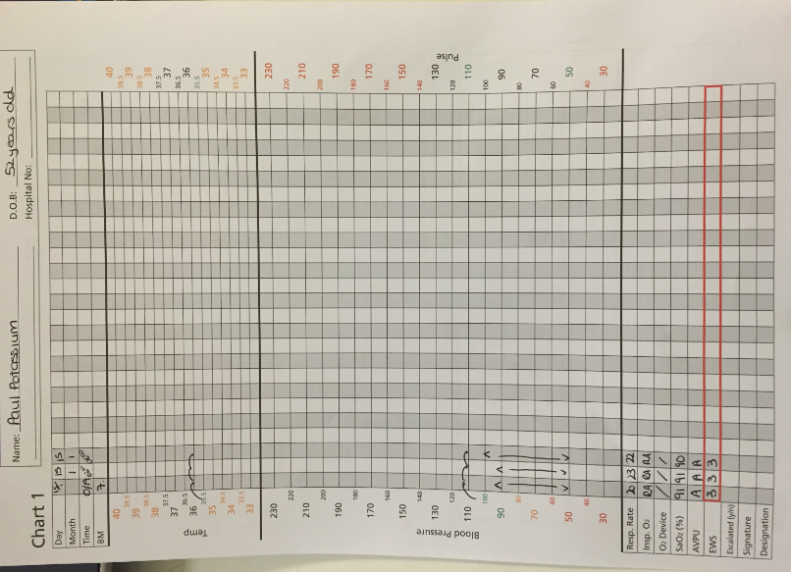

Slide 15
Total Input:
3 episodes of sips.
Total Output:
200mls in 6 hours
Weight 100kg
Notes:
Discuss expected urine output for suggested weight – remember calculation should be based on ideal body weight.
Candidates should discuss the fact that input is minimal and by documenting sips we are unable to quantify.

Slide 16
