Slide 1
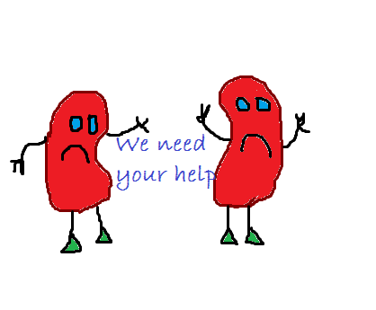
Fluid Balance & Acute Kidney Injury Study Package

Slide 2
This study package has been designed to aid multidisciplinary staff in developing their knowledge of Acute Kidney Injury and Fluid Balance.
The best format for this package is an interactive study day with a facilitator and expert faculty members to deliver the content.
Any reference to patients and blood results are fictional and confidentiality is maintained at all times.
Notes:
Ideal faculty should include:
A senior pharmacist with an interest in Acute Medicine or Renal Medicine.
A senior level trained acute care physician or renal physician.
A senior level nurse with an acute care or renal background.

Slide 3

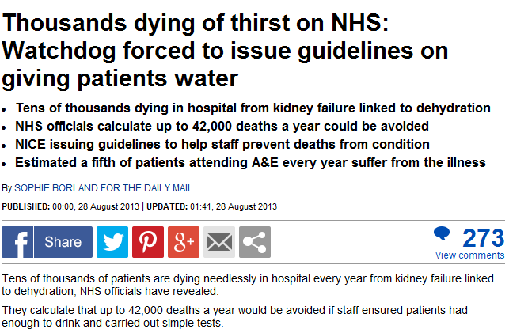
Why are we here?
Notes:
- AKI can affect all ages, races, parents, children, mums, dads, brothers, sisters, friends, neighbours.
Its prevalent – 20% of acute admissions.
It kills – mortality risk associated with AKI as high as 80% in ICU
It costs a lot – spend less of AKI spend more of cancer.
This package is designed to outline some of the key aspects regarding Acute Kidney Injury.
Aims to cover
– What the kidneys do
- How AKI can be identified.
- Biochemistry in relation to AKI.
- Medication in relation to AKI.
- Assessment and treatment of AKI.

Slide 4
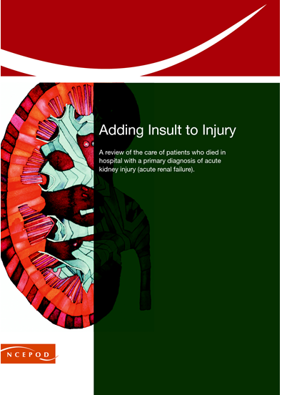

Notes:
Some shocking evidence out there that we don’t always get it right.
However we are all in healthcare to provide the best care for our patients.
Increased awareness through education and training is one way that we can hope to achieve this.
NCEPOD identified that 30% of the deaths reviewed were preventable.
Mid staffs reported patients in dehydrated states with no apparent recognition or treatment.

Slide 5
Objectives:
To develop a basic understanding of what the kidneys do and how they work at cellular level.
Gain further knowledge in understanding the biochemistry that relates to AKI.
Discuss the common causes of AKI and how these may be treated.
Understand some of the common medications associated with AKI.
Discuss the concept of fluid balance and the challenges we face to get this right.
Consolidate learning through case scenario discussions.

Slide 6
References
The Mid Staffordshire NHS Foundation Trust Public Inquiry (2013) Report of the Mid Staffordshire NHS Foundation Trust Public Inquiry: executive summary. London:Stationery Office (Chair: R Francis). Available at: www.midstaffspublicinquiry.com/sites/default/files/report/Executive%20summary.pdf
A review of the care of patients who died in hospital with a primary diagnosis of acute kidney injury (acute renal failure). National Confidential Enquiry into Patient Outcome and Death (NCEPOD). 2009

Slide 7
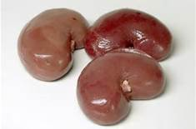
Pathophysiology of the Kidneys

Slide 8
Objectives:
To develop a basic understanding of what the kidneys do and how they work at cellular level.
Gain further knowledge in understanding the biochemistry that relates to AKI.
Discuss the common causes of AKI and how these may be treated.
Understand some of the common medications associated with AKI.
Discuss the concept of fluid balance and the challenges we face to get this right.
Consolidate learning through case scenario discussions.

Slide 9
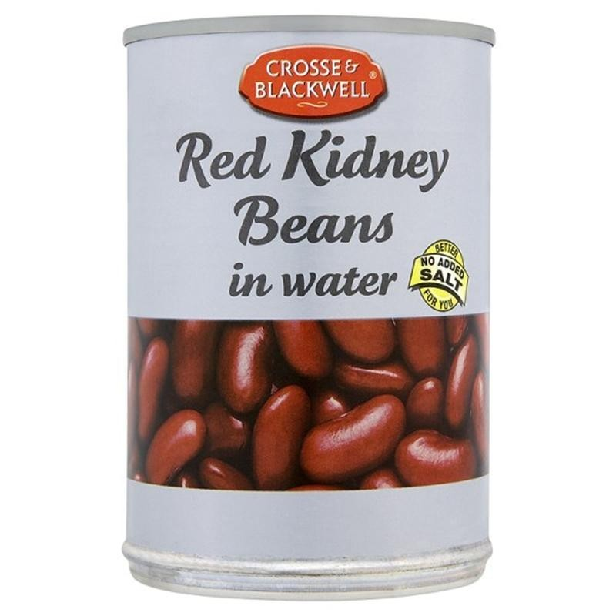
What’s a kidney?

Slide 10
Functions of the Kidney
Regulation of electrolytes
Maintenance of acid–base balance
Regulation of blood pressure (via maintaining salt and water balance).
Natural filter of the blood, and removes water soluble wastes, which are diverted to the urinary bladder.
Production of Urine
Reabsorption of water, glucose, and amino acids.
The kidneys also produce hormones including calcitriol, erythropoietin, as well as the enzyme renin.

Slide 11
Components of the Body regulated by the kidneys
Electrolytes:
Na, K, Chloride
Total Body Water
Ph:
By excreting hydrogen ions
By regulating the concentration of HCO3- the major extracellular buffer
Minerals:
Calcium, Phosphurus and Magnesium
Endogenously produced waster products:
Urea-end point of protein catabolism
Creatinine-produced by skeletal muscle
Uric Acid-nucleic acid breakdown product

Slide 12
Endocrine Functions
Sole source of Erythropoietin (red blood cell production)
Produces final enzyme to produce Vitamin D
Produces Renin
Paracrine Substances within the kidney such as prostaglandins and endothelin which are produced in response to injury and may act as vasoconstrictors
Notes:
Loss of renal mass leads to loss of active vit D and hypocalciaemia.
also known as an angiotensinogenase, is an enzyme that participates in the body's renin-angiotensin system (RAS)—also known as the renin-angiotensin-aldosterone axis—that mediates extracellular volume

Slide 13
Nephron
Each kidney contains 1 million nephrons
Functional Unit of the Kidney
Blood is first filtered and then different components reabsorbed or further secreted along tubules
The resulting fluid is passed from the kidneys down the ureters to the bladder and is excreted as urine
Notes:
Ultrafiltrate accounts for approx 180litres per day
Requires a large constant amount of blood flow- 20% of total cardiac output
99% of which must be re-absorbed or die within minutes.
Glomeruli-filter unit of the nephron. Allows water, amonio acids, sodium and other free ions pass through its membranes and into the tubule system.
PCT is responsible for reasborbtion
3 sections of loop of henle. Essentially working against each other to create a counter current system to work as a water pump.

Slide 14
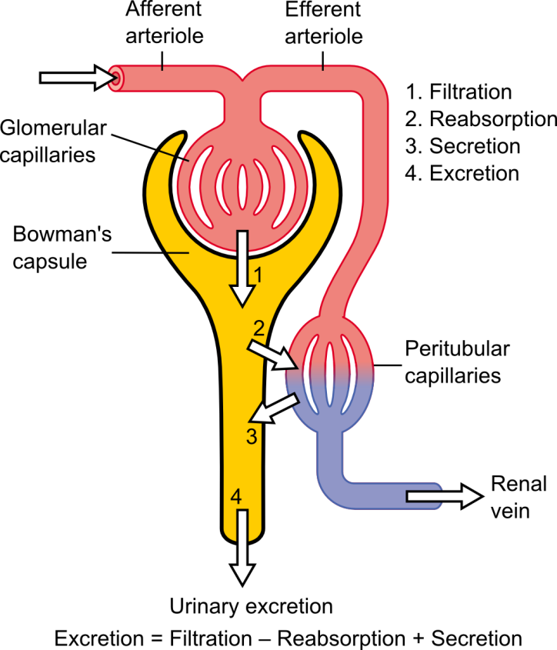

Slide 15
Autoregulation
Blood flow directly affects the glomerulus filtration rate
The blood flow into the glomerulus is via the afferent arteriole and the blood flow out of the glomerulus is by the efferent arteriole
Altering the radius of both or one of these vessels will alter the pressure within the glomerulus.

Slide 16
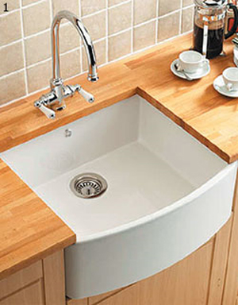
Notes:
Can be supplemented with hand drawn diagrams on white board
Tap / sink / plug analogy
Tap = afferent arteriole
Drain = efferent arteriole
Sink = volume of blood being filtrated
If flow from tap is low (low water / blood pressure or narrow tap), sink will not fill significantly = low filtration rate
If the drain is narrowed, flow out of the sink is reduced and sink will fill = filtration improved
If drain is widened, flow out of sink is fast and it will not fill = filtration improved

Slide 17
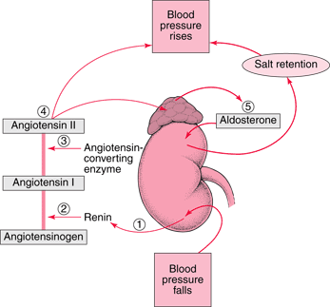
Renin- Angiotensin system

Slide 18
The renin angiotensin aldosterone system is a series of reactions designed to help regulate blood pressure.
When blood pressure falls (for systolic to 100mmhg or lower) the kidneys release the enzyme renin into the bloodstream.
Renin splits angiotensinogen, a large protein that circulates in the bloodstream into pieces. One piece is angiotensin I.
Angiotensin I (relatively inactive) is split into pieces by angiotensin-converting enzyme (ACE). One piece is angiotensin II: a hormone which is very active.
Angiotensin II causes the muscular walls of efferent arterioles to constrict increasing blood pressure. It also triggers the release of aldosterone (a hormone) from the adrenal gland and antidiuretic hormone from the pituitary gland.
Aldosterone and antidiuretic hormone cause the kidneys to retain salt. Aldosterone can also cause the kidneys to excrete potassium. The increased sodium causes water to be retained thus increasing blood volume and blood pressure.
Notes:
Refer back to tap / sink analogy
Reassure that this is revisited in other sessions

Slide 19
Water Haemostasis
Water balance is controlled by antidiuretic Hormone (ADH).
ADH is released in response to three stimuli:
-Increased blood osmolality (concentration of blood constituents)
-Decreased blood volume
-Angiotension II
Receptors facilitate greater water reabsorbtion.

Slide 20
Acid Base Balance
Maintenance of a constant pH is important as many of our enzymes are pH sensitive.
pH is the concentration of hydrogen ions
Bicarbonate is the main buffer to acid in the human body and is filtered by the kidneys so must be reabsorbed.
H₂O + CO₂ HCO₃⁻ + H⁺
Notes:
Explain chemical formula, if more acid is in the circulation, more bicarbonate must be retained to counteract it.

Slide 21
Any Questions?

Slide 22
Summary
The kidneys play a vital role in maintaining blood volume.
Blood flow into the kidneys maintains function.
Any alterations in kidney pathology could result in acid base imbalance, electrolyte disturbance and interruption to regulation of blood pressure.

Slide 23
References
renin-angiotensin-aldosterone system http:// www.merckmanuals.com/home/heart_and_blood_vessel_disorders/high_blood_pressure/high_blood_pressure.html

Slide 24
Blood results and Urinalysis

Slide 25
Objectives
To develop a basic understanding of what the kidneys do and how they work at cellular level.
Gain further knowledge in understanding the biochemistry that relates to AKI.
Learn the common causes of AKI and how these may be treated.
Discuss the concept of fluid balance and the challenges we face to get this right.
Consolidate learning through case scenario discussions.
Notes:
Topics to cover:
Common electrolytes relating to AKI.
NHS Algorithm for detection of AKI.
eGFR
Urinalysis & Point of Care Testing.

Slide 26
The kidney and biochemistry
Three major functions
  Excretion of waste
  Maintenance of fluid balance
  Hormone synthesis

Slide 27
Sodium (134-145mmol/L)
Most abundant extracellular cation
  Carries a positive charge
Important in determining water distribution across cell membranes
  Input and output usually balanced
25000mmol/L filtered at the glomerulus
  Normally 99% reabsorbed

Slide 28
Sodium and water control
Sodium
  Regulated by aldosterone
  Adrenal glands
  Low sodium, aldosterone production increases to increase renal reabsorption (in exchange for potassium/hydrogen)
Water
  Regulated by Vasopressin (Anti-diuretic hormone)
  Hypothalamus
  Stimulated by rising osmolality, low circulating blood volume
  Increased water reabsorption by renal collecting ducts

Slide 29
Potassium (3.5-5.3 mmol/L)
Main intracellular cation
  98% is stored within cells
Reasons for movement out of cell
  Acidosis
  Lack of insulin
  Severe cell damage
External balance determined by intake and renal excretion
Plasma K⁺ poor indicator of body content
However, it is the changes in the extracellular concentration that affect neuromuscular and cardiac function
Notes:
<10% of potassium reaches the distal tubule almost all reabsorbed by the proximal tubule.

Slide 30
Potassium
Increased | Decreased
Acidosis | Alkalosis
Artefactual | Treatment with insulin
Decreased renal output Renal failure Oliguric Potassium sparing diuretics Interstitial nephritis | GI losses Vomiting Laxative abuse fistula
Tissue necrosis | Renal losses Diuretics Renal tubular acidosis Aldosteronism Cushing's
Haemolytic disorders
Insulin deficiency

Slide 31
Chloride (98-108 mmol/L)
Extracellular anion
Sodium and chloride involved in maintenance of water distribution
Filtered at the glomeruli and reabsorbed in proximal tubule
Changes should mirror sodium

Slide 32
Urea (2.5-7.8 mmol/L)
Synthesised in liver
By-product of the deamination of amino acids
Elimination in urine is major route for nitrogen excretion
Filtered from blood at the glomerulus
Significant tubular reabsorption

Slide 33
Urea
Increased | Decreased
High protein intake | Low protein
Dehydration | Chronic liver disease
Gastrointestinal bleeding
Increased protein metabolism Surgery, trauma, starvation
Reduced GFR
Any obstruction to urinary flow
Notes:
Absorption of amino acids and peptides after haemorrhage.
Tubular absorption increases at low rates of urine flow (fluid depletion) can cause elevated urea when creat normal.
Urinary flow – BPH, malignant obstruction, stone

Slide 34
Creatinine (50-110 μmol/L)
Most reliable biochemical test of glomerular function
End product of nitrogen metabolism
Changes can occur independently of renal function
  Muscle mass changes
  Immediately after surgery
  Steroid treatment
  Re-feeding

Slide 35
Creatinine
Increased | Decreased
Renal disease Indicates a fall in GFR | Low muscle mass Children
Impaired renal perfusion Reduced blood pressure Fluid depletion Renal artery stenosis | Reduced muscle bulk Starvation Wasting disease Steroid therapy
Loss of functioning nephrons Glomerulonephritis
Pressure increases in tubules Urinary tract obstruction
Drugs Compete with creatinine
Transient
Notes:
Salicylate, cimetidine compete with creatinine for tubular transport
Pregnancy – increased creatinine synthesis off set by the combined effects of fluid retention and rise in GFR.

Slide 36
GFR – Glomerular filtration rate
Reflects the number of functioning glomeruli
Estimate of renal impairment
Serum sample for U&E’s
Calculation of glomerular filtration rate using the following formula:
  186 x (Creat / 88.4)^{-1.154} x (Age)^{-0.203} x (0.742 if female) x (1.210 if black)
  eGFR should not be used in identifying Acute Kidney Injury but for monitoring chronic kidney disease and function.
Notes:
Modification of diet in renal disease

Slide 37
GFR – Glomerular filtration rate
More reliable that creatinine clearance
  Removes inaccuracies of urine collections
Separate formula for children and those with renal failure

Slide 38
GFR stages
Stage | GFR* | Description | Treatment stage
1 | 90+ | Normal kidney function Any urine findings or structural abnormalities or genetic trait may indicate kidney disease | Observation, control of blood pressure.
2 | 60-89 | Mildly reduced kidney function, and other findings (as for stage 1) may indicate kidney disease | Observation, control of blood pressure and risk factors.
3A 3B | 45-59 30-44 | Moderately reduced kidney function | Observation, control of blood pressure and risk factors.
4 | 15-29 | Severely reduced kidney function | Planning for end stage renal failure.
5 | <15 or on dialysis | Very severe, or endstage kidney failure (sometimes called established renal failure)
Notes:
The renal association

Slide 39
Blood gases – acid base
Kidneys vital for the excretion of Hydrogen ions (H⁺)
If increase in H⁺ acidosis (Low pH)
If decrease in H⁺ alkalosis (High pH)
Kidneys not functioning means the patient is at risk of acid-base disorder.

Slide 40

Urinalysis
Provides important information about kidney function
Combur 7
Seven patch test strip
Visually read or using urisys meter
Fresh samples only
Mix well before use
Notes:
Reflectance photometry

Slide 41
Tests
pH
Glucose
Ketones
Leucocytes
Nitrites
Protein
Blood

Slide 42
Interpretation
pH
  acid base status of urine
  alkaline pH indicates old sample or urinary tract infection
Protein
  presence suggests renal disease
Glucose
  Generally found in urine at blood concentrations >10 mmol/L
  Can suggest diabetes mellitus
  Reduced renal absorption

Slide 43
Interpretation
Blood
  red blood cells, hemoglobin, or myoglobin (muscle hemoglobin)
  sensitive early indicator of renal disease
Ketones
  normal product of fat metabolism
  increased amounts seen in diabetes or starvation (extreme dieting)
Nitrites
  certain bacteria convert normal urine nitrate to nitrite
  indicator of urinary tract infection
Leucocytes
  indicator of urinary tract infection

Slide 44
Levels of detection
 | Visual | Urisys
Leucocytes | 10-25 LEU/μl | 25 LEU/μl
Nitrites | 11 μmol/L | 21 μmol/L
Protein | 6 mg albumin/dL | 25 mg albumin/dL
Glucose | 2.2 mmol/L | 2.8 mmol/L
Ketones | 0.5 mmol/L | 1 mmol/L
Blood | 5 ERY/μl | 20 ERY/μl
Just because there is an analyte detected does not mean that there is underlying pathology
Use locally derived action limits
Action limit for protein = 30mg/dL

Slide 45
Limitations
Captopril, phenoketones can produce false positive ketone results
Imipenen, meropenem and clavulanic acid can produce false positive leucocytes
False positive blood results 3 days before and 3 days after period

Slide 46
Good Practice
Analyse sample as soon as possible
Thoroughly mix the sample
Wear PPE
Note smell, colour and clarity
Analyse in well lit area
Dip the reagent strip into the specimen ensuring all areas are covered. Remove after 2 seconds
Tap the edge of the strip to remove excess urine
If test to be read visually wait 2 minutes before reading strip
Ensure results transferred to notes

Slide 47
Laboratory results and AKI
Since March 2015 all NHS trusts in England should have implemented a national algorithm in their biochemistry departments for Standardising the early detection of AKI. (NHS England 2015)
This laboratory system will generate an AKI result and score (1,2 or 3) depending on previous creatinine results.
It is essential that your clinical assessment is used in conjunction with the blood result to formulate the diagnosis.
Urine output is also a key indicator of acute kidney injury and must be considered.
Pregnancy, extremes in muscle mass, CKD patients may generate false positive results.
CAREFUL CLINICAL ASSESSMENT IS VITAL.

Slide 48
Responsibility
If blood samples have been taken ensure results are reviewed!
Medics
  Ensure you are aware of patients recent blood results and trends that may be developing
Pharmacists
  When undertaking a medication review ensure you have access to patient results
Nursing team
  If you are aware of abnormal results ensure they are being acted upon

Slide 49
Laboratory contact
Phone wards to inform users of critically abnormal results
  Follow the FRCPath recommendations and locally agreed guidance
  Sodium <120 >155
  Potassium <2.7 >6.5
  Urea >25 (if no previous abnormal urea within current admission)
  Creatinine >400 (if no previous abnormal)

Slide 50
Summary
Rise in creatinine is the only laboratory test that can aid in the diagnosis of AKI.
Ensure blood results requested are reviewed
Ensure action is taken and documented
Any clinical questions contact Clinical Scientist
Any diagnosis of AKI should be made in conjunction with cautious assessment, patient history and clinical examination.

Slide 51


Slide 52
References
Guidance document G025 Out of hours reporting of laboratory results. www.rcpath.org (accessed June 2015)
NHS England 2014 Standardising the early identification of Acute Kidney Injury (AKI www.england.nhs.uk/2014/06/09/psa-aki

Slide 53
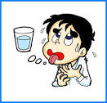
Stay hydrated, have a drink.

Slide 54
Acute Kidney Injury

Slide 55
Learning Objectives
To develop a basic understanding of what the kidneys do and how they work at cellular level.
Gain further knowledge in understanding the biochemistry that relates to AKI.
Discuss the common causes of AKI and how these may be treated.
Understand some of the common medications associated with AKI.
Discuss the concept of fluid balance and the challenges we face to get this right.
Consolidate learning through case scenario discussions.

Slide 56
Acute Kidney Injury
20% of all admissions to hospital will have acquired AKI as part of that episode.
NCEPOD 2009 stated that 1 in 4 cases could have been managed better and outcomes improved.
Even small rises in creatinine can be associated with a poor outcome (Kellem 2002)
Mortality for patients with severe AKI around 60%. (Murugan 2011)
Costs to the NHS estimated around £500million per year (Kerr 2012)
Notes:
Associated mortality dependent on the severity.
Costs ranges from 450 – 600 million pounds.

Slide 57
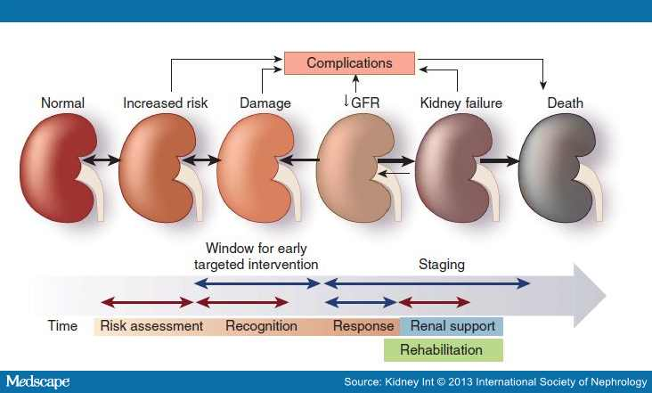
Define it…..
Seen as an spectrum of injury.
Notes:
- AKI is not a primary diagnosis but rather a syndrome.
- It occurs on the background of other illness – such as worsening heart failure or sepsis.
- Usually treating the primary problem will help the kidneys but may require further input and careful assessment.
- Kidney damage can occur long before we are aware it is happening.
- Key is to recognise those at risk and intervene at the earliest opportunity throughout regular monitoring and assessment.

Slide 58
Define it…..
The international guideline group Kidney Disease: Improving Global Outcomes (KDIGO) has developed a definition and staging system that harmonises previous definitions compiled by other groups.
Acute kidney injury is defined when one of the following criteria is met:
Serum Creatinine rise by greater than 26umol/L within 48 hours
OR
Serum creatinine rise 1.5 x from the reference value which is known or presumed to have occurred within one week
OR
Urine output is less than 0.5ml.kg/hr for 6 consecutive hours.
Reference serum creatinine should be the lowest creatinine value recorded within 3 months of the event.

Slide 59
Stage it……
Stage | Serum Creatinine | Urine Output
Stage 1 | 1.5-1.9 x baseline | <0.5mls/kg/hr 6-12 hrs
Stage 2 | 2.0-2.9x baseline | <0.5mls.kg.hr for > 12 hrs
Stage 3 | 3.0 x baseline | <0.3mls/kg/hr for 24rs
Kidney Disease: Improving Global Outcomes Staging Classification
Notes:
- Staging of AKI is important part of AKI diagnosis.
- Stage 3 is the worse and may require input from renal teams if deemed appropriate.

Slide 60
Stage it…
Creatinine was 100 last month and is now 159
STAGE 1
Urine output noted to be 0.2ml/kg/hr for past 24 hours
STAGE 3
Creatinine was 180 five days ago but is now 392
STAGE 2

Slide 61
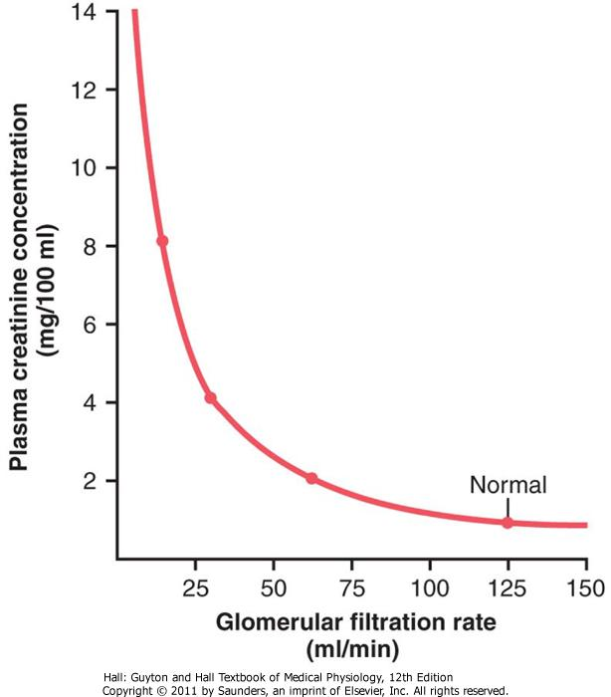
Creatinine clearence…
Beware the early changes!
Notes:
Even small rises in creatinine can be associated with a worse outcome.

Slide 62
Risk Factors….
Age (above 75 years)
Chronic Kidney Disease
Cardiac Failure
Atherosclerotic Peripheral Vascular Disease
Liver Disease
Diabetes
Nephrotoxic medications

Slide 63
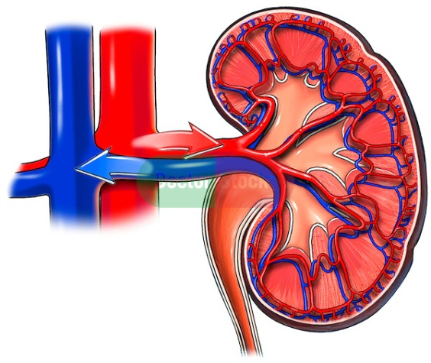
Causes…..
Pre Renal
Most common cause of AKI
Flow disruption to the kidney
For example:
  Low blood pressure
  Heart Failure
  Low blood volume
Blood flow reduced
Notes:
- 77 year old
- Past medical history of COPD
- Admitted with infective exacerbation of COPD and D&V.
- Not taken anything orally for few days.
- Rapid breathing rate, sweating.
- Dark Urine
Pre renal cause – dehydration/infection – resulting in reduced blood pressure – and reduced renal perfusion.
-

Slide 64
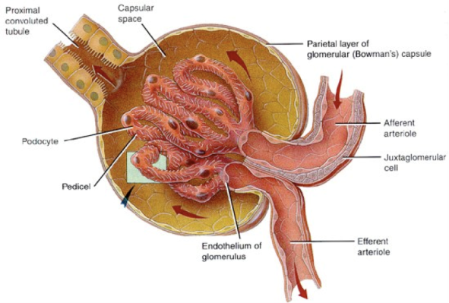
Causes….
Intrinsic
Damage to the kidney itself
For example:
  Glomerulonephritis
  Acute tubular Necrosis
Notes:
- 47 year old
- Background of diabetes
- Presented with hypertension
- Haematuria & Protein in Urine.
Suspected intrinsic cause requires senior and possible specialist referral.
Important to rule out other causes first – intrinsic AKI is the rarest but does occur.
Further investigations may be required such as a kidney biopsy to confirm diagnosis.

Slide 65
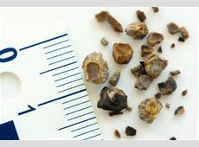
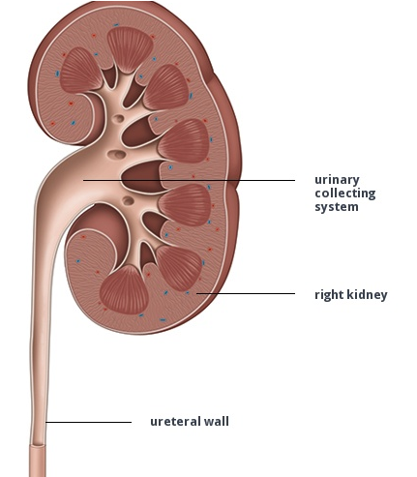
Causes….
Post Renal
A consequence of
urinary tract obstruction.
For example:
  Blocked catheter
  Renal calculi
  Bladder tumours.
Notes:
-86 year old gentleman
-Long term catheter in-situ
-Recent UTI
-Admitted with abdominal pain and reduced urine output via catheter
-Palpable bladder and severe pain on palpation.

Slide 66

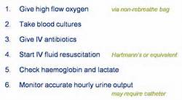
Sepsis
Always consider AKI in any septic patient

Slide 67
Assessment….
ABCDE Approach
Baseline U&E, FBC
Urinalysis
Cultures (if indicated)
ECG
CXR / AXR (if indicated)
Renal USS
Review by Senior Clinician and or discussion with nephrology

Slide 68
Assessment….
Careful consideration of volume status must be made in patients who are at risk of AKI and / or require fluid therapy (NICE CG169)
History should include any previous limited intake, thirst, abnormal losses and any co-morbidities.
Clinical Examination should include the following:
Pulse, Blood Pressure, CRT, JVP
Presence of pulmonary or peripheral oedema
Presence of postural hypotension
Passive leg raising
(NICE CG169)
Notes:
- Above taken from NICE CG 169
Fluid assessment can be difficult however any patient with AKI should have their fluid status documented.
The majority of AKI treatment requires fluid – however this is not always the case and can lead to life threatening complications such as pulmonary oedema.
Patients with worsening AKI due to worsening heart failure will not benefit from fluid resuscitation.
Fluid status assessment will be revisited in the later sessions

Slide 69
Ultrasound…..
When adults, children and young people have no identified cause of AKI offer urgent ultrasound within 24 hours. (NICE CG169)
Majority of patients who present with AKI should have an renal USS requested.

Slide 70
Treatment…..
Treat the underlying cause
Relieve any obstruction
Refer to nephrology / specialists
Indications for Renal Replacement Therapy (NICE169)
Hyperkalaemia
Acidosis
Uraemia
Fluid overload
Pulmonary oedema
(if none of the above have responded to medical management)

Slide 71
Treatment….
Do NOT offer loop diuretics to treat AKI (NICE CG169)
Consider loop diuretics for treating fluid overload or oedema while (NICE CG169):
Waiting for RRT
or
Renal function is recovering

Slide 72
Renal Teams?
All patients with the following should be escalated to a senior clinician who may need to refer to the nephrologist.
Stage 3 AKI
Suspected Vasculitis, Myeloma, glomerulonephritis.
AKI with no clear cause.
AKI with complications that have not responded to medical therapies.
Patients with transplanted kidney(s).

Slide 73
Nursing Considerations…
Monitor Fluid balance on a daily and CUMULATIVE basis.
Daily Weights are also a good indicator or acute fluid loss of gain.
Consider catherisation in patients who are persistently hypotensive or septic or obstructed.
Observations should be completed 4 hourly or more frequently if unwell.
Ensure patients are hydrated via oral or IV/NG route.
Escalate any patients who have shown signs of deterioration at the earliest opportunity.
Notes:
- Cumulative balance should take into account a patients fluid balance over a number of days.
- Where accurate fluid balance is difficult use daily weights instead, acute loss gain is usually always fluid.
- Catheterisation should be carefully considered. Avoid where possible as there is risk of infection or injury – however in patients who are critically unwell close monitoring via a catheter is warranted.

Slide 74
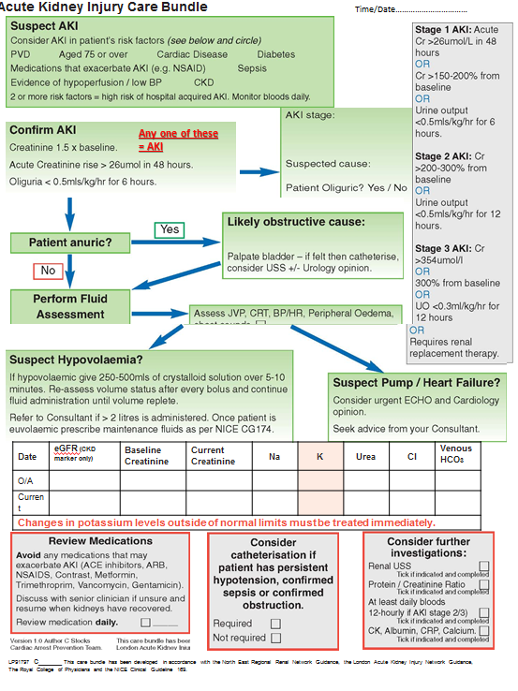
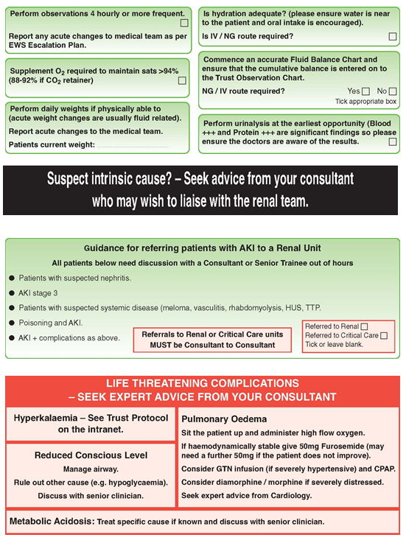
AKI Care Bundle – examples of potential AKI bundles in use.

Slide 75
Patient 1:
AKI Warning Stage 2
Bloods:
Admitted July 2015
Na 141
K 3.8
Ur 3.3
Creatinine 55
Patient did not have AKI. No recent creatinine result available in last 7 days therefore median results used.
Previous creatinine results during prolonged ITU stay with multi-organ failure. Creatinine was 16.
Notes:
Patient did not have AKI.
Median result lower due to ITU admission in November: Multi organ failure and prolonged admission – creatinine level 16 at one point during admission.

Slide 76
Patient 2.
AKI Warning Stage: 1
Bloods:
Na 135
K 4.6
Ur 19
Creatinine 220
Patient did have AKI. Admitted with worsening heart failure. Last creatinine result 6 days previously was 150.
Notes:
Correct the person did have an AKI.
Last recent creatinine level was 150.

Slide 77
Causes?
Patient A:
55 year old admitted with D&V for 5 days, not eating or drinking.
Admitted to AMU, hypotensive, tachycardia, feeling thirsty and poor urine output.
Urea 17.8, Creatinine 227, K5.0, Na 147,
AKI warning stage 2

Slide 78
Causes?
Patient A:
55 year old admitted with D&V for 5 days, not eating or drinking.
Admitted to AMU, hypotensive, tachycardic, feeling thirsty and poor urine output.
Urea 17.8, Creatinine 227, K5.0, Na 147,
AKI warning stage 2
PRE Renal AKI

Slide 79
Patient B
27 year old gentleman admitted to ED after leg being crushed by a heavy load at work for 4 hrs.
No obvious fractures.
Unwell – drowsy
Urine very dark in colour
Bloods:
Ur 27, Cr 457, K3.1, Na 147
AKI Warning Stage 3

Slide 80
Patient B
27 year old gentleman admitted to ED after leg being crushed by a heavy load at work for 4 hrs.
No obvious fractures.
Unwell – drowsy
Urine very dark in colour
Bloods:
Ur 27, Cr 457, K3.1, Na 147
AKI Warning Stage 3
Instrinic AKI

Slide 81
Patient C
78 year old admitted with abdominal pain from nursing home.
Past medical history of dementia, LT catheter, gallstones, CKD.
Difficult to assess due to severe pain, but lower abdominal swelling. Poor appetite and more confused.
Bloods: Ur 10, Cr 210, K3.9, Na 138
AKI Warning 1

Slide 82
Patient C
78 year old admitted with abdominal pain from nursing home.
Past medical history of dementia, LT catheter, and gallstones, CKD.
Difficult to assess due to severe pain, but lower abdominal swelling. Poor appetite and more confused.
Bloods: Ur 10, Cr 210, K3.9, Na 138
AKI Warning 1
Post Renal AKI

Slide 83
Patient D
88 year old admitted with breathlessness
Past medical history of severe LV dysfunction.
On examination – chest crackles, JVP raised, Sacral oedema and breathless.
Bloods:
Ur 19, Creat 227, K3.8, Na 129
AKI Warning Stage 2

Slide 84
Patient D
88 year old admitted with breathlessness
Past medical history of severe LV dysfunction.
On examination – chest crackles, JVP raised, Sacral oedema and breathless.
Bloods:
Ur 19, Creat 227, K3.8, Na 129
AKI Warning Stage 2
Pre Renal Cause
Notes:
Not all AKI is dehydration!

Slide 85
Advice for Patients/carers and regarding hydration.
It has been reported that nearly 65% of AKI starts in primary care (Selby 2012).
Patients who are at risk of AKI should be informed that sufficient hydration is essential to kidney health. Dehydration is the underlying cause of many common conditions including: constipation; falls; urinary tract infections; pressure ulcers; malnutrition; incontinence; and confusion.
Other important factors for carers to consider is whether their relative or patient is able to hold a cup themselves and how often they require prompts to have a drink.
The idea of ‘sick day rules’ may be appropriate on the basis of individualised assessment to patients who are currently well.
Notes:
Hydration is essential for health – fluid loss of 15% is life threatening.
Staff should inform patients and carers on how to spot dehydration and what they should do.
It is important to consider that all your patients are sufficiently hydrated – can they reach and actively take a drink in front of you? If they cant then they will need assistance.
How much intake should we advise patients/carers? General rule of thumb suggest 30ml/kg however in hot weather or periods of illness more fluid may be required.
A wide variety of patient information leaflets have been developed in a multitude of NHS Trusts and could be utilised in your clinical areas if deemed suitable.
Could also access public health websites such as NHS Choices, NHS Kidney Care, Think Kidneys websites.

Slide 86
Signs & Symptoms of Dehydration for carers/patients
Thirst
Sunken Eyes
Headaches
Irritability
Confusion
Headache
Reduced urine output or darker colour urine
Decreased skin turgor
Notes:
We lose the thirst sensation with age – routine drinking might be beneficial to the elderly population.

Slide 87
Any Questions?

Slide 88
Summary
Acute Kidney Injury may affect approximately 20% of all emergency admissions to hospital.
AKI occurs as a consequence of another primary insult.
AKI should be identified and staged using the KDIGO guidance.
Treatment is dependant on the primary cause and should include on going monitoring and assessment.
If in doubt seek advice from a senior clinician.
Patients and carers should be fully informed about hydration and its importance.

Slide 89
References
Acute Kidney Injury Guidelines (2012) Kidney Disease : Improving Global Outcomes. http://kdigo.org/home/guidelines/acute-kidney-injury/ (accessed June 2014)
Adding insult to injury (2009) National confidential enquiry into patient outcome & death. http://www.ncepod.org.uk/2009aki.htm (accessed June 2014)
Murugan A (2011) AKI – what’s the prognosis? Nat Rev Nephr. 209-217
Kellum JA, Angus DC. Patients are dying of acute renal failure. Crit Care Med. 2002;30:2156–2157
National Institute for Clinical Excellence CG174 Intravenous Fluid Therapy CG169 Acute Kidney Injury (2014)
Selby et al (2012) Use of Electronic Results Reporting to Diagnose and Monitor AKI in Hospitalised Patients
Campbell (2014) - Recognising and preventing dehydration among patients. Nursing Times

Slide 90
Medication and Acute Kidney Injury

Slide 91
Objectives
Understand why we need to consider medication in AKI
Identify common medications which can contribute to, or are affected by, AKI
Understand how to manage medications in patients with AKI

Slide 92
Why do we need to consider medication in AKI
Prescribing medication is a common intervention
Complacent - medicines are dangerous
Between 5 and 20 % of all AKI cases occur as a direct result of medication
We need to consider medication because:
  Wide range of drugs which can cause/contribute to AKI
  Kidneys are responsible for the metabolism of two drugs:- vitamin D and insulin
  Kidneys are responsible for the excretion of many water soluble drugs and their metabolites
Notes:
Many patients are harmed and die every year as a direct result of the medicines we prescribe and administer.
Reduced excretion = increased adverse events due to accumulated drugs.

Slide 93
Why do we need to consider medication in AKI?
On admission, a thorough review of medication is required to:
  Identify drugs which have potentially caused/contributed to AKI
  Avoid inappropriate combinations of medications which may exacerbate AKI
  Ensure all doses of medications prescribed continue to be correct and clinically appropriate
Notes:
In addition when prescribing, we should remember that:
The absorption of drugs may be affected due to nausea, vomiting and diarrhoea associated with uraemia.
Changes in hydration state, alterations in protein binding and alterations in tissue binding can affect the distribution of a drug. This can affect drug dosing.
Water soluble drugs stay in the blood and interstitial fluid
Fat soluble drugs tend to stay in fatty tissues

Slide 94
Common medications which can contribute to, or are affected by, AKI
Several options when reviewing medication in AKI:
  Stop
  Withhold
  Amend
  Continue
First we need to know which medications to pay attention to

Slide 95
Common medications which can contribute to, or are affected by, AKI
UK Renal Pharmacy Group – AKI Medicines Optimisation Toolkit (March 2012)
Consider Acute Nephrotoxic Drug Action
Contrast media
ACE Inhibitors
NSAID’S
Diuretics
ARB’s

Slide 96
Contrast media
A
N
D
A
Contrast induced nephropathy
Can occur in any patient with intra venous or intra-arterial contrast
Known renal dysfunction or CrCl = <60mls/min, consider non-contrast imaging
Oral N-acetylcysteine – antioxidant. Neutralises free radicals
IV sodium bicarbonate can also be used
No authorised protocol for this in the trust
Notes:
Aintree Hospital – comprehensive protocol
N-acetylcysteine (NAC) 600 mg orally twice a day, on the day before and of the procedure if creatinine clearance is estimated to be less than 60 mL/min
Out of hours, oral NAC won’t be stored in the trust – therefore iv preparation can be given orally.
If patient is nil by mouth give NAC 1gm intravenously in 100ml 0.9% saline on day of contrast and on the day post procedure

Slide 97
C
ACE Inhibitors
N
D
A
Used to treat hypertension, heart failure, nephropathy
Work on the RAAS system
Inhibit conversion of angiotensin I to angiotensin II
Dilate efferent arterioles
Reduced renal perfusion and GFR
Hyperkalaemia – potassium retention due to reduction of aldosterone
Notes:
Reduction in blood pressure secondary to vasodilatation following ACE inhibition is greatest when the renin-angiotensin system is stimulated (e.g. following diuretic therapy or in renal artery stenosis) but ACE inhibitors also lower blood pressure when there is normal or low activity of the renin-angiotensin system. Remember patients on ACE are likely to be on diuretic of some description.

Slide 98
Renin- Angiotensin system
ACE Inhibitors work HERE
Notes:
ACE inhibitors lead to dilatation of efferent arterioles of the glomerulus, which causes decrease in GFR, reduced blood pressure and reduced renal perfusion.
Aldosterone
Excrete potassium
kidneys to retain salt
increases retention of water
increases blood pressure
Reduced aldosterone
Retain potassium
kidneys retain less salt.
less water is retained
reduced blood volume and a reduced blood pressure

Slide 99
ACE inhibitors cause dilatation HERE.

Slide 100
C
A
NSAIDS
D
A
Analgesic, antipyretic and anti-inflammatory
Non-selective COX inhibitors
  Acetic acids – diclofenac, indomethacin
  Proprionic acids – ibuprofen, naproxen
  Salicylates - aspirin
  Enolic acid derivatives – meloxicam
  Anthranilic acid derivatives – mefenamic acid
  Two other groups which we never see
Selective COX II inhibitors - celecoxib
Notes:
Sulfonanilides and ‘Others’

Slide 101
C
A
NSAIDS
D
A
Inhibit cyclooxygenase
Impair prostaglandin synthesis
Prostaglandins usually mediate renal blood flow
Reduced prostaglandin synthesis = Reduced renal perfusion
Tend to promote sodium retention and subsequent fluid retention therefore increasing blood pressure
Notes:
Complicated mechanism of action

Slide 102
NSAID’s cause constriction HERE.
Notes:
Vasodilation of afferent arterioles helps to maintain renal perfusion when renal blood flow is reduced e.g. angiotensin II constricting efferent.
NSAIDS reduce prostaglandin production which causes constriction of the afferent arteriole which reduces renal perfusion pressure
IMPORTANT NOTE
Long term use of NSAIDS can cause analgesic nephropathy – renal papillary necrosis and chronic interstitial nephritis.

Slide 103
C
A
N
Diuretics
A
Three main classes of diuretic
Loop diuretics
  Act on the ascending links of the loop of Henle
  Inhibit reuptake of sodium
  Less water uptake therefore increased urine production
  Reduced circulating volume
  Reduced renal perfusion
Notes:
Loop diuretics still have some efficacy in renal impairment, unlike thiazides. As a rule don’t offer unless managing oedema or when renal function is recovering or awaiting RRT

Slide 104
C
A
N
Diuretics
A
Potassium sparing diuretics
  Act on the distal convoluted tubule
  Competitive antagonists which inhibit sodium/potassium exchange
  Inhibits reuptake of sodium therefore increasing water excretion.
  Reduces excretion of potassium - Hyperkalaemia
Thiazide diuretics
  Act on distal convoluted tubule
  Inhibit reuptake of sodium therefore increasing water excretion
  Causes volume depletion and hypoperfusion
Notes:
Requires renal excretion into the renal tubule to exert its affect. Efficacy falls in renal impairment

Slide 105
C
A
N
D
Angiotensin Receptor Blockers
Antagonise the action of angiotensin II by blocking the angiotensin II AT1-receptor.
Reduces production and secretion of aldosterone
Hyperkalaemia – potassium retention due to reduction of aldosterone

Slide 106
Renin- Angiotensin system
ARB’s work HERE
Notes:
Take care when ARB’s or ACE inhibitors are co-administered with potassium supplements/potassium sparing diuretics due to risk of hyperkalaemia
Should also be cautious when NSAID’S are prescribed with ARBs/ACE inhibitors.
Angiotensin II usually constricts efferent arteriole but can also constrict afferent arteriole in high levels. Prostaglandins would usually dilate the afferent arteriole but NSAIDs reduce renal perfusion by constricting afferent arteriole. Double whammy
Add in diuretic – Triple whammy
At these elevated levels, angiotensin II also constricts the afferent arteriole into the glomerulus in addition to the efferent arteriole it normally constricts. Prostaglandins serve to dilate the afferent arteriole; by blocking this prostaglandin-mediated effect, particularly in renal failure, NSAIDs cause unopposed constriction of the afferent arteriole and decreased renal perfusion pressure.

Slide 107
Other ‘problem’ drugs
Analgesics
  Opiates – avoid MR preps. Reduce dose of standard release preps. Risk of accumulation.
  Fentanyl – minimal renal excretion
Antibiotics
  Aminoglycosides – gentamicin – AVOID
  Glycopeptides – vancomycin - AVOID
  Refer to CDDFT Antibiotic formulary for advice (CrCl calculator within)
Antiepileptics
  Consider reducing dose and/or monitoring levels

Slide 108
Other ‘problem’ drugs
Antihypertensives
  May exacerbate poor renal perfusion - monitor
Hypoglycaemic agents
  Risk of accumulation - monitor BM’s
  Avoid Metformin – increased risk of lactic acidosis
Immunosuppresants and Chemotherapy
  Increased risk of accumulation and associated toxicity – seek Specialist Advice
Allopurinol
  Accumulates leading to risk of interstitial nephritis – Reduce dose
Warfarin
  INR may be raised due to warfarin displacement from binding sites
Notes:
If transplant patient on immunosuppressants presents with worsening renal function – seek specialist advice. Do not stop!

Slide 109
Other ‘problem’ drugs
Anticholinergics
  Can cause urinary retention
    Antihistamines
    Antipsychotics
    Antispasmodic
  Reduce dose
Digoxin
  Accumulates – monitor level and consider reducing dose
Lipid lowering agents
  Statins
  Fibrates
  increased risk of rhabdomyolysis
Lithium
  Accumulation
  Can cause chronic interstitial nephropathy
Notes:
Statins – rare side effect, pigment from break down of myoglobin in rhabdomyolysis blocks tubules
Lithium – can cause water and electrolyte loss

Slide 110


‘Sick Day Rules’
Many health care professionals provide advice to such patients that certain drugs should be temporarily discontinued during acute intercurrent illnesses, particularly where there is disturbed fluid balance. This advice is commonly described as ‘sick day rules’ or to take a ‘drug holiday’.
Notes:
We have to be cautious.

Slide 111
Sick Day Rules.
There are three main reasons for providing such advice:
1. Non-steroidal anti-inflammatory drugs impair renal autoregulation by inhibiting prostaglandin-mediated vasodilatation of the afferent arteriole and may increase the risk of AKI.
2. Drugs that lower blood pressure, or cause volume contraction, might increase the risk of AKI by reducing glomerular perfusion.
3. Drugs might accumulate as a result of reduced kidney function in AKI, increasing the risks of adverse effects.
In terms of medicines management, advice from the Think Kidneys Programme Board is that it is reasonable for clinicians to provide “sick day rules” guidance on temporary cessation of medicines to patients deemed at high risk of AKI based on an individual risk assessment.

Slide 112
Useful sources of info
BNF. Current edition.
Renal Drug Handbook (3rd Ed)
Medicine Summary of Product Characteristics www.medicines.org.uk
Medicines Information departments – Telephone numbers can be found in the BNF.
Version 6: (July 2015) “Sick day rules” in patients at risk of Acute Kidney Injury: an Interim Position Statement Think Kidneys Board Griffith K, Ashley C, Blakeman T, Fluck R, Lewington A, Selby N, Tomlinson L, Tomson C. Available online at bit.ly/TK-Sick-Day-Rules

Slide 113
Fluid Balance Workshop

Slide 114
Workshop Guidance
Discuss why fluid balance is important (5 mins).
Discuss when fluid balance is indicated (5 mins).
Discuss how to complete daily fluid balance, how to estimate and what should be included on fluid balance chart (Demonstrate measures of cups, jugs, bottles & bed pans, bed linen and pads) (15 mins).
Discuss what insensible loss is and why it should be measured (5 mins).
Discuss how to calculate CUMULATIVE Balance and why this is important (10 mins).
Discuss importance of daily weights and highlight that acute changes in weight are usually fluid related (5 mins).
Discuss how to assess fluid status JVP, Chest Sounds, CRT, Passive Leg Raising, HR, BP, Peripheral oedema (15 mins).

Slide 115
Scenarios
Notes:
Please refer to the facilitator guidance for the scenarios.

