Slide 1


An Introduction to
Acute Kidney Injury (AKI)
An Education Package for Healthcare Professionals in Medical Directorates

Slide 2
What is Acute Kidney Injury (AKI)?
AKI is now the universal term used to describe sudden deterioration of renal function, and it replaces the previous term know as Acute Renal Failure (ARF)
AKI is detected by monitoring creatinine blood levels, and urine output
AKI is a common condition amongst hospital inpatients and affects mortality and length of stay

Slide 3
NCEPOD ‘Adding Insult to Injury’ Report
A 2009 report by the National Confidential Enquiry into Patient Outcome and Death (NCEPOD) found that 15% of AKI cases were avoidable and recommended:
All acute NHS trusts should have a policy for the management of AKI
All acute admissions should receive adequate senior reviews (with a consultant review within 12 hours of admission)
Predictable and avoidable AKI should never occur

Slide 4
AKI – Common and Serious
10-20% of hospital admissions
2-4 pts on average 20 bed ward
Who are they and how can we identify early?

Slide 5
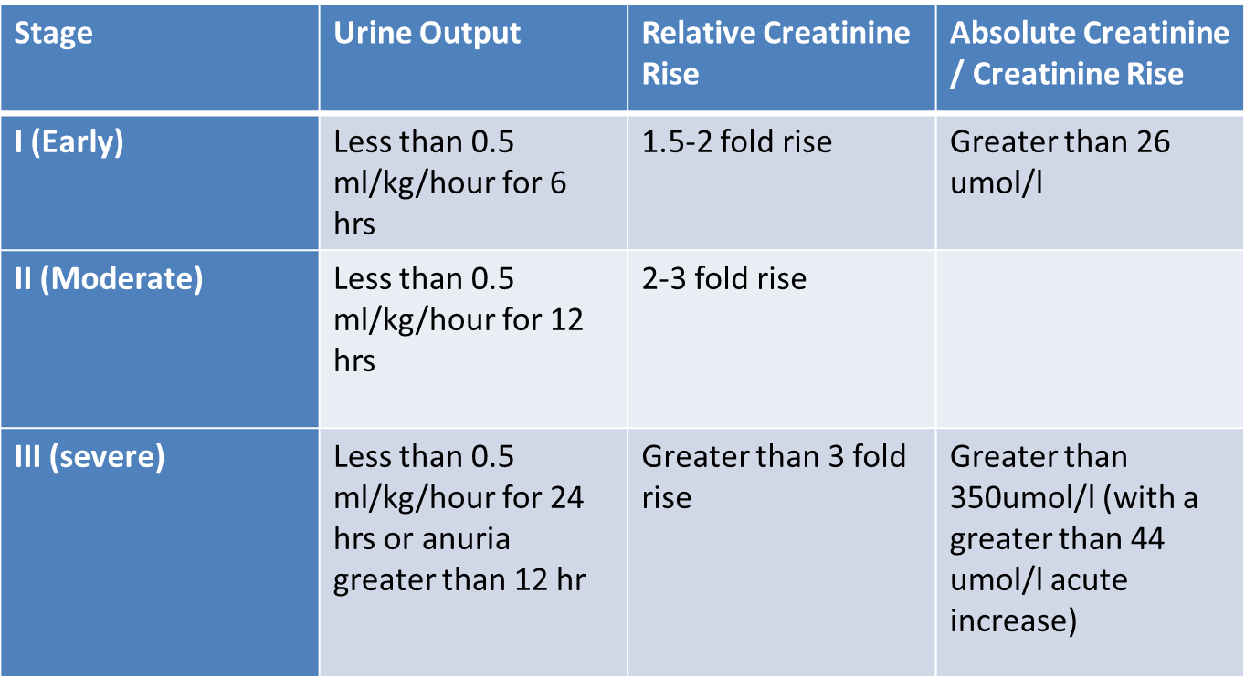
Identifying AKI

Slide 6
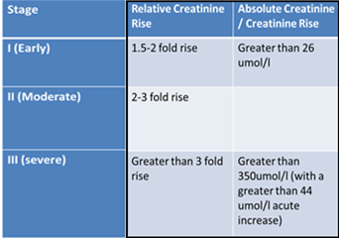
Identifying AKI from Creatinine Levels!
A national algorithm standardizing the definition of AKI is now in use. The report indicates whether the patient is suspected to have AKI stage 1, 2 or 3. This is reported on the ICE system
If a clinician determines that the patient is in any stage of AKI after reviewing the lab results and assessing the patient, then the AKI Care Bundle Checklist must be put in the notes, medical staff informed.

Slide 7
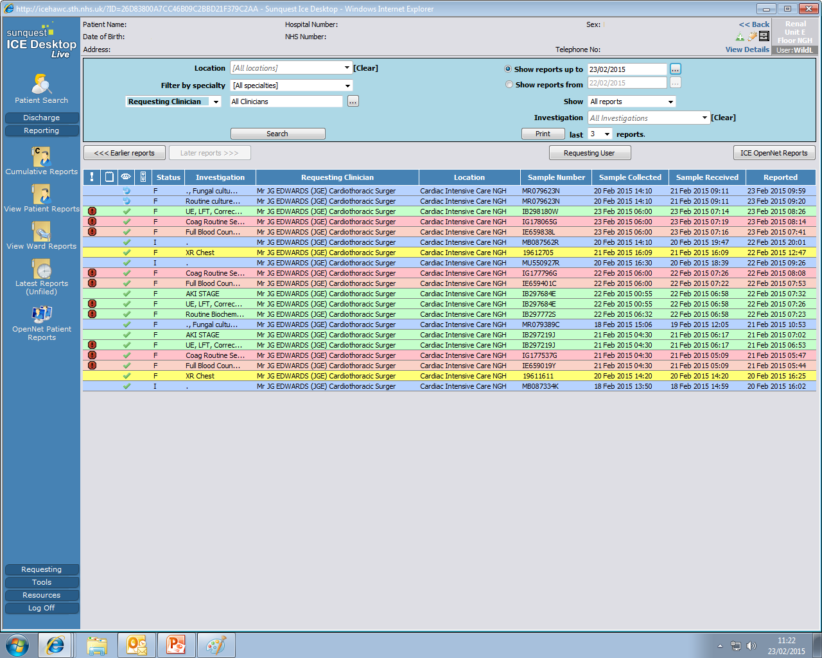
Notes:
Can we make this so that the Drs/Nurses can click on it & see how it work live on ICE- Have prompt for them to click on & view the bundle State that “must be printed off & put in the notes!!!”

Slide 8
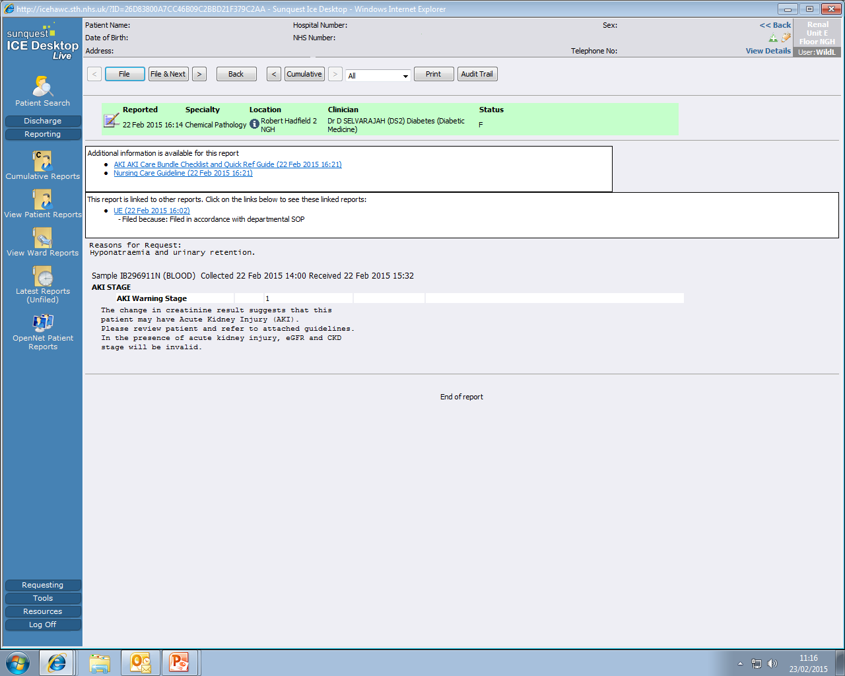
Notes:
Get to click on NCG & AKI care bundle to pop up.

Slide 9
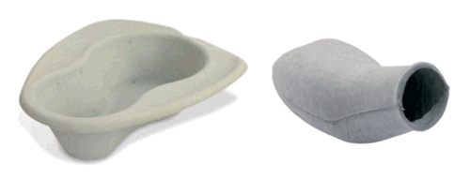
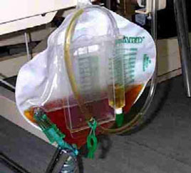
Identifying AKI from Urine Output!
If urine output is less than the minimum required output of 0.5mls/kg/hr (oliguria) as per the identifying AKI criteria, medical staff need to be informed and the AKI Care Bundle Checklist must to be placed in the notes.
None Catheterised
Catheterised
Always consider the urine output even if the patient is not catheterised.
Explain to the patient the importance of monitoring urine output. Provide container to measure urine
Record amount of incontinence; a little or a lot, damp or saturated
Consider Bladder scan as a none invasive intervention or ISC if the patient has not passed urine for 6-8 hours. Record findings/residual on charts and in the patients notes.
Consider catheterising if patient shows signs of deterioration
If the patient is catheterised follow the SHEWs algorithm monitoring urine output 1-2 hourly and score correctly.
Report reduced urine output (oliguria) early so that appropriate management/treatments can be implemented.
Notes:
Explanations for each pop up? (slide 25 & 26)

Slide 10
Questions-Urine Output
Why do you need to know a patients Accurate Urine Output?
Urine output is used to Identify potential AKIs (see identifying AKI criteria)
How do you work out the patients minimum urine output requirements and what is it?
Weight – 0.5mls/kg/hour (half a persons body weight)
If the weight is 49.8kg. Her minimum urine output should be 25mls/hour (Record on Fluid Balance Chart)
How can you measure the patients urine output?
Measure using jugs/bed pans/bottles
Bladder scan
catheter
When should you consider catheterising?
Deteriorating SHEWs score/Acutely unwell
To gain accurate urine output as above and/or with AKIs stages ll & lll
Notes:
*Use a scanned I&O chart to illustrate this*

Slide 11
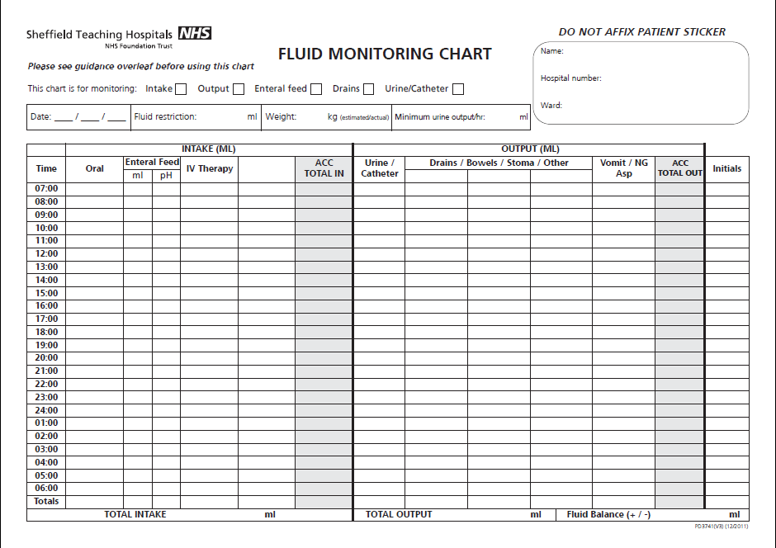

Slide 12
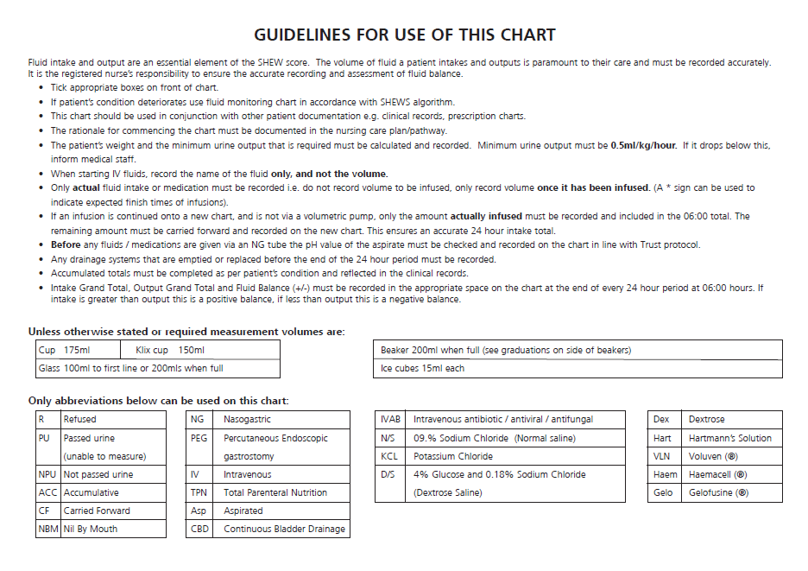

Slide 13
Who is at risk?
At risk patient = High risk group + Insult
High Risk Groups | Common Insults
Patients age is 65 and over Patient has heart failure, liver disease or diabetes Chronic kidney disease – adults with an estimated glomerular filtration rate (eGFR) less than 60 ml/min/1.73 m2 are at particular risk History of AKI Multiple Myeloma | Hypotension (absolute relative) Sepsis Use of iodinated contrast agents (contrast scan) within the past week. Use of drugs with nephrotoxic potential such as: non-steroidal anti-inflammatory drugs (NSAIDs) aminoglycosides, e.g. Gentamicin angiotensin-converting enzyme (ACE) inhibitors, e.g. Rampril angiotensin II receptor antagonists (ARBs), e.g. Losartan and diuretics

Slide 14

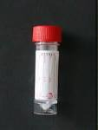
Urinalysis All Patients should have a urinalysis performed. If protein and blood present in the urine, samples should be sent to the labs;
Protein Creatinine Ration (PCR)
Send to Clinical Chemistry
Mid Stream Urine (MSU)
Send to Microbiology
Reason…..
High PCR can suggests glomerular disease
MSU can confirm infection

Slide 15
Nursing Care Guideline (NCG) and
AKI Care Bundle
Patient’s from high risk groups with an identified insult are at high risk of developing AKI & need to be assessed by Medical, Nursing & Pharmacy staff which should include a review of medications, SHEWS & Urine Output monitoring. Make sure daily & post operative bloods are taken to monitor creatinine levels.

Slide 16
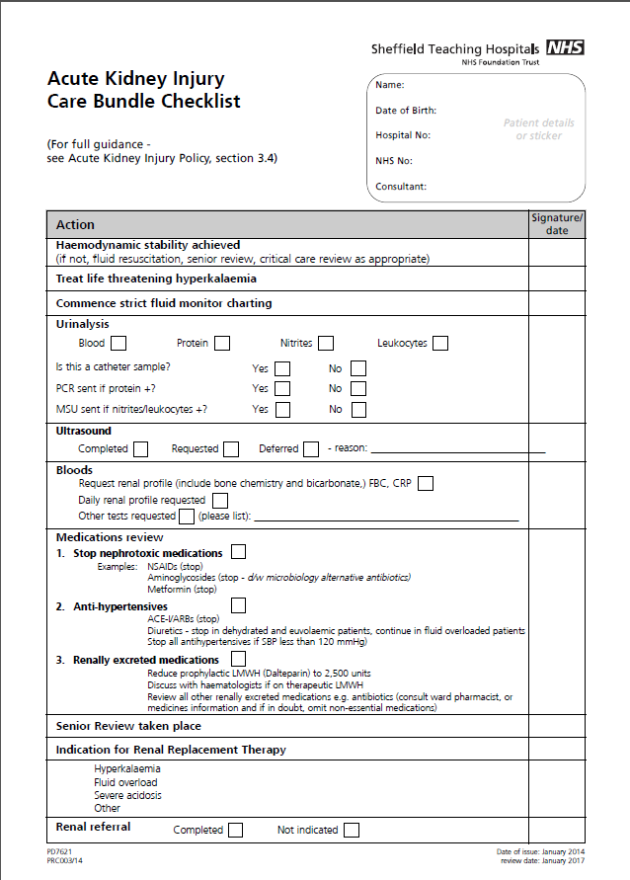
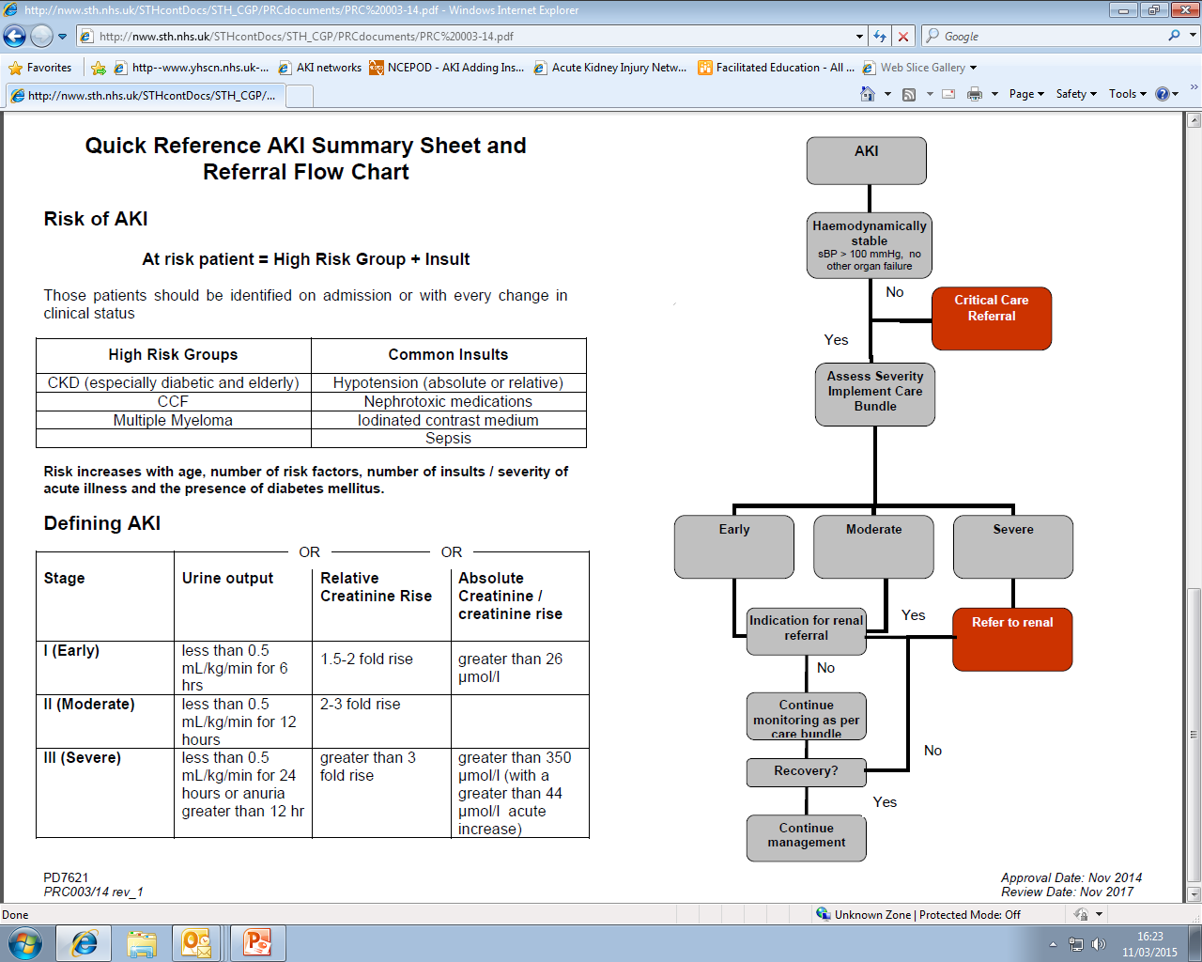
The AKI Care Bundle is for AKI Management and should be included in the notes for Patients Identified as having AKI at any stage

Slide 17
NCG (No.20) helps nurses caring for patients with or at increased risk of AKI

Slide 18
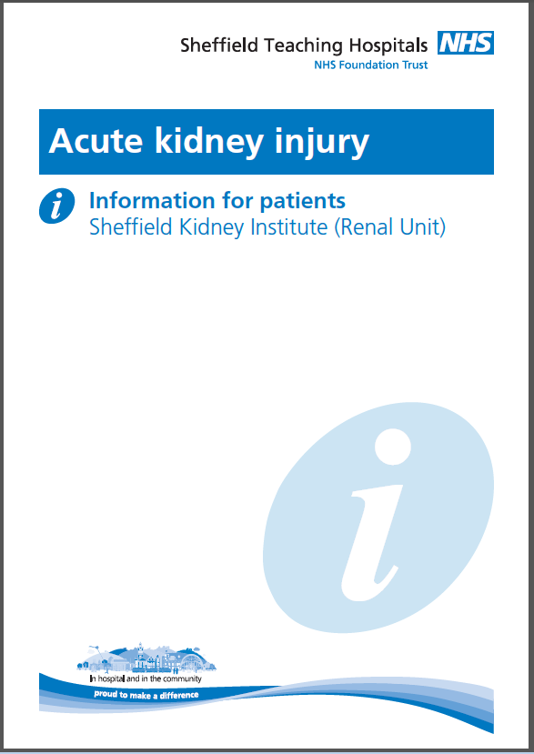
Give all Patients Identified as having an AKI a Patient Information Leaflet Empower patients to understand what has happened to them & to be aware of risks in the future which may prevent another occurrence of AKI (part of past medical history, alerts staff)

Slide 19
How can you assess for AKI in your everyday practice?
Nursing Care Guidelines for AKI (NO. 20) Risk factors and Identified AKI’s
Care Rounding
SHEWs monitoring
Deteriorating Patient Stickers
Accurate fluid balance monitoring
Hydration & Nutrition monitoring (HANAT)
AKI Care Bundle Checklist To be put in the Notes for the management of all Identified AKI’s

Slide 20
Based on this information why are the following interventions necessary?
Increased frequency of SHEWS
A- to monitor Clinical response, high early warning scores give greater risk of developing AKI
Encourage fluids, IV Fluid challenge, monitor input
A- Optimise hydration and improve kidney perfusion
Catheterise
A- Accurate Urine Output (Minimum requirements of 0.5mls/kg/hr)
Urinalysis
A- Intrinsic renal disease if no obvious cause of AKI could suggest underlying disease process also infection
Review medications
A- for nephrotoxicity dose adjustment or to stop
Send blood samples U&Es/Full Renal Profile
A- To monitor kidney function and complications such as hyperkalaemia
Daily weights
A- To assess hydration
Pain relief
A- Adjust doses for kidney function, aid recovery
Nausea medication
A- Aid eating and drinking

Slide 21
Points to remember
Remember the AKI risk factors
Always consider urine output even if the patient isn’t catheterised (strict I&O, monitor SHEWs regularly)
Daily U&Es or Full Renal Profile. Repeat bloods post invasive procedure or surgery
Urinalysis; If protein present send PCR & MSU urine samples
Ensure the AKI NCG is adhered to
Ensure all patients at risk of AKI have been assessed
Ensure all patients identified as having AKI have an AKI Care Bundle in their notes
Prevention, early identification and early management is
key to stopping avoidable AKI, reducing mortality and length
of stay.

Slide 22
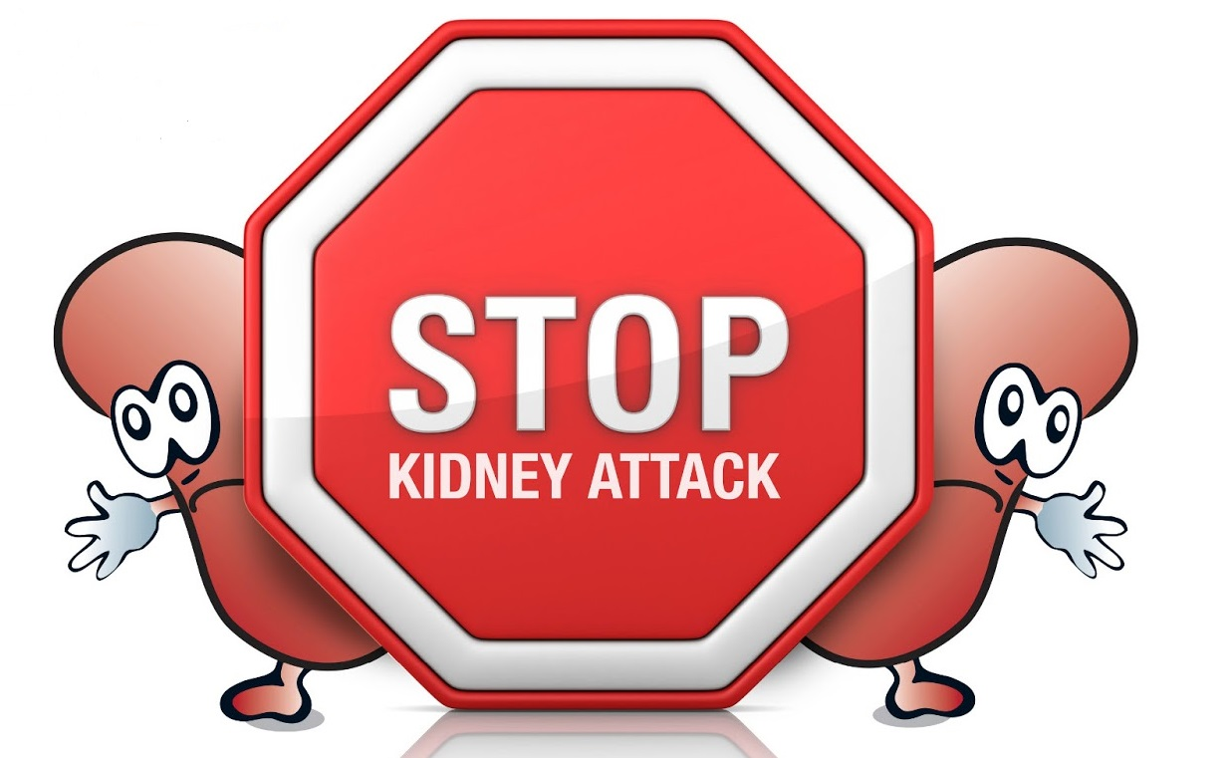
Remember …
Thank you for your time

