Slide 1


An Introduction to
Acute Kidney Injury (AKI)
An Education Package for Healthcare Professionals in the Surgical Care Group

Slide 2
The session will cover:
What is Acute Kidney injury (AKI)
Identifying the risk factors
Use of the AKI Nursing Care Guideline (NCG) and AKI Care Bundle
An AKI case study
Monitoring and assessing AKI using:
  Care Rounding
  Deteriorating Patient Pathway (DPP)
  AKI Care Bundle
STH Acute Kidney Injury (AKI) Project Intro slide 2 of 7
Notes:
Have any of you nursed a AKI
What was there experience.

Slide 3
What is Acute Kidney Injury (AKI)?
AKI is now the universal term used to describe sudden deterioration of renal function, and it replaces the previous term know as Acute Renal Failure (ARF)
AKI is detected by monitoring creatinine blood levels, and urine output
AKI is a common condition amongst hospital inpatients and affects mortality and length of stay
STH Acute Kidney Injury (AKI) Project Intro slide 3 of 7

Slide 4
NCEPOD ‘Adding Insult to Injury’ Report
A 2009 report by the National Confidential Enquiry into Patient Outcome and Death (NCEPOD) found that 15% of AKI cases were avoidable and recommended:
All acute NHS trusts should have a policy for the management of AKI
All acute admissions should receive adequate senior reviews (with a consultant review within 12 hours of admission)
Predictable and avoidable AKI should never occur
STH Acute Kidney Injury (AKI) Project Intro slide 4 of 7
Notes:
4 & 5 merge?

Slide 5
Identifying AKI
Stage | Urine Output | Relative Creatinine Rise | Absolute Creatinine / creatinine rise
I (Early) | Less than 0.5 ml/kg/hour for 6 hrs | 1.5-2 fold rise | Greater than 26 umol/l
II (Moderate) | Less than 0.5 ml/kg/hour for 12 hrs | 2-3 fold rise
III (severe) | Less than 0.5 ml/kg/hour for 24 hrs or anuria greater than 12 hr | Greater than 3 fold rise | Greater than 350umol/l (with a greater than 44 umol/l acute increase)
STH Acute Kidney Injury (AKI) Project Intro slide 5 of 7

Slide 6
Who is at risk?
At risk patient = High risk group + Insult
High Risk Groups | Common Insults
Patients age is 65 and over Patient has heart failure, liver disease or diabetes Chronic kidney disease – adults with an estimated glomerular filtration rate (eGFR) less than 60 ml/min/1.73 m2 are at particular risk History of AKI Multiple Myeloma | Hypotension (absolute relative) Sepsis Use of iodinated contrast agents (contrast scan) within the past week. Use of drugs with nephrotoxic potential such as: non-steroidal anti-inflammatory drugs (NSAIDs) aminoglycosides, e.g. Gentamicin angiotensin-converting enzyme (ACE) inhibitors, e.g. Rampril angiotensin II receptor antagonists (ARBs), e.g. Losartan and diuretics
STH Acute Kidney Injury (AKI) Project Intro slide 6 of 7
Notes:
Hypotension (absolute/relative) / Elderly (esp if cognitive or physical impairment) /
At risk patient = High risk group + Insult

Slide 7
Nursing Care Guideline (NCG) and
AKI Care Bundle
The new NCG has been produced to help nurses caring for patients with or at increased risk of AKI
Patient’s from high risk groups with an identified insult are at high risk of developing AKI & need to be assessed by Medical, Nursing & Pharmacy staff which should include a review of medications, SHEWS & Urine Output monitoring. Make sure daily & post operative bloods are taken to monitor creatinine levels.
If identified as having AKI the AKI Care Bundle Checklist should be included in the patients notes, medical staff informed
STH Acute Kidney Injury (AKI) Project Intro slide 7 of 7

Slide 9
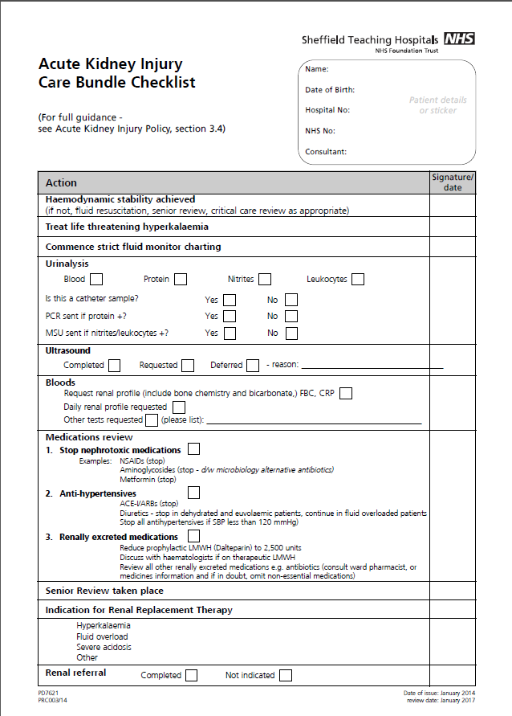

Slide 10
An AKI Case Study
What would you do differently?
STH Acute Kidney Injury (AKI) Project 1 of 27

Slide 11
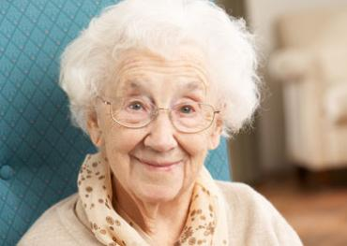
Audrey – Day 1
86 year old woman
Lives independently at home and still drives
Just discharged from MAU for dizzy spells
Found on the floor by her son after a fall
Brought in to A&E at 14:00 on 21/06/14
Complaining of right groin pain and unable to weight bear
STH Acute Kidney Injury (AKI) Project 2 of 27

Slide 12
Audrey – Day 1
Past Medical History
  Hypertension
  Type 2 Diabetes
  Fractured left femur 2004
  Ca Cervix (curative resection)
  Vaginal prolapse
  Osteoporosis
STH Acute Kidney Injury (AKI) Project 3 of 27

Slide 13
Audrey – Day 1
Current Drugs:
  Metformin 500mg BD
  Gliclazide 80mg BD
  Amlodipine 5mg OD
  Atorvastatin 20mg ON
  Ramipril 5mg OD
  Paracetamol 1g PR
STH Acute Kidney Injury (AKI) Project 4 of 27

Slide 14
Questions
Can you identify Audrey’s AKI risk factors?
Age
Hypertension
Diabetes
Takes Ramipril
Recent admission
Initiate the AKI Nursing Care Guideline

Slide 15
Audrey – Day 1
Pelvic x-ray confirmed fractured neck of femur
Bloods sent by A&E
Referred to orthopaedics
Transferred to SAC
Observations and blood sugars stable
IV fluids running and nil-by-mouth for theatre the next day
Clerked and regular drugs prescribed by F1
STH Acute Kidney Injury (AKI) Project 5 of 27

Slide 16
Questions
What contributing risk factors can you think of that surgery brings?
NBM
Potential of infection/sepsis
Potential of Bleeding
Pain and pain medication
Potential reduced mobility
Initiate Nursing Care Guidelines for the patient with or at risk of AKI, if not already done so

Slide 17
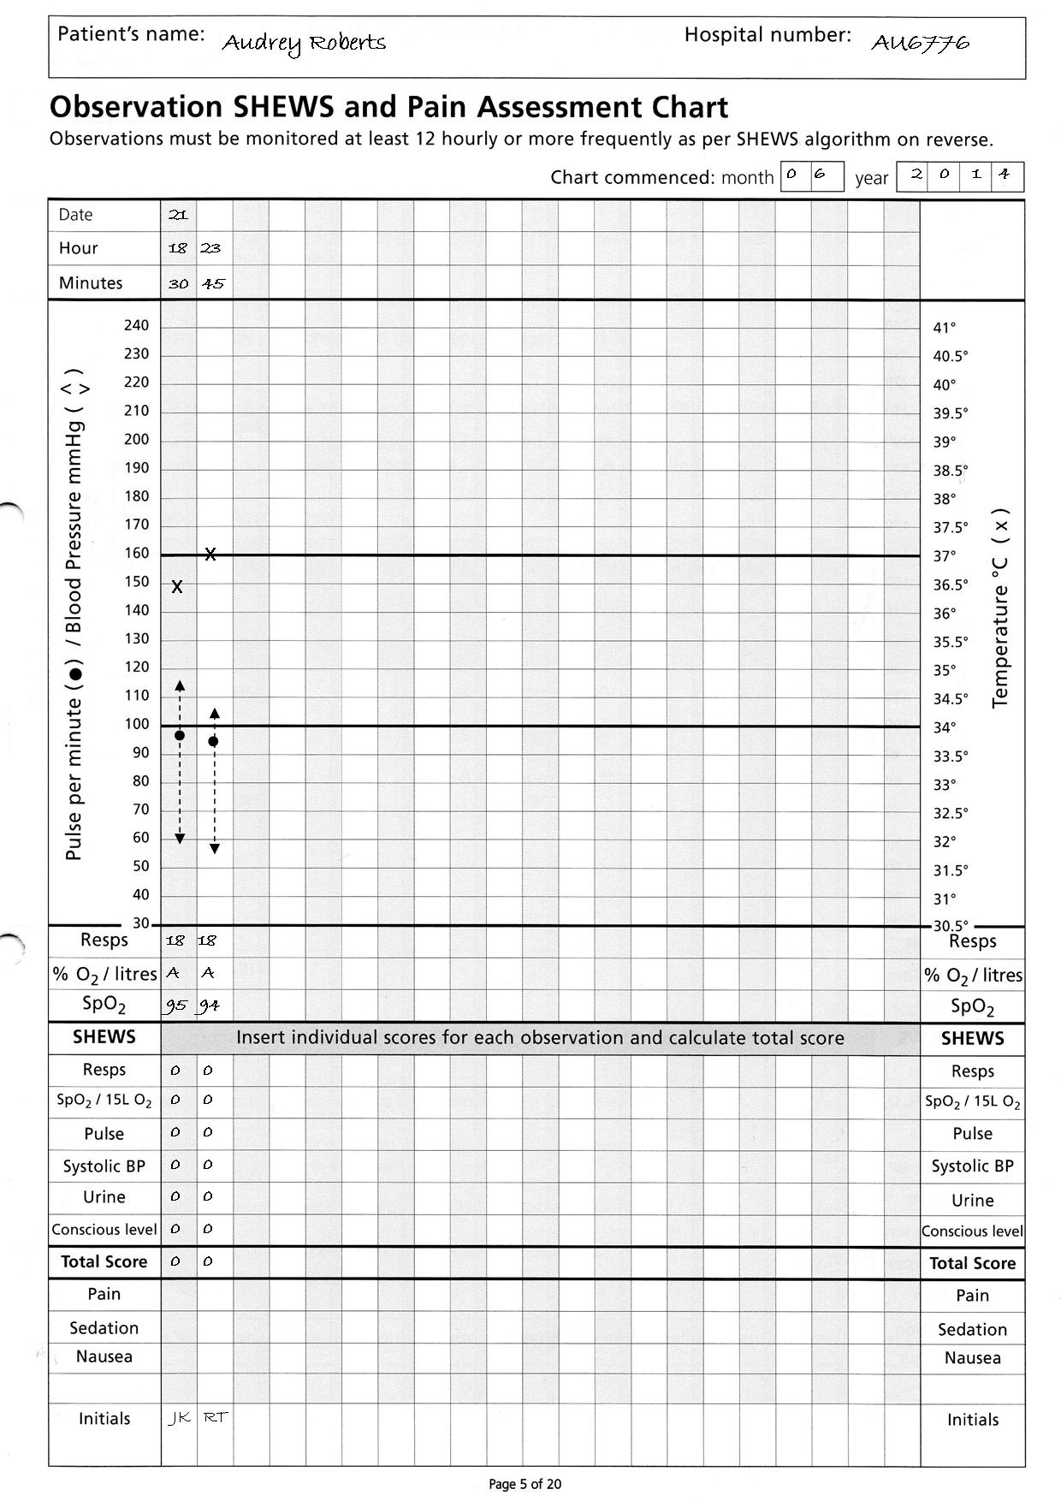
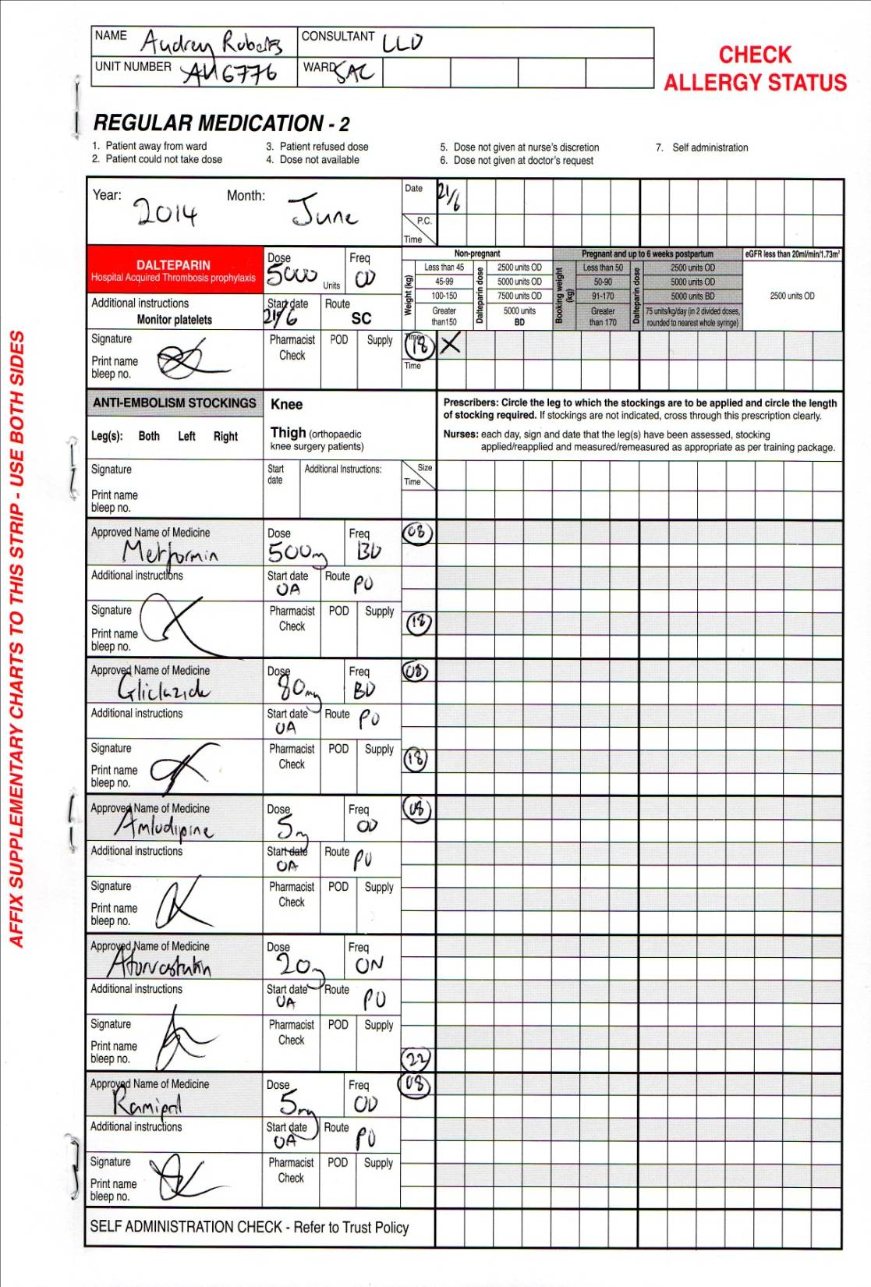
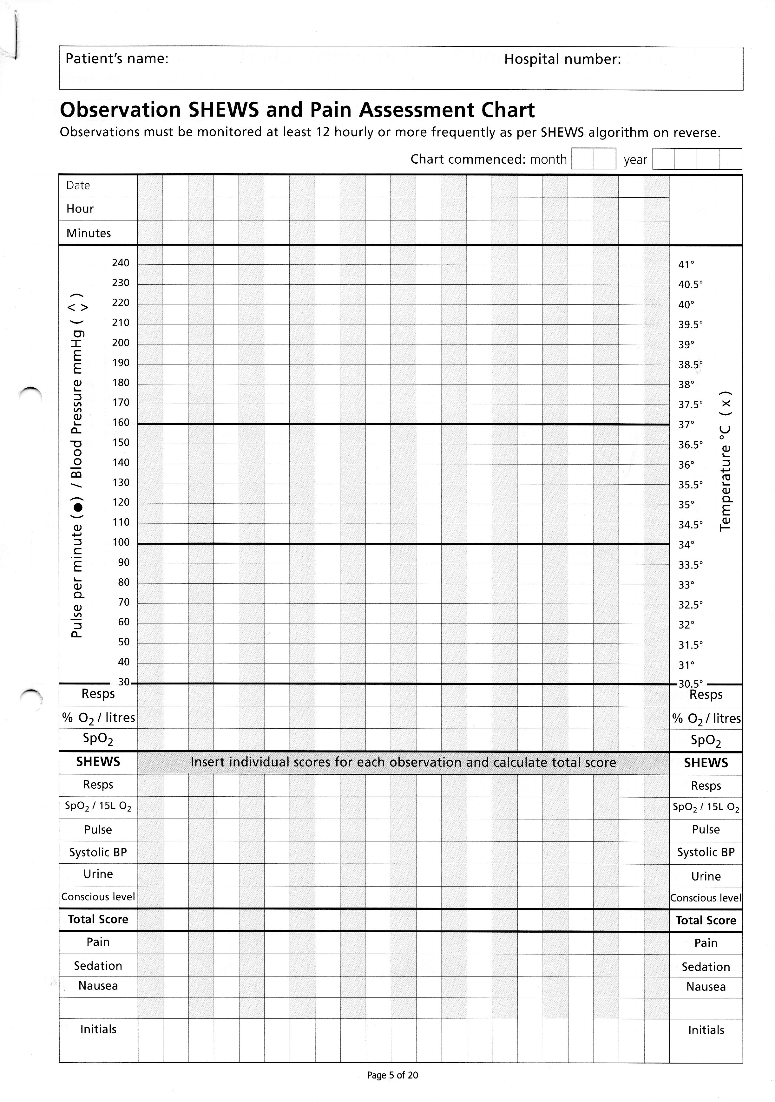
Audrey Roberts
Audrey Roberts AU6776
0 6 2 0 1 4
21
18 23
30 45
X
X
18 18
A A
95 94
0 0
0 0
0 0
0 0
0 0
0 0
0 0
JK RT

Slide 18
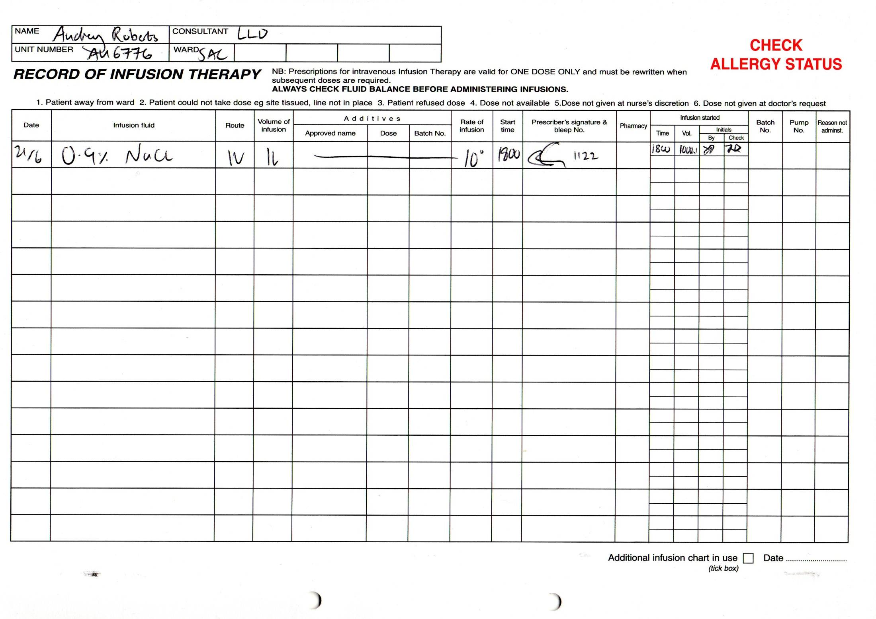

Slide 19
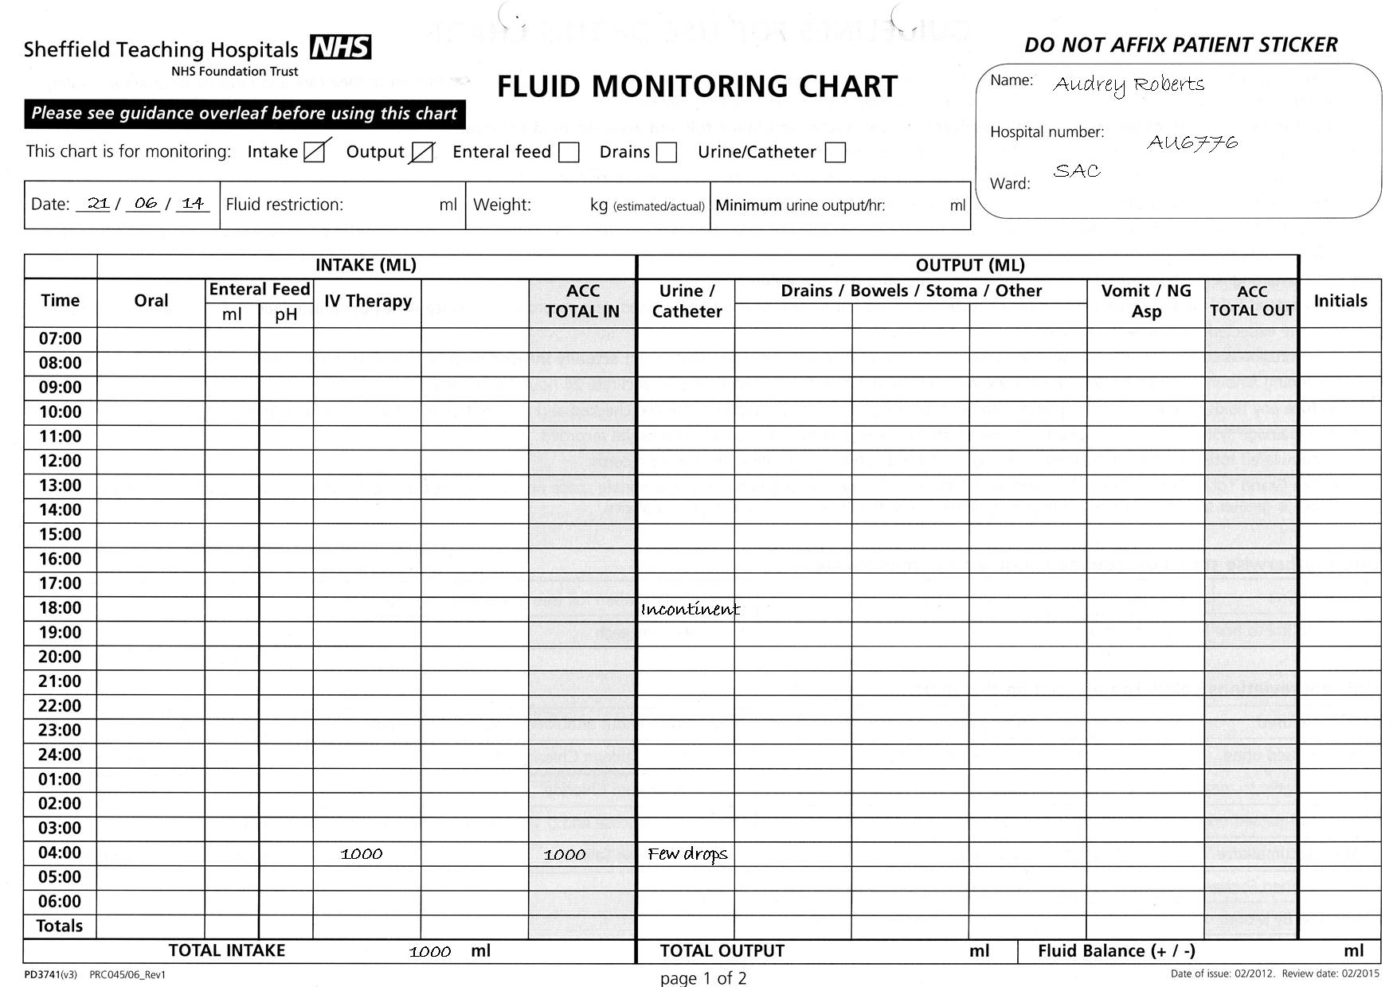

Slide 20
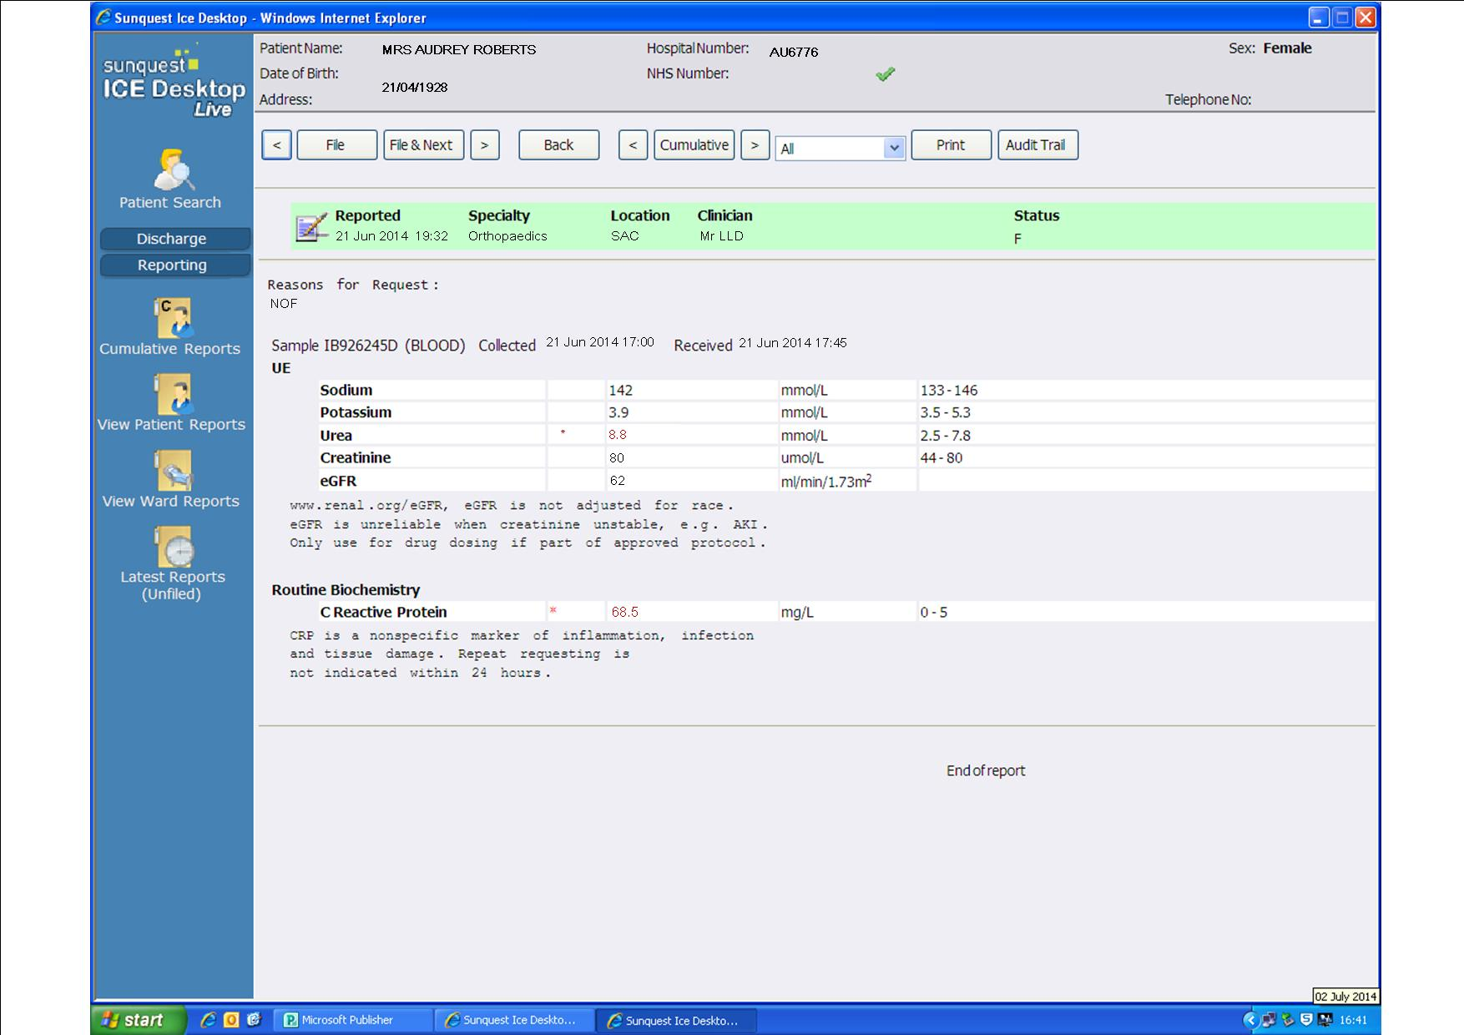

Slide 21
Audrey – Day 2
Has uneventful right hip hemiarthroplasty under spinal anaesthetic.
IVI (8 hourly) running and plan to mobilise and discharge when safe.
Passed urine in recovery (incontinent)
Post operative pain so given oramorph as needed (given 6 doses of 5mg over the day)
Feeling nauseous after the morphine
Slept for significant periods of the day
STH Acute Kidney Injury (AKI) Project 10 of 27

Slide 22
Audrey – Day 2
Nursing staff bleep Orthopaedic F2 due to SHEWS score 1 (BP). She reviews Audrey and notes dropping BP so increases IVI rate.
Audrey tries bed pan but can’t pass urine so has in/out catheter (volume not documented)
Poor oral intake noted by nursing staff
Hypoglycaemia (BM 2.3) before bed, nurses give hypo stop and Ribena
No bloods sent as Audrey in theatre
F:\Lou Lou
STH Acute Kidney Injury (AKI) Project 11 of 27

Slide 23
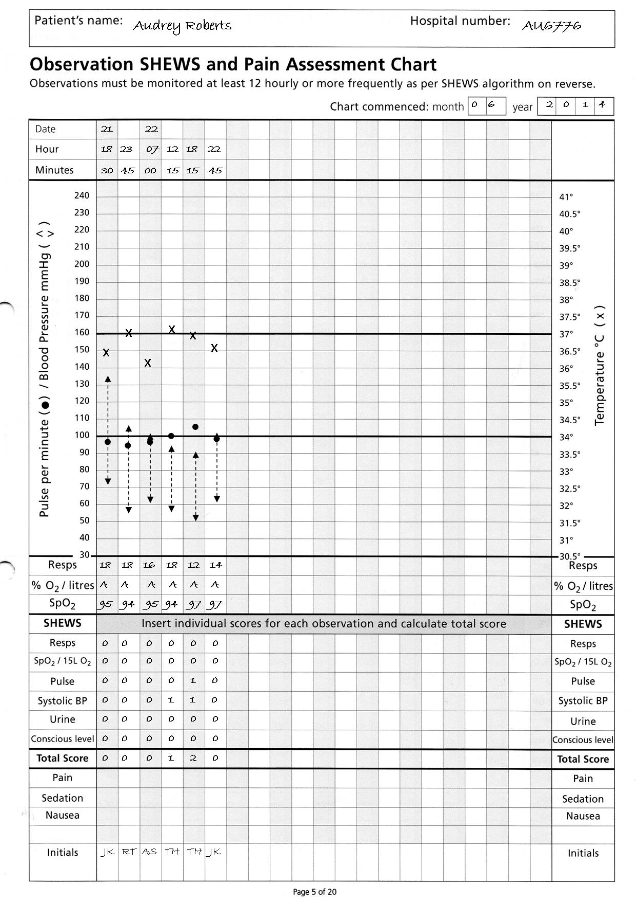
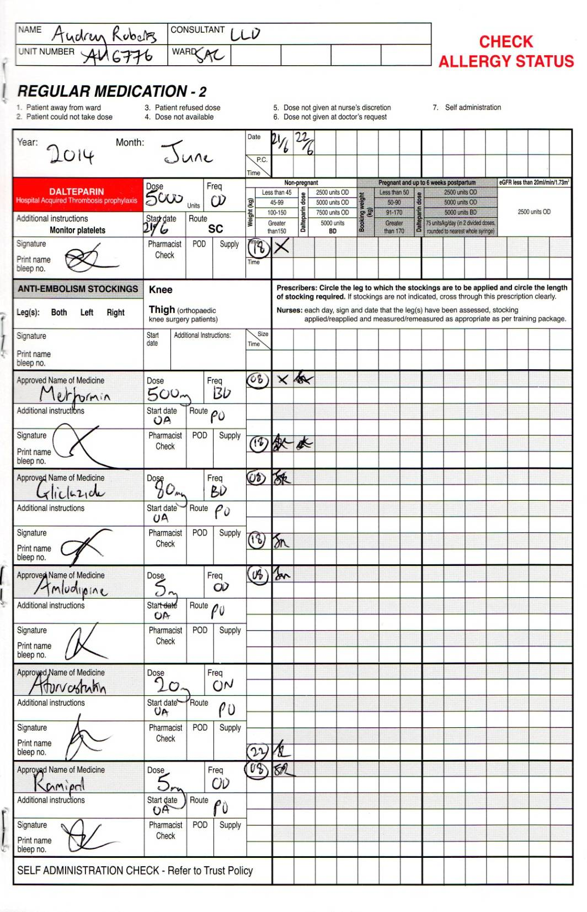

Slide 24
Questions
What is wrong with the SHEWs and Drug charts?
Continuous low B/P during the day
Shews score of 3 at 18:15 but documented as a score of 1
No recognition of deterioration
Therefore no increase of SHEWs monitoring as per ‘SHEWs algorithm for action’ and ‘deteriorating patient sticker’
Urine output scored as 0
Remains on all of her medications

Slide 25
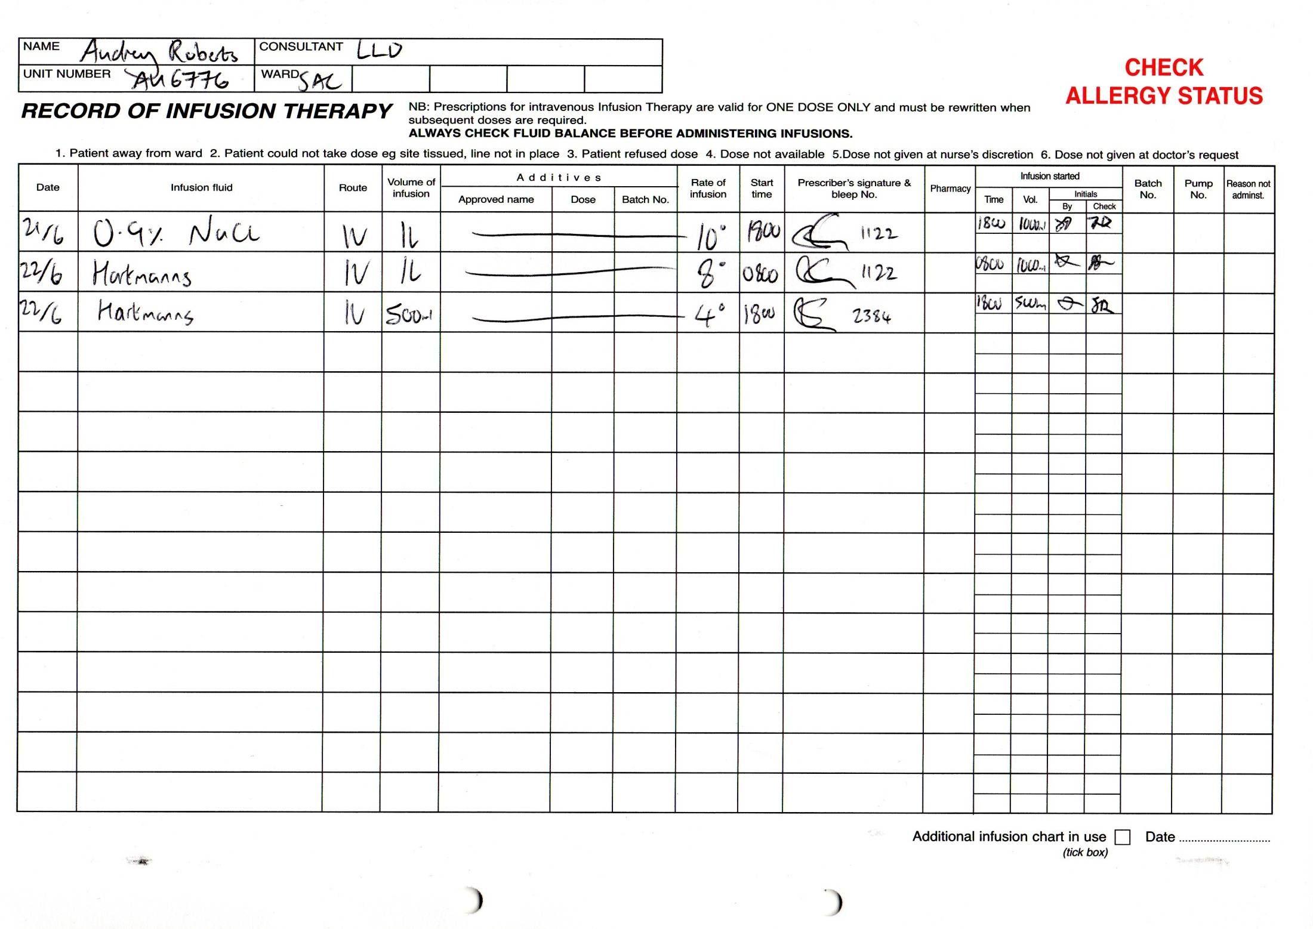

Slide 26
Questions
What is wrong with the IV therapies Chart?
No Fluid challenge only eventual increase of IVI flow then stopped.
Hartmann's solution prescribed.

Slide 27
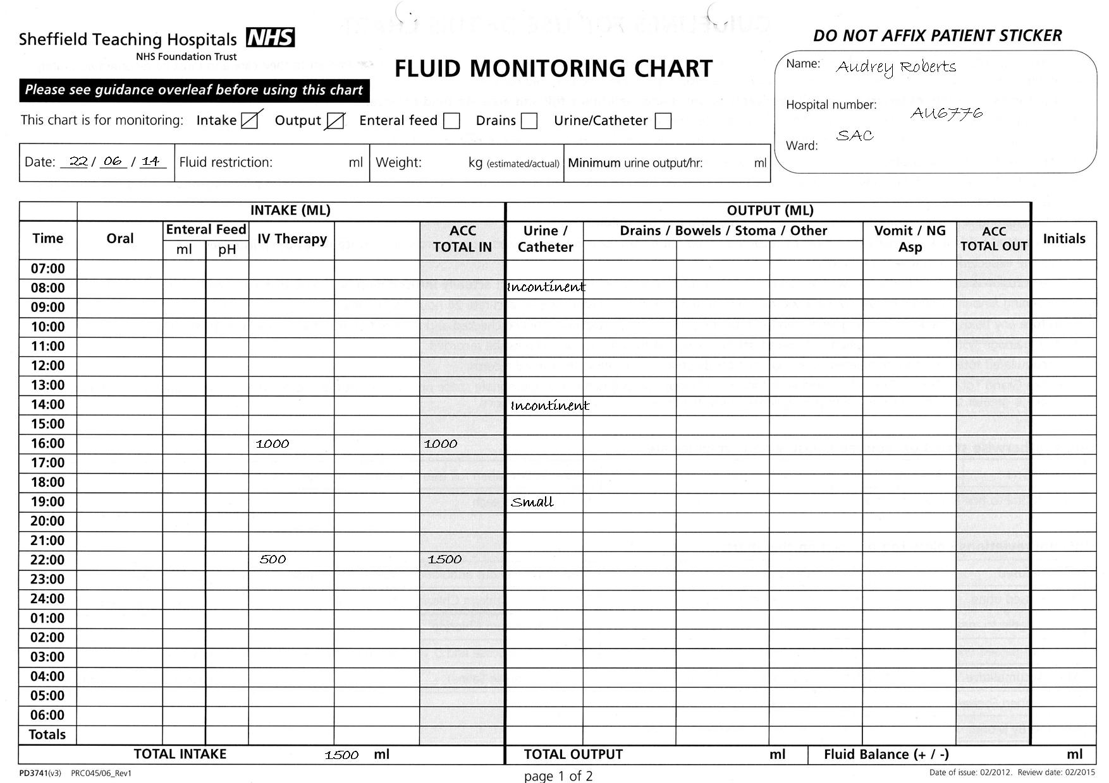

Slide 28
Questions
What is wrong with the fluid balance chart?
No weight or minimal urine output calculated
No oral intake documented
No measurable urine output.
The evidence is lacking to show if there is an insult for AKI (refer to back of fluid chart; 0.5mls of urine/Kg/Hour)

Slide 29
Based on this information why are the following interventions be necessary?
Increased frequency of SHEWs
A- to monitor Clinical response, high early warning scores give greater risk of developing AKI
Encourage fluids, IV Fluid challenge, monitor input
A- Optimise hydration and improve kidney perfusion
Catheterise
A- Accurate Urine Output (Minimum requirements of 0.5mls/kg/hr)
Urinalysis
A- If no obvious cause of AKI could suggest underlying disease process (intrinsic AKI). Also infection
Review medications
A- for nephrotoxicity to adjust the dose or to stop these medications
Send blood samples U&Es/FRP (Full Renal Profile)
A- To monitor kidney function and complications such as hyperkalaemia
Daily weights
A- To assess hydration
Pain relief
A- Adjust doses for kidney function
Nausea medication
A- Aid eating and drinking

Slide 30
Audrey – Day 3
Further hypoglycaemia overnight and remained drowsy and a bit confused. Obs stable. Settled in the morning.
Ward round noted Audrey incontinent of urine and struggling to mobilise. Push oral fluid and stop IVI.
Antiemetic's given due to worsening nausea
Requiring oramorph for post-op pain
STH Acute Kidney Injury (AKI) Project 15 of 27

Slide 31
Audrey – Day 3
Nursing staff inform doctors that blood stickers still in the request tray at 2 pm
Orthopaedic SHO asked to review due to further hypoglycaemia BM 1.9
Given 50ml 10% glucose and gliclazide reduced to 40mg BD. Plan for diabetic nurse review.
Audrey catheterised due to being unable to pass urine but residual is not documented
STH Acute Kidney Injury (AKI) Project 16 of 27
80

Slide 32
Questions
Why might Audrey be hypoglycaemic?
Not eating and drinking
Not excreting gliclazide (kidneys!)
Inappropriately high doses of gliclazide
?Sepsis

Slide 33
Audrey – Day 3
Audrey now scoring SHEWS score 3 for BP 88/65 so reviewed by F1 on-call but is now managing oral fluids with regular antiemetics so plan is to encourage oral fluids and wait
Further hypoglycaemia later so diabetes nurse reviews and stops all diabetic drugs. F1 doctor gives further IV glucose
Nursing staff start new fluid balance chart due to catheter and realise anuric for 8 hours
SHEWS score now 7 for BP, UO and GCS
STH Acute Kidney Injury (AKI) Project 17 of 27
80

Slide 34
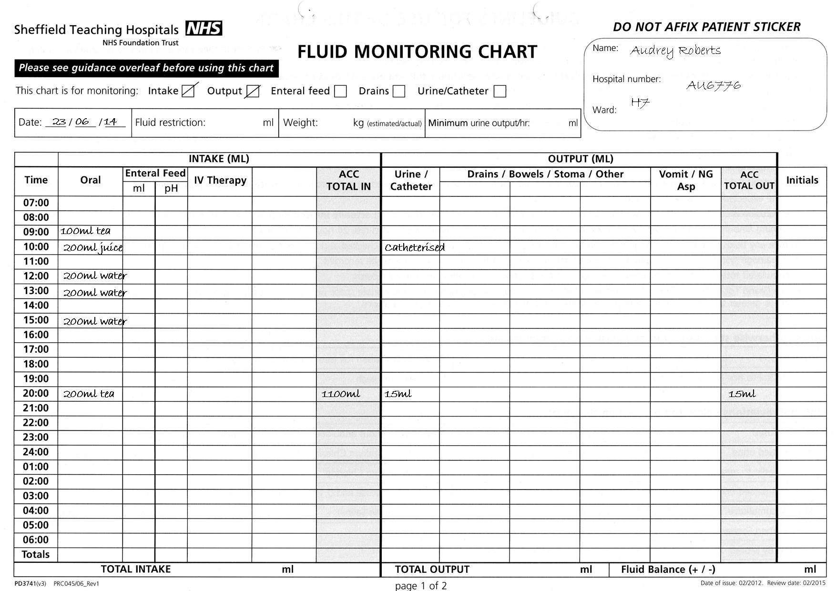

Slide 35
Questions
Q What is a significantly reduced urine output (“oliguria”)?
Depends on body weight:
Less than 0.5ml per kg body weight per hour (0.5ml/kg/hr)
For 60kg person, this is less than 30ml/hr
“Anuria” – no or negligible urine output, less than 50ml/day

Slide 36
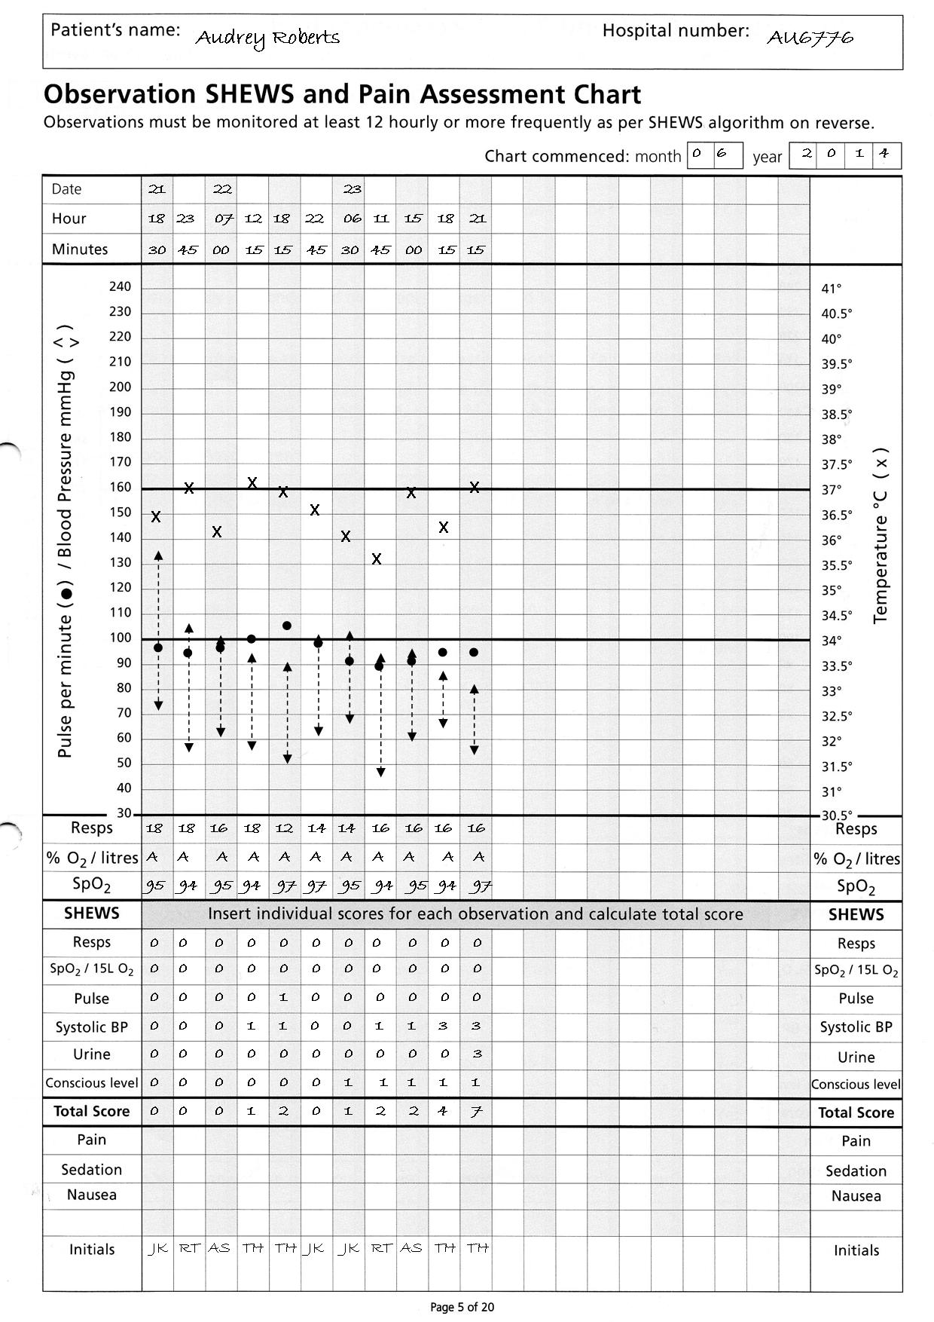
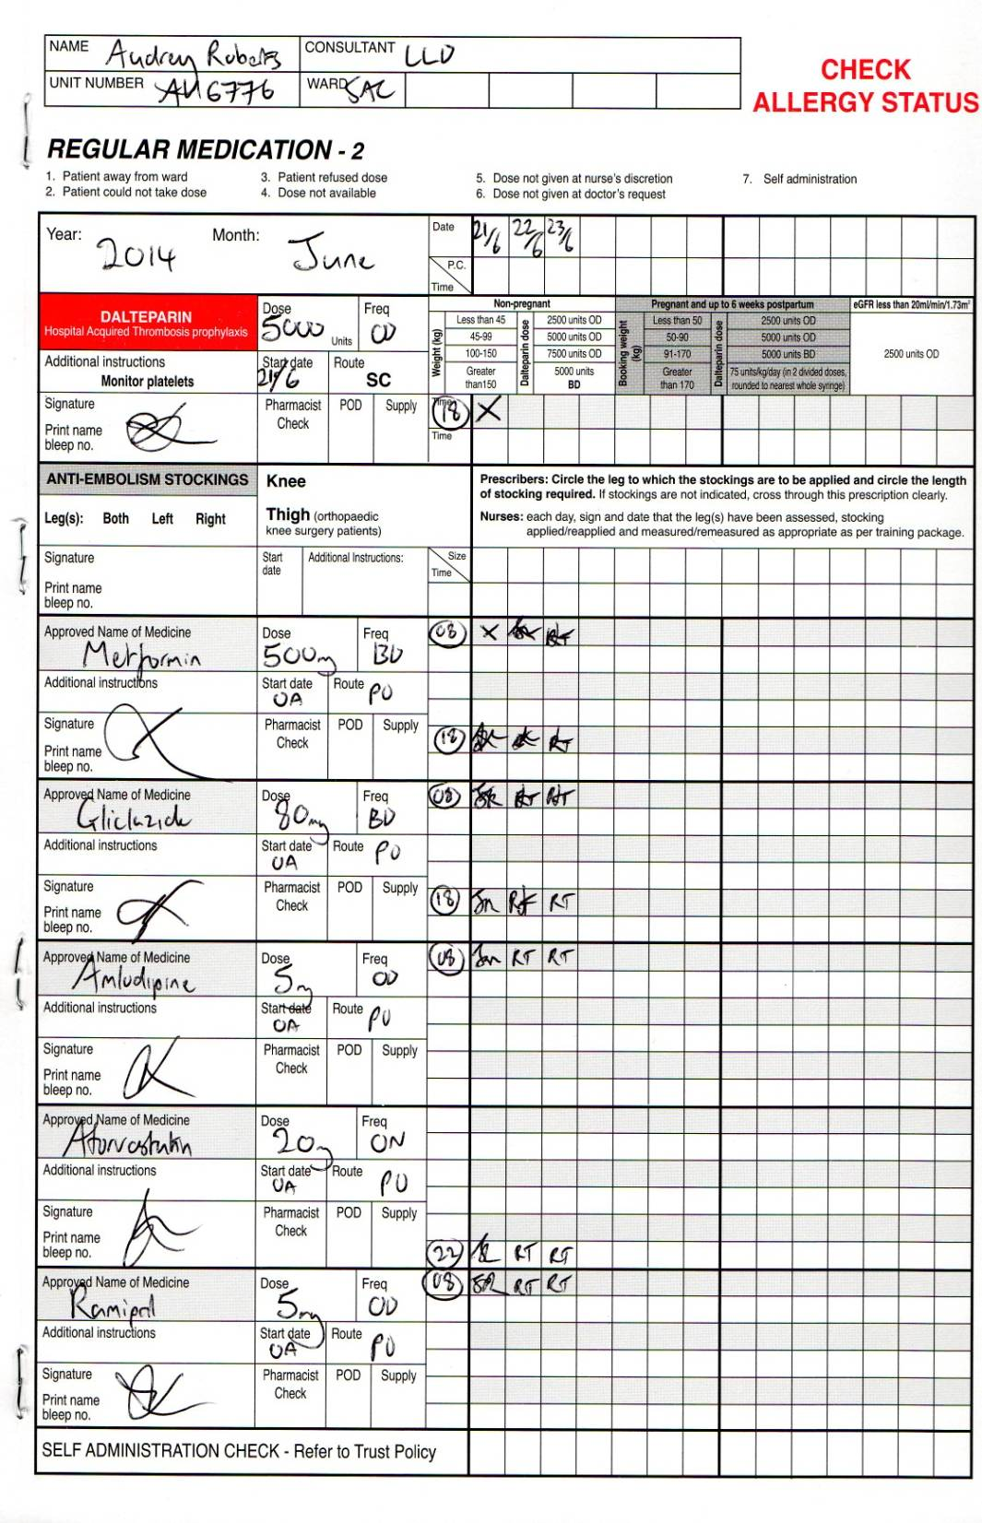

Slide 37
Audrey – Day 3
Orthopaedic SHO reviews due to SHEWS score 7 and starts IV fluid challenges when the labs ring with this afternoons blood results...
STH Acute Kidney Injury (AKI) Project 20 of 27
80

Slide 38


Slide 39
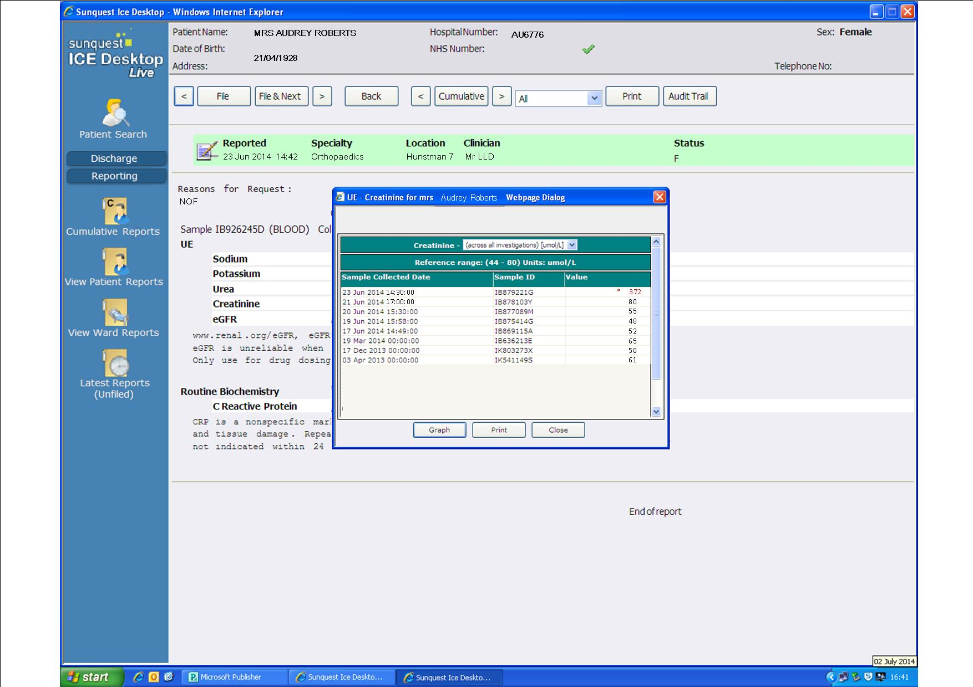
.

Slide 40
Audrey – Day 3
Orthopaedic SHO pushes with IV fluids and discusses with the medical SpR on call due to drowsiness, deranged U&Es and anuria
Medical SpR advises flush catheter, push IV fluids, stop all regular drugs / morphine, check hourly urine output & repeat U&Es
STH Acute Kidney Injury (AKI) Project 23 of 27
80

Slide 41


Slide 42
Audrey – Day 4
Audrey clinically deteriorates in the early hours of the morning. She is hypotensive and tachycardic and repeat U&E are worsening
The orthopaedic team, after discussion with general medical SpR, arrange urgent ITU / HDU review for ?haemofiltration
In liaison with Renal SpR, the decision is made that ITU / HD not in her best interests
DNAR filled in and Audrey dies at 06:23
STH Acute Kidney Injury (AKI) Project 25 of 27
80

Slide 43
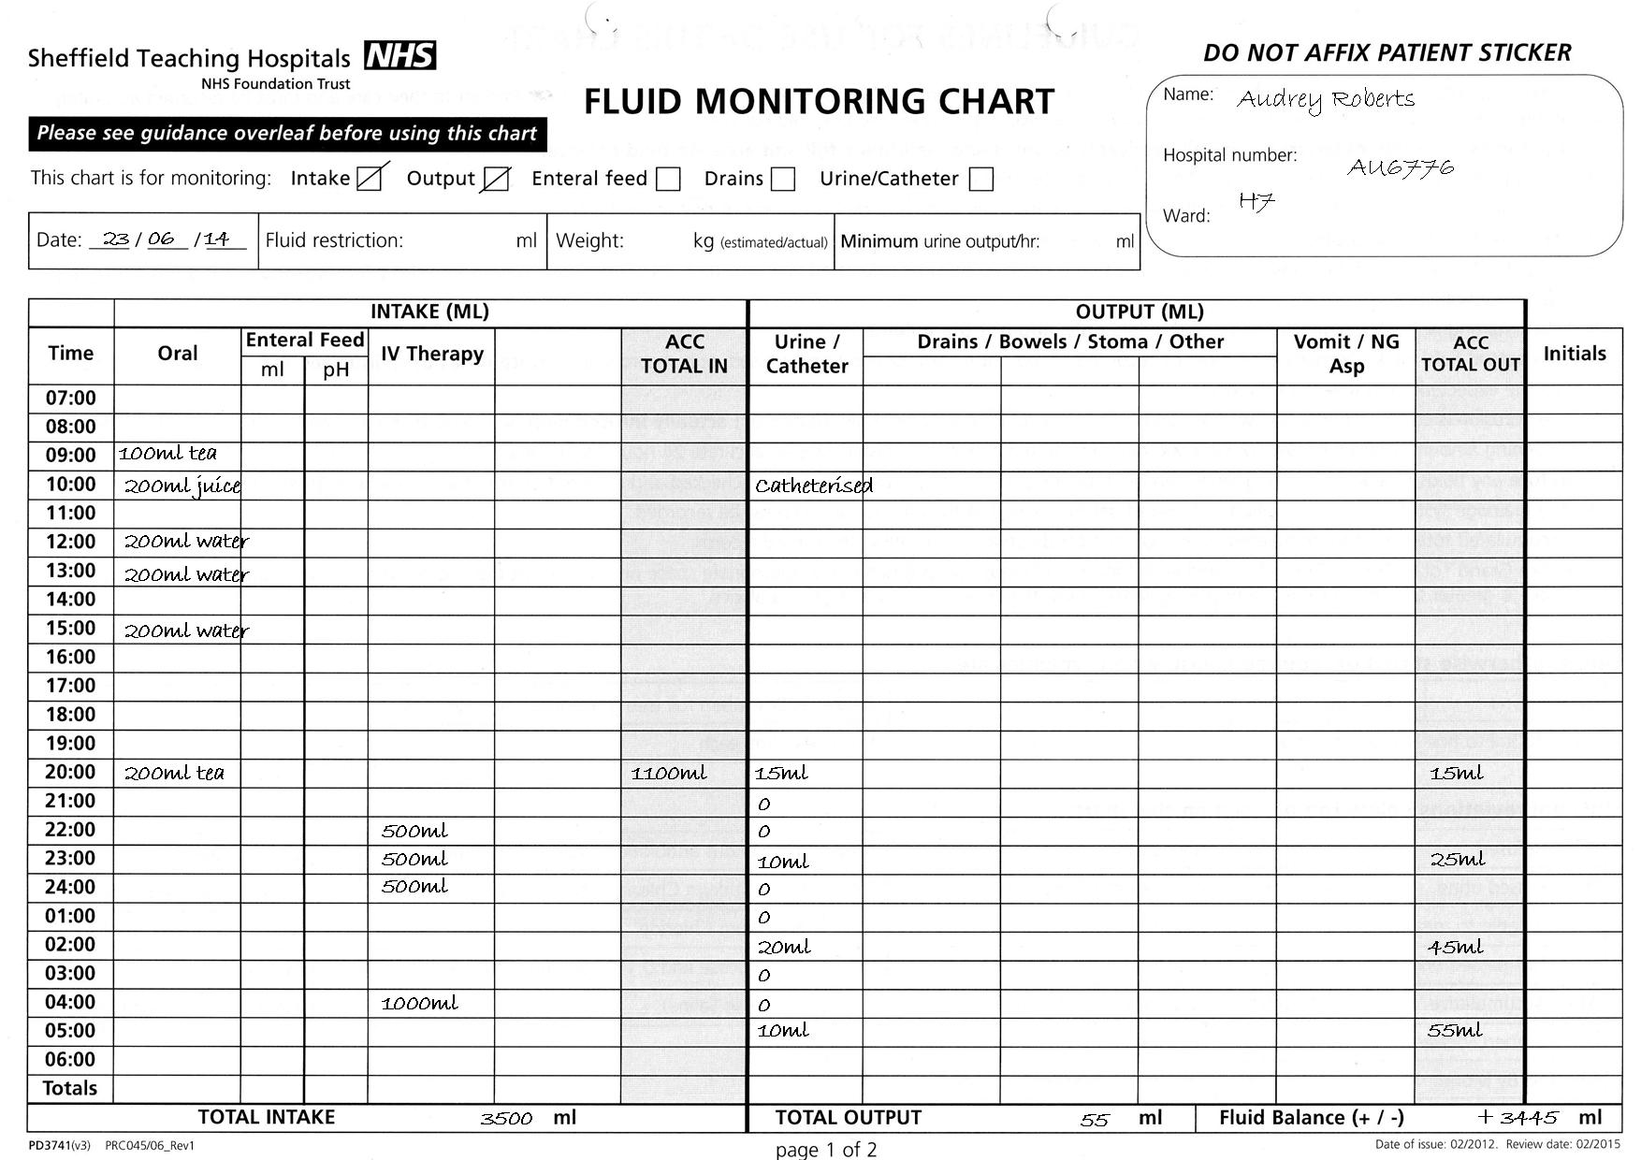

Slide 44
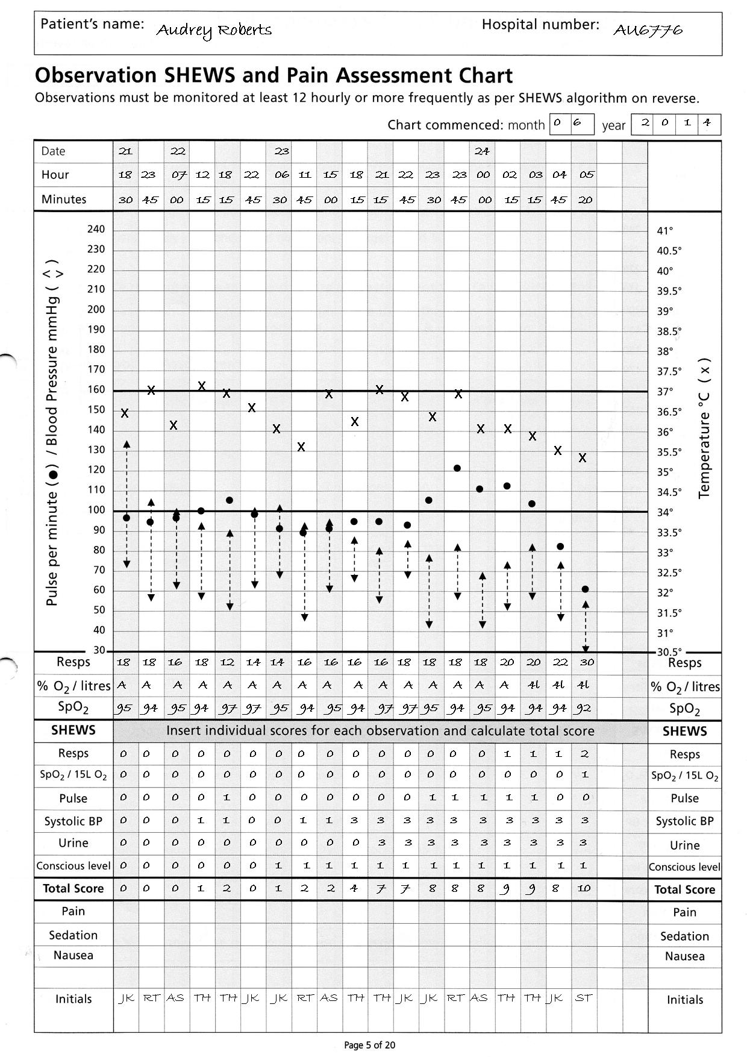

Slide 45
Questions
What could Clinical Support Workers have done better?
Recorded vital signs on SHEWs chart correctly
Report abnormalities and concerns to staff or charge nurse
Monitor patients drinking, eating and urine output (report amount of incontinence of urine, a little or a lot?) and document
Take urinalysis

Slide 46
Questions
What could the nursing staff have done better?
Record, review and interpret vital signs on SHEWs chart correctly
Follow the SHEWS ‘algorithm for action’ remembering to always consider the urine output
Record on fluid balance chart correctly
Monitor fluid input; oral or IV “Think Hydration”
Catheterise acutely unwell patients to accurately monitor their output. Document any residual and act on findings
Take a urinalysis
Bloods must be taken daily or more frequently if indicated
Use SBAR to communicate with medical staff. Question doctors decisions if you have concerns
Initiate AKI NCG with risk factors & Insults
Initiate AKI care bundle an with identified AKI

Slide 47
Questions
What could medical staff have done better?
Communicate with nursing staff using SBAR
Review recent creatinine and order U&E / FRP blood tests daily due to risk factors
Review medications due to risk factors. Stop nephrotoxic drugs with AKI insult. Stop Gliclazide with hypoglycaemia and Amlodipine with hypotension cause for AKI)
Initiate AKI care bundle checklist as AKI with Identified AKIs
Prescribe and monitor fluid challenges
Question fluid balance and urine output
Seek more senior help earlier

Slide 48
Questions
When should the renal team have been informed?
When Cr > 350 or any degree of AKI and …
Oliguria > 12 hours after haemodynamically stabilised (BP > 100mmHg) or > 6 hours if BP has been normal
Hyperkalaemia resistant to medical treatment
Pulmonary oedema
Severe acidosis
Blood and protein in urine (suspecting intra-renal cause)
AKI due to poisoning

Slide 49
A Summary
Monitoring and Assessment of AKI
How can we do this in our everyday practice?
Care Rounding
Deteriorating Patient Pathway (DPP)
AKI Nursing Care Guideline (NCG20)
AKI Care Bundle (PD7621)
STH Acute Kidney Injury (AKI) Project Close slide 1 of 4

Slide 50
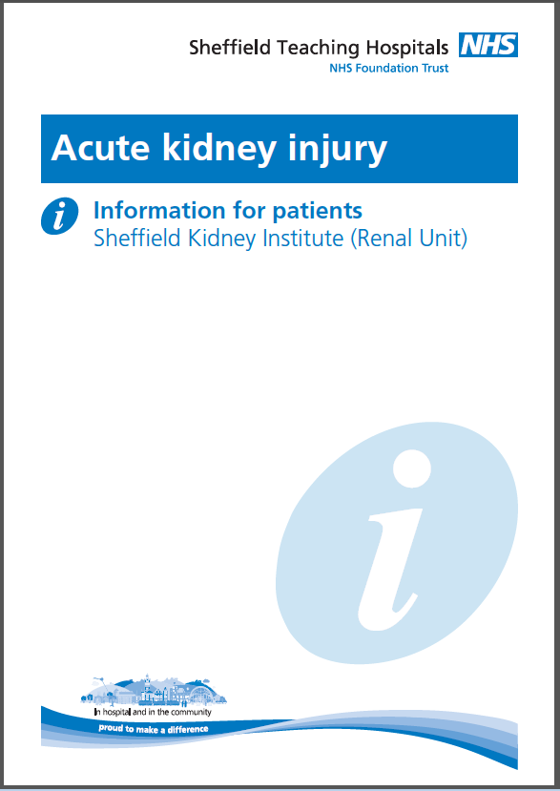
Give all Patients Identified as having an AKI a Patient Information Leaflet
PD7986

Slide 51
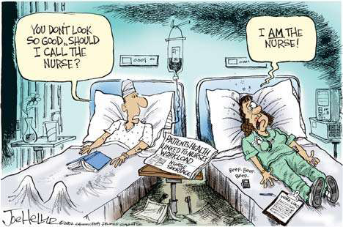
STH Acute Kidney Injury (AKI) Project Close slide 2 of 4

Slide 52
Final Points
Remember the AKI risk factors
Always consider urine output even if the patient isn’t catheterised
Ensure the AKI NCG is adhered to
Ensure all patients at risk of AKI have been assessed
Ensure all patients identified as having AKI have an AKI Care Bundle in their notes
STH Acute Kidney Injury (AKI) Project Close slide 4 of 4

Slide 53
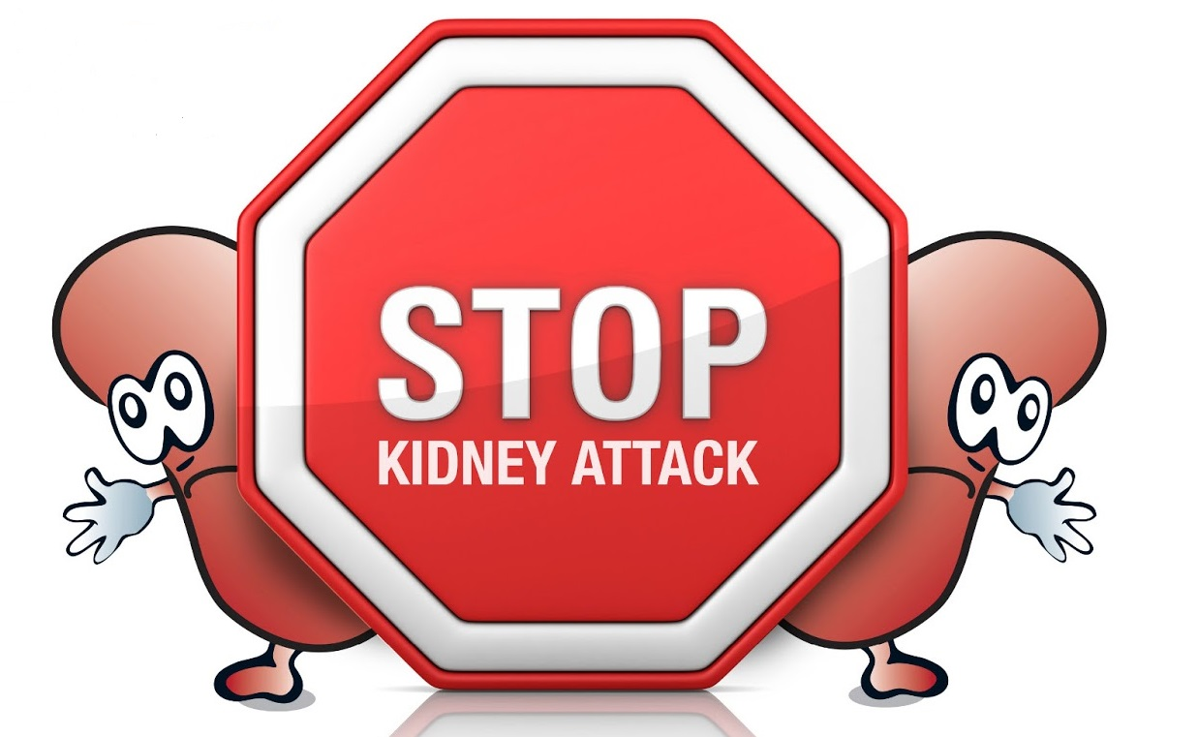
Remember …
Thank you for your time

