Slide 1
Acute Kidney Injury and Care Homes
Revised November 2018

Slide 2
Acute Kidney Injury
Acute kidney injury is a sudden and recent reduction in a person’s kidney function. It is often referred to as AKI.
Acute kidney injury is identified by blood tests when a raised level of creatinine shows the stage of AKI.
Acute kidney injury can be caused by a number of things such as:
Stress on the kidneys due to illness or infection
Severe dehydration
Side effects of some drugs when you are unwell

Slide 3
Key Messages
AKI is common, serious and harmful; however, you can take steps to prevent it by understanding what it is and what you can do to reduce the risk.
Some residents are more at risk of getting AKI. Your residents with diabetes/heart failure/dementia etc are at high risk. Work with the nurse in charge or care home manager to compile a list of which residents are at risk.
It is important that these residents drink plenty to stay well hydrated. Keep an eye on urine output and colour and know when to report changes to the nurse in charge or care home manager.

Slide 4
Think Kidneys in Care Home settings
Wherever you work and whatever your role in health and/or care you should be aware of AKI. This will enable you to understand how to reduce the risk of AKI for residents in your home.
Health and care professionals need to be well informed and proactive, to understand who is at risk, take an active lead in prevention, learn how to recognise AKI and help the person to recover.
Staff working in care and nursing homes can play a vital role in the early detection, treatment and management of people who may have had an episode of AKI or may be at risk of AKI.

Slide 5
Learning Outcomes
Define Acute Kidney Injury (AKI)
Discuss the possible causes of AKI
Top Tips for carers
Identify those at risk of AKI

Slide 6
Is Acute Kidney Injury (AKI) really a problem?
In the UK up to 100,000 deaths each year in hospital are associated with acute kidney injury. Up to 30% could be prevented with the right care and treatment
One in five people admitted to hospital in the UK each year as an emergency has acute kidney injury
Just one in two people know their kidneys make urine
About 65% of acute kidney injury starts in the community
NCEPOD. Adding insult
to injury, 2009
Wang, et al. 2012
Ipsos MORI survey,
July 2014
Selby, et al. 2012

Slide 7
People at higher risk of AKI
Those aged 75 or over
People with the following:
Heart failure
Diabetes
Chronic Kidney Disease
Dementia
Acute illness (sickness and diarrhoea)
residents with poor nutrition and low fluid intake

Slide 8
Medicines
Residents who are prescribed certain medicines may be at risk of AKI:
ACE inhibitors e.g. ramipril
ARBs e.g. losartan,
Diuretics e.g. furosemide
NSAIDs e.g. naproxen, ibuprofen

Slide 9
Think Kidneys public campaign
Find out more on the Think Kidneys Website: https://www.thinkkidneys.nhs.uk/
Watch the Think Kidneys public campaign video (3 minutes):
https://www.thinkkidneys.nhs.uk/campaign/

Slide 10
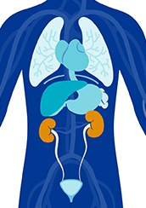
Causes of AKI
Pre Renal (before the kidneys)
Most common cause of AKI
Disruption of blood flow to the kidney
For example:
Low blood pressure (dehydration)
Heart Failure
Low blood volume (dehydration)
Infection, causing low BP

Slide 11
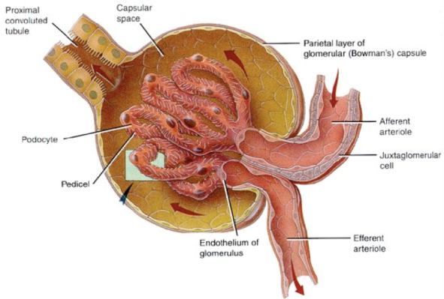
Causes of AKI
Intrinsic (inside the kidneys)
Damage to the kidney itself
For example:
inflammation of kidney cells inside the kidneys (Glomerulonephritis)
Damage to the kidney cells (Acute tubular Necrosis)

Slide 12
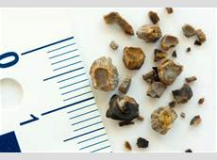
Causes of AKI
Post Renal (after the kidneys)
Caused by a blockage in the urinary
tract
For example:
Blocked catheter
Kidney stones (renal calculi)
Bladder tumours
Enlarged prostate

Slide 13
Symptoms of AKI
In the early stages there may be no real symptoms or signs. A blood test is needed to detect it.
However, someone with AKI can deteriorate quickly and suddenly experience any of the following:
Changes to urine output, particularly a major reduction in the amount of urine passed
Changes to urine colour/smell
Nausea, vomiting
Abdominal pains and feeling generally unwell, similar to a hangover
Dehydration or thirst
Confusion and drowsiness
Consider urine test to test for presence of blood/protein to inform GP

Slide 14
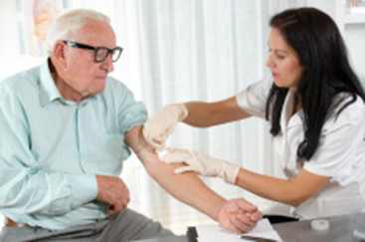
Treatment of AKI
Treatment of AKI is about identifying the cause to help you address the actions needed.
Certain drugs can affect the kidneys and these include:
Non-steroidal anti-inflammatory drugs (eg Ibuprofen)
Drugs that lower blood pressure (eg Ramipril)
Drugs used in heart failure such as diuretics (eg furosemide)
Drugs used by Mental Health patients (eg Lithium)
The GP may decide that some of drugs need to be stopped for a day or two
The resident might need some more blood tests
The GP might recommend to increase fluids or to send the resident to hospital to have some fluid replacement

Slide 15
Preventing AKI
Staff working in care and nursing homes can play a vital role in the early detection, treatment and management of people who may be at risk of AKI.
The following slides show how you can do this.

Slide 16
Tips for carers regarding the prevention of acute kidney injury
Fluid balance
Dehydration is the underlying cause of many common conditions including constipation, falls, urinary tract infections, pressure ulcers, malnutrition, incontinence, confusion and pre renal AKI.
The elderly are more prone to dehydration because:
They may lose the ability to recognise thirst
poor mobility and incontinence may mean a person avoids drinking enough
Cognitive impairment eg dementia, may mean they forget to eat and drink

Slide 17
Tips for carers regarding the prevention of acute kidney injury
Staying hydrated
Some residents may need further support to stay hydrated.
For example:
Choose a cup suitable for the resident – they may prefer to use a straw
Support and encouragement to maintain fluid intake throughout the day
It could be as simple as set drink routines rather than relying on thirst alone
Jelly and other food rich in fluid can be offered to increase fluid intake if the resident doesn’t want to drink
Encourage fluids when giving care at night

Slide 18
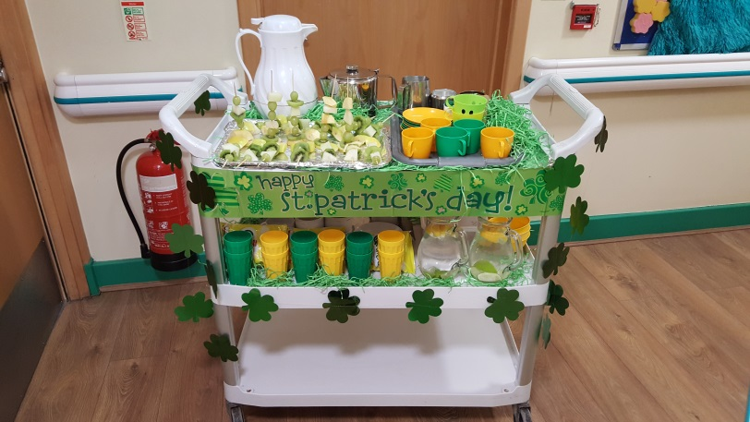
More tips for carers
Think about support needed to help your resident to drink:
lighter weight cup, cup with two handles, physical help to drink
make drinks more appealing e.g. colourful drinks and decorating drinks trolleys)
Use of a drinks diary to monitor if drinking enough - this can be done by the resident.
Offer more drinks when ill: loss of body fluids through sweat, vomit, diarrhoea, and there is a higher risk in hot weather.
Offer a greater variety of drinks:
Hot and cold
Use of colourful cups to attract attention,
Use of fruit and jellies, ice lollies in summer etc,
Decorate the trolley, theme the trolley for special events or seasons.
Remember caffeine can have a diuretic affect in some people so not too much caffeine eg coffee, tea, coca cola

Slide 19
Signs of dehydration
Irritability
Confusion
Thirst
Darker urine
Sunken eyes
Cool hands or feet
Low blood pressure
Raised heart rate
Headaches
If a person has AKI they may pass less urine than usual, or pass no urine at all
dry lips and skin

Slide 20
Tips for carers regarding the prevention of acute kidney injury
Spotting dehydration
This urine colour chart will give you an idea of whether a resident is drinking enough. Good means they are drinking enough and dehydrated means the body has lost water and they may need to drink more to make up for the loss.
This chart could be useful although not always a reliable tool in older people because certain certain conditions, medicines and foods can change urine colour

Slide 21
Assessing fluid balance in residents
When you start to assess fluid balance you may face some barriers.
The following slides are to help to identify these barriers and suggest solutions that could be employed to overcome them

Slide 22
Assessing fluid balance
If the resident goes to the toilet independently and doesn’t tell the carer it may not be recorded on the chart.
If the resident is able to record their own output, you may be able to explain the importance of recording it and give them a chart to complete.

Slide 23
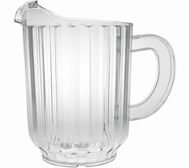
Assessing fluid balance
If the relatives give drinks to the resident it is difficult to record how much fluid is being taken.
You could let the relatives know that you would like to monitor how much fluid is being taken –and even give the relatives a sheet to record the amounts on. This works for some residents too
To help understand the quantities, how much fluid do you think is in these…?

Slide 24
Assessing Fluid Balance
Standard glass = 200mls
Standard Cup = 150mls
Standard Jug = 1000mls

Slide 25
Assessing urine output
If the resident is incontinent of urine it is difficult to assess how much has been passed.
Can you record the weight of incontinence pads or the number of times the resident goes to the toilet?
You could also record the number of incontinence pad changes

Slide 26
Assessing urine output
How do you know how much urine has been passed residents are wearing pads?
Do the pads used in your care setting have level indicators?

Slide 27
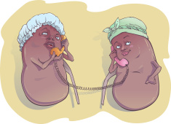
Think Kidneys
The kidneys don’t usually complain
The kidneys can lose up to 90% of their function before you may even begin to notice
The kidneys are clever organs but need a good blood supply to work effectively

Slide 28
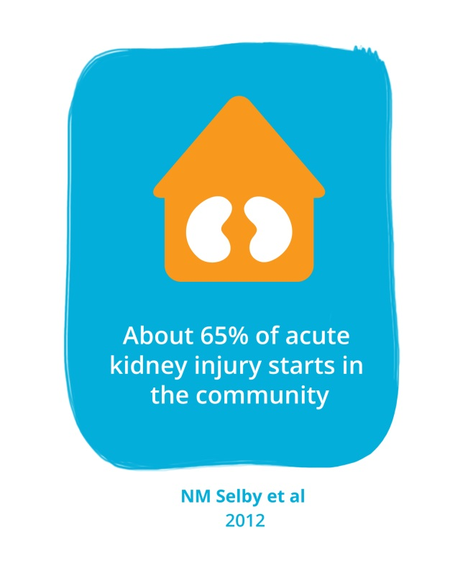
What can carers do to prevent Acute Kidney Injury?
Think Kidneys:
Do they have any risk factors?
Do they show signs of dehydration?
Have they passed any urine?
If they are ill with sickness and/or diarrhoea they may need to temporarily suspend some medications
Increase fluid intake
Check if resident taking medicines that affect fluid balance or can cause dehydration eg diuretics, laxatives
Ask the nurse in charge for a visit from the GP

Slide 29
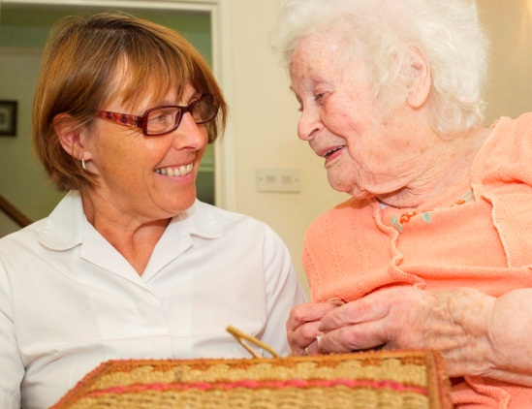
Case study
Marjory is an 83 year old resident in your care home
Lived in the care home for three years after she fell at home and fractured her hip
She has lost confidence in walking and likes to have assistance to walk around the home
She takes ibuprofen for some pain in her hip and has tablet controlled diabetes
She has some heart failure and takes Furosemide and Ramipril
Do you think she is at risk of AKI? Why?

Slide 30
Answers to Case Study
Marjory is at risk of AKI:
Older people are the group most at risk of AKI
Older patients are especially prone to dehydration – particularly if they also have dementia or frailty, making food and fluid intake more difficult, particularly if they are reliant on others for access to fluids
Patients with heart failure often have an element of Chronic Kidney Disease and are on diuretics and medicines to regulate the blood pressure
Metformin (a diabetes drug) is excreted by the kidneys, and therefore raises the risk of AKI – Metformin may need suspending - NOT because it increases AKI risk, but because the levels of this drug can accumulate during AKI, causing metformin toxicity (lactic acidosis) - so suspending this drug reduces patient harm due to metformin toxicity, but does not reduce AKI risk. Blood sugars would need watching whilst stopped.
The ibuprofen (NSAID) can also affect kidney function and cause AKI.
If she had a hip fracture, and if she is in a wheelchair or in need of support to mobilise, her mobility might be reduced and so she is less access to get own drinks when thirsty.

Slide 31
Important points about AKI
AKI is common, serious and harmful; however, you can take steps to prevent it by understanding what it is and what you can do to reduce the risk.
Some residents are more at risk of getting AKI. Your residents with diabetes/heart failure/dementia etc are at high risk. Work with the nurse in charge or care home manager to compile a list of which residents are at risk.
It is important that these residents drink plenty to stay well hydrated. Keep an eye on urine output and colour and know when to report changes to the nurse in charge or care home manager.

Slide 32
References and acknowledgements
Kerr M, Bedford M, Matthews B, O’Donoghue D. The economic impact of acute kidney injury in England. Nephrol Dial Transplant (2014) 29: 1362–1368.
National Confidential Enquiry into Patient Outcome and Death (NCEPOD) 2009. Acute Kidney Injury: Adding Insult to Injury.
National Institute for Health and Care Excellence (NICE) 2013, Clinical guideline 169, Acute Kidney Injury.
Selby NM, Crowley L, Fluck RJ, McIntyre CW, Monaghan J, Lawson N, Kolhe NV. Use of electronic results reporting to diagnose and monitor AKI in hospitalized patients. Clin J Am Soc nephrol. 2012 Apr;7(4):533-40. doi: 10.2215/CJN.08970911. Epub 2012 Feb 23
Urine colour chart: http://jbfitnesssystems.com/eddie-vendetta-part-2/
Claire Stocks - Sister – Cardiac Arrest Prevention Team Darlington Memorial Hospital
Mrs Sundus Jawad MRPharmS - NICE Medicines and Prescribing Associate, Lead Medicines Optimisation Care Homes Pharmacist

Slide 33
For further information and resources regarding
Acute Kidney Injury please see the
Think Kidneys website
www.thinkkidneys.nhs.uk

