Slide 1
KQuIP/UKRR Regional Day
North West
31 January 2018
Park Royal Hotel, Stretton Road, Stretton, Warrington, WA4 4NS
09:00am –16:30pm

Slide 2
KQuIP/UKRR Regional Day
North West
09:30 - 09:50
Introduction from Network Clinical Lead and Co-Chair of KQuIP
Introducing the Region – Smeeta Sinha, Clinical Lead
KQuIP – Graham Lipkin, Chair of KQuIP

Slide 3





Housekeeping
Fire alarms and exits…
Toilet location…
Mobiles and pagers…
Breaks…
Photos…

Slide 4
Introduction to the Region
Smeeta Sinha
Clinical Director Renal Services
Salford Royal NHS Foundation Trust

Slide 5
Who’s here…
KQuIP team
Aintree University Hospital NHS Foundation Trust
Lancashire Teaching Hospitals NHS Trust
Manchester University NHS Foundation Trust
Northern Care Alliance (Salford Royal NHS Foundation Trust & Pennine Acute NHS Trust)
Royal Liverpool & Broadgreen University Hospitals NHS Trust
Wirral University Teaching Hospital NHS Foundation Trust

Slide 6
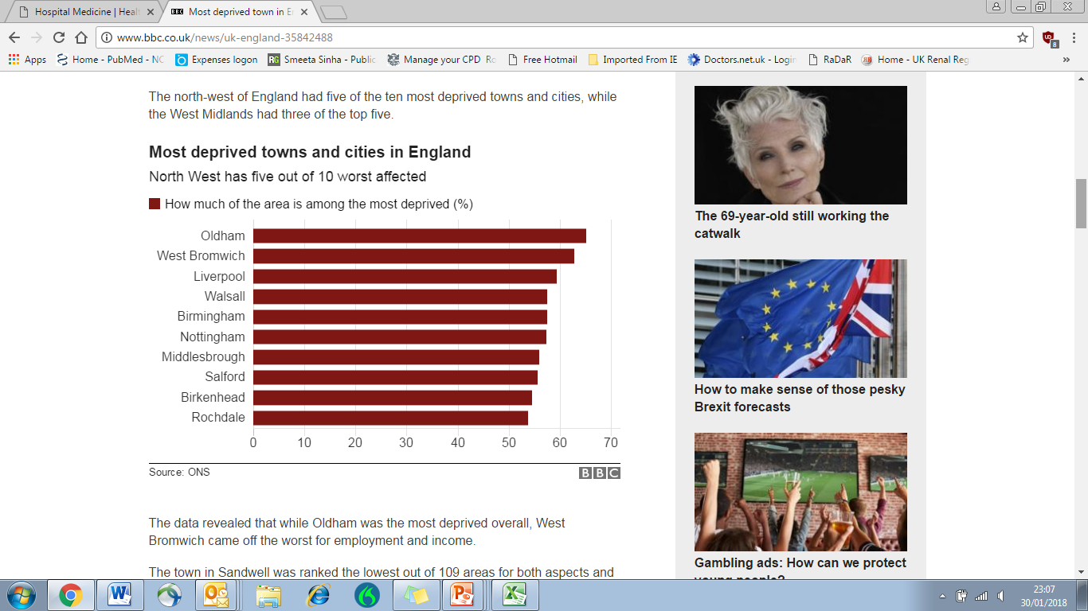
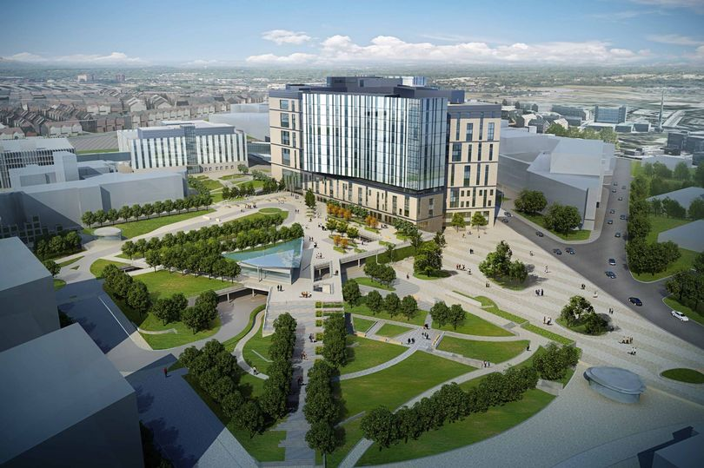
Things we may not be able to control
Geography and population demographics
Challenges that come with large areas
Changing catchments areas
Varying ethnic, socio-economic and deprivations status
Regional re-organisation (STP/devo-Manc)
Loss of strategic clinical networks
Carillion insolvency
Notes:
Out of 10 in Salford catchment are only; 2 in Liveprool

Slide 8
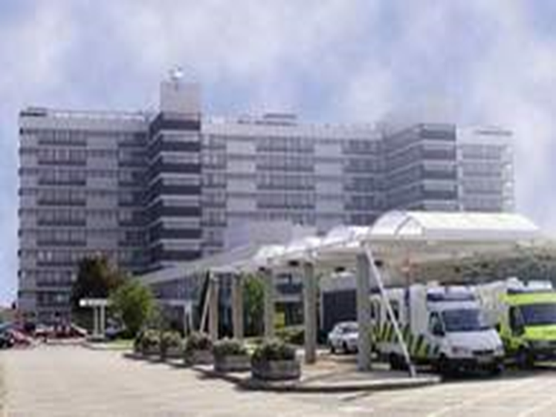
Aintree Renal Unit
Established 2002
7.7 WTE (Renal & GIM)
25 inpatient beds and a day ward (PCU)
1 acute renal unit and 3 satellites
Onsite haemo and PD access available

Slide 9
Wirral NHS Foundation Trust
Main unit at Arrowe Park (22 stations) with satellites at Clatterbridge (12) and Countess of Chester Hospital (17)
Catchment population of 0.6m
Strengths: Strong senior engagement with QI methodology with formal education sessions; participation in ASSIST-CKD
Challenges: VA struggles but identified the largest cohort starting on HD with lines are from Home Therapies. Developing plans to facilitate pre-emptive fistula formation.

Slide 10
Northern Care Alliance
NCA established April 2017: SRFT & PAT
Catchment population 1.3 – 1.5 million
25 inpatient beds, 548 dialysis patients, 835 transplant patients
16.6 WTE consultants
Strengths: embedded formal QI infrastructure within trust with some protected time for projects; sustained improvement in home therapies (30%); transplant one-stop; acute PD service
Challenges: demand > capacity (10% increased in dialysis population over 6 months); vascular access; patient flow/inpatient issues

Slide 11
Manchester Foundation Trust
Sizeable organisational change over last 5 years
Catchment population 1.3 – 1.8 million
44 inpatient beds
13 FT consultants + 2 dual-specialty appointments
Transplant service > 500 per year and supports GM & LTHTR catchment population
Internationally recognised leader in home haemodialysis: host national home therapies conference
Challenges: “competing demands, appropriate resourcing and streamlined pathways”

Slide 12
Lancashire Teaching Hospitals NHS Trust
LTHTR supports a population of 1.65 million across Lancashire and South Cumbria caring for just under 1300 RRT patients.
515 in-centre HD patients, 688 transplant patients, 48 HHD, 41 PD
Strengths: Staff trained and delivering quality improvement within the renal dept
Very strong LD programme – 227/668 transplants are live donor recipients and about to have their 300th living donor
Challenges: wide geographical area – 7 units

Slide 13
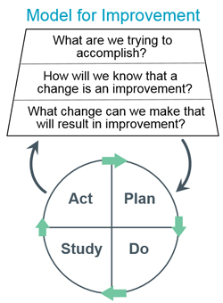
Things we may be able to control
Established relationships
GM & Lancs + Mersey
Transplant services and nephrology
Quality improvement
Improving outcomes for patients
Model for Improvement methodology
‘Traditional’ QI techniques
Training future nephrologists
Shared Health Education North West (Mersey & North Western)

Slide 14
Summary
Wide variation within renal units
Infrastructure including staffing and roles
Exec level support for formal QI training
Similarities and common themes
KQuiP priorities
Evidence of ‘quality improvement’ across the board
Opportunities to share experience and learning across the North West.

Slide 15





Kidney Quality Improvement Partnership (KQuIP)
UKRR/KQuIP North West Regional Day
Graham Lipkin
Co-chair of KQuIP

Slide 16
North West Network
KQuIP/Registry Regional Day
Aims
Know your outcomes-data
Identify your Unit QI leads: Medic and MPT
Decide on your Unit Key priority
Feel supported to embed QI in your practice
Sign up to KQuIP

Slide 17
Quality Improvement in Renal Services
Every Unit is committed to high quality care
Improvement only happens at Renal Unit Level
You know best how to improve your services

Slide 18
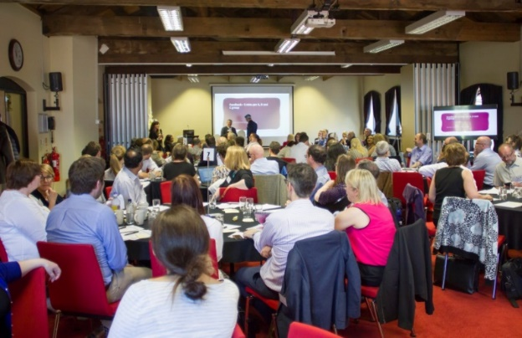
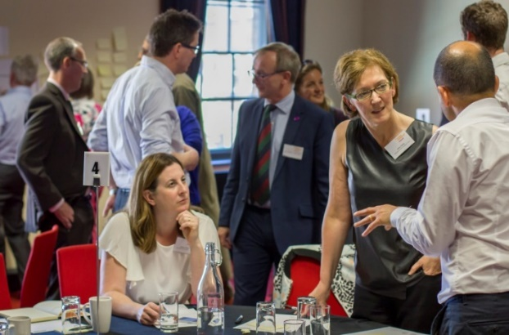
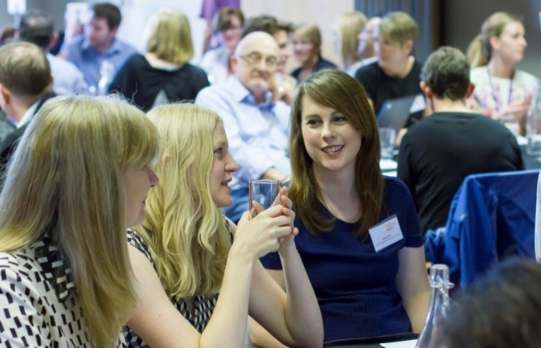
Design Event: Launch June 2016

Slide 19
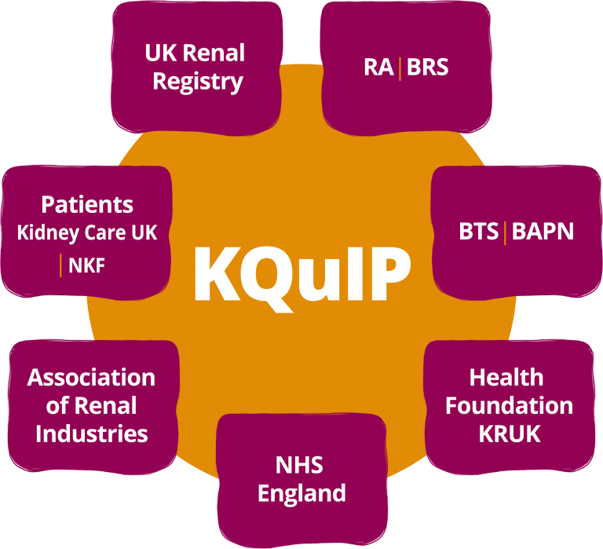
Kidney Quality Improvement Partnership (KQuIP)
KQuIP is a dynamic network of kidney health professionals, patients carers and industry …committed to developing, supporting and sharing quality improvement in kidney services…. in order to enhance outcomes and quality of life for patients with kidney disease.
Professional Society Led
Multi-Professional
UK
Adults and Children’s Care

Slide 20

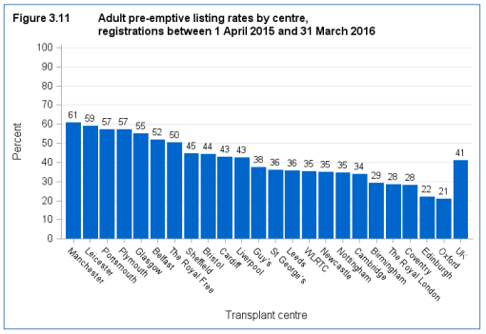
Pre-emptive Transplantation Listing Rates

Slide 21
Home Dialysis: UK Renal Registry-Do we improve?

Slide 22
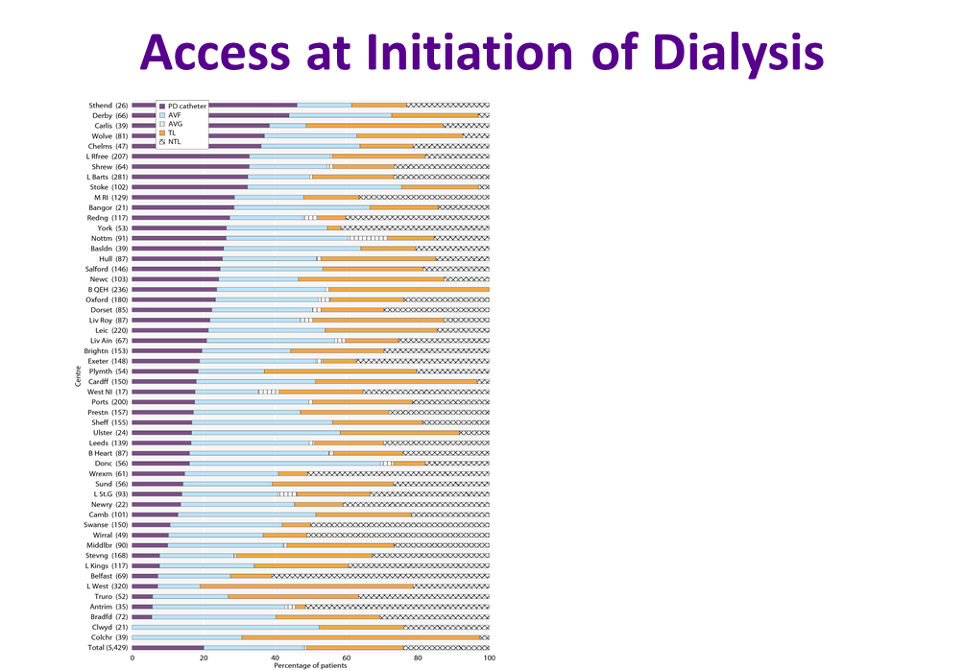
Access at Initiation of Dialysis

Slide 23
NW UKRR Dashboard data: PD Peritonitis

Slide 24
Why does unwarranted variation persist?
Many reasons:
Specific to each Unit-solutions can only come from those on the front line-you know your system best
Some systematic
Resource?
Leadership & leadership training
Training in QI methodology
Structure
We don’t share good practice (or learn from less good practice)

Slide 25
KQuIP Progress so far…National Projects
Improving access to kidney transplantation; Transplant First
Pre-emptive transplant listing and kidney transplantation major unwarranted variation. Transplant First, developed in West Mids. Project managed & packaged by KQuIP. Signed off at KQuIP board and roll out next week.
Improving access to home therapies for suitable patients : Home First
Improve access to peritoneal and home haemodialysis. KQuIP mananged national QI project. KQuIP launch Jan 2018.
Improving vascular access; MAGIC - Managing Access by Generating Improvements in Cannulation
Improve prevalence AVFs & patient experience by reducing complications of cannulation of arteriovenous fistulae and grafts. Launch in April 2018.

Slide 26
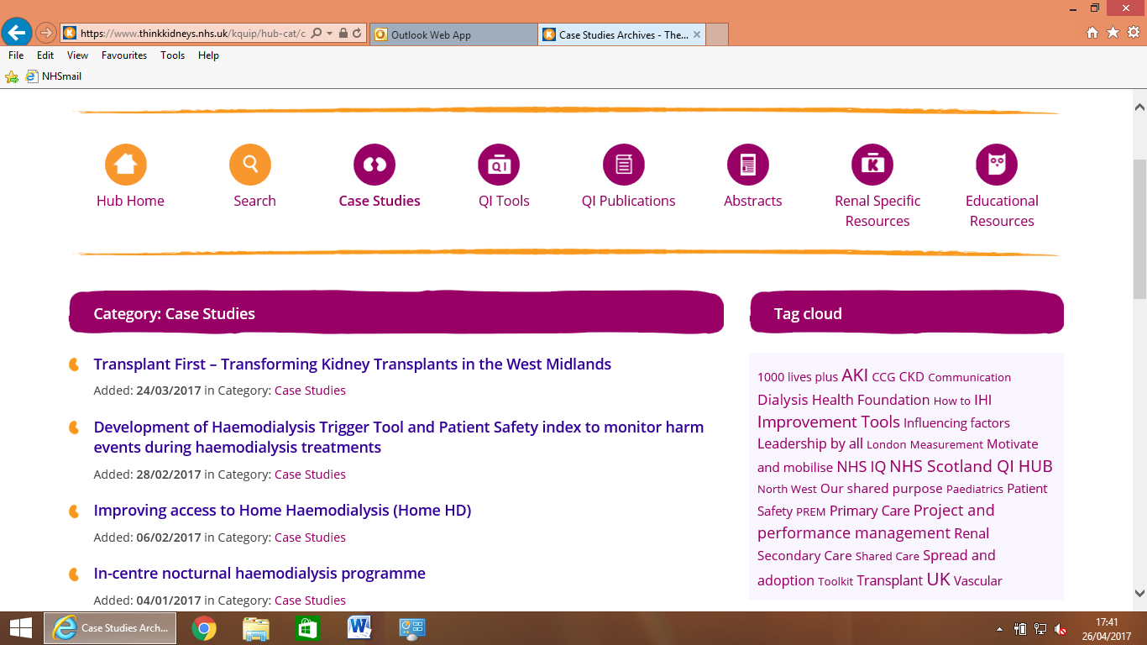
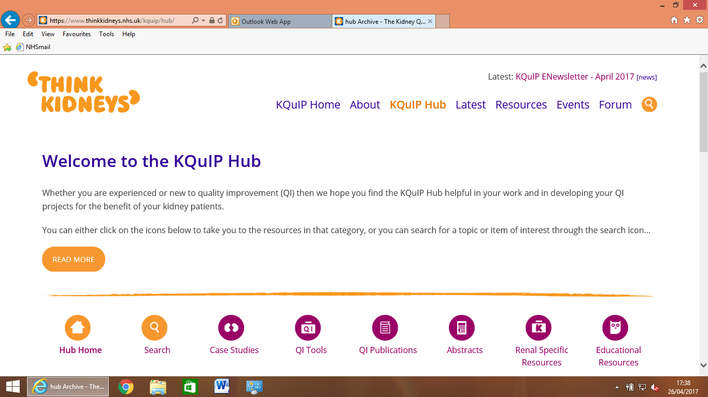
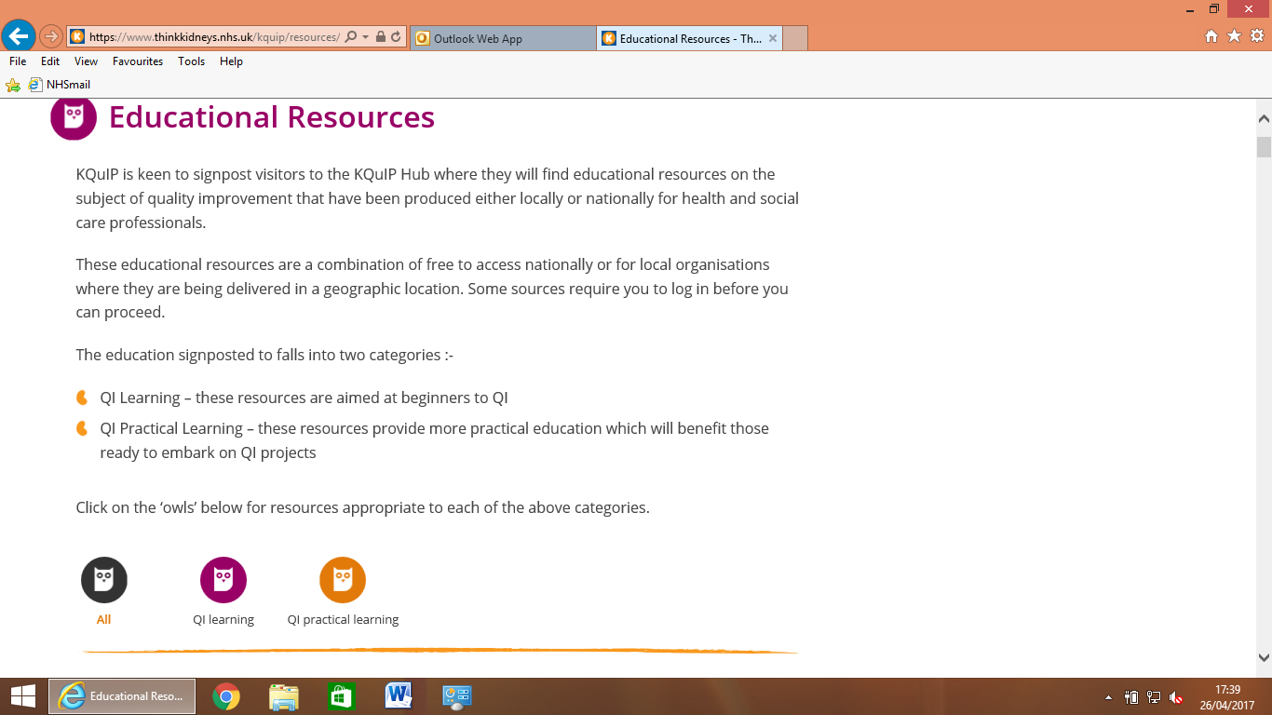
KQuIP Hub-Repository*

Slide 27
Why Regions are Key to QI Delivery?
Right size
Healthy competition
Peer support and Assist
MDT time and travel particularly difficult
Work together
Regional focus
Renal Association - SIGs
GiRFT
Rightcare

Slide 28
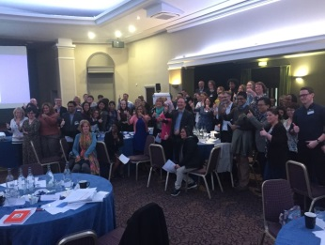
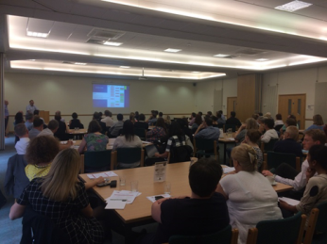
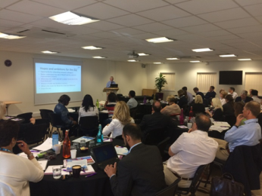
KQuIP Progress so far… Regional Days
KQuIP have supported 4 QI regional days so far…..
West Midlands - Built QI infrastructure with identified QI leads. Set up an AKI network. Delivered a Peer Review Day. Identifying next steps.
Yorkshire and the Humberside - Identifying infrastructure with QI leads. Identifying national project. Identifying next steps for delivery.
East Midlands - Identifying infrastructure with QI leads. Identifying national project. Identifying next steps for delivery

Slide 29
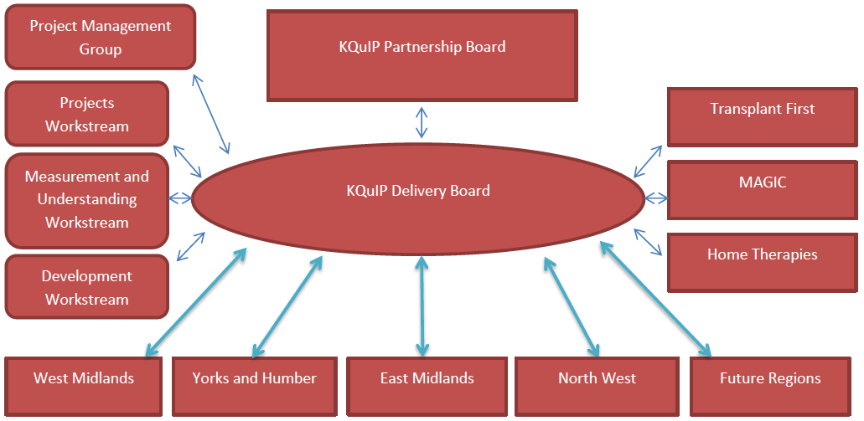
KQuIP Delivery Structure –Regional Focus
Work
streams
Projects
Regional Networks

Slide 30
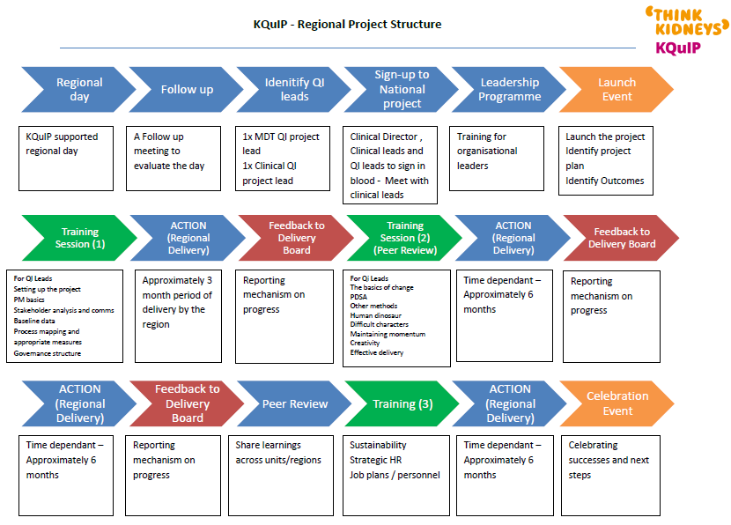
KQuIP Regional Delivery Support Plan

Slide 31
What happens in practice?
This diagram shows how different teams within the GIRFT programme work with trusts and other partners at different times to support implementation.
Clinical Leads set the direction, supported by the Review & Analytics teams.
GIRFT Regional Hubs are the main source of ongoing local support for implementation.
As well as accessing GIRFT metrics and findings in their data packs, trusts can access a range of metrics per specialty via the Model Hospital portal at https://model.nhs.uk/

Slide 32
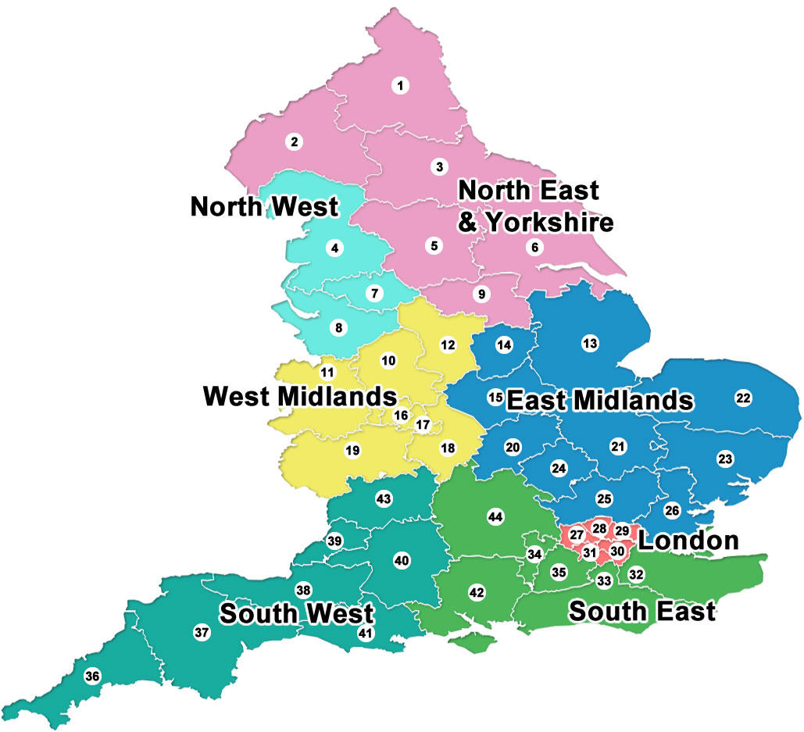
GIRFT Regional Support
7 GIRFT Regional Hubs operating from Nov 2017.
implementation plans reflecting:
1. Variations highlighted in Trusts’ data packs
2. Improvement priorities from Clinical Lead visits
3. Recommendations from each National Report
GIRFT will also produce good practice manuals full of case studies and best practice guidance Hubs will also help to ensure that GIRFT findings and plans are cascaded widely within each trust.

Slide 33
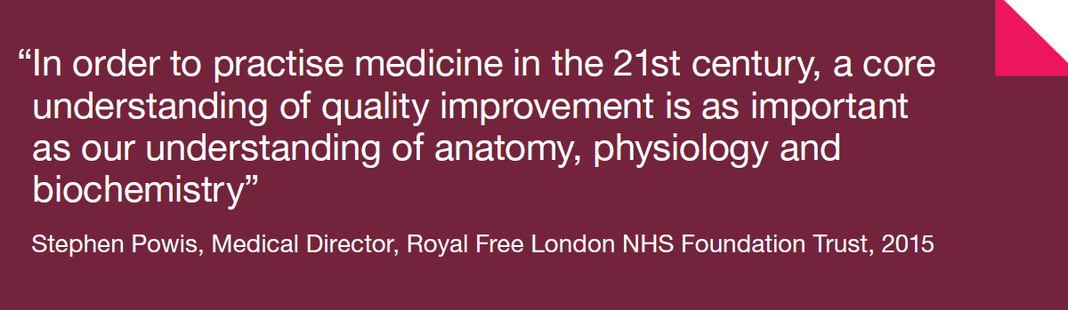


Training in Leadership & QI Methods-Medical and MDT
E-Learning and Faculty

Slide 34
Outcomes of today:
Select Priority project (s)
Identify Quality Improvement Leads in each Renal Unit Medical & MPT
Sign up to KQuIP

Slide 35

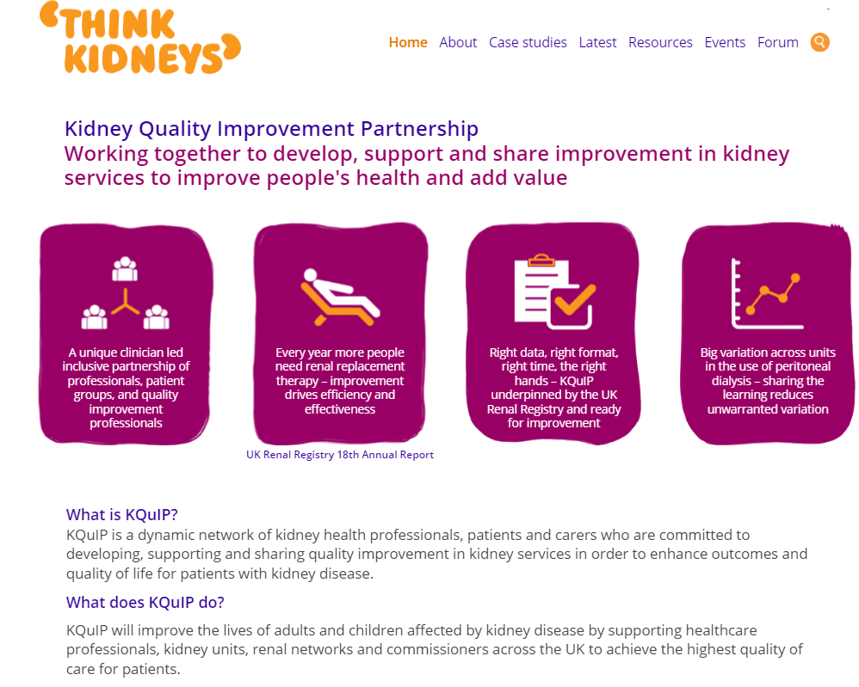
KQuIP welcomes you… …enabling you and your team to improve quality and safety
www.thinkkidneys.nhs.uk/kquip/
Kidney Quality Improvement Partnership – Graham Lipkin

Slide 36
Enjoy the Day

Slide 37
KQuIP/UKRR Regional Day
North West
09:50 - 10:10
Setting the Scene - Holly Loughton

Slide 38
5 THINGS I’LL NEVER FORGET.
MY KIDNEY JOURNEY
Holly Loughton
@HollyMLoughton

Slide 39
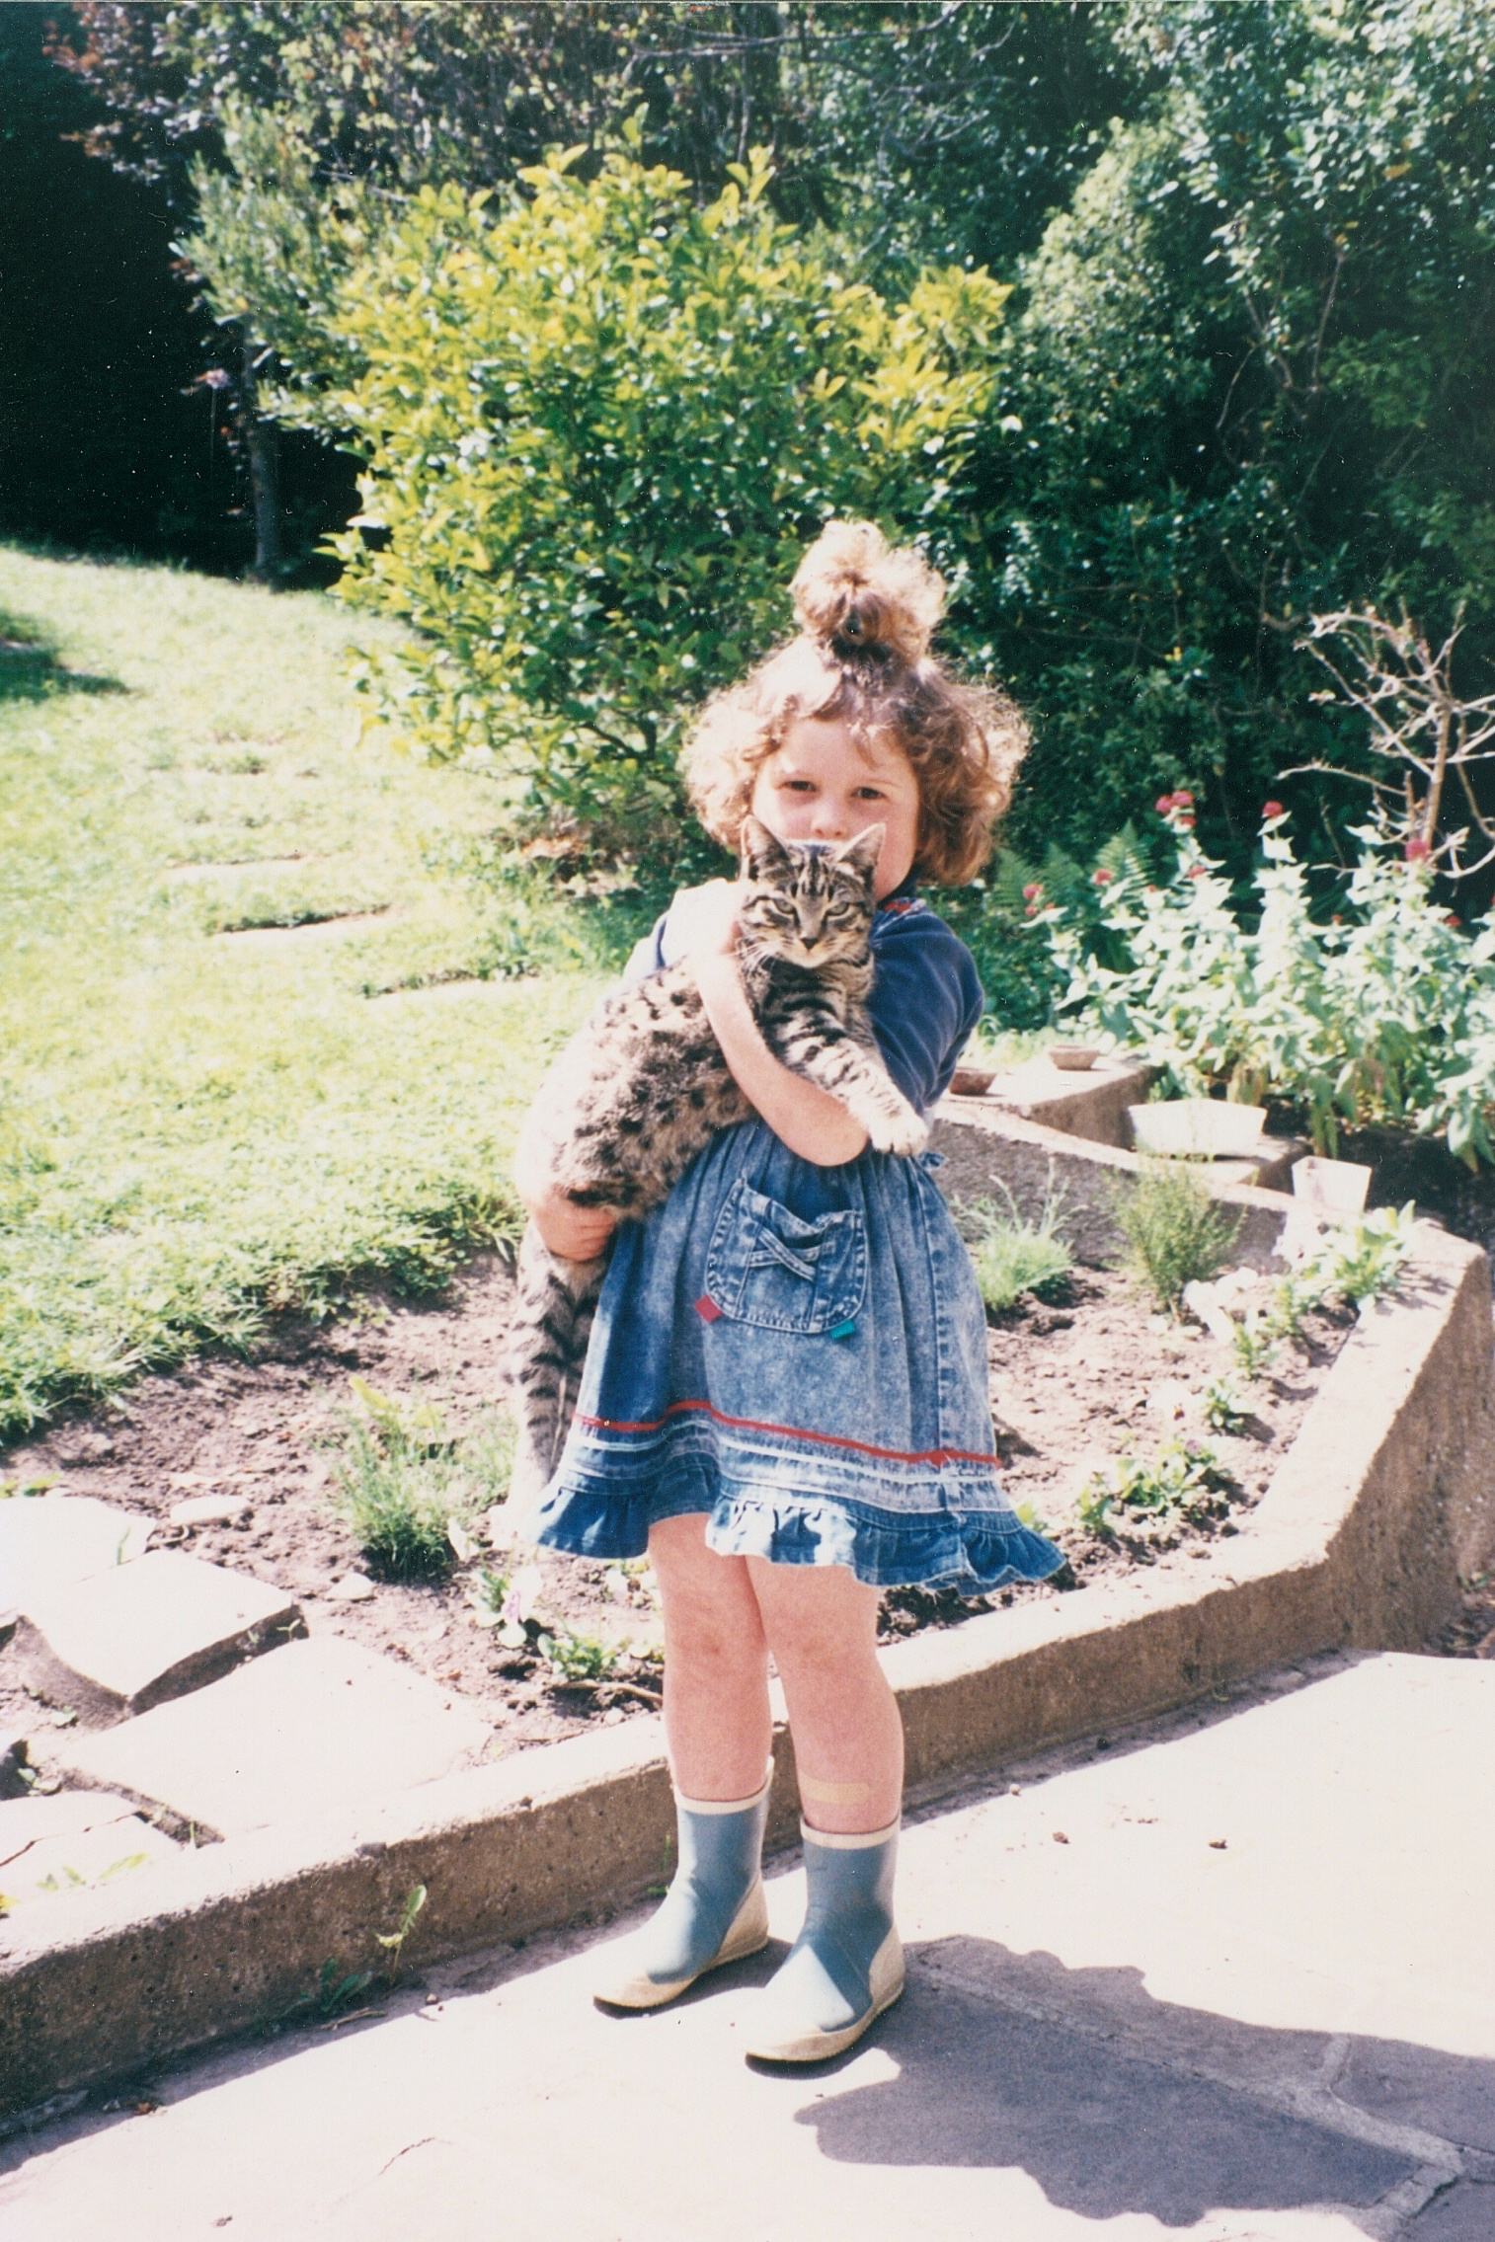
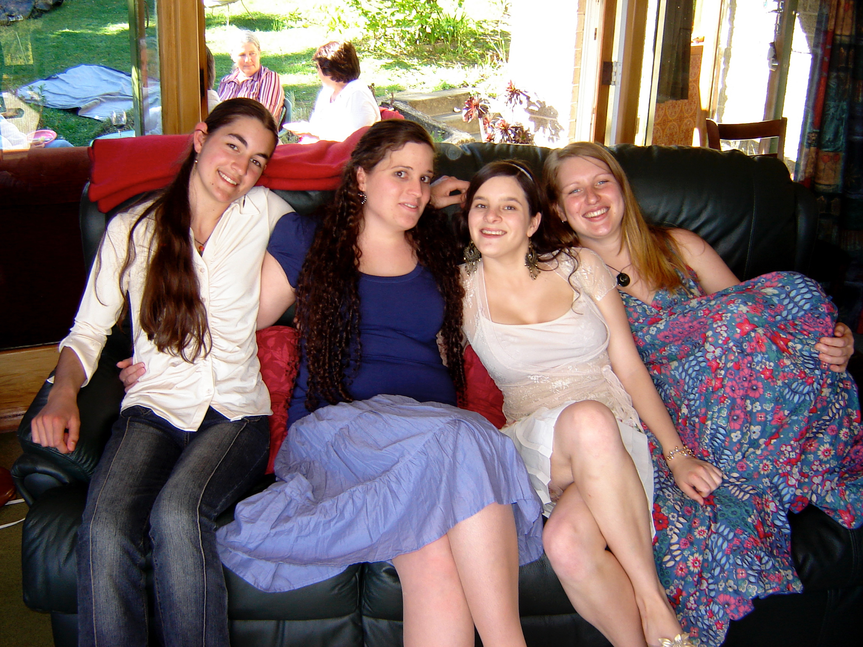
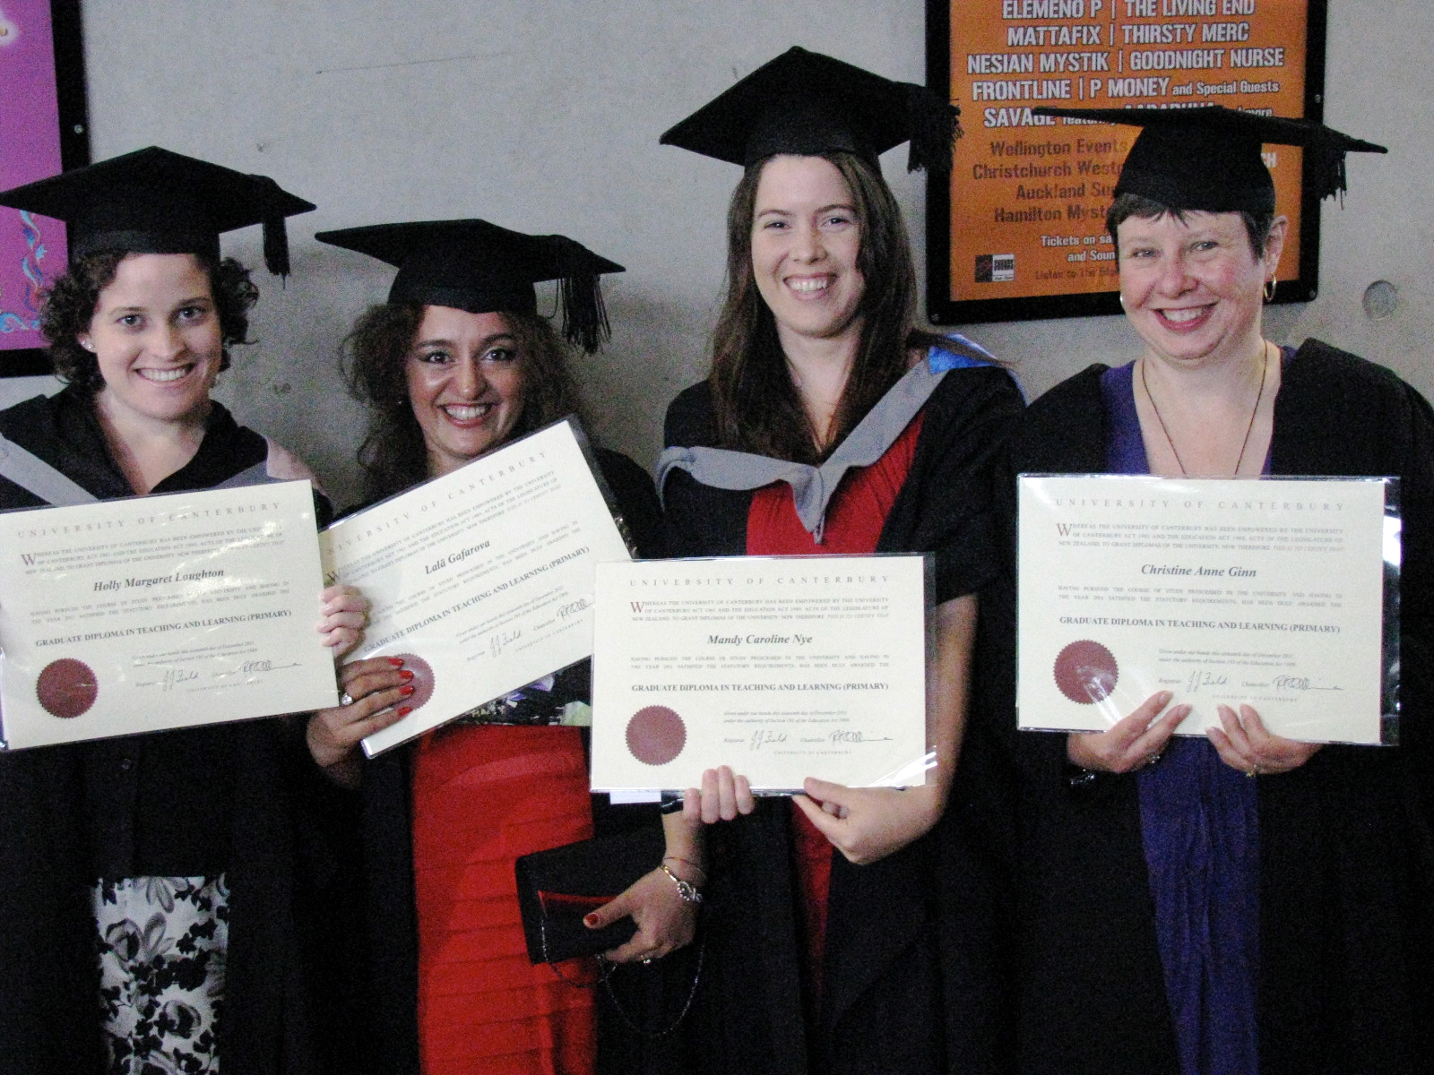

Slide 40
“Is this really me?”

Slide 41
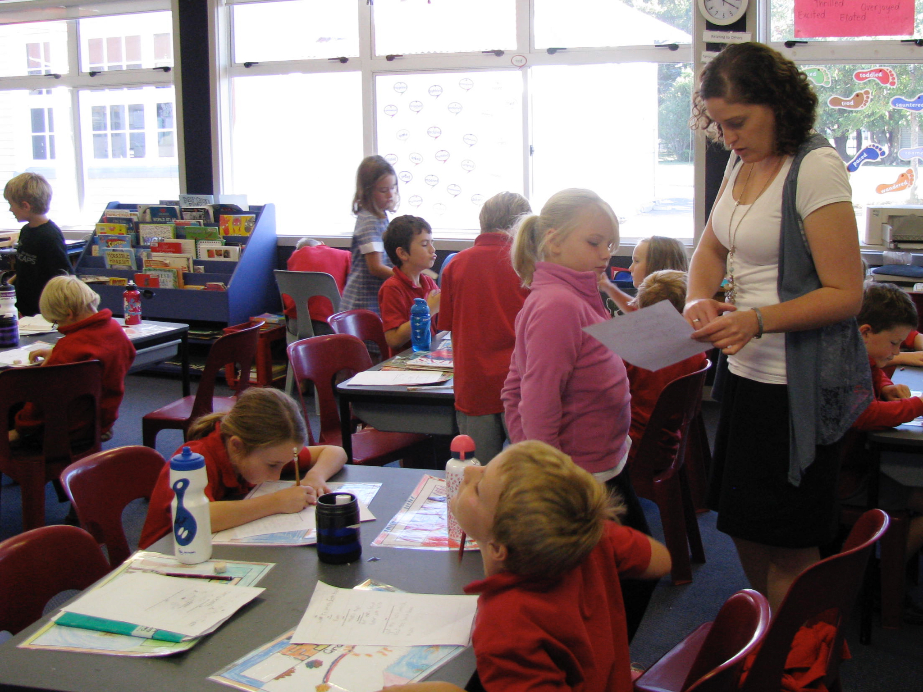
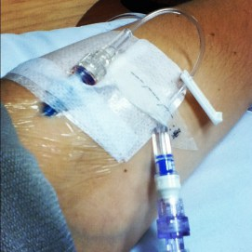
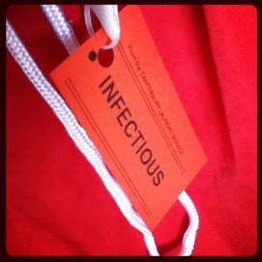
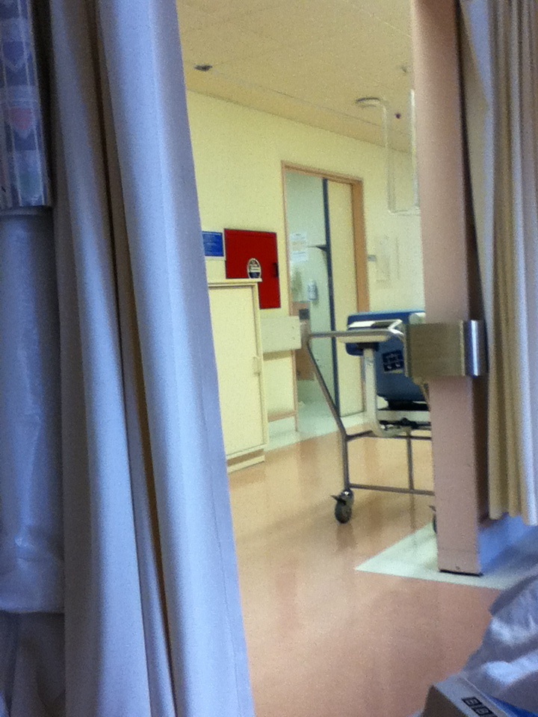
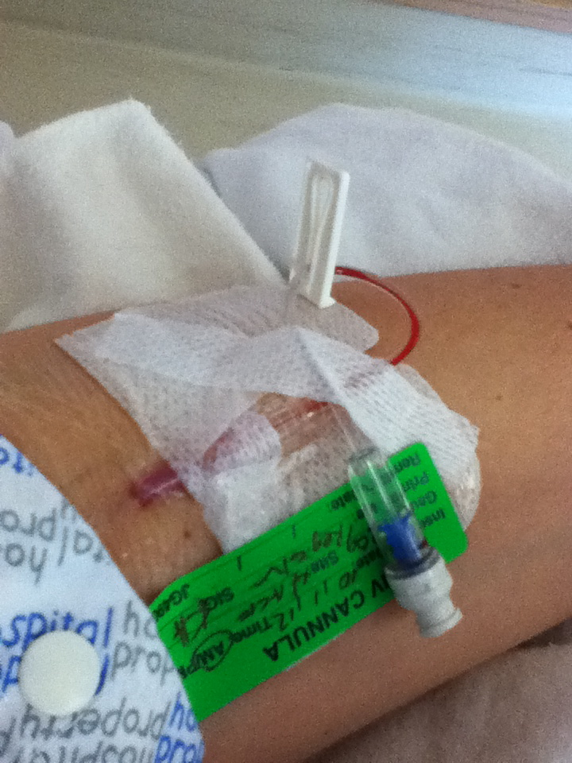
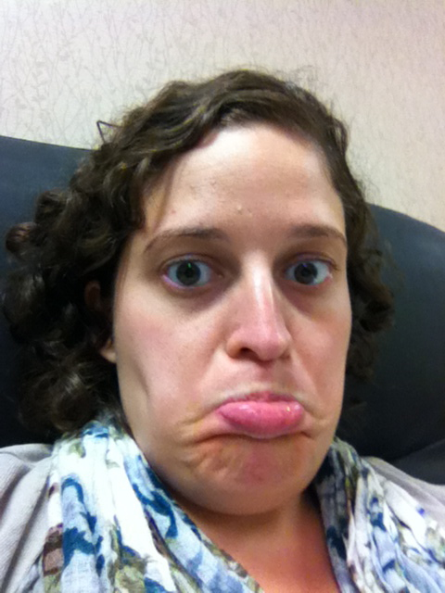

Slide 42
“I don’t know what to say…”

Slide 43
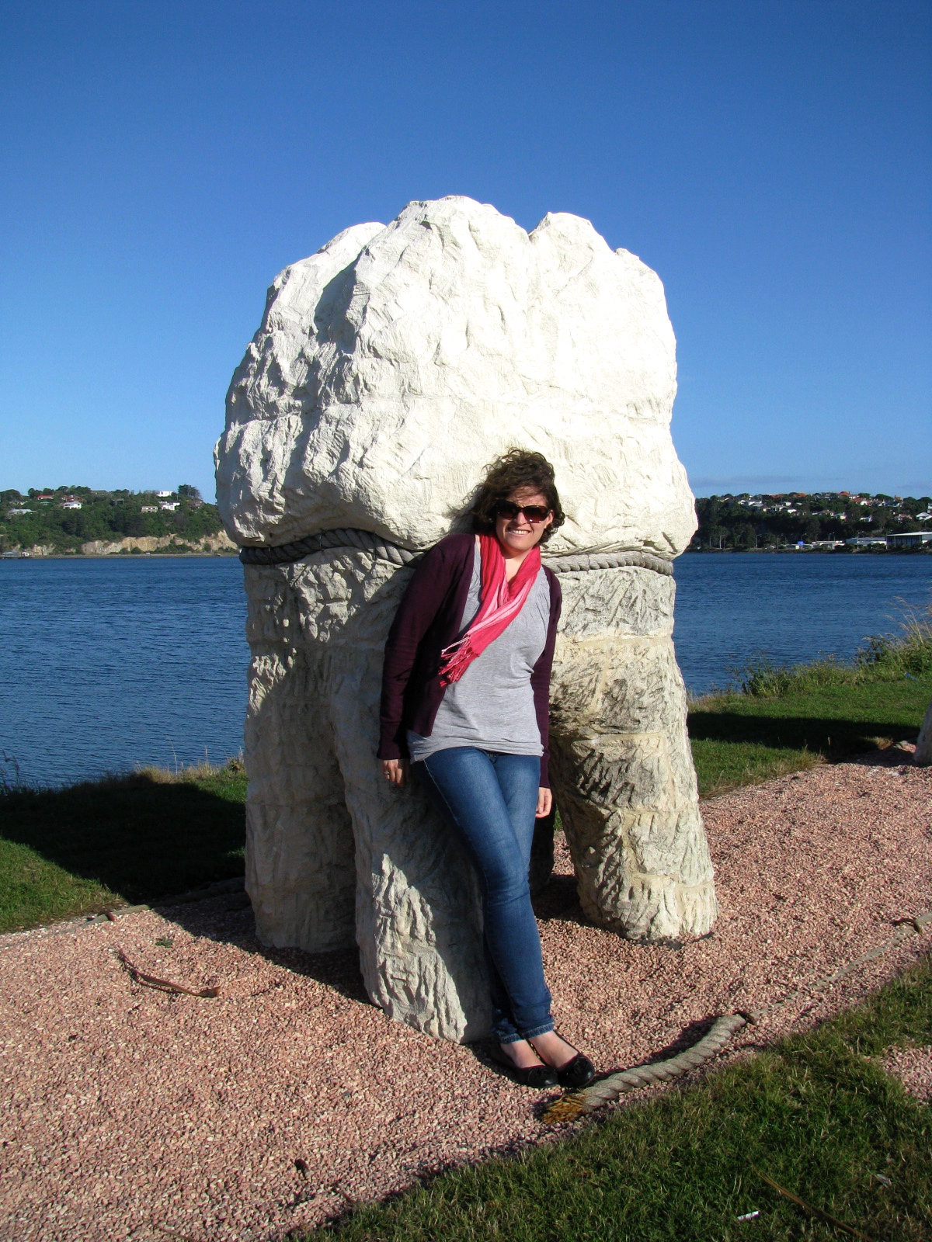
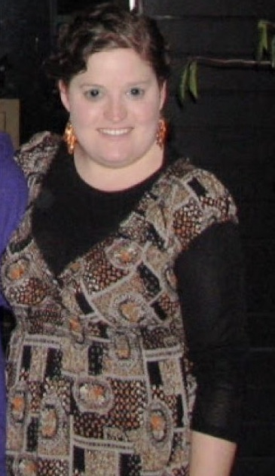

Slide 44
“You used to be Pretty.”

Slide 45
Building relationships

Slide 46
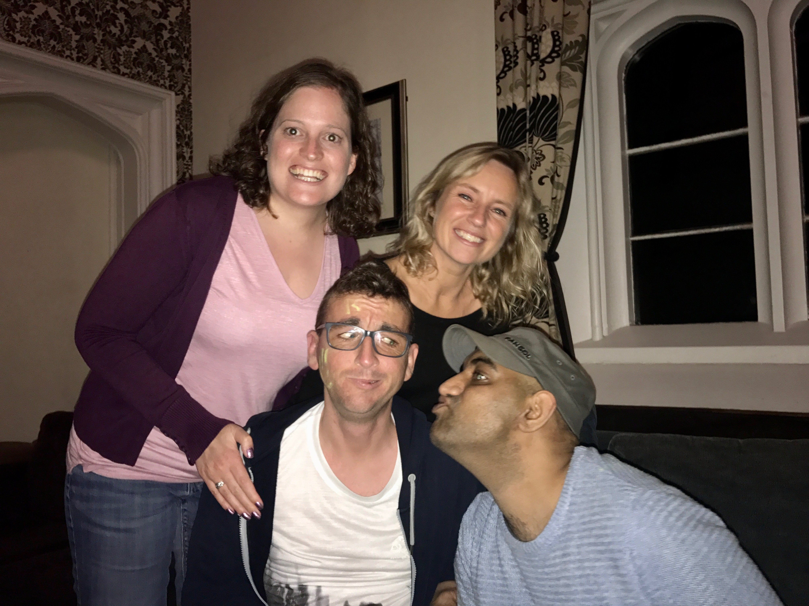

Slide 47
it’s Ok to not be ok.

Slide 49
choosing to be empowered

Slide 50
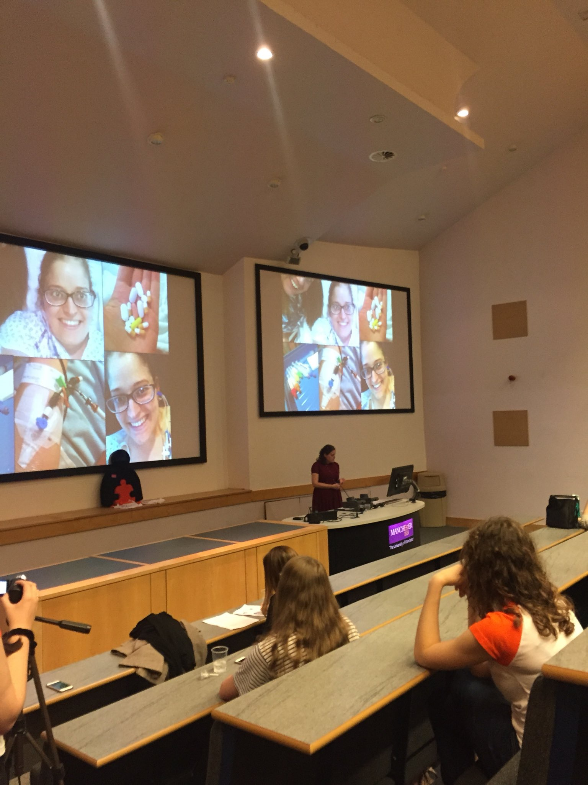
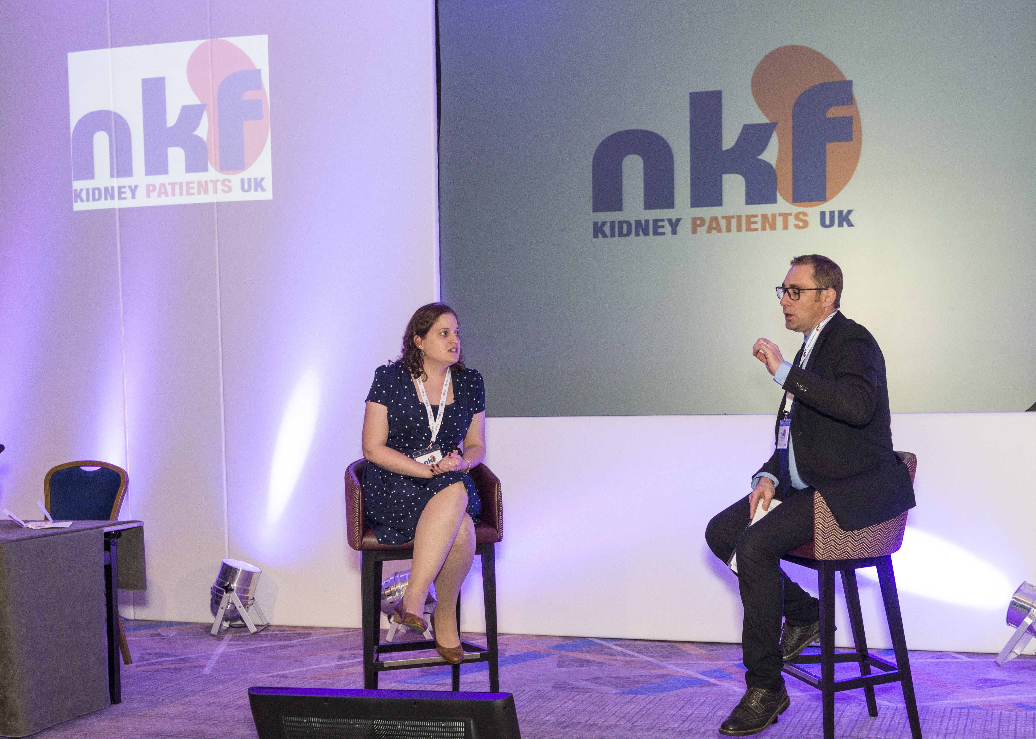
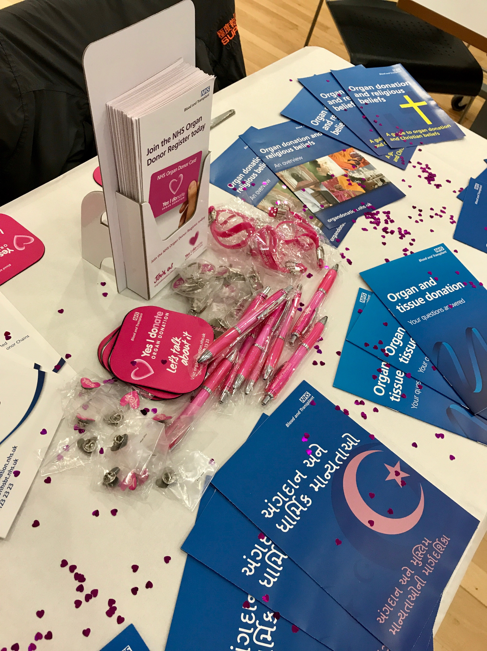

Slide 51
KQuIP/UKRR Regional Day
North West
10:10 – 10.40
KQuIP Transplant First LKD Transplantation – Caroline Wroe, NHSBT
Quality improvement in Preston with special focus on Transplantation - Dr Mark Brady and Dr Aimun Ahmed
KQuIP & Transplant First – Kerry Tomlinson, Project Lead

Slide 52
KQuIP Transplant first- Living kidney donor transplantation
Caroline Wroe
Chair Living Kidney Donor Network
NHSBT data slides provided by Lisa Mumford
KQuiP North West Meeting, January 2018

Slide 53
Background

Slide 54
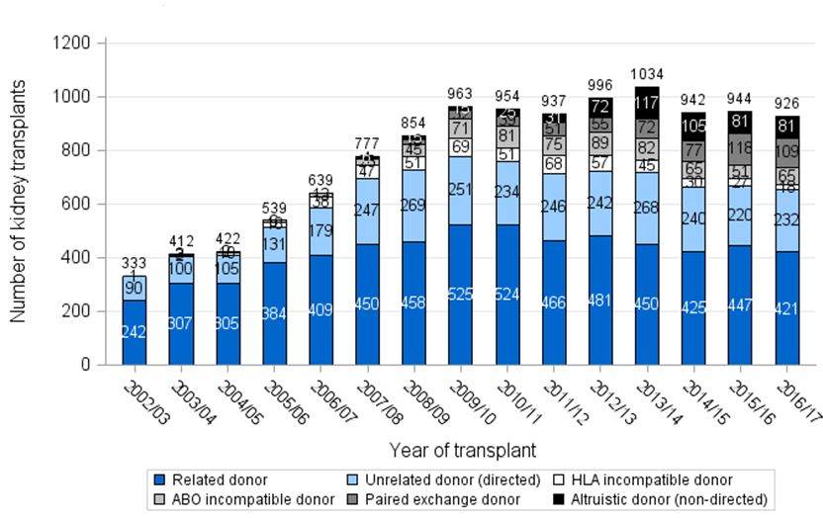
Living donor kidney transplants,
2002-2017

Slide 55
International Comparison
2010

Slide 56
Benefits of living donor transplant

Slide 57
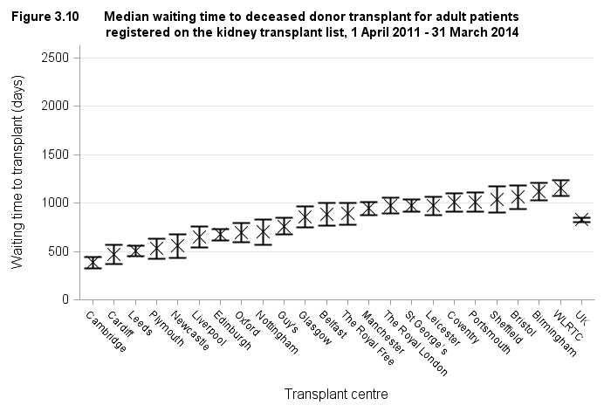
Median waiting time to deceased donor kidney transplant for adult patients, 1 April 2011 – 31 March 2014
1157 days
389 days
829 days
2.3 years

Slide 58
Pre-emptive transplants,
1 April 2016 – 31 March 2017

Slide 59
Cold ischaemia time for kidney transplants, 1 April 2016 – 31 March 2017

Slide 60
HLA mismatch levels of transplants,
1 April 2015 – 31 March 2017
Level 1 = 000, Level 2 = [0 DR and 0/1 B],
Level 3 = [0 DR and 2 B] or [1 DR and 0/1 B], Level 4 = [1 DR and 2 B] or [2 DR]

Slide 61
Outcomes

Slide 62
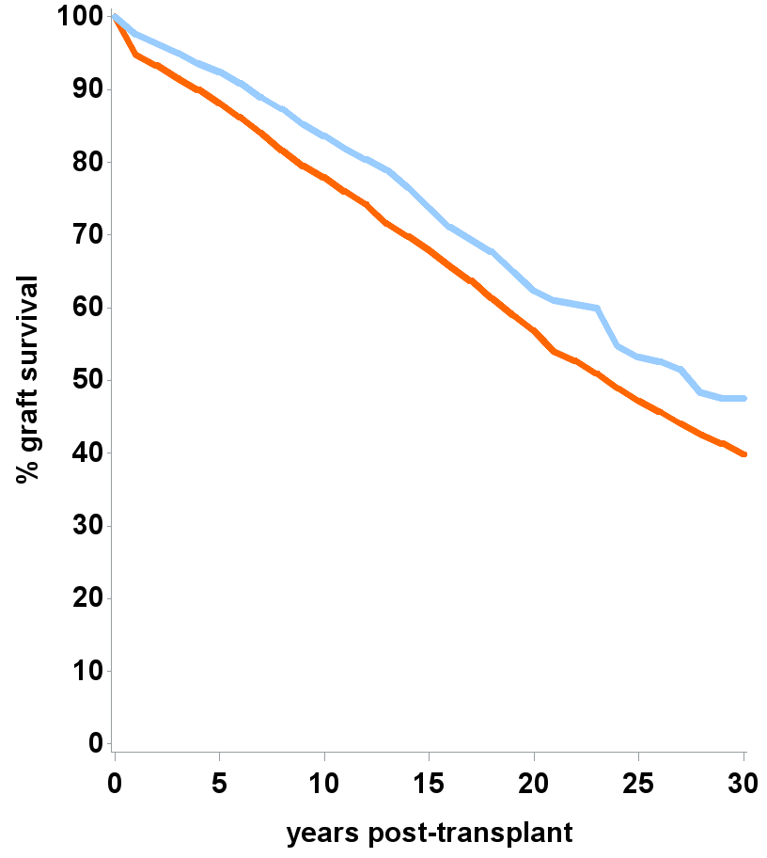
Graft survival estimates following kidney transplant
Period analysis, 01Apr12 – 31Mar16
30 year estimates
Living ~ 48% (42-53%)
DBD ~ 40% (38-42%)
Median survival estimates: Living donor ~ 27 years
DBD donor ~ 23 years

Slide 63
UK Variation in access to living donor transplantation

Slide 64
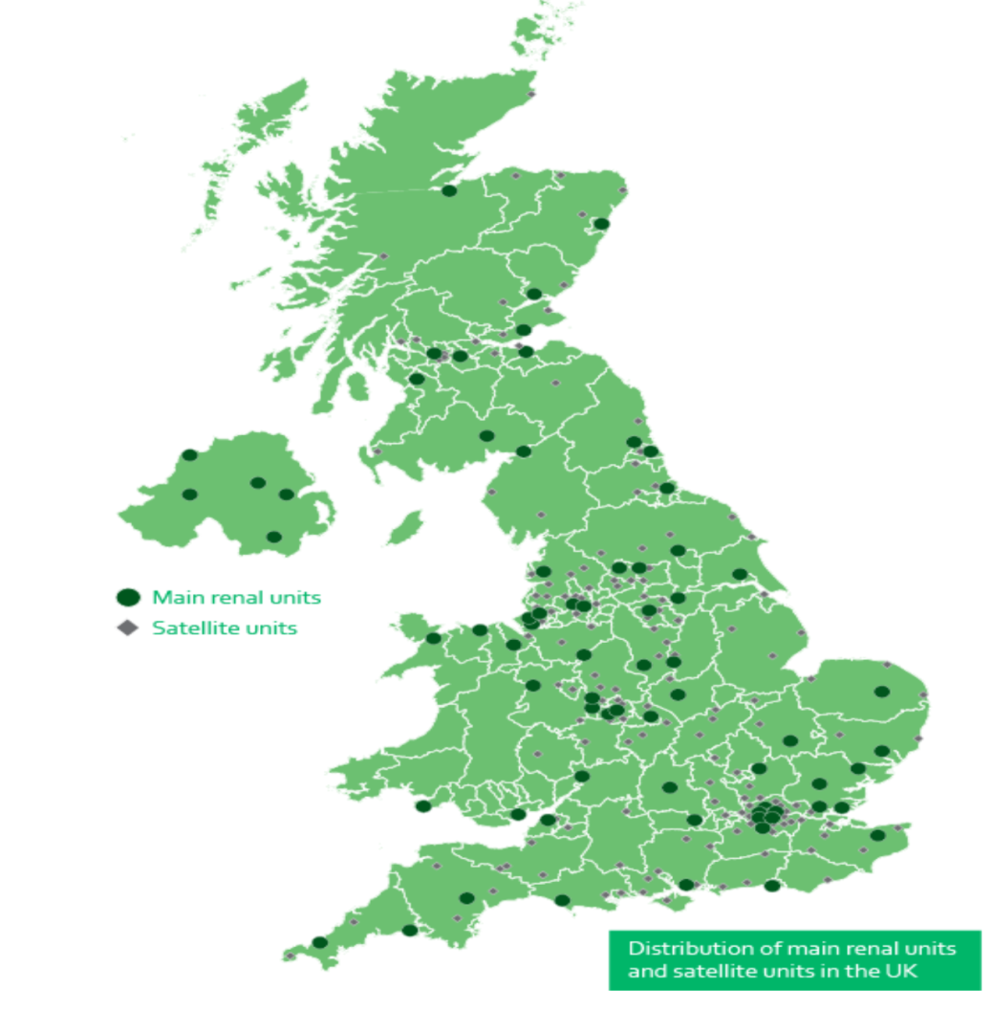
Referral centre
Dialysis unit
Transplant centre

Slide 65
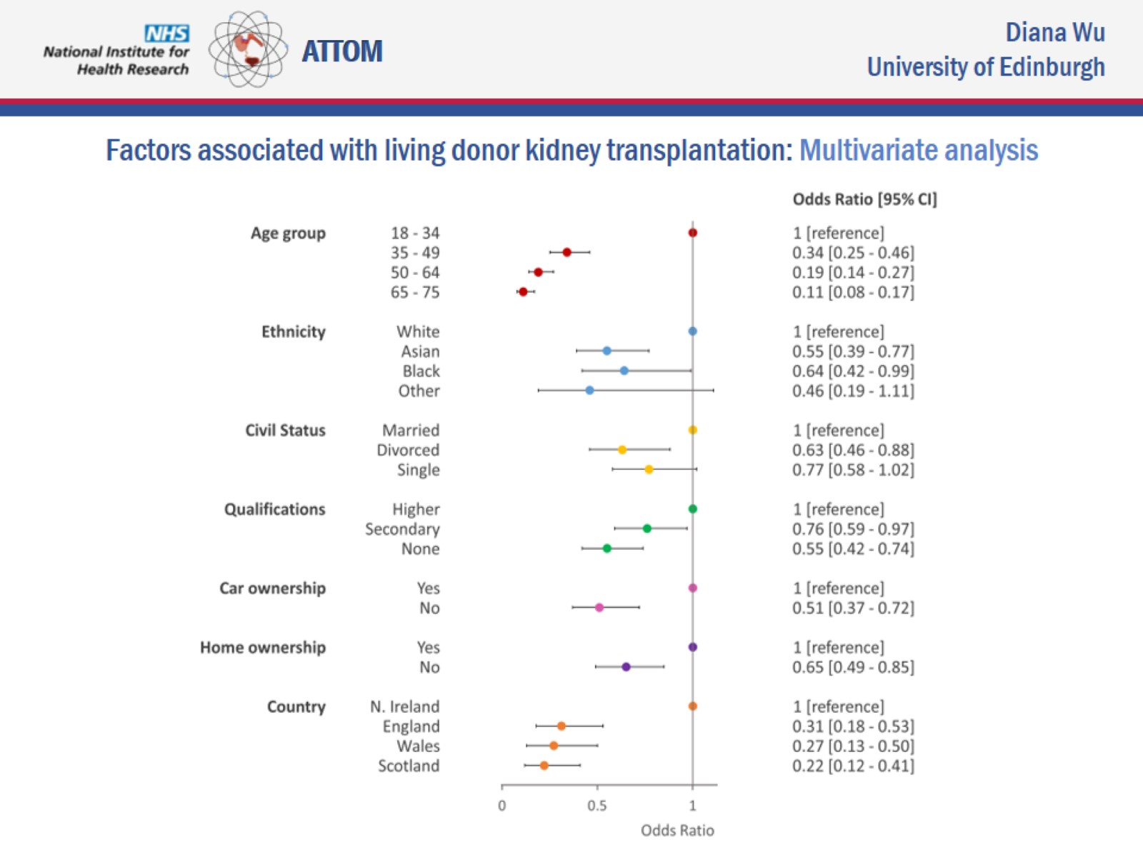
What do we know from the ATTOM study?

Slide 66
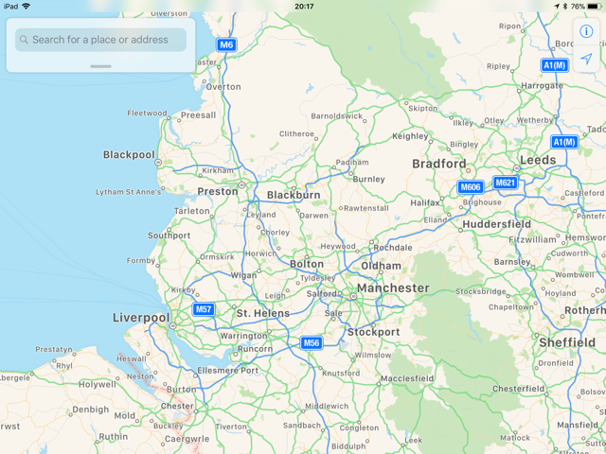
North West data
Extracted from UK transplant registry data 2014-2017
Unit | Population | Number of living donors/year |  |  | mean | rate pmp
 |  | 2014/15 | 2015/16 | 2016/17
Salford Royal | 1.49 | 19 | 27 | 22 | 22.7 | 15.2
Manchester RI | 1.53 | 31 | 34 | 20 | 28.3 | 18.5
Preston & Lancashire | 1.49 | 25 | 25 | 22 | 24.0 | 16.1
Liverpool (Royal and Aintree) | 1.48 | 22 | 26 | 27 | 25.0 | 16.9
Arrow Park (Wirral) | 0.57 | 10 | 7 | 10 | 9.0 | 15.8
Bradford | 0.65 | 9 | 4 | 7 | 6.7 | 10.3

Slide 67
How can we offer every opportunity for living kidney donation?

Slide 68
Where could we start?
How do we assess the quality of our living donor pathway?
What are the problems we encounter on a regular basis?
What barriers to living kidney donation should we expect to see in the community we serve?
What steps can we take to reduce these problems and barriers?

Slide 69
Sr Fiona Biggins Live Donor Coordinator Dr Aimun Ahmed living donor lead DR mArk brady clinical director Kquip meeting, warrington 31st January, 2018
Lancashire Teaching Hospitals
TRANSPLANT SERVICES

Slide 70
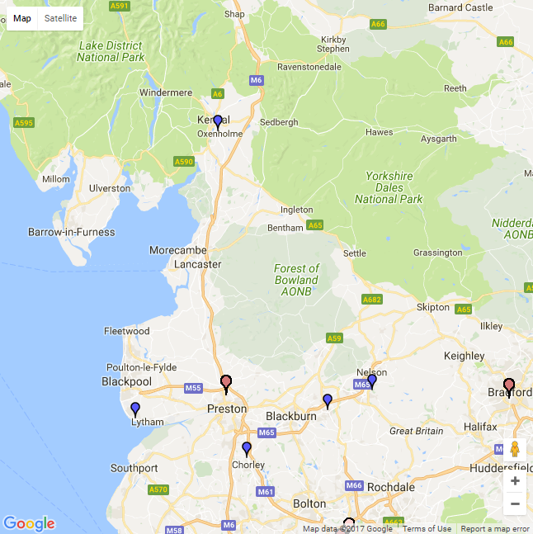
Renal Services across Lancashire & South Cumbria
Serving 1.6 million population
~1270 RRT patients
670 Tx patients
90 Home Dx
515 in-centre
Main hub Preston
6 satellite units
Acute Dialysis Bay main ward
Kendal
Preston
Burnley
Clifton
Accrington
Blackburn
Chorley

Slide 71
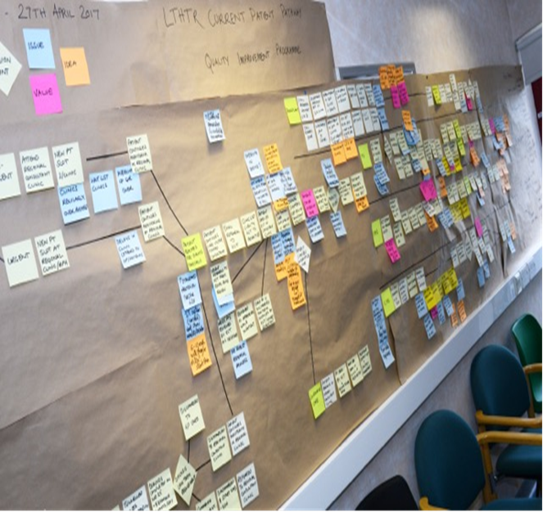
Quality Improvement Work across LTHTR Renal Services – working with Baxter
Since April 2017 to present
Key Areas –
Vascular access
Home Therapies
Kidney Choices
Live Donor/Tx workup

Slide 72
LTHTR TRANSPLANT TEAM
Living Kidney Donation
Dr Ahmed Consultant Lead
Dr Garrues
Sr Fiona Biggins WTE Band 7
Sr Wendy Moore WTE Band 6
Transplant Work-up
Prof Woywodt (RPH) Consultant Lead
Dr Solomon & Dr Garrues (East Lancs)
Sr Lyndsey Rushton WTE Band 6
Post Renal Transplant
Dr Arunachalam Consultant Lead
Dr Ahmed
Dr Ponnusamy
Dr Solomon
Prof Woywodt
Sr Mags Delargy 0.8 WTE Band 7
Sr Jenny Barlow WTE Band 7
Pharmacy
Renal Pharmacist Zoe Thain
Renal Pharmacist Simon Mann
Administration Louise Dowling and Amy McNally - Doctors
Anne-Marie Pearson and Sharifa Nakhuda - Nurses
Nicola Williams - Pharmacy

Slide 73
Preston Deceased Kidney Tx Rates
60
48
42
44
25%

Slide 74
Lean Improvements In Recipient Work-up. Ongoing Since 2014
Electronic referral to the team. Indicate what cardiology investigations required
Electronic signature for Tx related letters
Spread sheet – automated flags
HLA results directly to Tx team, not consultant
OPD appointments – txt to patients. Filling all vacant and cancelled slots
Named coordinator at Manchester
Electronic referrals to Manchester – reply with clinic appointment

Slide 75
Preston Living Kidney Donation and Pre-emptive Rates
20

Slide 76
Preston Living Donation Breakdown

Slide 77
LD Team strength and achievements
One of the highest LD rates in the UK-17.7 pmp
Good team effort!
Generous patients and large population- 1.6 million
The oldest UKD in the UK 85 years old!
Reasonable infrastructure
Dedicated Live donor clinic, 2 specialists, 2 LD Coordinators
Live donor protocol based on evidence and guidelines
Donor data base
Full range of patient information, books, leaflets, DVDs
Education (colleagues and patients)

Slide 78
Areas of improvement implemented Quality Improvement Work
Shortens the pathway and avoid delays in referral
e-Signing of letter by nurses/cross cover between doctors
Nurses to book investigations
Audit mean average waiting times for investigations and discuss delays with relevant directorates
Audit average time for referrals to tx centre :
LD – 1st appt > surgery
Recipient – 1st appt > listed
Dedicated regular appt slots for RPH pts in MRI

Slide 79
Quality Improvement Work New Donor Pathway
Notes:
We are considering
1 day assessment -1 stop clinic
Increasing number of IA’s

Slide 80
Quality Improvement Work Recipient Pathway

Slide 81
Thanks for listening

Slide 82
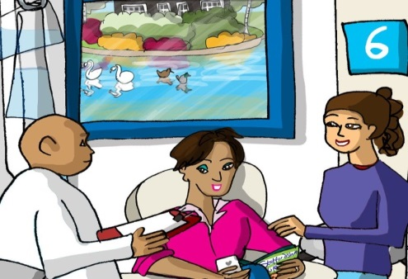
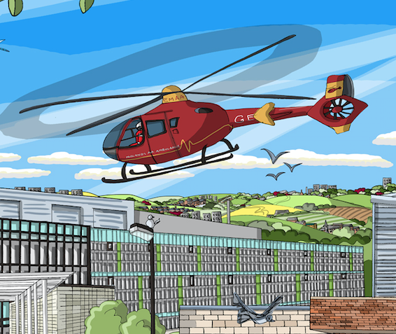
Transplant first: Addressing inequality of access to renal transplantation across the West Midlands
Kerry Tomlinson on behalf of sponsor group
North West KQUIP/UKRR regional day

Slide 83
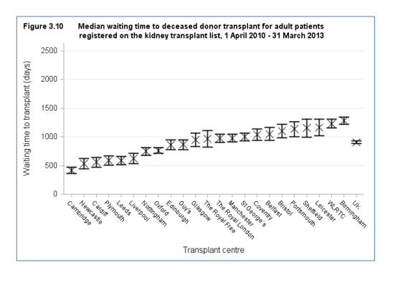
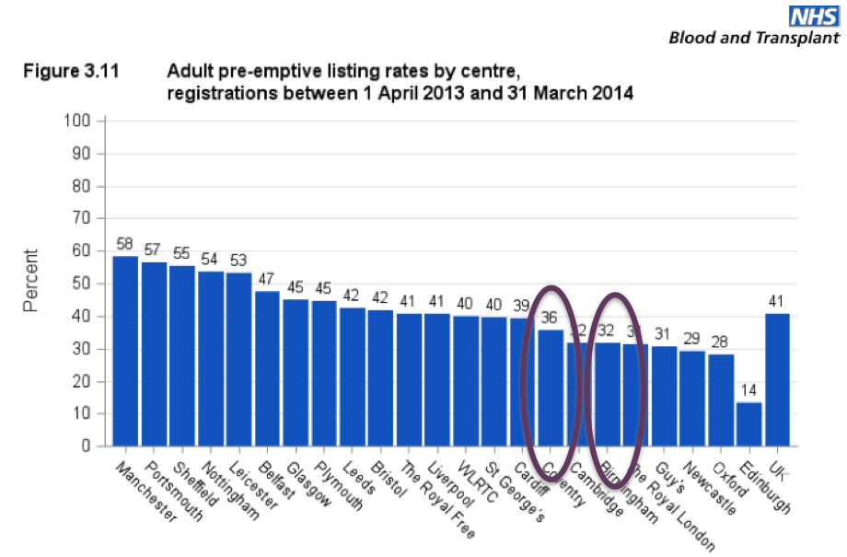
Why did we do it?
UK RR 2014 report median time to listing
488, 598, 641, (683), 712, 765, 787, 867

Slide 84
Is it working?
UHB listings from all units

Slide 85
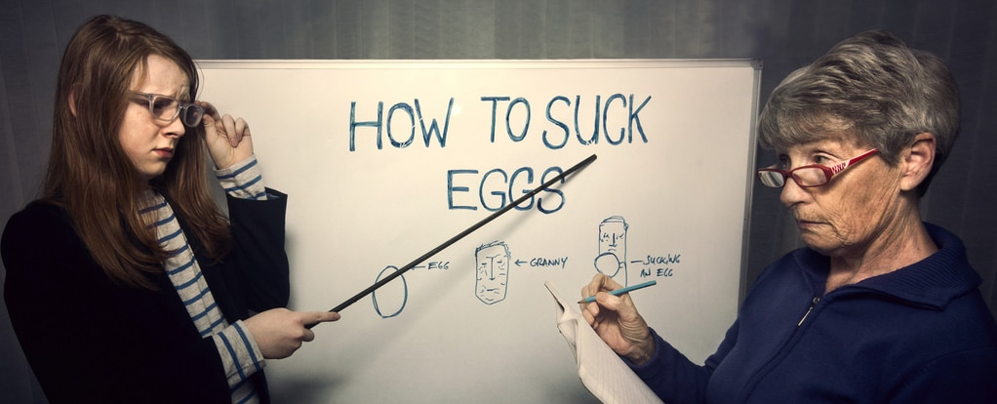
What it isn’t

Slide 86
What it is
Model for region wide QI which will fit into regional KQUIP model
Ready made data collection tool to understand why you don’t pre-emptively list more patients
Some lessons learned that are likely to be transferrable
How to Guide
Flexible around which part of pathway you want to concentrate on

Slide 87
What did we do?
Project events
Transplant Units
Renal Units
Patients and carers
External experts
SCN/KQUIP
Launch event
July 2015
Pathway Redesign 1
Pathway redesign 2
Audit/Education event Jul 2016
Audit Education event July2017

Slide 88
Launch event
July 2015
Pathway Redesign 1
Pathway redesign 2
Audit/Education event Jul 2016
Audit Education event July2017
Early agreement
Valuable time
BMI debate
Unit feedback
Handover points
Cardiac catheter abstract
Honest discussion
Quick Wins
Patient Voice
Sponsor team meetings, conference calls, working with RR, subgroup meetings, contact with units etc

Slide 89
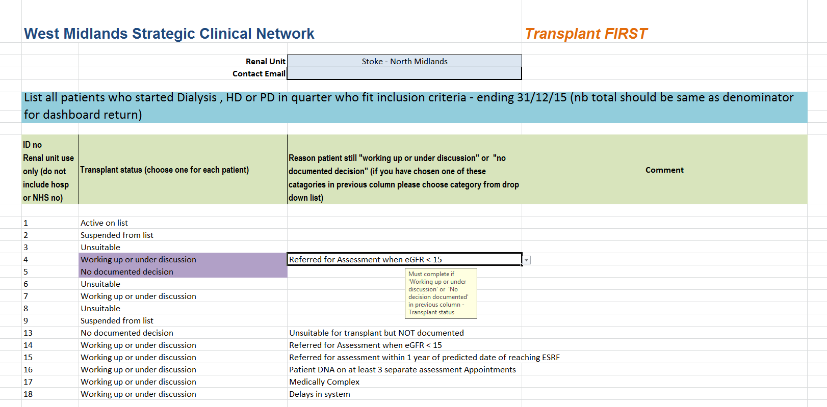
Data : Enhanced Dashboard (It’s taken ages so I am telling you about it whether you like it or not!)

Slide 90

Data: transplant listing

Slide 91
Transplant status from Enhanced dashboard
“Missed” patients

Slide 92
Reason patients are “missed”

Slide 93
Lessons learnt from data
Transferable causes for missing listing:
Failing transplants
Predictable but rapidly declining patients
Different approaches to cardiac angiography pre-dialysis
Referral to other specialties slows listing
Local causes for missing listing :
Specific clinics (e.g. diabetes multi-disciplinary)
Different feeder hospitals
Other reasons that will be apparent locally
It only works if you use it locally

Slide 94


Slide 95
Why should you do it?
UHNM

Slide 96
RR 2016 (2010-2012 starters)
 | Median time to transplant wait listing | Proportion of patients wait listed within 2 years of RRT (adjusted)
Bradford | 458 | 52.3
Liverpool Aintree | 837 | 39.8
Liverpool Royal | 613 | 47.4
Manchester RI | 225 | 62.4
Preston | 568 | 53.1
Salford | 181 | 66.1
Wirral | 835 | 45.0
Adjusted for age, gender, ethnicity, PRD
Multi organ and listed then suspended excluded

Slide 97
ATTOM: Centre factors associated with transplant listing
Centre variables linked to pre-emptive listing were
Being a transplant centre
Number of consultant nephrologists
Whether transplantation is discussed with all patients
Centre variables linked better access to listing after dialysis were
Number of consultant nephrologists
Written protocol

Slide 98
ATTOM: Patient factors associated with pre-emptive listing
Age>50
Ethnic group (Asian and Black)
BMI(>35)
Education
Car Ownership
Accommodation
Employment
Time First seen by nephrologist
Diabetes
Cerebrovascular disease
Vascular Disease
Malignancy
Heart Disease
Heart Failure
Current Smoker
Transplant First: Improve understanding of barriers to transplantation in your unit and remove them

Slide 99

Transplant First

Slide 100
KQuIP/UKRR Regional Day
North West
10:40 – 11.30
Group Work – Review of Transplantation data locally

Slide 101
KQuIP/UKRR Regional Day
North West
Group Work Questions for Consideration:
What is the data telling us, what works well and what are the important issue’s to address?
Do we need any more data? What are the barriers?
Have we any examples of interventions that worked and where is the evidence?
What are the next steps?

Slide 102
KQuIP/UKRR Regional Day
North West
11:30 – 12.00
Feedback from each group

