Slide 1
KQuIP/UKRR Regional Day
  North West
  12:00 - 12:30
    Home Therapies Data presentation – Dr Retha Steenkamp
    The Manchester Experience of a Navigator Nurse on Recruitment and Training for Home Haemodialysis – John Woods, Specialist Nurse
    KQuIP & Home Therapies - Richard Fluck – Home Therapies lead

Slide 2

Home Therapies Data -
North West Regional Day
Retha Steenkamp
Head of Operations UKRR

Slide 3

Percentage of prevalent dialysis patients by modality, 2011 and 2016
Notes:
3

Slide 4
Median age in prevalent dialysis patients by dialysis modality and centre on 31 December 2016
Notes:
4

Slide 5
Percentage of prevalent dialysis patients by modality, age and gender on 31 December 2016
Notes:
5

Slide 6
Percentage of prevalent dialysis patients by modality and ethnicity on 31 December 2016
Notes:
6

Slide 7
Percentage of prevalent dialysis patients by treatment modality and social deprivation, 31/12/2015
Notes:
7

Slide 8
Percentage of prevalent dialysis patients by treatment modality and comorbidity, 2011 and 2016
Notes:
8

Slide 9

Acknowledgements
Thank you to all renal units that submit data to the UKRR
Thank you also to all the people at the UKRR who work in the background to make all this possible.

Slide 10



“The Manchester Experience of a Navigator Nurse on Recruitment and Training for Home Haemodialysis”
John Woods, Specialist Nurse in Dialysis
Sandip Mitra, Consultant Nephrologist

Slide 11
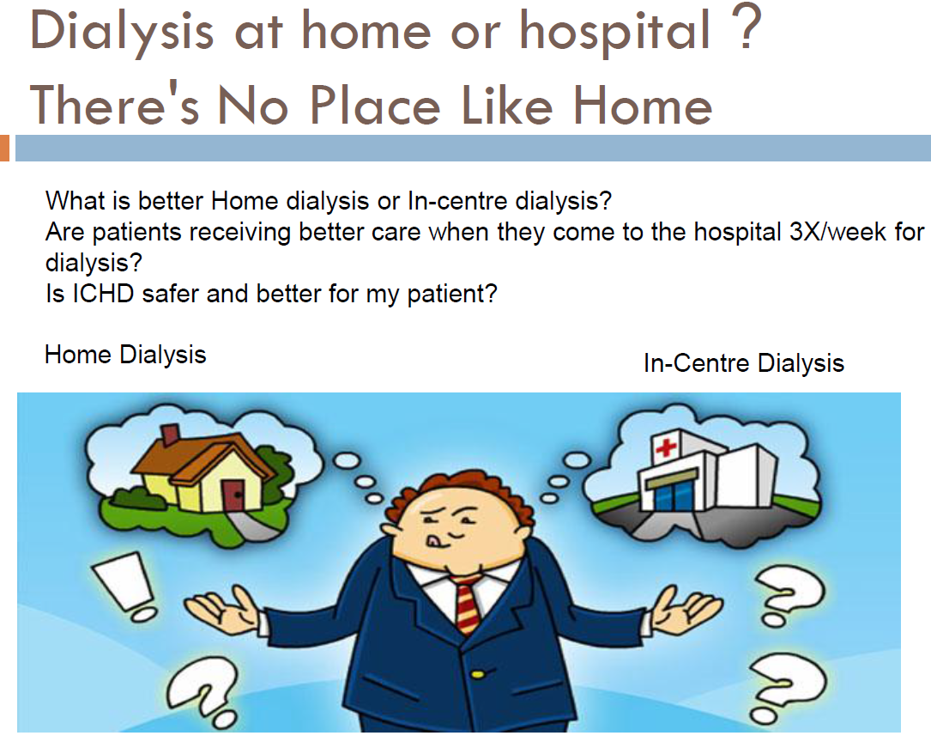
Notes:
We are still far off from achieving optimal number of patients on home dialysis in UK

Slide 12
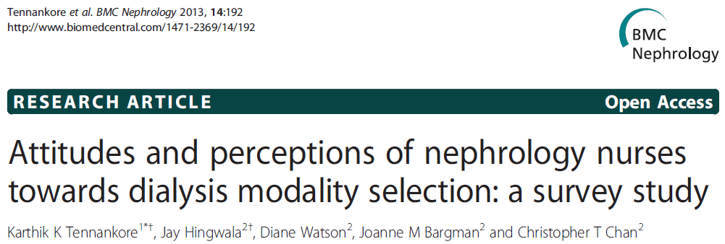
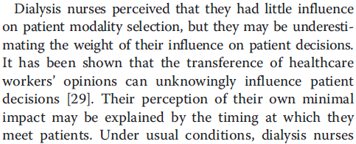
“Conclusion: Dialysis nurses have prevailing views about modality selection that are strongly determined by their area of experience and expertise”

Slide 13

Manchester TReNDs model of Haemodialysis Care
The Central Hub Dialysis unit
Complex and unstable patients
Satellite
Fully assisted
care
Satellite
Shared – care level 1
and above
Satellite
Self/shared – care level 4
Home

Slide 14
Initial Scoping for In-centre HD Jan 2015
428 Prevalent in-centre HD patients
Potential 63 % shift in Modality

Slide 15
My Project Aim (Oct 2015 - Sept 2016)
Identify and demonstrate the potential and eligibility of patients who could transfer from existing fully assisted HD care to collaborative/shared/independent care within the HD centres.
Increase patients opting for Home or Shared care across the service
Develop a Proof of Concept of future HD care design at CMFT

Slide 16
Methods
Scoping of 135 patients across all CMFT HD units and face-face discussions.
Home assessments for patients interested in home dialysis and facilitation of their transfer to the home training unit.
Attended unit meetings/handovers to discuss the project and address any concerns with staff.
Developed appropriate training and competency documentation/tools utilising and adapting existing materials.
One to one training to shared-care lead nurses (Train the Trainer approach)
Facilitation of training of shared care patients.

Slide 17
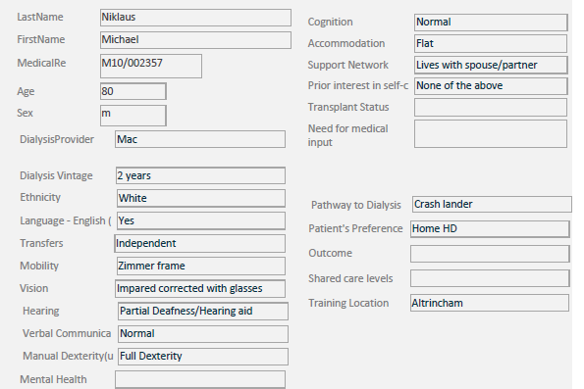
Patient level scoping exercise
Bespoke ACCESS Database
32 parameters of assessment
Demographics
Comorbidity
Impairment/Cognition
Motivation/skills
Social circumstances
Patient Preferred outcomes

Slide 18
Results April 2017 ( in 18 months)
Initial 135 patients analysis
49% chose more independent HD (n=66)
20 Home HD, 46 Self/Shared-care
35 since have shifted their modality
13 trained or training for Home HD in 18 months
2 self-care patients waiting for rehousing
20 patients trained or training for in-centre shared/self-care
HD Modality shift Oct 15 – April 17 | Impact Shift %
Home | +47%
Fully Self Care In-centre | + 79%
Shared-care | + 60%
Discharges from Training unit | x3 fold increase
Drop offs
2 patients stopped training for Shared care,
1 patient failed HHD training,
1 patient failed with Self-care after first 2 weeks
Notes:
Self/Shared care 33, training 7 = 40 pt Home HD 59, training 8 = 67 pts
Total 107 Independent HD , PD 61, rest incentre
20% at Home , 12% of HD at home

Slide 19
Oct 2015 - Jan 2018
ShC Self Care Home
Modality | Oct 2015 | Sept 2016 | Sept 2017 | Jan 2018
Home HD | 36 | 52 | 57 | 63
Self-care | 14 | 21 | 29 | 32
Shared-care Level 2+ | 3 | 5 | 16 | 18
2015 2016 2017 2018
Level of self/shared-care | Tasks performed
1 | BP, pulse, temp, weight, oxygen saturations (if appropriate), document these.
2 | Level 1, plus preparing table, lining machine, priming machine and cleaning arm.
3 | Level 2, troubleshooting with machine alarms, stripping the machine.
4 | Level 3 plus inserting and removing own needles/unlocking or locking central venous catheter, connecting and disconnecting to access and documenting the full dialysis session
Notes:
Self/Shared care 33, training 7 = 40 pt Home HD 59, training 8 = 67 pts
Total 107 Independent HD , PD 61, rest incentre
20% at Home , 12% of HD at home

Slide 20
Barriers and Biases – Main themes
Lack of confidence (in their own ability to train or with regards to their health status)
Change not necessary: Happy where they are and with the present care provided
Concerns for safety
Needling fears
Logistics/Convenience: Travelling to the training unit. No late shift available for training
Home circumstances: No room, Social and personal/relationship issues
Misconceptions (Patients and staff)
  Spare room required at home
  Lone dx not allowed
  AVF required
  Can’t have home dx if got other health problems/co-morbidities

Slide 21
    Summarising My Role
Developed a bespoke database to characterise patient phenotype & preferences
One to one patient contact across the network
Provide education around home dialysis
Troubleshooting barriers at a patient level (Myths and Facts)
Guide patients through the Decision making process [Transition to Training and discharge]
Support to unit nursing teams for shared-care and the ShareHD initiative
Handover to the home teams customised to individual preferences
Reporting of data to Senior management

Slide 22
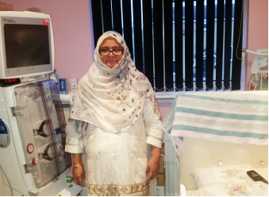
ICHD.. to ShC HD.. to HHD
“I was on regular hospital dialysis for 2 ½ years. I then did shared-care on my unit. This gave me confidence to change to home dialysis. I can now fit the dialysis around my life. I feel better and healthier on home dialysis”

Slide 23
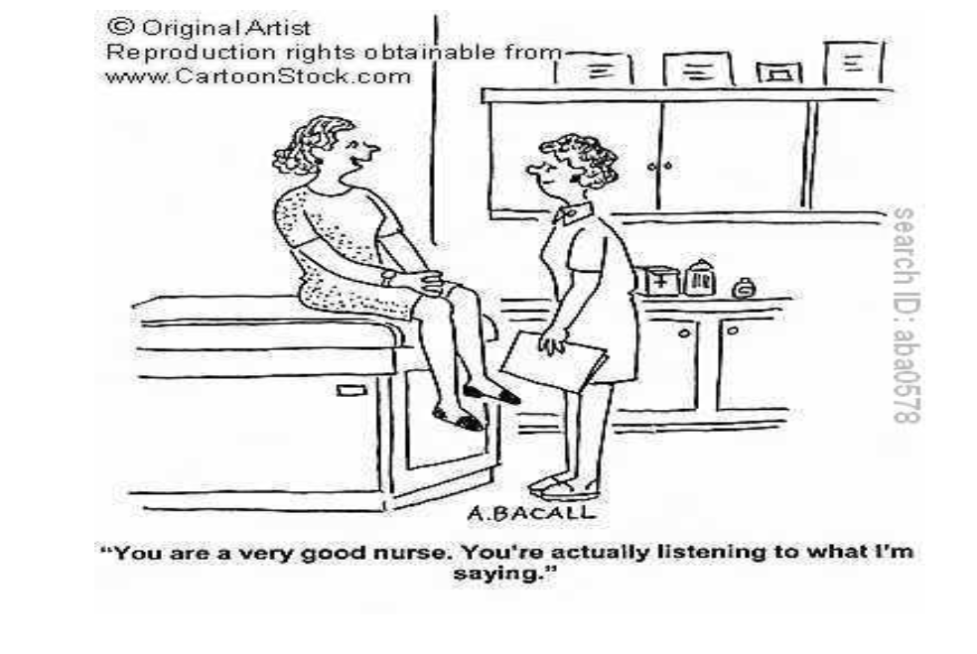
A Take home message
Notes:
A scoping model introduced successfully, Introduced Train the trainer programme for sustainability
49% HD patients opted to shift care modality
Significant impact on the training and home pathway

Slide 24
Home dialysis
Breakout session

Slide 25
What do we want to think about?
Consider the challenge
  Diagnostics
    Do we know why we are where we are?
    What should we measure?
  Can we identify aspects of practice to generate change?
    What do we do well?
    Where can we learn from?
  How do we do it?

Slide 26

Where are we now?

Slide 27
Think about patient flow
Plan dialysis access - insert PD catheter
Start PD pathway
Screen low clearance, Prevalent HD, Incident HD, Failed Tx
Assess for suitability– clinical, patient factors and home suitability
Patient and MDT sign off for PD pathway
Identify potential PD patients through shared decision making
Selection
Initiation
Maintenance
Drop out
Figure 4 PD pathway adapted from Perit Dial Int. 2013 May-Jun;33(3):233-41.
doi: 10.3747/pdi.2012.00119.Peritoneal dialysis and the process of modality selection.
Blake PG, Quinn RR, Oliver MJ.

Slide 29
Project structure
‘Co production’ – patients involved at the start and at every level
A regional team to coordinate the work, representative of the region
Each centre to form a project team
Support from KQuIP
  Project management, expertise, measurement

Slide 30
The project cycle
Research and discovery
  Consider barriers and evidence
Consider solutions and ideas
  Long list
  Short list
Test ideas
  Test, evaluate, share
Review and report then repeat process

Slide 31
Your task: think about the change model
For each of the elements of the change model consider what you need to do, within your centre and across the region.
Concentrate on measurement, leadership and how you will engage and spread across the region and within your service
Metrics – process, outcomes, balancing measures

Slide 32
KQuIP/UKRR Regional Day
  North West
  12:30 – 13.20
  Group Work – Review of Home Therapies data locally

Slide 33
KQuIP/UKRR Regional Day
  North West
  Group Work Questions for Consideration:
  What is the data telling us, what works well and what are the important issue’s to address?
  Do we need any more data? What are the barriers?
  Have we any examples of interventions that worked and where is the evidence?
  What are the next steps?

Slide 34
KQuIP/UKRR Regional Day
  North West
  13:20 – 13:50
  Feedback from each group

Slide 35
KQuIP/UKRR Regional Day
  North West
  13:50 – 14:20
  Lunch and refreshments

