Slide 1
KQuIP/UKRR Regional Day
  North West
  14:20 - 14:50
    Vascular Access Data presentation – Dr Retha Steenkamp Data presentation
    Our Vascular Access experience - Vicky Ashworth
    KQuIP & MAGIC - Vascular Access – Katie Fielding, Project Lead

Slide 2

Vascular Access Data Session
North West Regional Day
Retha Steenkamp
Head of Operations UKRR

Slide 3

Vascular Access Audit Methods
All adult patients in renal centres in England, Wales and Northern Ireland
Provide vascular and peritoneal access data for patients on dialysis
The Vascular Access Audit Report does not include AKI patients
Incident data at patient level
Prevalent data in centre level
1 year PD follow-up data
Notes:
3

Slide 4
Vascular Access Audit Standards
60% of incident patients commencing planned HD should receive dialysis via a functioning AVF/AVG
80% of all prevalent long-term dialysis patients should receive dialysis treatment via definitive access: AVF/AVG or PD
Notes:
4

Slide 5

AVF/AVG % of incident dialysis patients
Centre | 2012 | 2013 | 2014 | 2015 | 2016 | 2017
Liv Ain | 57.9 | 50.0 | 41.3 | 27.7 | 23.8 | 29.8
Liv Roy | 31.5 | 32.8 | 28.7 | - | 17.6 | 42.5
M RI | 37.7 | - | 22.9 | - | 15.7 | 48.1
Prestn | 41.7 | 41.4 | 36.2 | 29.5 | 31.4 | 37.7
Salford | 41.2 | 42.3 | 32.1 | 23.2 | 14.2 | 23.6
Wirral | 28.1 | 39.4 | 28.9 | 25.0 | 24.3 | 35.3
UK | 31.8 | 32.6 | 30.9 | 30.3 | 23.7
Notes:
5

Slide 6
AVF/AVG % of incident HD patients
Centre | 2012 | 2013 | 2014 | 2015 | 2016 | 2017
Liv Ain | 73.3 | 66.7 | 53.1 | 43.9 | 35.2 | 39.0
Liv Roy | 46.9 | 50.0 | 36.8 | - | 39.0 | 42.5
M RI | 64.4 | - | 32.9 | - | 21.3 | 48.1
Prestn | 46.7 | 52.7 | 45.1 | 35.2 | 44.0 | 37.7
Salford | 55.3 | 57.3 | 44.2 | 29.2 | 24.0 | 38.7
Wirral | 39.1 | 53.1 | 32.5 | 31.1 | 30.9 | 35.3
UK | 40.9 | 41.8 | 39.2 | 38.4 | 28.9
Guideline 60%
Notes:
6

Slide 7
NTL % of incident dialysis patients
Centre | 2012 | 2013 | 2014 | 2015 | 2016 | 2017
Liv Ain | 15.8 | 11.7 | 22.2 | 6.2 | 18.8 | 46.7
Liv Roy | 6.8 | 13.1 | 12.6 | - | 9.2 | 11.3
M RI | 0.0 | - | 30.3 | - | 32.2 | 0.0
Prestn | 13.3 | 12.9 | 20.5 | 20.2 | 25.0 | 29.6
Salford | 4.4 | 0.9 | 13.7 | 19.7 | 19.2 | 15.4
Wirral | 25.0 | 22.7 | 46.7 | 32.1 | 54.4 | 64.7
UK | 16.9 | 16.5 | 19.8 | 19.9 | 31.0
Notes:
7

Slide 8
TL % of incident dialysis patients
Centre | 2012 | 2013 | 2014 | 2015 | 2016 | 2017
Liv Ain | 5.3 | 13.3 | 14.3 | 29.2 | 25.0 | 0.0
Liv Roy | 28.8 | 19.7 | 36.8 | - | 18.3 | 46.2
M RI | 20.8 | - | 16.5 | - | 25.8 | 51.9
Prestn | 34.2 | 24.1 | 23.6 | 34.1 | 15.0 | 32.7
Salford | 28.9 | 30.6 | 26.7 | 36.6 | 25.7 | 22.0
Wirral | 18.8 | 12.1 | 13.3 | 23.2 | 0 | 0
UK | 29.1 | 28.9 | 28.0 | 28.7 | 27.3
Notes:
8

Slide 9
AVF/AVG % of prevalent dialysis patients
Centre | 2012 | 2013 | 2014 | 2015 | 2016 | 2017
Liv Ain | - | - | - | - | 79.9 | 72.2
Liv Roy | - | - | - | - | 92.0 | 76.3
M RI | - | - | - | - | - | 58.3
Prestn | - | - | - | - | 47.9 | 76.0
Salford | 63.9 | 67.2 | 68.9 | 58.9 | 55.6 | 54.4
Wirral | - | 59.9 | 65.7 | 62.8 | 70.3 | 66.8
UK | 62.4 | 61.2 | 56.7 | 54.8 | 67.7
Notes:
9

Slide 10
AVF/AVG/PD % of prevalent dialysis patients
Centre | 2012 | 2013 | 2014 | 2015 | 2016 | 2017
Liv Ain | - | - | - | - | 79.9 | 84.4
Liv Roy | - | - | - | - | 92.0 | 76.3
M RI | - | - | - | - | - | 69.2
Prestn | - | - | - | - | 47.9 | 76.0
Salford | 85.8 | 88.7 | 87.8 | 79.4 | 76.4 | 76.0
Wirral | - | 76.1 | 76.8 | 74.4 | 70.3 | 66.8
UK | 82.3 | 79.0 | 73.6 | 72.6 | 67.7
Guideline 80%
Notes:
10

Slide 11
TL/NTL % of prevalent dialysis patients
Centre | 2012 | 2013 | 2014 | 2015 | 2016 | 2017
Liv Ain | - | - | - | - | 20.1 | 15.6
Liv Roy | - | - | - | - | 8.0 | 23.7
M RI | - | - | - | - | - | 30.8
Prestn | - | - | - | - | 52.1 | 24.0
Salford | 14.2 | 11.3 | 12.2 | 20.6 | 23.6 | 24.0
Wirral | 0.0 | 23.9 | 23.2 | 25.6 | 29.7 | 33.2
UK | 17.7 | 21.0 | 26.4 | 27.4 | 32.3
Notes:
11

Slide 12

Acknowledgements
Thank you to all renal units that submit data to the UKRR
Thank you also to all the people at the UKRR who work in the background to make all this possible.

Slide 13

Our Vascular Access Experience
Tilly Leach (VAN) Vicky Ashworth (ANP)

Slide 14
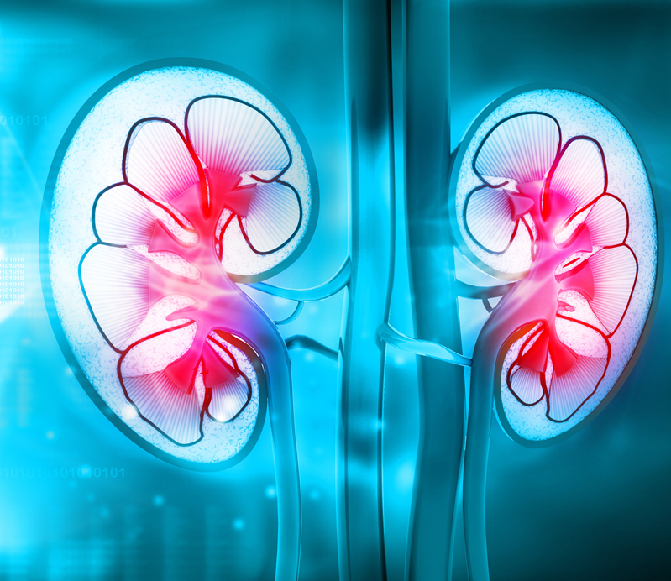
Outline
Vascular access audit past and present
Past process
Current process
Low clearance clinic
1st dialysis pathway

Slide 15
New Starters working AVF/AVG
2015 | 2016 | 2017
24% | 31% | 44%

Slide 16
Audit Jan – Dec 2017
106 new starters
40 patients unpredictable | 66 RRT choice (HD)
17 AKI/CKD3-4/ crashlanders | 45 working AVF/AVG
15 unplanned conversion PD | 14 AVF/AVG not ready to use
4 change of RRT | 7 no access plan
68%

Slide 17
Prevalent Patients AVF/AVG
Jan 2015 | June 2016 | Jan 2018
???? | 69% | 77%

Slide 18
Current Population
Site | Patients | AVF/AVG | PNL
Royal | 147 | 94 | 53
Broadgreen | 78 | 65 | 13
Halton | 35 | 31 | 4
Warrington | 44 | 37 | 7
St Helens | 50 | 41 | 9
HHD | 43 | 37 | 6
 | 397 | 305 | 92
Total |  | 77% | 23%
 |  |  | 22 AVF maturing 53 unable to have AVF/AVG 17 in work up for AVF/AVG

Slide 19

In the past
Unstructured
Un coordinated
Prone to congestion

Slide 20
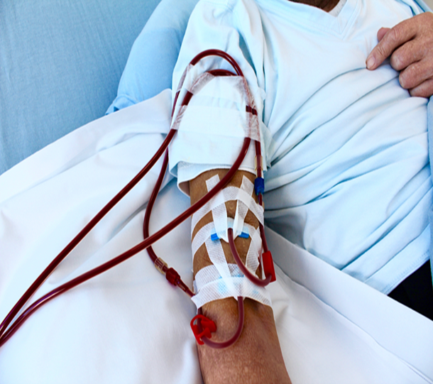
Full time vascular access nurse
Focus on all patients having a working AVF/AVG starting HD
Controlling vascular access pathway
Up to date spreadsheet, checked at weekly intervals
Weekly MDT – to address access issues in a time appropriate fashion

Slide 21

Low clearance clinic NOV 2014
MDT
Consultant
Vascular access surgeon
Pre dialysis nurse
Dietician
ANP
Focus on transplant first, RRT plan, Access, Education, Support

Slide 22
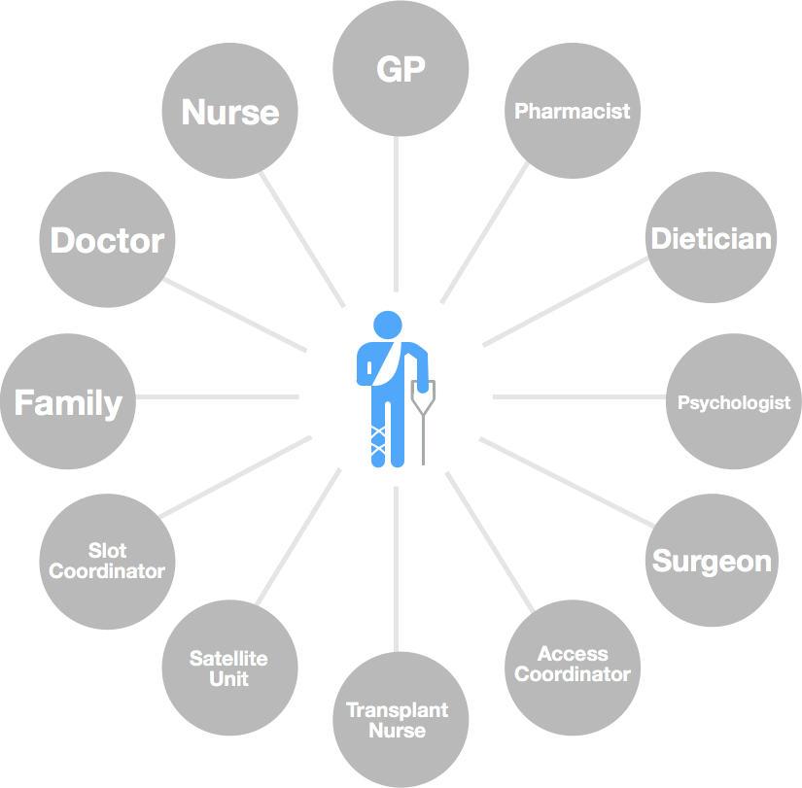
Complex Transition period
Delivery of care is multi-disciplinary and complex
Multiple needs

Slide 23

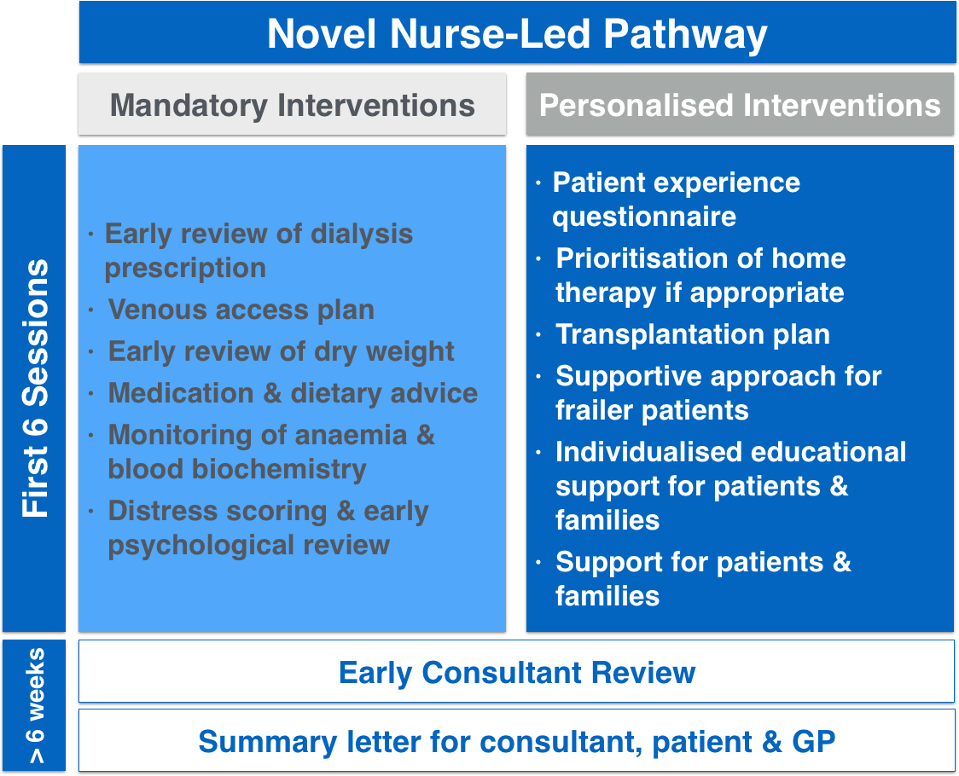
Nursing intervention

Slide 24
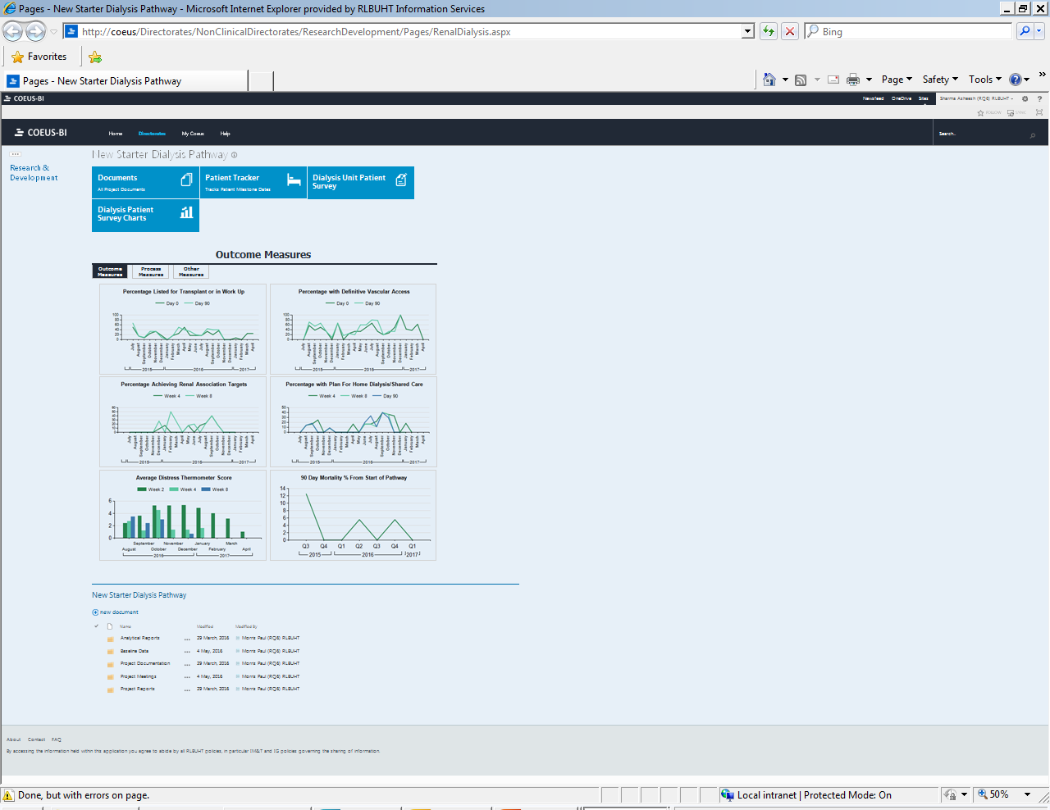
Monitoring the patient
Bespoke dashboard
Developed with Business Intelligence team

Slide 25
Patient Demographics
 | Control group | New pathway
Patients (n) | 78 | 94
Mean age (SD) | 58.4 (15.6) | 60.5 (14.1)
% male | 62% | 59%
% diabetic | 45% | 43%
Mean eGFR starting HD (SD) (ml/min) | 8.6 (2.7) | 7.7 (2.4)
% definitive vascular access at day 0 | 31% | 44%

Slide 26
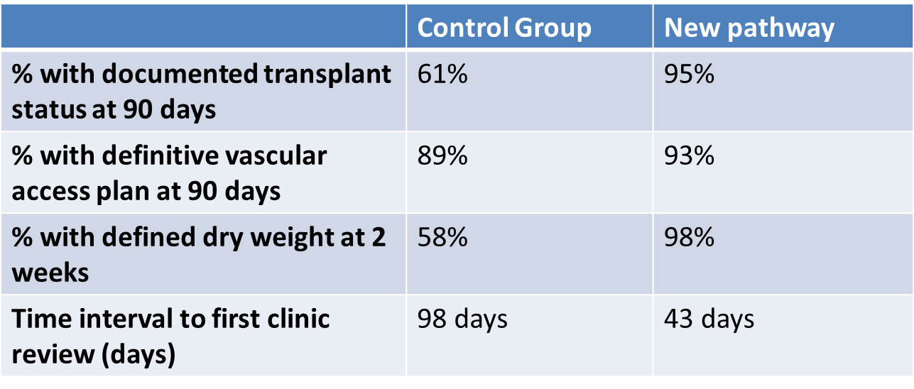
Improved Process

Slide 27
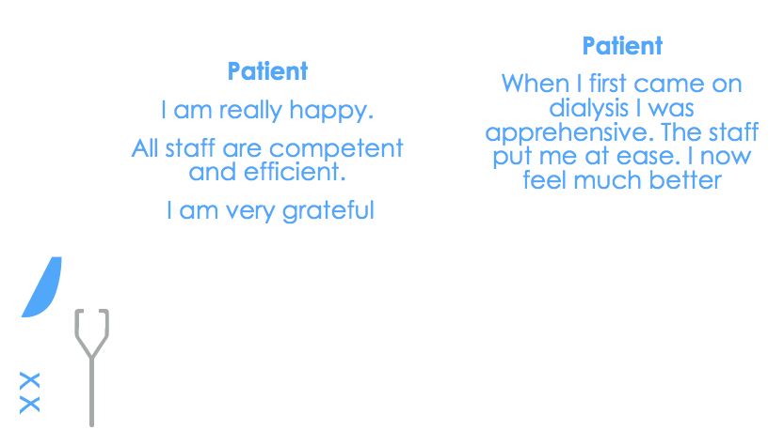
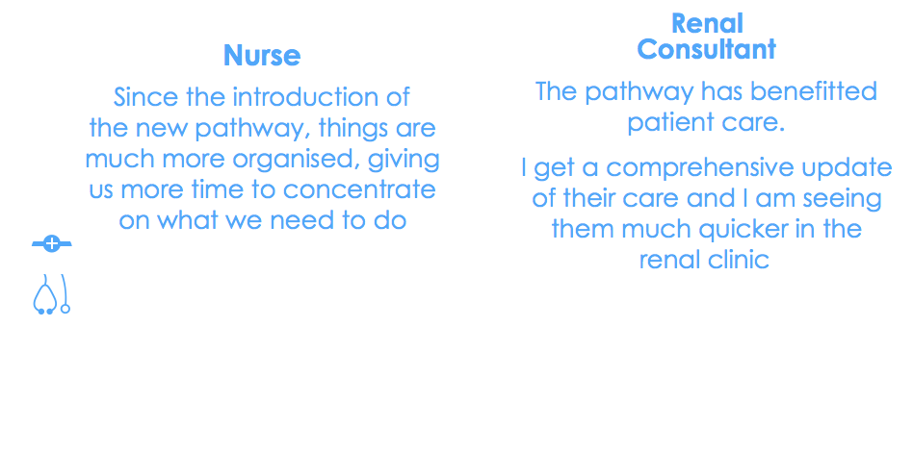
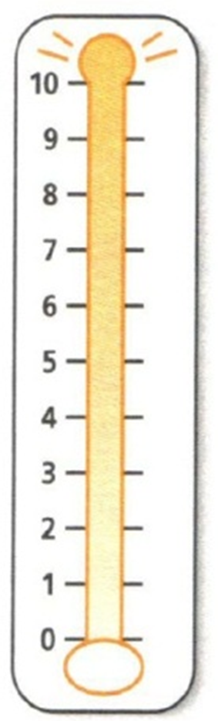
Improved Experience: PREM questionnaire and distress thermometer
Patient distress diminished from a score of 4.3 (week 2) to 2.4 (week 8)
Patient feedback has been strongly positive

Slide 28
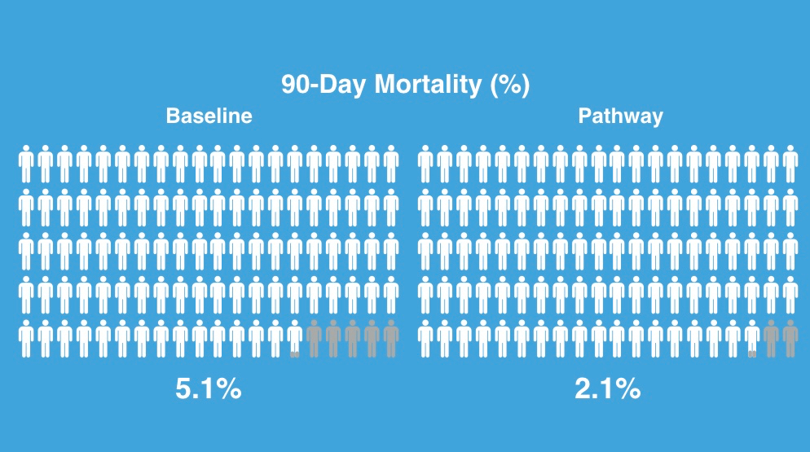
58% reduction in unadjusted mortality
Notes:
Ash

Slide 29


The new process
Vascular Access
May 2015
1st Dialysis
Pathway
June 2015
Low Clearance
Clinic
Nov 2014
ANP/VAN overseeing patient pre and transitioning onto haemodialysis

Slide 30
Next steps….
Continue to improve performance
Acknowledge the challenges around maintaining vascular access and strive for best practice
Nurse patient education crucial
Aim to provide the best for our patients

Slide 31


Slide 32

Managing Access by Generating Improvements in Cannulation
Katie Fielding,
Co-Chair, BRS VA
Professional Development Advisor – Haemodialysis, Derby Teaching Hospitals NHS Foundation Trust
MDT Fellow, UK Renal Registry
Co-Chair, Measurement and Understanding Workstream, KQuIP
Notes:
Introduce self
I would like to tell you about MAGIC which is KQuIP’s project to improve VA for HD

Slide 33
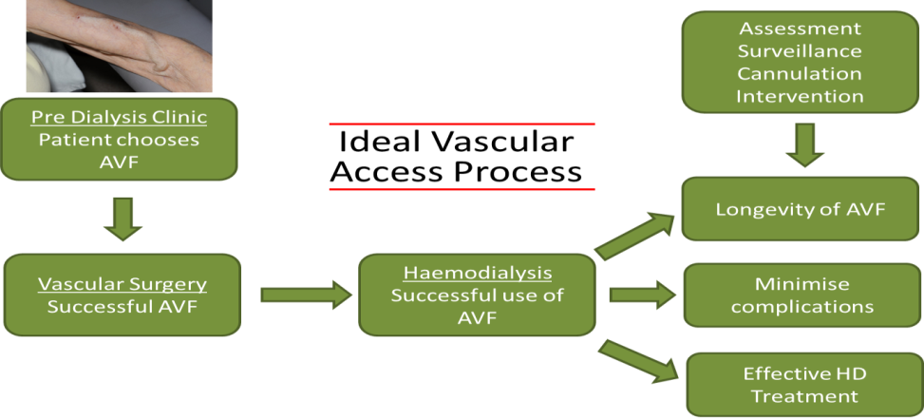
AVF/G is gold standard for VA
RA audit standards recommend 80% of prevalent dialysis patients dialyse via AVF, AVG or Tenckhoff
Huge variation across the UK
Notes:
We know the RA standards
Seems a simple statement but we know there is a complex pathway behind it – go through diagram
We know there is huge variation across the UK – how do we improve this
Regardless of your opinion of this – there is over-whelming evidence that AVF is best for majority of patients and no evidence to say who it is and isn’t good for – whilst there maybe a selection of pts it is not good for how can we make non-evidence based judgements – this is people’s lives we are talking about
Need to develop some common sense about VA
Many steps to achieving definitive access – I’m going to focus on VA for HD but still numerous steps - go through briefly.
Often focus on VA surgery steps, possibly as it is not our problem ---- next slide

Slide 34
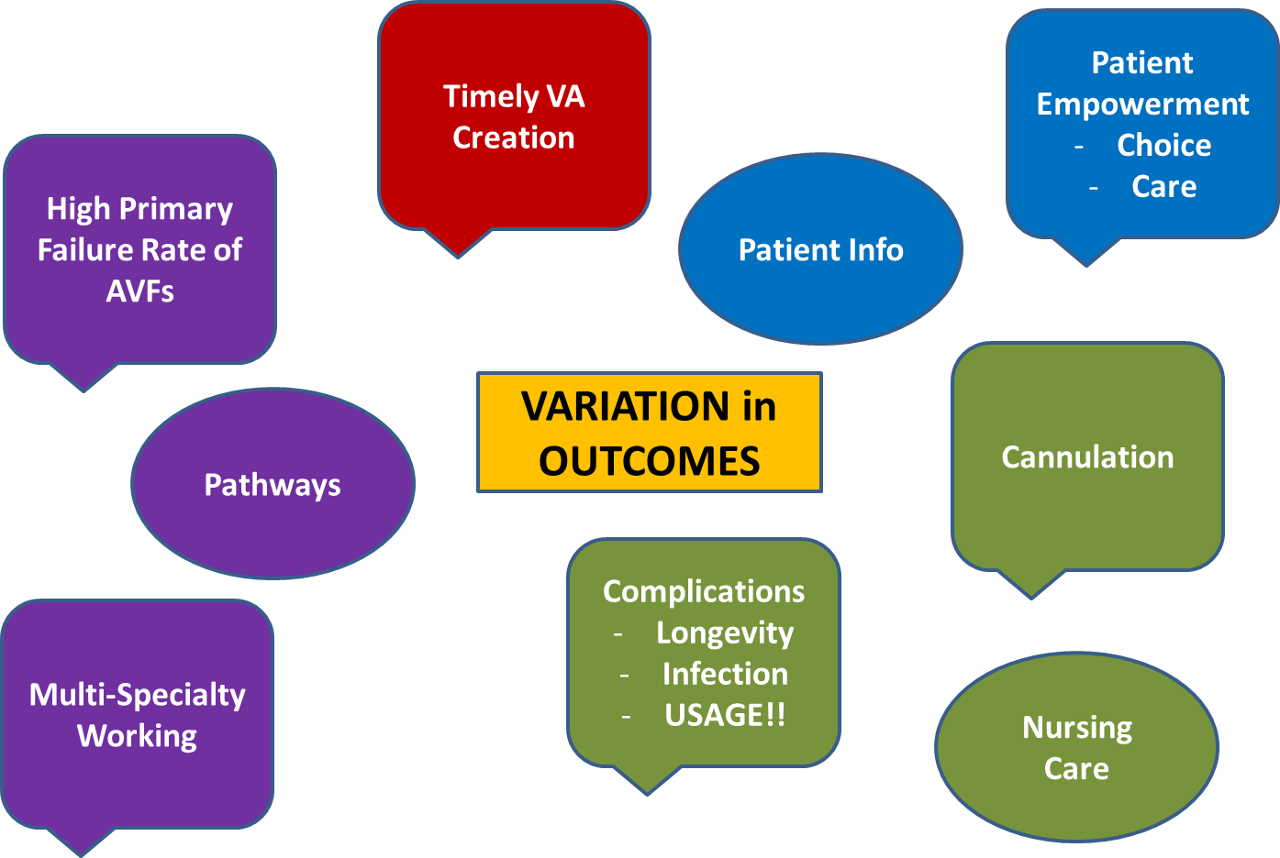
There is more to AVF/G use than Vascular Surgery!!
Cannulation is the centre of AVF/G rates
AVF/Gs are formed to be used
Prevention is better than cure
Cannulation affects:
Longevity of AVF/Gs
Patient experience of HD
We can improve cannulation practice
Notes:
Many aspects to achieving good VA care
Maybe that’s why we haven’t got to the bottom of good AVF rates as we don’t consider all of this
Go through briefly
I’m interested in cannulation – mainly because the reason we have AVF/G formed is cannulate them – without that aspect meaningless
Cannulation damages AVF/G – need to minimise

Slide 35
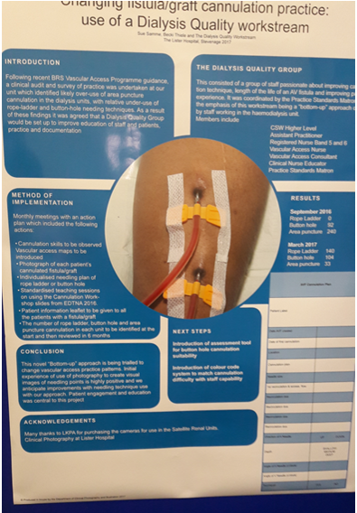
The Problem with Cannulation
65.8% of cannulation was area puncture
(Parisotto, 2014)
Initial PREM results indicates needling is a problem
Variation in practice across the UK
  Buttonhole v. Rope Ladder
Notes:
Buttonhole v. rope ladder – why do some units get infections and others don’t – lack of consistency of practice – don’t want to get into debate about what is right and wrong

Slide 36
MAGIC
Core structure of a quality improvement programme
  Allow adaption at regional and unit level
  BRS / VASBI / KQuIP collaboration with regions
Aim: To improve prevalent AVF/G rates:
  Improve cannulation to preserve AVF/G function
  Make AVF/G more attractive through better patient experience
  Develop structures to support good VA care

Slide 37

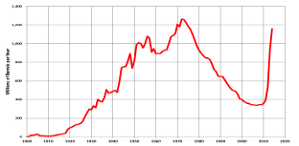

Core Structure
Leadership MAGIC Regional Network
Needling Champion
Haemodialysis Nurse
VA Appraisal Lead
Nephrologist / Surgeon
Measurement
Monthly clinical outcomes
Run Charts
Evaluate MAGIC
Materials
Slidesets + lesson plans
ELearning
Competency document
Awareness materials for patients
VA Scorecard Appraisal
with PDSA cycles
Notes:
Start with leadership, then measurement then materials

Slide 38
Phased Approach
Baseline Measures
Education from KQuIP
Phase 1
Education from KQuIP
Phase 2
Phase 4
Phase 3
Peer Review
Education from KQuIP
Education Materials + PDSA 1 VA appraisal
AVF/G rates, AVF/G loss, infection, needling technique used, patient experience of needling, missed cannulation, appearance of AVF/G
Competency Document + PDSA 2 VA Appraisal
Awareness Materials + PDSA 3 VA Appraisal
Region designed QI
Leadership, PDSA, Managing change, Run Charts
Peer Review, Maintaining Momentum, Creativity
Share learning across region
Sustainability, Statistical process control charts and other measures, continuing infrastructure
MAGIC Network (3 monthly) + Monthly Measures
Notes:
Phased approach
Go through 4 phases
Has educational structure from MAGIC around it
Running through it will be the MAGIC regional network and monthly measures
Animated – hope by end of the project you will have skills and ability to continue doing this yourselves – leave you with leadership skills, network and measures to do it yourselves and continues with PDSA cycles

Slide 39
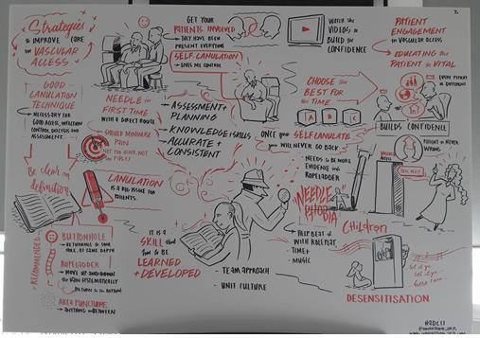

Website - www.thinkkidneys.nhs.uk/kquip/magic/
Facebook - www.facebook.com/groups/1918050308446120/
Twitter - twitter.com/HaemodialysisVA
Scottish VA Appraisal - http://www.srr.scot.nhs.uk/Projects/PDF/2015/Scottish-Renal-Registry-vascular-scorecard-151117.pdf
Notes:
To summarise, MAGIC is about needling AVF/G, which is the central element of definitive VA for HD
Its about doing this well to promote AVF/G longevity and patient expereince
Relevant to adults and paediatrics
Relevant to AV fistulae and grafts
Based on BRS / VASBI Needling Recommendations
Consensus base
We have webpage, twitter and facebook page – also link to the scorecard which came Scottish VA appraisal
This image here is from the Home Therapies meeting – summarises what MAGIC is about

Slide 40
KQuIP/UKRR Regional Day
  North West
  14:50 – 15.40
  Group Work – Review of Vascular Access data locally

Slide 41
KQuIP/UKRR Regional Day
  North West
  Group Work Questions for Consideration:
  What is the data telling us, what works well and what are the important issue’s to address?
  Do we need any more data? What are the barriers?
  Have we any examples of interventions that worked and where is the evidence?
  What are the next steps?

Slide 42
KQuIP/UKRR Regional Day
  North West
  15:40 – 16:10
  Feedback from each group

Slide 43

Kidney Quality Improvement Partnership (KQuIP)
Closing Statement and
Next Steps
Graham Lipkin
Co-chair of KQuIP

Slide 44
Review of Key Outcomes:
Know your data
Identify your Unit QI leads: Medic and MPT
Decide on your Unit Key priority project
Feel supported to embed QI in your practice
What’s Next?

Slide 45
What do I do next - as Part of KQuIP?
Communication: Sign up to KQuIP to stay informed
Structure: Define and work with your QI leads within your Unit
Support: Explore local QI & PM resource within Trust to support you
Teams: Agree project lead for your key QI Focus and
    build small steering group team

Slide 46
Which National KQuIP Priority Project?
    Improving access to kidney transplantation; Transplant First
    Transplant First, developed in West Mids under KQuIP. Now packaged.
    Improving access to home therapies for suitable patients
      Home Therapies project to launch in 2018 with West and East Midlands regions
    Improving Vascular Access – Managing Access by Generating Improvement to Access (MAGIC)
    Yorkshire and Humber region to commence project early 2018

Slide 47
KQUIP Support following today?
Regional QI Days Report
NW Region Webpage-talks and data
Project management support - Vicky/James
KQuIP Hub-talks and data
NW Regional Delivery strategy

Slide 48
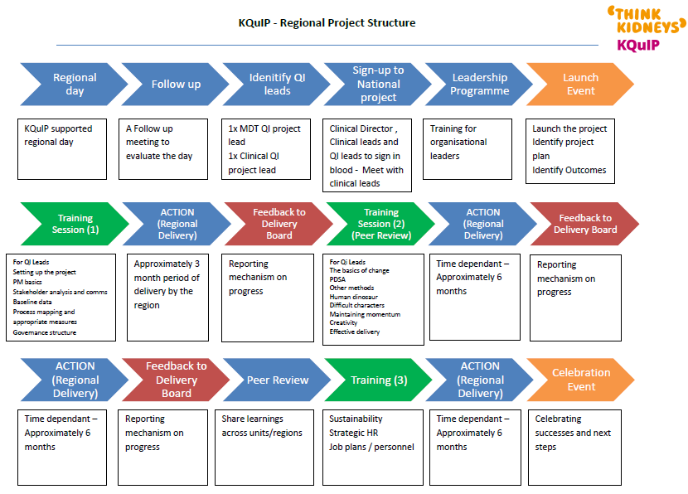
KQuIP NW Regional Delivery Support Plan

Slide 49

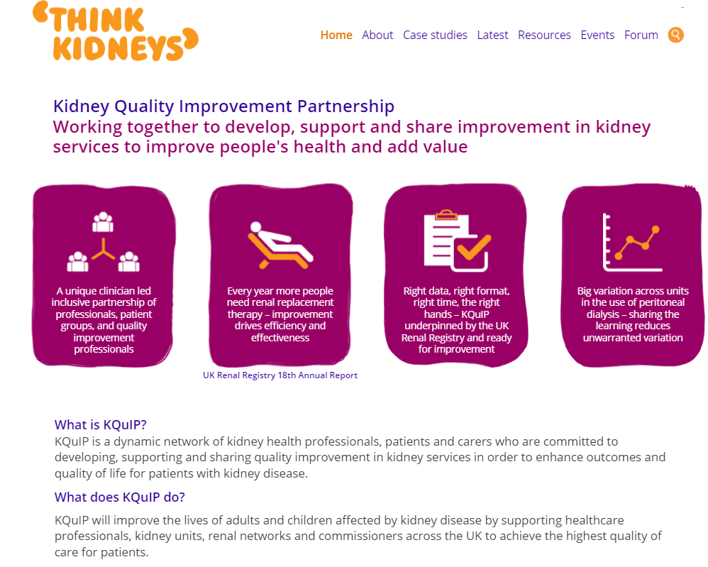
KQuIP welcomes you…
…enabling you and your team to improve quality and safety
www.thinkkidneys.nhs.uk/kquip/
Kidney Quality Improvement Partnership – Graham Lipkin

Slide 50
Have a good
Journey Home

