Slide 1
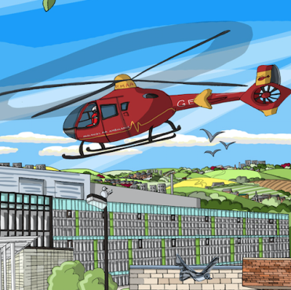
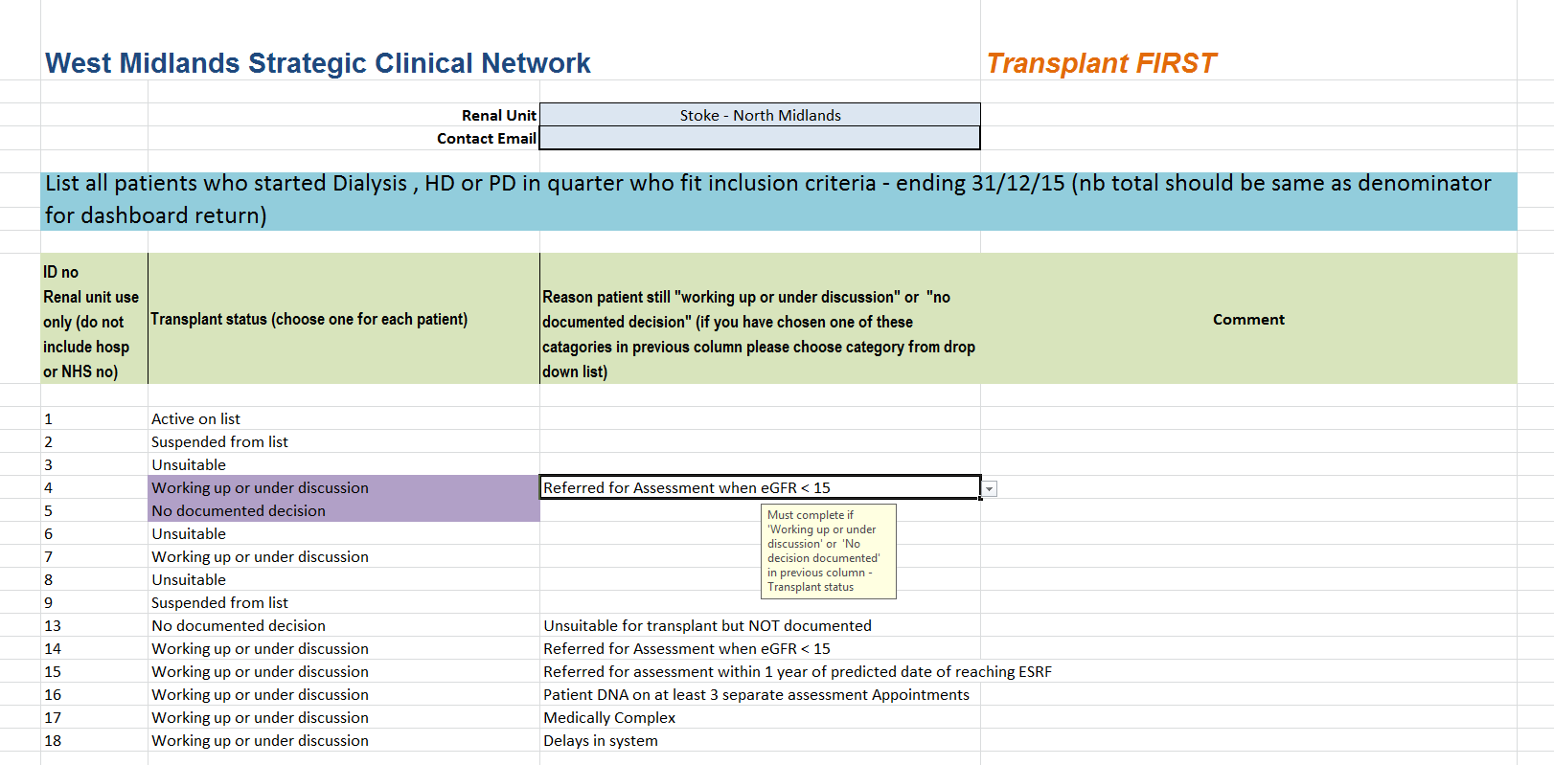
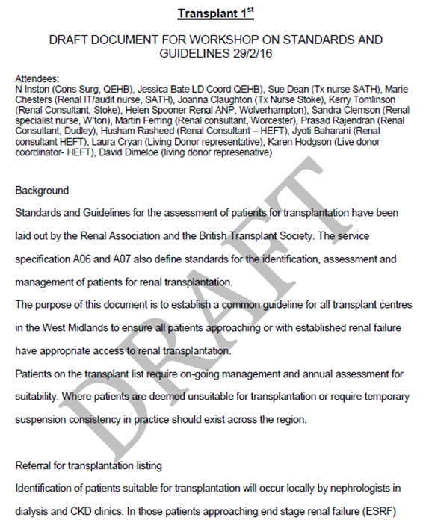
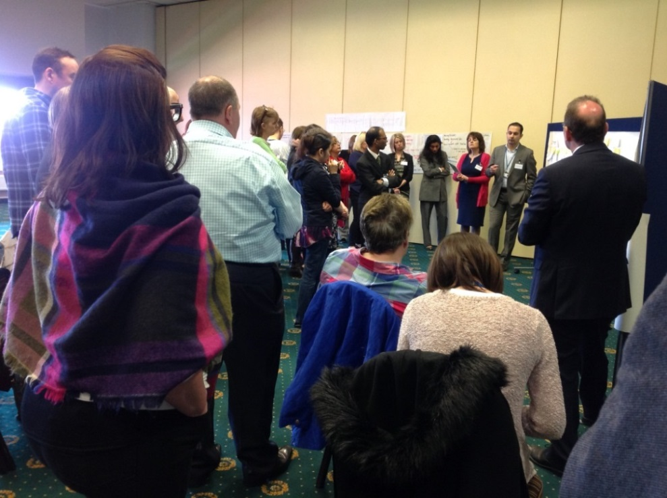
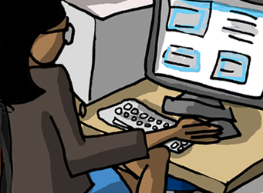
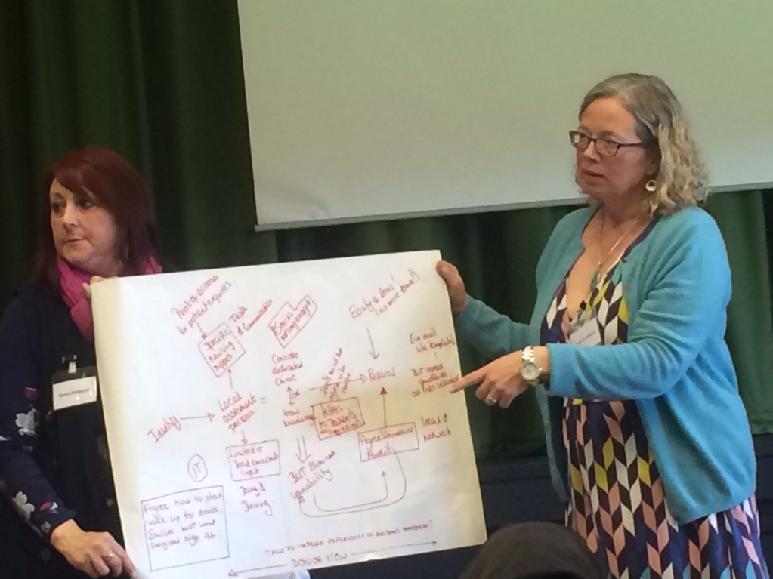
Transplant First: Addressing inequality of access to transplantation across the West Midlands
West Midlands Clinical Network
AUTHORS: Dr Kerry Tomlinson, Project Co-Lead for Transplant First and Clinical Lead & Consultant Nephrologist, UHNM
Cecily Hollingworth, Quality Improvement Officer, West Midlands Clinical Network
Helen Spooner, Project Co-Lead & Advanced Nurse Practitioner, Royal Wolverhampton NHS Trust
INTRODUCTION: Renal Registry and NHSBT data have highlighted major concerns with access to transplantation in our region, specifically rates of pre-emptive transplant listing and transplantation, time to listing, wait time while listed, and consequently overall transplant rates were worse in the West Midlands than the national average. A multi- disciplinary region wide project was set up in May 2015 to address these problems with the aim of improving access to transplantation and reducing exaggerated wait times. Early progress is reported here.
Further members of Sponsor team :
Dr Clara Day, Renal Clinical Director, West Midlands Clinical Network
Mr Nick Inston, Renal Surgery – Consultant, UHBFT
Dr Nithya Krishnan, Consultant Transplant Nephrologist, UHCW
Ron Cullen, Chief Executive, UK Renal Registry
Dr David Dimeloe, Donor Representative
OUTCOMES: At the launch event in June 2015 data was shared showing variable median times to transplant listing. Elements of local changes in practice that had contributed to reduced time to listing included dedicated listing clinics, low eGFR MDTs and good IT. Barriers to improvement were identified as poor IT, time taken to collect data and audit, delay in cardiac investigations and patient DNA rate. An enhanced Quality dashboard, to run in parallel with the NHSE dashboard, including a brief RCA for all patients who miss transplant listing at the start of RRT has been developed in conjunction with the RR. Data collection began in February 2016.
Pathway redesign workshops involving training in QI and real time support for units making change ran in Feb and April 2016. Units reported already making changes to pathways with further changes planned. Simple solutions such as adding mobile numbers to referral letters and authorising early workup of donors were identified, while other more challenging work will go on at the various units.
Groups are working on Standards and Patient information with the aim of increasing clarity and pooling scarce resource. In addition to the overarching project aims, specific goals have been set which are:
95% of CKD5 patients will have a documented transplant decision
95% of know patients starting RRT will have a transplant status
>50% of listed patients will be listed pre-emptively
The West Midlands will have the highest rate of pre-emptive transplant listing in the UK
West Midlands transplant units will be in the top 50% nationally for pre-emptive transplants
In conjunction with the RR, ‘Donor View’, an online programme to support live donors through the donation process, is in development.
Patients have contributed a powerful voice and been a vital element of the project.
METHODS: The project encompasses all renal and transplant units across the region. CEOs from each Trust have given commitment to the project. The project has been facilitated by the West Midlands Clinical Network (WMCN) and endorsed by the Renal Registry (RR), ODT and KQUIP. The sponsor team is multidisciplinary and patients are included at every level and in every work stream (Data, Pathways, Standards, Patient information and Education). The project aims to equip each contributing unit with the means and skills to improve quality. Data shared openly, Quality Improvement training provided, information and guidance as well as good practice shared. Each unit is in turn able to identify whatever local solutions and changes are required.
Donor View
CHALLENGES: Although the project has given permission for teams to take time out, they see this as a scarce resource and need the time to be used productively. Resource in terms of clinic time, staffing levels and, at times, money is seen as a barrier to some changes. As with any large group there have been tensions and conflicting views but the process of running the project has allowed these to be openly discussed and, in general, agreement reached. Process mapping events made it clear that individual behaviour can make change difficult but can be actively changed.
CONCLUSION: In this project a large multidisciplinary team are striving to improve access to transplantation for patients in the West Midlands. The West Midlands renal community has a history of delivering whole scale change, for example in improving access to home therapies. This project demonstrates the vital role of Clinical Networks in delivering Quality Improvement. In addition to benefits for local patients, there is an opportunity to roll out learning (lessons for a large QI project) and resource (e.g. enhanced data collection) nationally at the conclusion of the project. Our patients and partners (RR, ODT, KQuIP, NHS England) await the outcome with interest.
Service Delivery, Quality & Innovation

