Slide 1
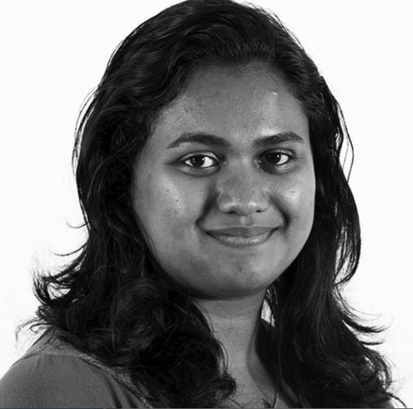
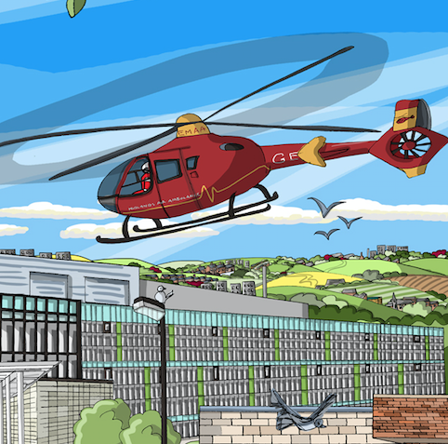
Transplant first: Addressing inequality of access to renal transplantation across the West Midlands
Kerry Tomlinson on behalf of sponsor group
UKKW 2017

Slide 2
Content
Background
Is it working
What we did
Lessons learnt
Next steps and KQUIP roll out

Slide 3
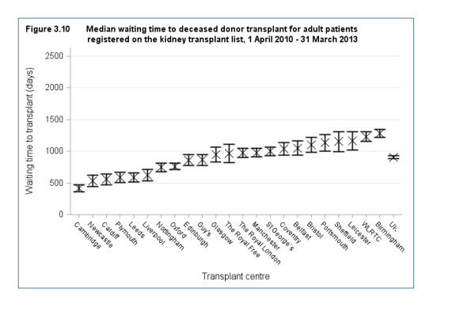
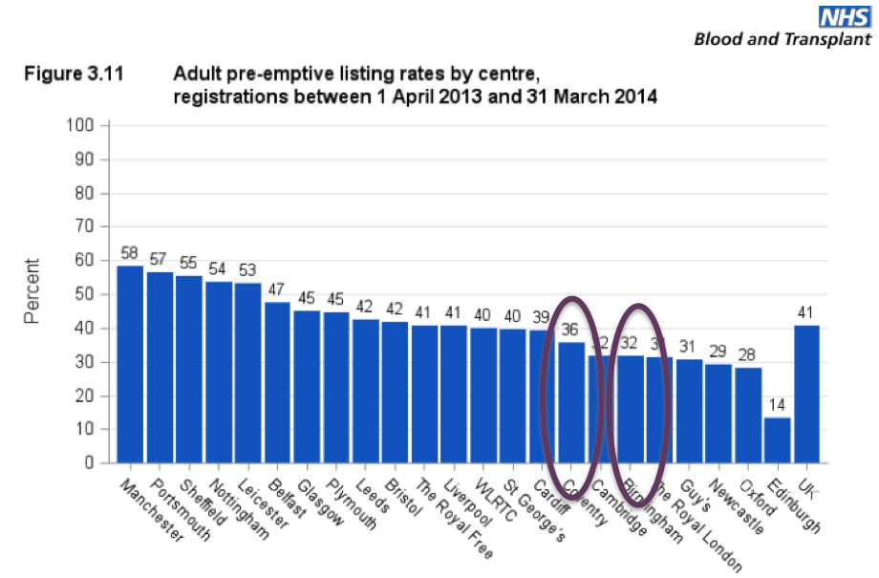
Background: identifying the problem
  UK RR 2014 report median time to listing
  488, 598, 641, (683), 712, 765, 787, 867

Slide 4
Project Background
Proposed to and adopted by West Midlands Cardiovascular Strategic Clinical Network (Renal Expert Advisory Subgroup)
Aims to:-
  lead to a progressive reduction in the excessive waiting times to renal transplantation in the West Midlands
  Improve access to renal transplantation for all patients in the west midlands
Full mandate and documents on website www.wmscnsenate.nhs.uk
The project will not disadvantage existing dialysis or transplant listed patients
www.thinkkidneys.nhs.uk/kquip/transplant-first/

Slide 5
What will we achieve? (Is it working?)
West Midlands will achieve >95% patients starting RRT with a transplant status
The West Midlands will have the highest rate of pre-emptive listing in the UK
The wait for deceased donor kidneys in the West Midlands will be in line with the national average or better
We will be in the top 50% of transplant units for pre-emptive transplants
95% of all CKD 5 patients will have a documented transplant decision
> 50% of patients will be listed pre-emptively

Slide 6
% of CKD 5 patients with recorded transplant status on IT system

Slide 7
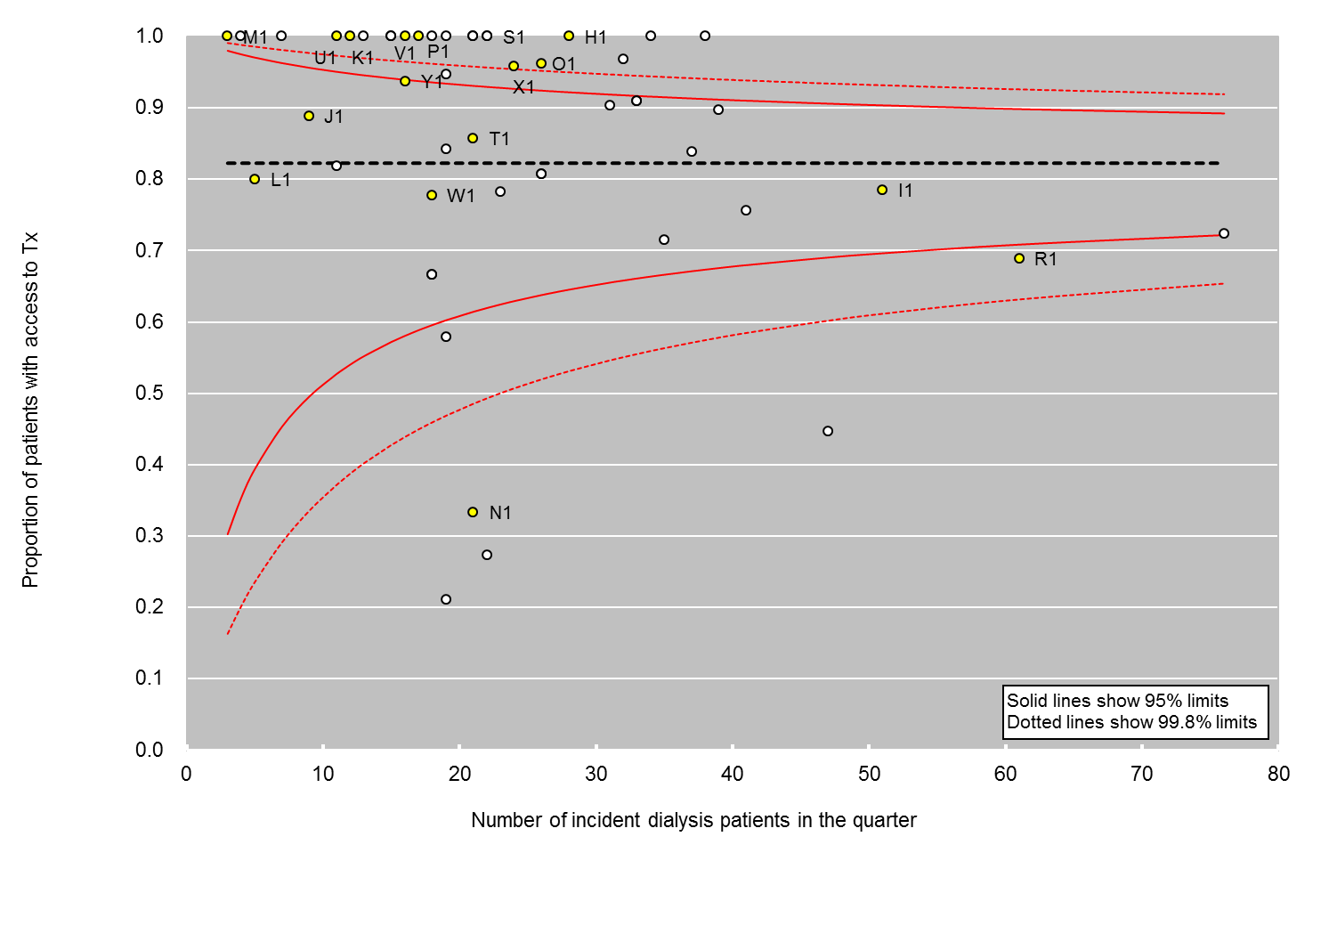

Slide 8
UHB listings from all units

Slide 9
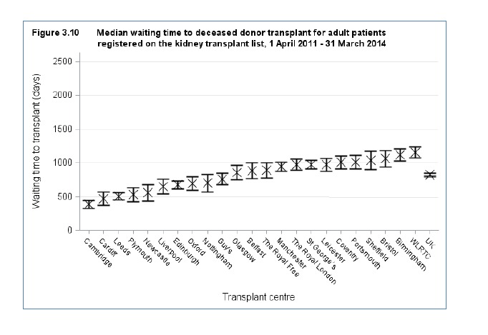
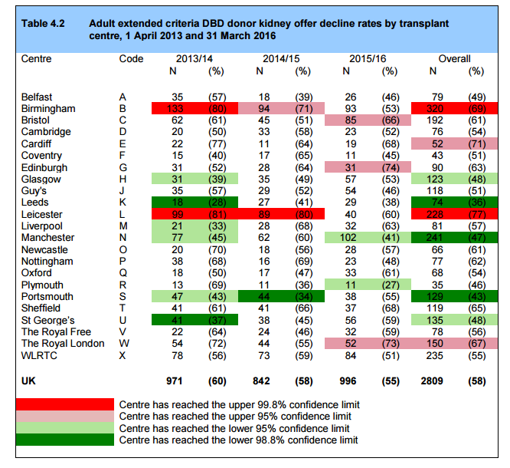
Median days from listing to transplant | UHB | Coventry
2016 | 1121 | 1008
2015 | 1542 | 1056

Slide 10
Self reported pre-emptive kidney alone transplant rates (note includes transplants outside the region)

Slide 11
What did we do?
Project events
Transplant Units
Renal Units
Patients and carers
External experts
SCN/KQUIP
Launch event
July 2015
Pathway Redesign 1
Pathway redesign 2
Audit/Education event Jul 2016
Audit Education event July2017

Slide 12
Launch event
July 2015
Pathway Redesign 1
Pathway redesign 2
Audit/Education event Jul 2016
Audit Education event July2017
Early agreement
Valuable time
BMI debate
Unit feedback
Handover points
Cardiac catheter abstract
Honest discussion
Quick Wins
Patient Voice
Sponsor team meetings, conference calls, working with RR, subgroup meetings, contact with units etc

Slide 13
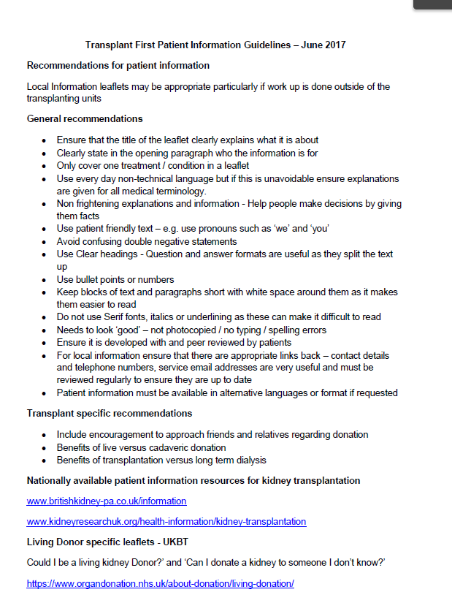
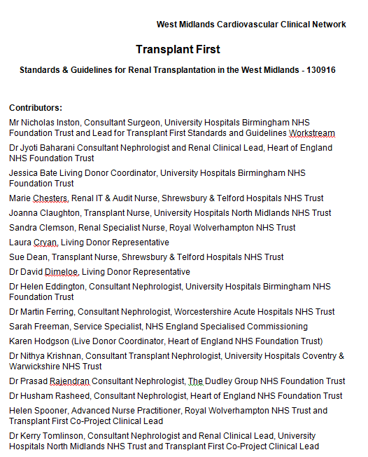

Project Structure
D
ata,
m
ea
sures
an
d
i
m
pl
ement
atio
n
(K
err
y
T
omli
nso
n )
•
I
de
ntif
y
da
t
a
r
eq
ui
r
ed
,
i
t
s
sou
r
ce
an
d obt
ai
n
ag
r
ee
m
en
t
t
o
sha
r
e
da
t
a
across
t
he
r
eg
i
•
A
g
on
KQUIP
r
ee
f
orm
att
i
ng
an
d r
eg
ul
arity
of
r
ep
ort
i
ng
,
e.g
.
q
ua
r
t
erly
au
di
t
an
d
f
ee
db
ack
of
t
otal
t
r
an
spl
an
t
,
l
i
do
no
v
e
r
,
de
cea
sed
do
no
r
an
d
pre
-
empt
i
v
e
t
r
an
spl
an
t
l
i
st
i
ng
r
ates
at
ea
ch
un
i
•
t
I
de
ntif
y
r
ep
osi
t
ory
f
or
da
t
•
D
ev
el
op
i
a
nf
r
astr
uct
ure
f
or
au
di
t
,
r
ev
i
ew
an
d
r
ep
ort
i
ng
,
e.g
.
R
C
A
an
d
au
di
t
of
al
l
pa
t
i
en
t
s
st
art
i
w
ng
R
R
T
i
t
ho
ut
a
t
r
an
spl
an
t
l
i
st
st
atus
d
S
r
t
an
da
r
ds
an
d g
ui
de
l
i
ne
(N
i
ck
I
m
nston )
a
a
•
o
I
de
nti
f
y
cl
i
ni
ca
l
stand
ards
an
d
g
ui
de
l
i
ne
s nee
de
d
t
o
i
mprov
e acc
es
s
t
o
t
r
an
sp
l
an
t
e.g
.
w
r
i
t
t
en
ac
ce
ptan
ce
Donor Patient View
cr
B
i
t
eria
f
or
acce
ptance
on
k
i
dn
ey
t
r
an
spl
an
t
w
ai
t
i
ng
l
i
e
•
st
I
de
ntif
y
w
he
r
e document
s
al
r
ea
dy
av
ai
l
ab
l
e
an
d
i
de
ntif
y
g
ap
s,
de
v
el
op
i
ng
r
eg
i
on
al
st
an
da
r
T
g
ui
de
ds
an
d
p
UKRR
l
i
ne
s
as r
eq
ui
r
r
ed
i
o
h
P
athw
ay
s
(
s
K
err
s
y
T
omli
nso
n)
r
n
•
M
ap
t
e
he
curr
en
t
pa
t
i
en
t
pa
t
hw
ay
s
by
r
en
al
un
i
t
across
t
he
r
eg
i
o
•
Co
on
n
-
de
si
g
n
ex
empl
ar
pa
t
hw
ay
s
w
i
t
h pat
i
en
t
s
an
d
cl
i
ni
ci
an
s
i
n li
ne
w
i
t
h ag
r
ee
d
st
an
da
r
ds
an
d g
ui
de
l
i
ne
p
s
t
S
r
P
atie
nt
a
i
nf
orm
atio
n
(
H
el
en
S
po
on
er)
P
•
C
ol
l
ate
i
nf
orm
atio
n
use
d
across
t
he
r
eg
i
on
an
d
up
l
oa
d t
o
S
C
N
w
eb
si
t
•
e
I
de
ntif
y
an
y
g
ap
s
an
d
de
v
el
op
f
urt
he
r
r
eso
urces
as r
eq
ui
r
ed
ODT
E
du
catio
n
(
C
eci
l
y
H
ol
l
i
ng
w
ort
h)
•
I
de
ntif
y
t
r
ai
ni
ng
ne
ed
s
of
al
l
proj
ect
pa
r
t
i
ci
pa
nts,
e.g
.
Q
I
f
or
un
i
t
l
ea
ds and pat
i
en
t
r
ep
r
ese
ntat
i
v
•
S
ou
es
r
ce/desi
g
n,
cost
an
d
de
l
i
v
er
t
r
•
E
st
ab
ai
ni
ng
l
i
•
D
esi
g
sh
actio
n le
arni
ng
sets
n
f
i
r
st
t
r
an
spl
an
t
ed
uca
t
i
on
an
d audi
t
ev
en
t
t
o
sha
r
e
be
st
pract
i
ce,
f
or
r
ol
l
-
ou
t
an
nu
al
l
y
t
he
r
ea
f
t
er
Taking organ transplantation to 2020
NICE
LDKT 2020

Slide 14
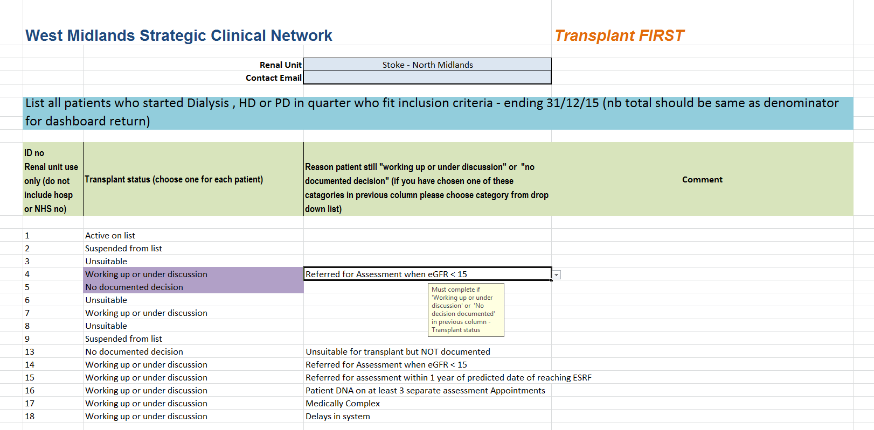
Data : Enhanced Dashboard
(It’s taken ages so I am telling you about it whether you like it or not!)

Slide 15
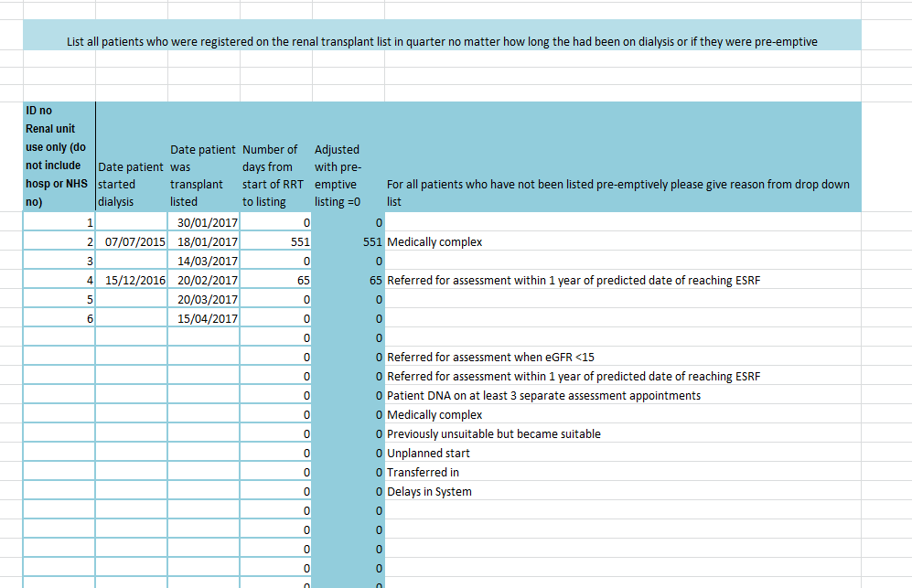
Data: transplant listing

Slide 16
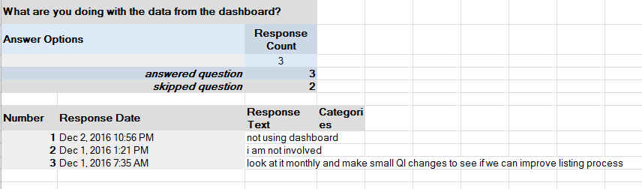
Barriers to using data effectively
Me/Time
It is extremely difficult to develop data set (anyone starting project now wont have to!)
    Definitions
    Collection
    Collation
Tendency to justify exceptions (balance between wanting data to look good and using it to improve)
Separation between people filing in data and those doing project
It only works if you use it locally

Slide 17
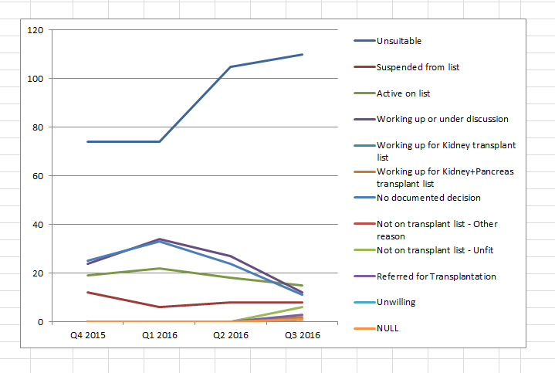
Cut and Paste: Argghhhh!!!
Active on list
Suspended from list
Unsuitable
Working up or under discussion
No documented decision

Slide 18
Transplant status from Enhanced dashboard

Slide 19
Lessons learnt from data
Transferable causes for missing listing:
  Failing transplants
  Predictable but rapidly declining patients
  Different approaches to cardiac angiography pre-dialysis
Local causes for missing listing :
  Specific clinics (e.g. diabetes multi-disciplinary)
  Different feeder hospitals
  Other reasons that will be apparent locally
It only works if you use it locally

Slide 20

Reason given why patients were not listed pre-emptively

Slide 21
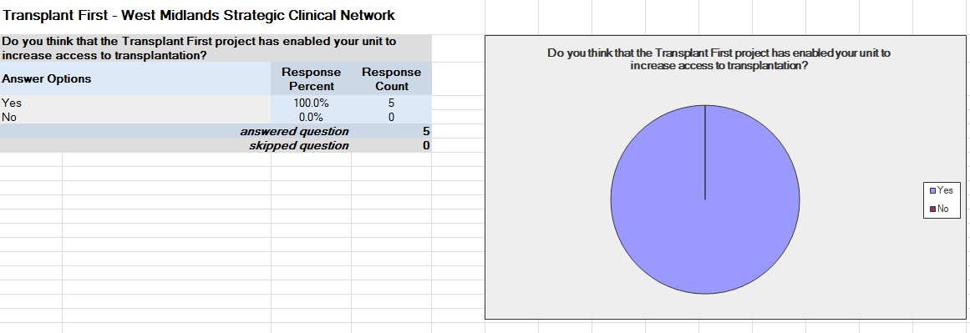
Positive stories
Working with other units to improve transplantation and work together for a better patient experience
  Better collaborative working to improve patient experience
  Highlighted pathway delays and led to re-design
We now have a Transplant Coordinator in post
Improving transplant profile for staff and patients
Better data to influence decisions

Slide 22
How sponsor team have found it
Time needed can’t be overestimated
Project support is key (Changed from SCN to KQUIP half way through)
Different Transplant Unit approaches to involvement
Have to rely on engagement of units and work hard to keep enthusiasm
Patient engagement is difficult both in breadth and sustainability
Data collection is very difficult
Getting feedback can be difficult
On-going need for human interactions and mediation

Slide 23
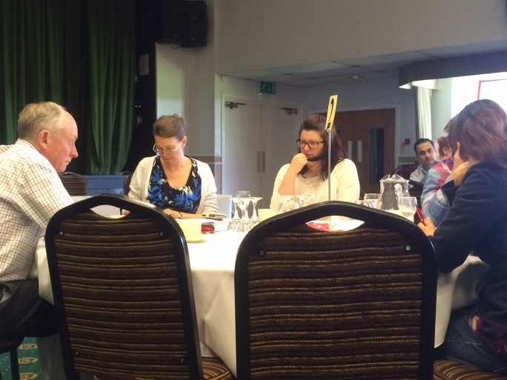
Barriers from Unit perspective
Consultants
Lack of time for individual units to discuss changes
Would like more personalized input
Software barriers
Change in unit personnel
Would like more interaction
Staffing shortages
Role of ongoing QI education

Slide 24
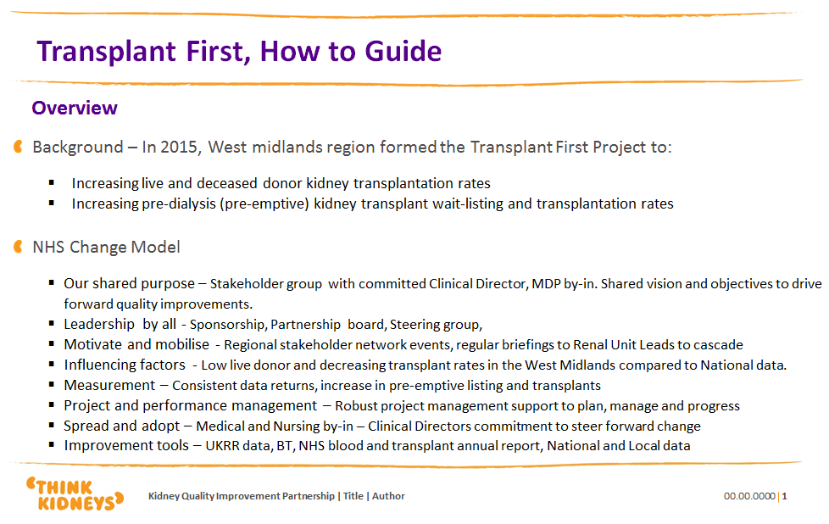
Next steps
TF rollout through KQUIP
Producing “How to Guide” and attending regional meetings
More work to access national data more easily
Dovetailing with other sources of information
  ATTOM
  Renal Registry
Increasing momentum e.g. GIRFT

Slide 25
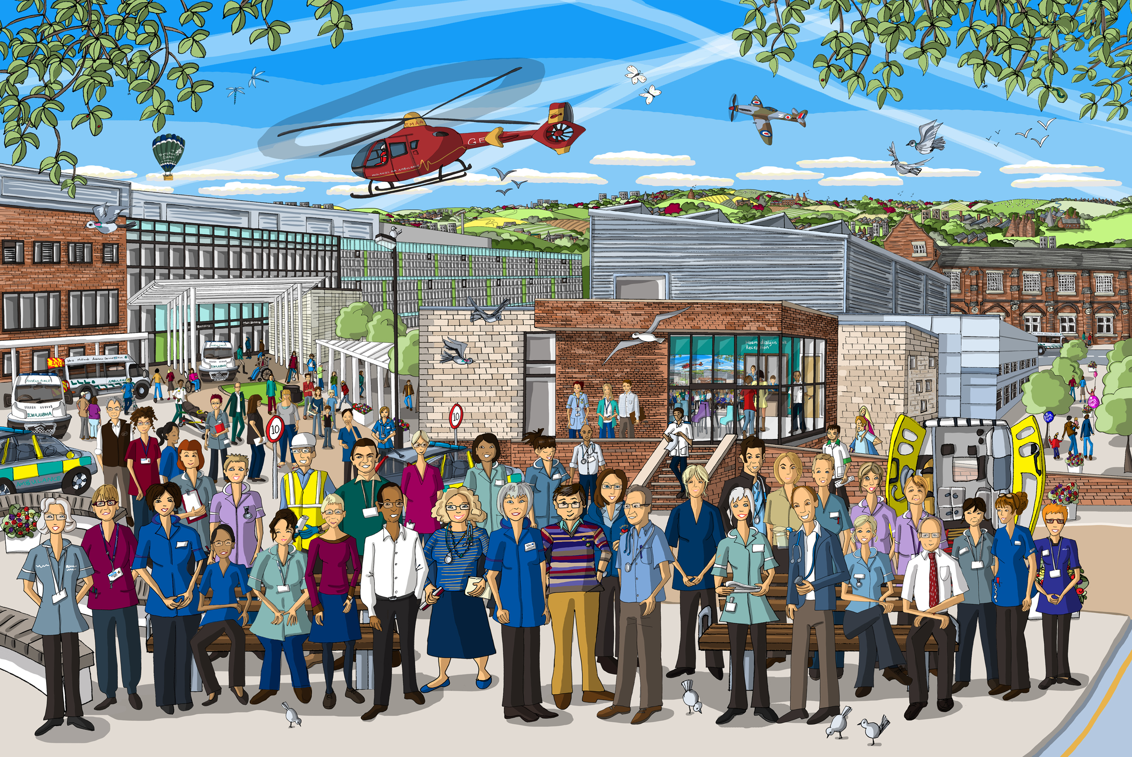



West Midlands Clinical Network
Thank you to all patients, carers, kidney unit staff, registry staff etc. who are working on the project

