Slide 1
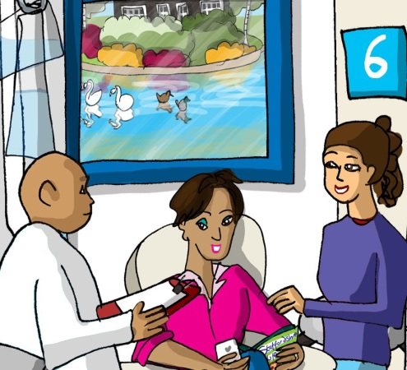
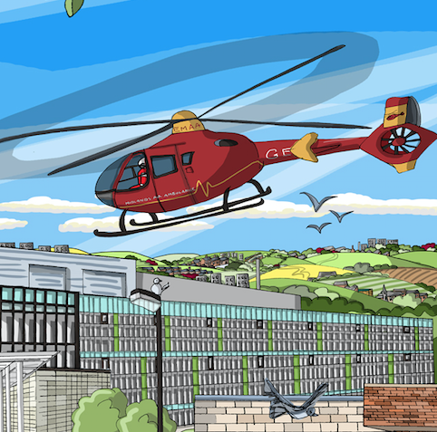


UKKW 2018 Pop up session
Transplant First: Increasing pre-emptive listing and living donor kidney transplantation. How do we turn the dream into reality?
Kerry Tomlinson on behalf of KQUIP

Slide 2
Structure of session
Aims and introduction
Breakout 1: Barriers
Transplant First and KQUIP
Breakout 2: Solutions
Summary

Slide 3
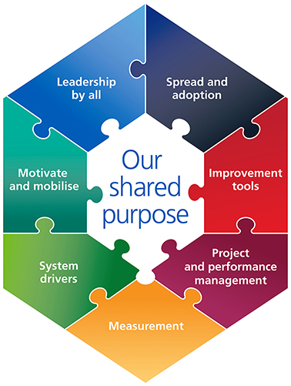
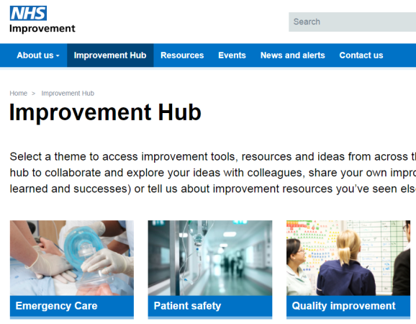
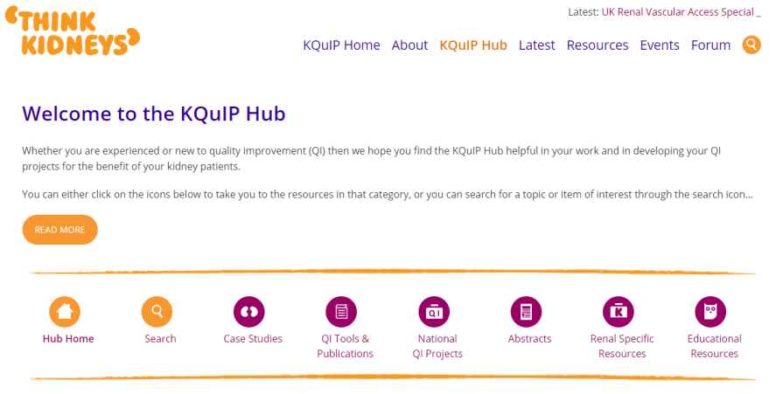
Aims
To improve our capability to increase access to transplantation as illustrated by the NHS Change Model

Slide 4
Why do pre-emptive kidney transplant listing and Living Donor Kidney Transplantation (LDKT) matter?
UK Renal Association: Planning, Initiating and Withdrawal of Renal Replacement Therapy
We recommend that all medically suitable patients should be informed about the advantages of pre-emptive living kidney transplantation and efforts made to identify a potential donor to allow pre-emptive transplantation before the need for renal replacement therapy
Notes:
Figure 1. Relationship between preemptive transplantation and outcomes among recipients of cadaver donor kidney transplants. Shown are unadjusted, Kaplan-Meier patient survival (upper panel) and graft survival (lower panel).

Slide 5
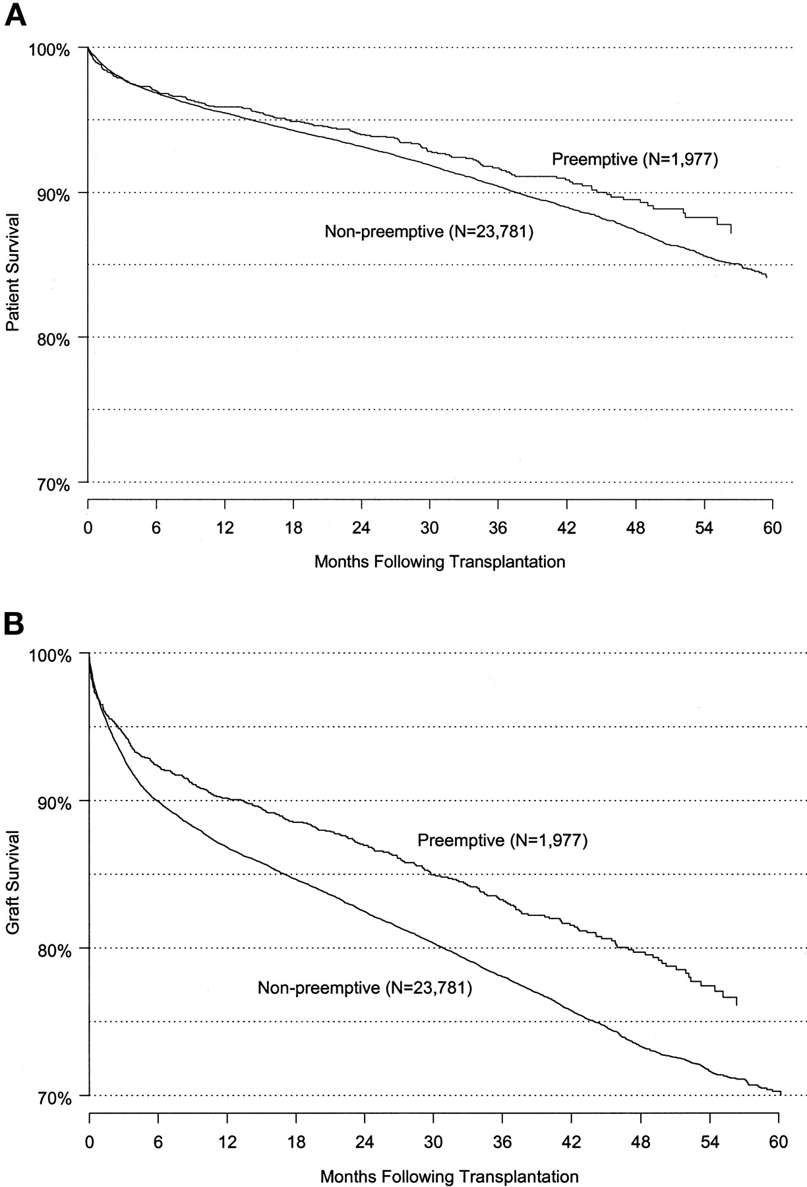

Why does pre-emptive listing matter?
Relationship between pre-emptive transplantation and outcomes among recipients of deceased donor kidney transplants.
Bertram L. Kasiske et al. JASN 2002;13:1358-1364
©2002 by American Society of Nephrology
Notes:
Figure 1. Relationship between preemptive transplantation and outcomes among recipients of cadaver donor kidney transplants. Shown are unadjusted, Kaplan-Meier patient survival (upper panel) and graft survival (lower panel).

Slide 6
Does pre-emptive transplantation versus post start of dialysis transplantation with a kidney from a living donor improve outcomes after transplantation? A systematic literature review and position statement by the Descartes Working Group and ERBP
 | Pre-emptive better | Same | Not clear
Patient survival | 47% | 21% | 31%
Graft Survival | 56% | 9% | 34%
Acute Rejection | 77% | 15% | 8%
Delayed Graft Function | 2-3.37% |  | 4-9.7%
Within 1 year of dialysis probably makes little difference
Nephrology Dialysis Transplantation, Volume 31, Issue 5, 1 May 2016, Pages 691–697

Slide 7
Improving pre-emptive listing is not about:
Transplanting people earlier than is good for them
Changing listing criteria
Favouring the care of pre-emptive patients over those on dialysis

Slide 8
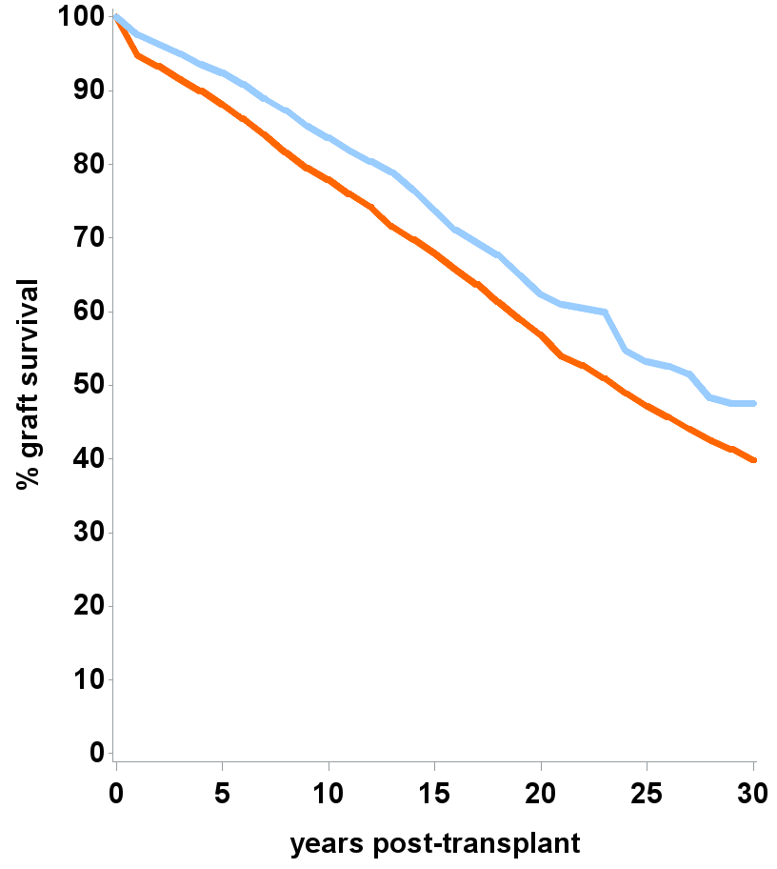
Why does Living Donor Kidney Transplantation matter?
Graft survival estimates following kidney transplant
Period analysis, 01Apr12 – 31Mar16
Median survival estimates:
Living donor ~ 27 years
DBD donor ~ 23 years
Increased numbers of transplants
Notes:
This slide highlights the excellent outcomes for both LKDT and DBD, but confirms that LKDT on average last longer than DBD kidneys
(DCD kidneys are not included in this data)

Slide 9
Variability, Variability, Variability
Best Renal Unit
?Worst Renal Unit?

Slide 11
Your chance of getting a LDKT, getting on the transplant list in a timely fashion and getting a pre-emptive transplant varies widely in the UK
Is that acceptable?
Why might that be?

Slide 12
What we know
ATTOM: Patient factors associated with pre-emptive listing
Age>50
Ethnic group (Asian and Black)
BMI(>35)
Education
Car Ownership
Accommodation
Employment
Time First seen by nephrologist
Diabetes
Cerebrovascular disease
Vascular Disease
Malignancy
Heart Disease
Heart Failure
Current Smoker

Slide 13
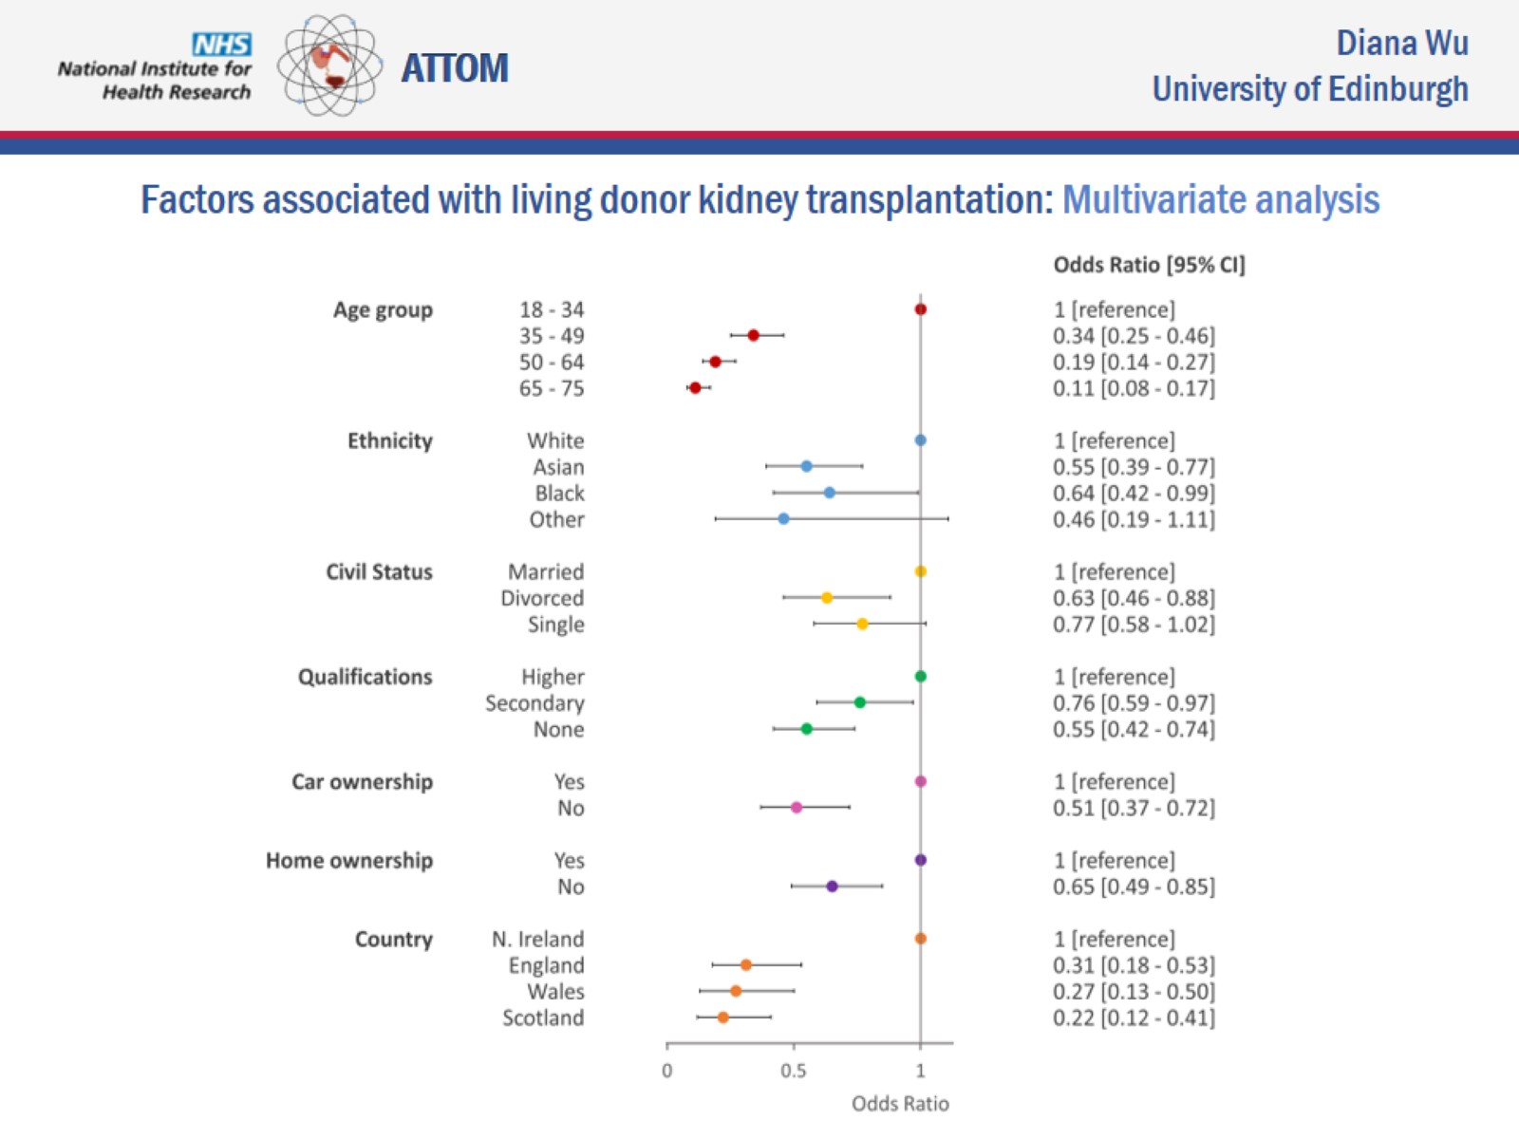
ATTOM: Factors associated with LDKT
Limited health literacy
Notes:
The ATTOM study collected data prospectively on 2055 transplant patients who were transplanted between 2011-2013 in the UK. Of those transplanted 40% received LKDT 60% deceased donor kidneys.
Data showed widespread inequality in access to LKDT in the UK with the following highlighted- You were more likely to get a LKDT transplant if you were young, white, married, living in Northern Ireland, owned a car and house and had tertiary education.
i.e. the barriers to LKDT are ethnicity, poverty, social isolation (or lack of a close potential donor) and health illiteracy.
While these facts do not perhaps surprise us they should as a community make us uncomfortable and question ‘how can we do all that we can to remove these barriers for our patients?’
Full ref: NDT 2017, May 1;32(5):890-900 Wu et al. Barriers to living donor kidney transplantation in the United Kingdom: a national observational study.

Slide 14
Why does it matter to us?
Better outcomes for limited resource
Pride in doing a job well
GIRFT and Peer review are on their way…

Slide 15
Why does it matter to us?
"When my kidneys failed, getting a kidney transplant became the most important thing that I had ever wanted in my life. I have never wanted anything more and never will. Each step of the way I was accompanied by a desperate longing for it to happen, and every setback and delay was something I felt acutely, and caused a lot of anxiety"

Slide 16
Breakout session 1
Rules of engagement
Be open (even if you think you know the answer)
Be non-hierachical
  Transplanting and non-transplanting
  Consultants and MDT
If you are talking all the time stop (particularly consultants)
The silent member holds the key?

Slide 17
Breakout session 1
What are the barriers to improving access to pre-emptive transplant listing in your unit
What are the barriers to improving access to Living Kidney Donor transplantation in your unit

Slide 18
ATTOM: Centre factors associated with transplant listing
Centre variables linked to pre-emptive listing were
  Being a transplant centre
  Number of consultant nephrologists
  Whether transplantation is discussed with all patients
Centre variables linked better access to listing after dialysis were
  Number of consultant nephrologists
  Written protocol

Slide 19
Barriers to LKDT
Lack of accessible information
  GP lack of knowledge
  Uncertainty about information resources
  Donors coming forward unaware how to access teams
  Uncertainty about information resources
Pathway issues
  Not giving information upstream e.g. in low clearance clinic
  Not being able to do all workup locally
  Radiology department schedules
  Batching donors
  Complexity/length of pathways
  Ability to personalise (e.g. out of hours appointments)
  Matching donor and recipient timelines- especially if done across two centres
Resources/Finance
  Location of HTA assessors and Psychologists
  GP responses to queries delayed
  Limited resource (staffing or money for tests)
  Living Donor Co-ordinator (LDC) time
  LDCs often single handed- back up for donors when they are away
  Parts of pathway not funded in non-transplant units
Skills/Knowledge
  How to discuss recipient concerns for donors
  Transplant expertise in low clearance settings
  Accessing UK Living Donor kidney Sharing Scheme
Uncertainty
  Perception of risk and how to convey it meaningfully
  Whether to contact donors

Slide 20

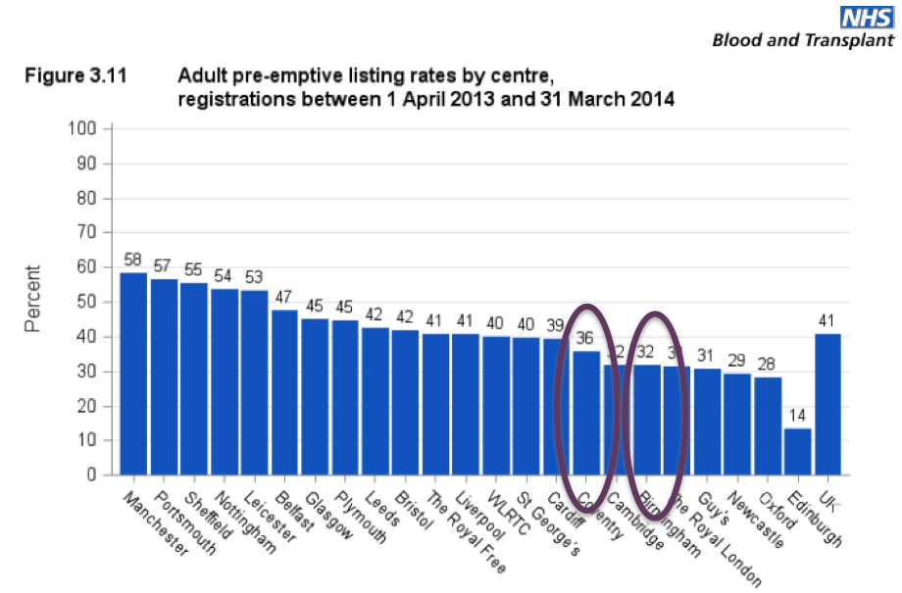
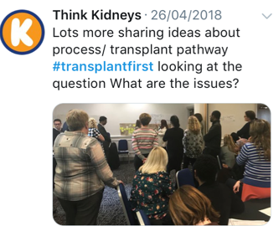
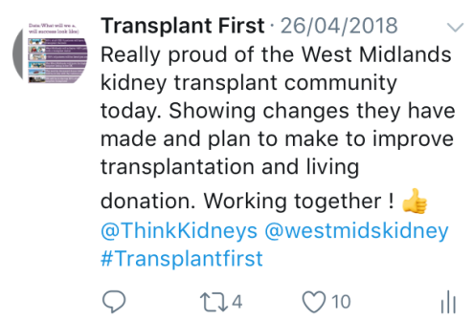
Transplant First in the West Midlands
West Midlands Clinical Network
Pre-emptive transplant listing from each renal unit April 17-Dec17
Renal Units

Slide 21
What did we do?
Project events
Transplant Units
Renal Units
Patients and carers
External experts
SCN/KQUIP
Launch event
July 2015
Pathway Redesign 1
Pathway redesign 2
Audit/Education event Jul 2016
Audit Education event July2017

Slide 22
Launch event
July 2015
Pathway Redesign 1
Pathway redesign 2
Audit/Education event Jul 2016
Audit Education event July2017
Early agreement
Valuable time
BMI debate
Unit feedback
Handover points
Cardiac catheter abstract
Honest discussion
Quick Wins
Patient Voice
Sponsor team meetings, conference calls, working with RR, subgroup meetings, contact with units etc

Slide 23
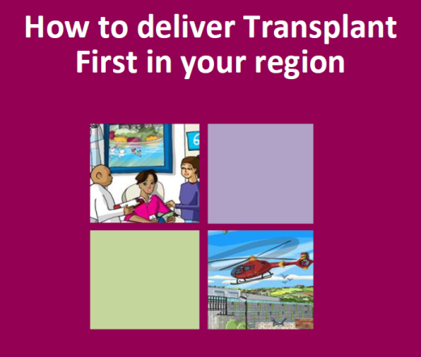
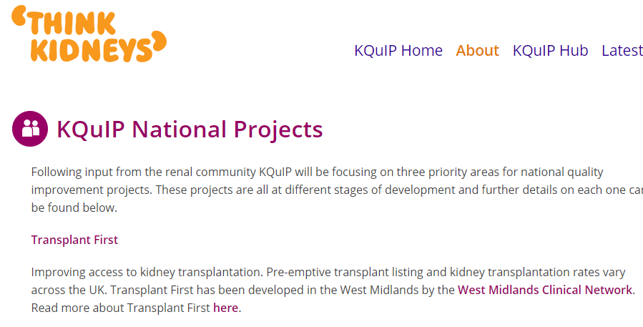
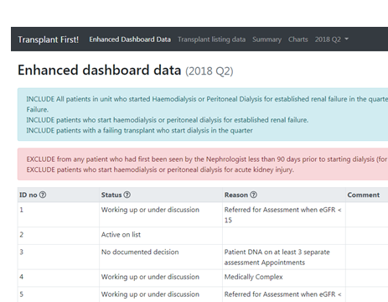
Transplant First and KQUIP
Measurement for improvement and RCA

Slide 24
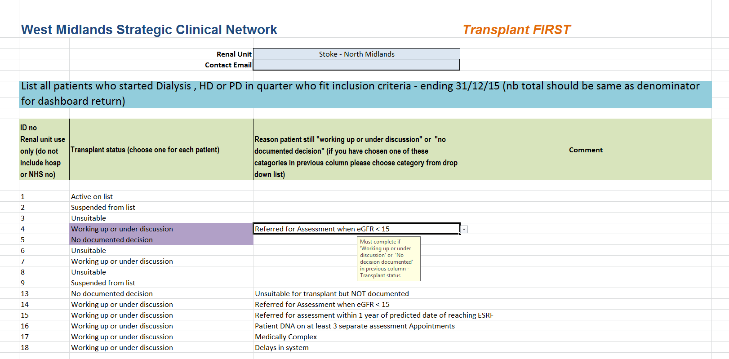
Data : Enhanced Dashboard RCA
(It’s taken ages so I am telling you about it whether you like it or not!)

Slide 25
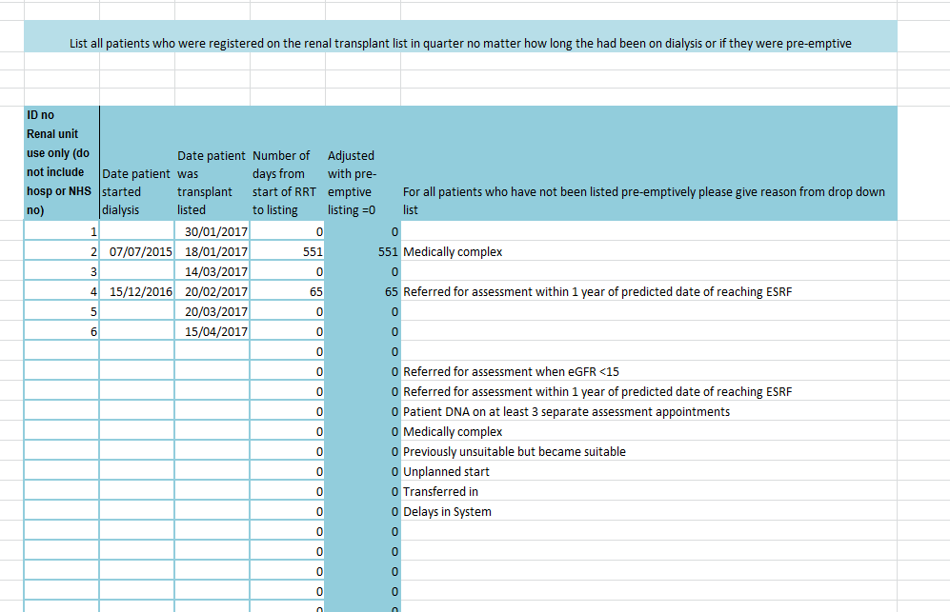
Data: Transplant listing RCA

Slide 26
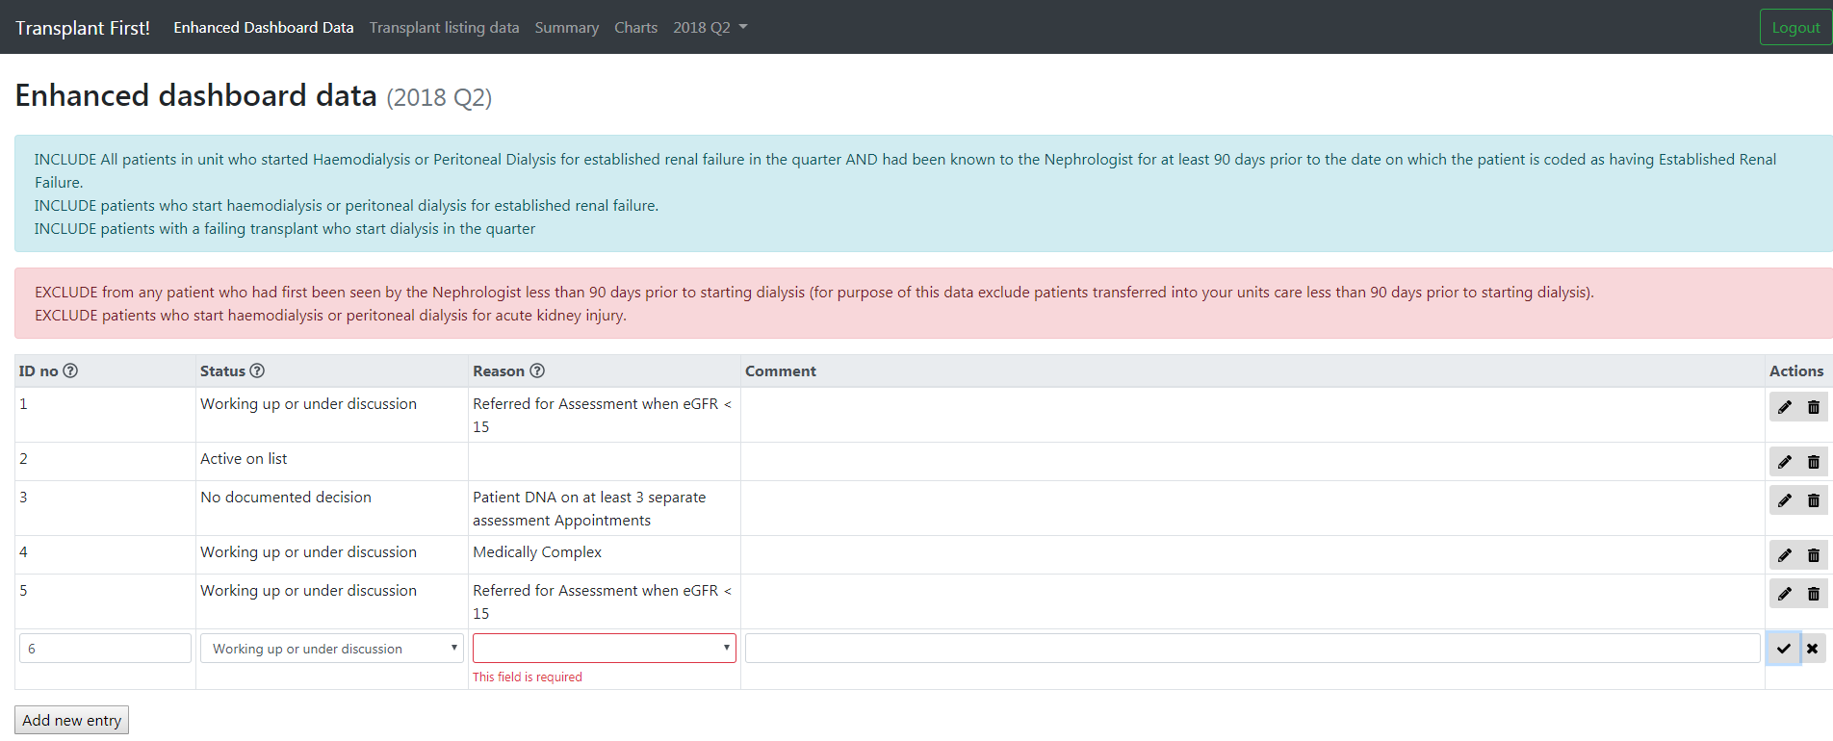
In development

Slide 27
Lessons learnt from data
Transferable causes for missing listing:
  Late referrals (Predictable but rapidly declining patients)
  Failing transplants
  Different approaches to cardiac angiography pre-dialysis
  Referral to other specialties slows listing
Local causes for missing listing :
  Specific clinics (e.g. diabetes multi-disciplinary)
  Different feeder hospitals
  Other reasons that will be apparent locally e.g. variable unit practise
It only works if you use it locally

Slide 28
ATTOM: Patient factors associated with pre-emptive listing
Age>50
Ethnic group (Asian and Black)
BMI(>35)
Education
Car Ownership
Accommodation
Employment
Time First seen by nephrologist
Diabetes
Cerebrovascular disease
Vascular Disease
Malignancy
Heart Disease
Heart Failure
Current Smoker
Transplant First: Improve understanding of barriers to transplantation in your unit and remove them

Slide 29
ATTOM: Centre factors associated with transplant listing
Centre variables linked to pre-emptive listing were
  Being a transplant centre
  Number of consultant nephrologists
  Whether transplantation is discussed with all patients
Centre variables linked better access to listing after dialysis were
  Number of consultant nephrologists
  Written protocol
www.thinkkidneys.nhs.uk/kquip/wp-content/uploads/sites/5/2017/04/Transplant_First_Standards_and_Guidelines_Final_version_091116.pdf

Slide 30
Breakout session 2
What actions can you take to improve access to pre-emptive transplant listing in your unit?
What actions can you take to improve access to Living Kidney Donor transplantation in your unit?

Slide 31
Changes, ideas and learning from Transplant First project (see handout)
Appointing lead nurse and doctor for transplantation in each renal unit (now mandated)
Appointing transplant co-ordinator
Centralising referrals to transplant centre via one e mail address
Sending patients mobile with referrals so they could be texted to avoid DNA
Joint assessments clinics set up with transplant centre
Set up transplant listing clinic in Renal Units (may be nurse led)
Restructuring Renal /Diabetes clinic which had a high rate of “missed” patients
Transplant centre MDT to speed up complex decision making
Regular feedback to teams as to why patients were “missed”
Renal unit low eGFR MDT meetings systematically including transplant status (may include co-ordinator)
Systematically recording CKD5 patients transplant status in their letters and IT system
Using IT to produce reports of CKD5 patients without transplant status
MDTs to discuss listed patients
Recording Living Donor workup on IT system
Collaborative working became more normal
Increasing early transplant discussion (defining pathway, cue cards, team education)
One stop/fewer stop recipient or Living donor clinics
Shared regional practice (e.g. early cardiology assessment) to encourage adoption

Slide 32


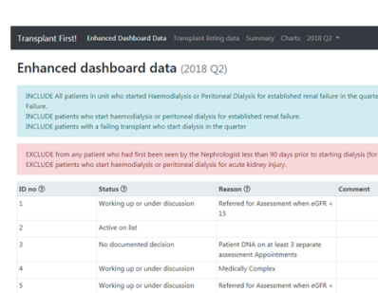
Go forth and multiply!
This is You

Slide 33
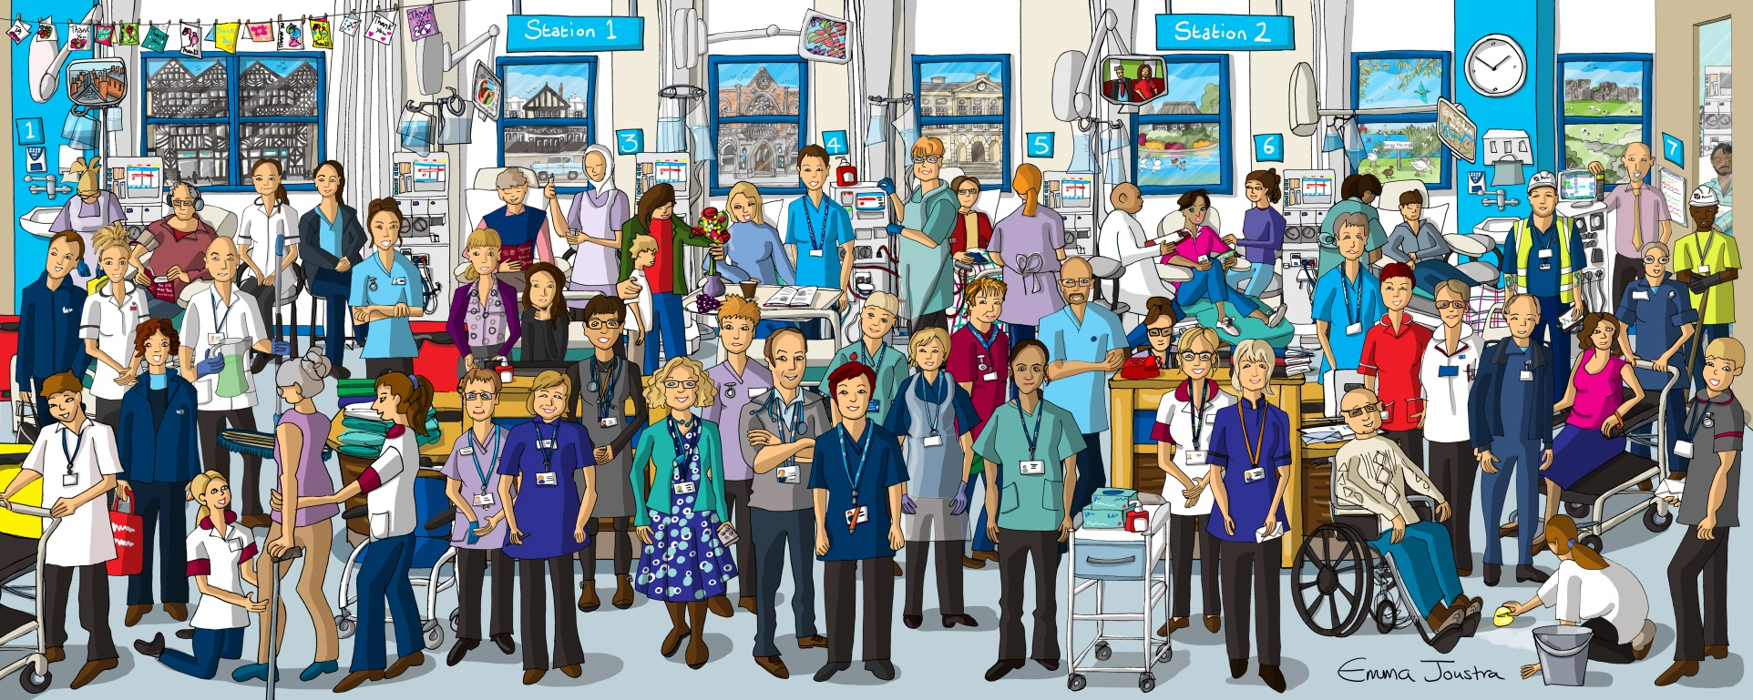
Transplant First: Thanks to everyone working to improve access to transplantation

