Slide 1
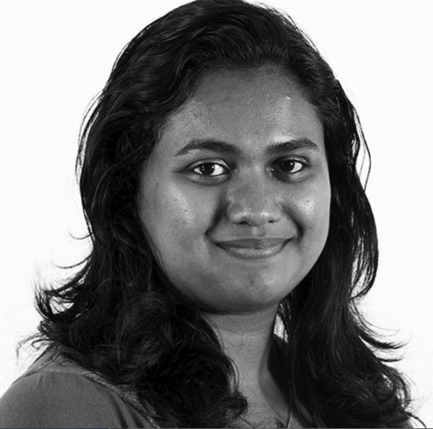
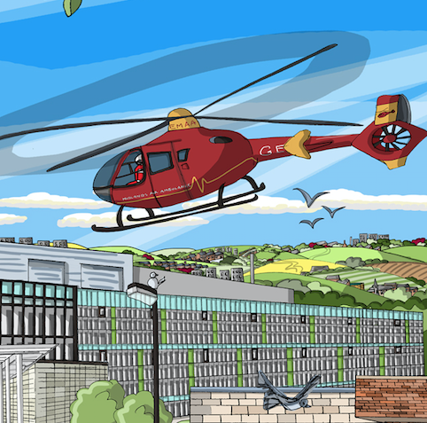
Transplant first: Addressing inequality of access to renal transplantation across the West Midlands
Kerry Tomlinson on behalf of sponsor group
UK Kidney Week 2016

Slide 2
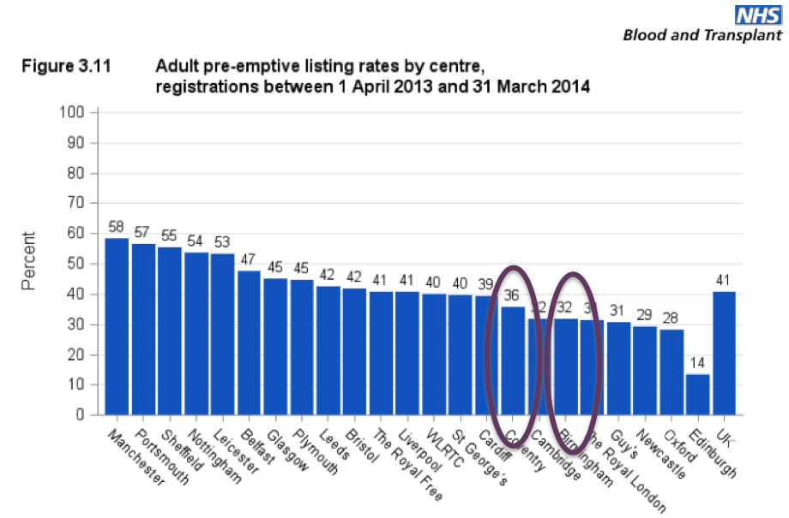
Background: identifying the problem
Transplant
ESRD
Transplant list
  UK RR 2014 report median time to listing
  488, 598, 641, (683), 712, 765, 787, 867

Slide 3
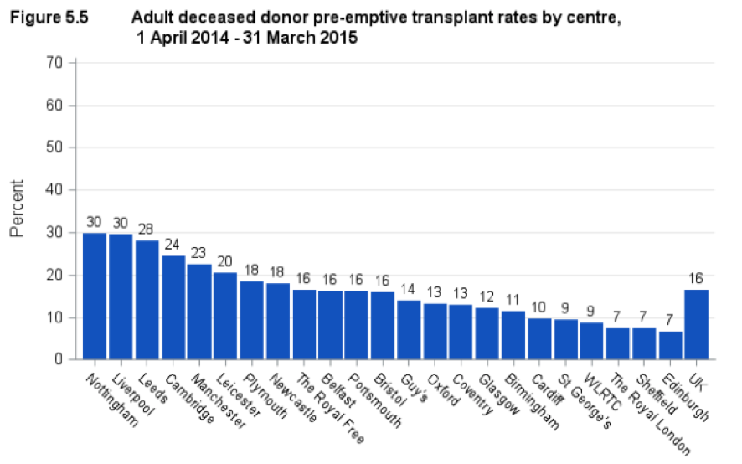
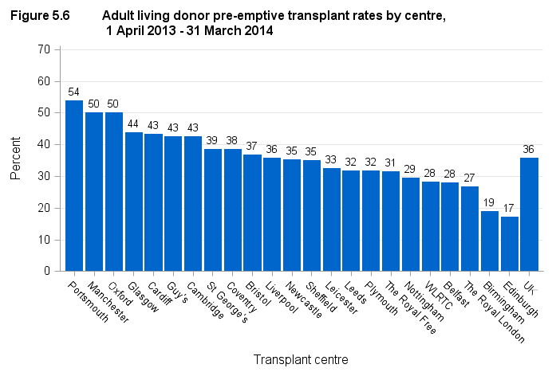
Pre-emptive transplant rates are lower than average

Slide 4
Brendans Voice
"When my kidneys failed, getting a kidney transplant became the most important thing that I had ever wanted in my life. I have never wanted anything more and never will. Each step of the way I was accompanied by a desperate longing for it to happen, and every setback and delay was something I felt acutely, and caused a lot of anxiety"

Slide 5
Project Background
Proposed to and adopted by West Midlands Cardiovascular Strategic Clinical Network (Renal Expert Advisory Subgroup)
Aims to:-
  lead to a progressive reduction in the excessive waiting times to renal transplantation in the West Midlands
  Improve access to renal transplantation for all patients in the west midlands
Full mandate and documents on website www.wmscnsenate.nhs.uk
The project will not disadvantage existing dialysis or transplant listed patients

Slide 6
Project Launch Event July 2015
Project and Mandate approved
Transplant Units
Renal Units
Patients and carers
External experts
SCN
Shared Data, Successes and Challenges

Slide 7
Early progress
All units signed up and identified project leads
CEOs were written to and committed to project
Agreement reached to openly share data
Patients recruited for workstreams
PID, project structure, and project plan agreed
Bimonthly team conference calls
Project management (communication, gentle encouragement, organization, central driving force without which there would be no project)
Sponsor team realised how enormous project was

Slide 8
Project Structure
D
ata,
m
ea
sures
an
d
i
m
pl
ement
atio
n
(K
err
y
T
omli
nso
n )
•
I
de
ntif
y
da
t
a
r
eq
ui
r
ed
,
i
t
s
sou
r
ce
an
d obt
ai
n
ag
r
ee
m
en
t
t
o
sha
r
e
da
t
a
across
t
he
r
eg
i
•
A
g
on
KQUIP
r
ee
f
orm
att
i
ng
an
d r
eg
ul
arity
of
r
ep
ort
i
ng
,
e.g
.
q
ua
r
t
erly
au
di
t
an
d
f
ee
db
ack
of
t
otal
t
r
an
spl
an
t
,
l
i
do
no
v
e
r
,
de
cea
sed
do
no
r
an
d
pre
-
empt
i
v
e
t
r
an
spl
an
t
l
i
st
i
ng
r
ates
at
ea
ch
un
i
•
t
I
de
ntif
y
r
ep
osi
t
ory
f
or
da
t
•
D
ev
el
op
i
a
nf
r
astr
uct
ure
f
or
au
di
t
,
r
ev
i
ew
an
d
r
ep
ort
i
ng
,
e.g
.
R
C
A
an
d
au
di
t
of
al
l
pa
t
i
en
t
s
st
art
i
w
ng
R
R
T
i
t
ho
ut
a
t
r
an
spl
an
t
l
i
st
st
atus
d
S
r
t
an
da
r
ds
an
d g
ui
de
l
i
ne
(N
i
ck
I
m
nston )
a
a
•
o
I
de
nti
f
y
cl
i
ni
ca
l
stand
ards
an
d
g
ui
de
l
i
ne
s nee
de
d
t
o
i
mprov
e acc
es
s
t
o
t
r
an
sp
l
an
t
e.g
.
w
r
i
t
t
cr
en
ac
ce
ptan
ce
B
i
t
eria
f
or
acce
ptance
on
k
i
dn
ey
t
r
an
spl
an
t
w
ai
t
i
ng
l
i
e
•
st
I
de
ntif
y
w
he
r
e document
s
al
r
ea
dy
av
ai
l
ab
l
e
an
d
i
de
ntif
y
g
ap
s,
de
v
el
op
i
ng
r
eg
i
on
al
st
an
da
r
T
g
ui
de
ds
an
d
p
UKRR
l
i
ne
s
as r
eq
ui
r
r
ed
i
o
h
P
athw
ay
s
(
s
K
err
s
y
T
omli
nso
n)
r
n
•
M
ap
t
e
he
curr
en
t
pa
t
i
en
t
pa
t
hw
ay
s
by
r
en
al
un
i
t
across
t
he
r
eg
i
o
•
Co
on
n
-
de
si
g
n
ex
empl
ar
pa
t
hw
ay
s
w
i
t
h pat
i
en
t
s
an
d
cl
i
ni
ci
an
s
i
n li
ne
w
i
t
h ag
r
ee
d
st
an
da
r
ds
an
d g
ui
de
l
i
ne
p
s
t
S
r
P
atie
nt
a
i
nf
orm
atio
n
(
H
el
en
S
po
on
er)
P
•
C
ol
l
ate
i
nf
orm
atio
n
use
d
across
t
he
r
eg
i
on
an
d
up
l
oa
d t
o
S
C
N
w
eb
si
t
•
e
I
de
ntif
y
an
y
g
ap
s
an
d
de
v
el
op
f
urt
he
r
r
eso
urces
as r
eq
ui
r
ed
ODT
E
du
catio
n
(
C
eci
l
y
H
ol
l
i
ng
w
ort
h)
•
I
de
ntif
y
t
r
ai
ni
ng
ne
ed
s
of
al
l
proj
ect
pa
r
t
i
ci
pa
nts,
e.g
.
Q
I
f
or
un
i
t
l
ea
ds and pat
i
en
t
r
ep
r
ese
ntat
i
v
•
S
ou
es
r
ce/desi
g
n,
cost
an
d
de
l
i
v
er
t
r
•
E
st
ab
ai
ni
ng
l
i
•
D
esi
g
sh
actio
n le
arni
ng
sets
n
f
i
r
st
t
r
an
spl
an
t
ed
uca
t
i
on
an
d audi
t
ev
en
t
t
o
sha
r
e
be
st
pract
i
ce,
f
or
r
ol
l
-
ou
t
an
nu
al
l
y
t
he
r
ea
f
t
er
Taking organ transplantation to 2020
NICE
LDKT 2020

Slide 9
Data: What will we achieve? (What will success look like)
West Midlands will achieve >95% patients starting RRT with a transplant status
The West Midlands will have the highest rate of pre-emptive listing in the UK
The wait for deceased donor kidneys in the West Midlands will be in line with the national average or better
We will be in the top 50% of transplant units for pre-emptive transplants
95% of all CKD 5 patients will have a documented transplant decision
> 50% of patients will be listed pre-emptively

Slide 10
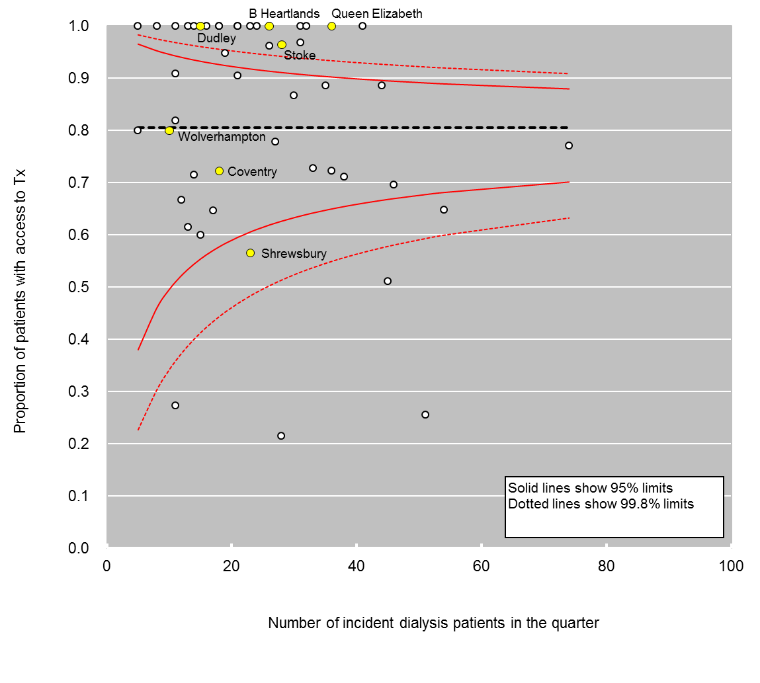
Open sharing: NHSE quality dashboard: access to transplant
Old Data

Slide 11
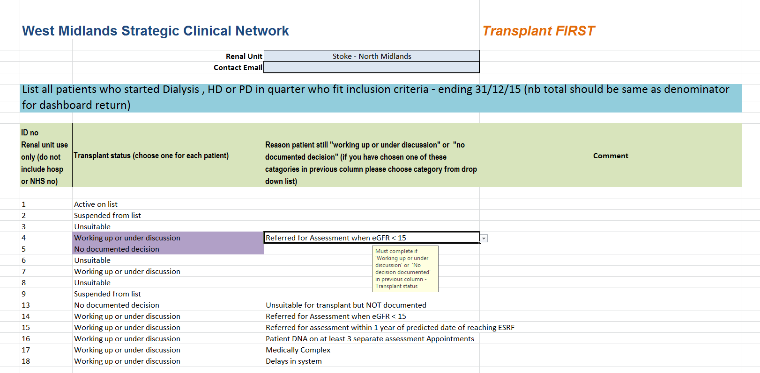
Enhanced dashboard

Slide 12
Early data
Commonest cause of missing transplant listing is late referral
Some immediate policy differences spotted (e.g. when to do cardiac catheter)
Units can spot patterns in causes e.g. from feeder hospitals/clinics
Needs some more refining
Units collecting data for annual audit event in July 16 including current pre-emptive rates

Slide 13
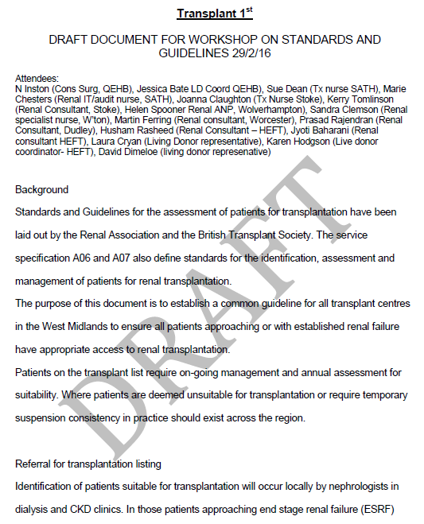
Standards and guidelines
Discussion re BMI cut off
Defined when to workup
Did not change referral threshold

Slide 14

Patient information
Patient information Collated
Working with patients to review current information and identify gaps
Aim to produce core information resources
In conjunction with the RR, ‘Donor View’, an online programme to support live donors through the donation process, is in development
Donor Patient View

Slide 15
Education
Encouraged enrolment in Massive Open Online Course (MOOC): Improvement FUNdamentals
  http://www.nhsiq.nhs.uk/capacity-capability/improvement-fundamentals.aspx
Absorbed and delivered in other workstreams
People much happier with doing rather than being taught
You need QI methodology but not everyone needs to know it

Slide 16
Pathways
2 all day Pathway redesign events
Some QI training included
5 CPD points from RCP and RCN reflective learning tool included
Opportunity to hear patient voice
Units worked on own pathways
Work on hand off between units
Target audience from each unit
  CKD consultant and nurse
  Transplant consultant and nurse
  Directorate manger
  Data Lead
  Patient representative
  Open to trainees
Pathways very varied and need to be designed and delivered locally with support

Slide 17
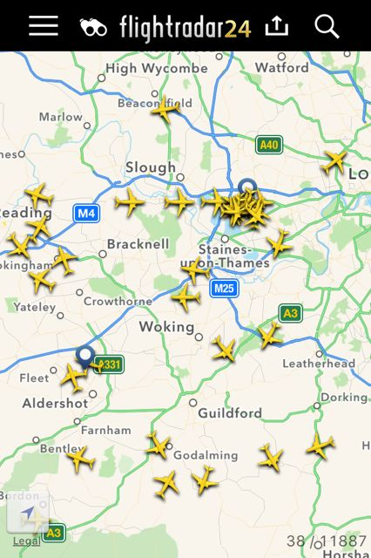
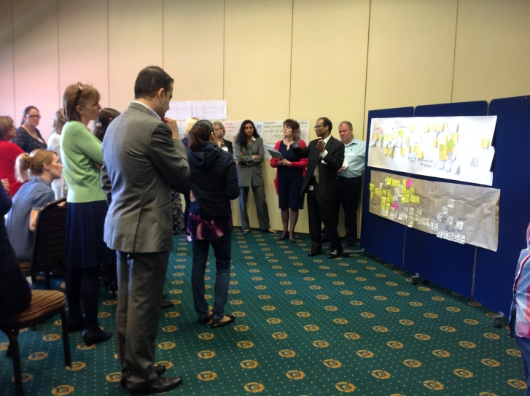
Challenges
Tension
  Between facilitators/participants
  Between units & opinions
  Between project leaders and their own units
  Between project teams and their other roles
People (Consultants)
Resources
  To complete project
  To work in different way
    Designated staff roles
    More clinic time
  Post its

Slide 18
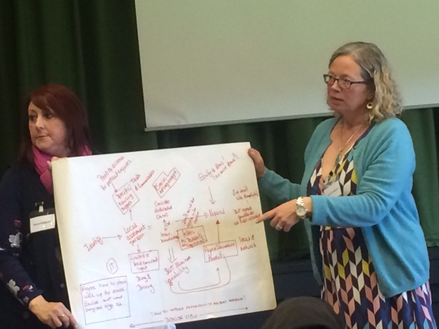
Positives
Permission to spend time together (people were very cross if they perceived this was wasted)
Quick Wins
  Mobile numbers on referral letters
  Transplant unit to tell referring units about appointments
Agreement
  Finish tests before referral
  Start Donor workup sooner
  Single point of referral
  Work towards limited or lead consultants

Slide 19
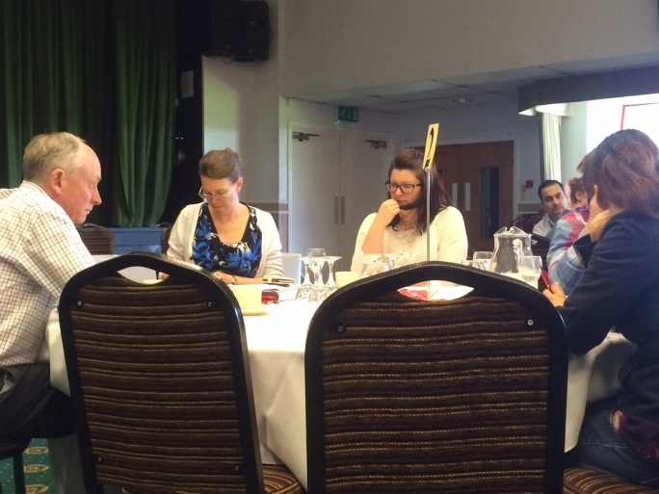
How have units found it: negatives
Lack of time for individual units to discuss changes
Software barriers – still unable to report all CKD5 patients on renal IT system
Whole process was slower or delayed due to Consultant shortage
Consultants not documenting
Staffing shortages with nurses as well as Consultants to improve transplant issues, this includes link nurses time as well

Slide 20
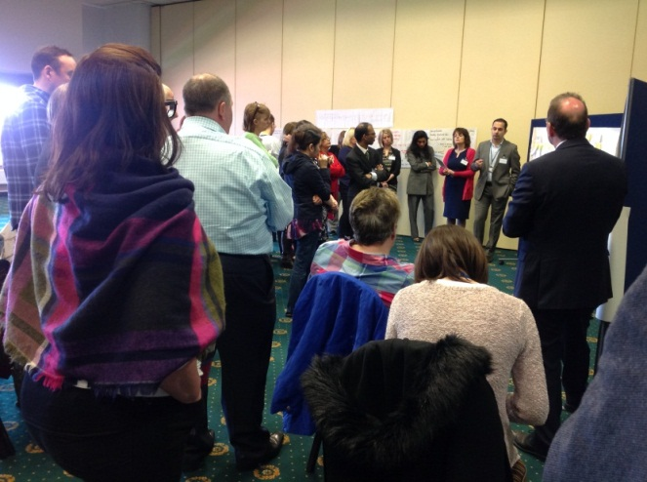
How have units found it: positives
Transplant status being recorded on all patients, which will make auditing easier
  Better collaborative working to improve patient experience
We now have a Transplant Co-ordinator in post
Increased communication
Working with other units to improve transplantation and work together for a better patient experience
6 project arms covering work-up all the way through process to listing
  Highlighted pathway delays and led to re-design
Identified timescales and how different members of staff contributed to the pathway
Pathways changes already evident
Better data to influence decisions
Improving transplant profile for staff and patients

Slide 21
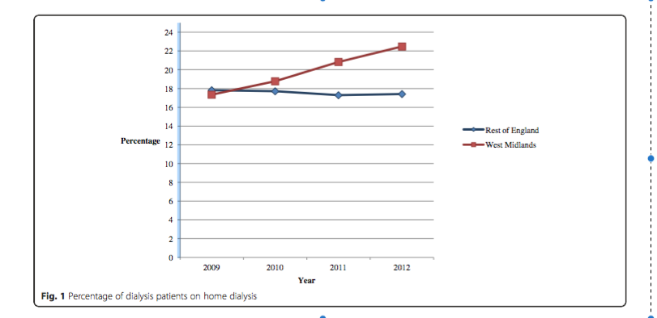
Can we do it?
We increased Home Dialysis rates
Target driven
Clinical Champions
Good systems
Finance

Slide 22
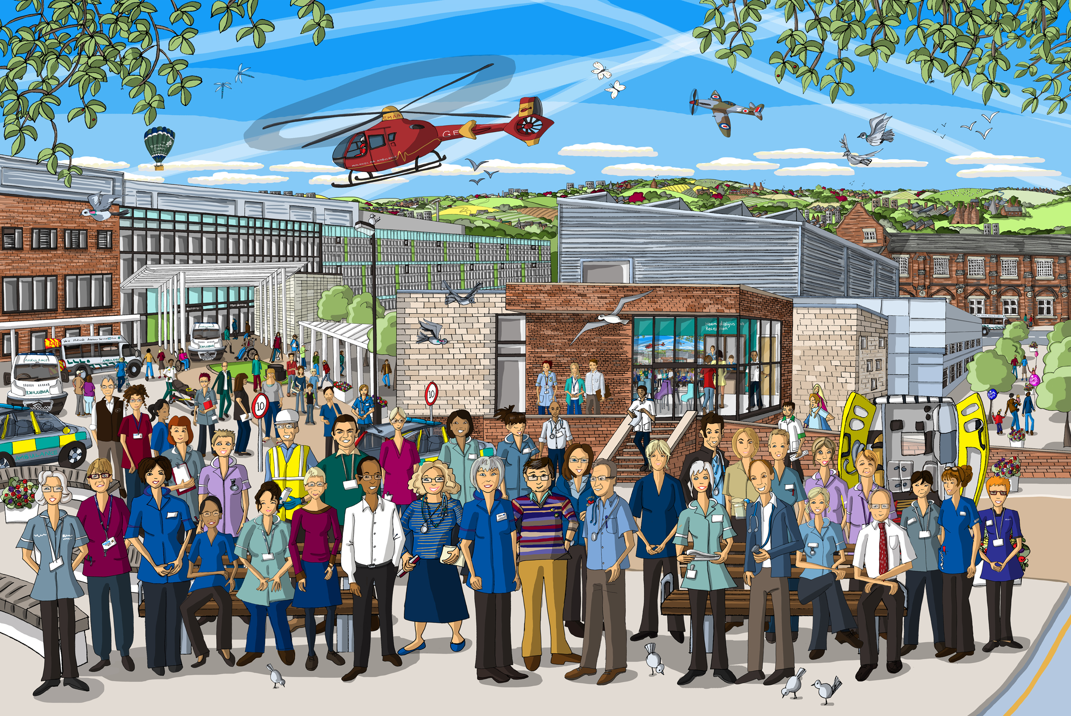

Acknowledgements
West Midlands Clinical Network
Sponsor team
Dr Kerry Tomlinson, Project Co-Lead for Transplant First, Consultant Nephrologist, UHNM
Cecily Hollingworth, Quality Improvement Officer, West Midlands Clinical Network
Helen Spooner, Project Co-Lead & Advanced Nurse Practitioner, Royal Wolverhampton NHST
Dr Clara Day, Renal Clinical Director, West Midlands Clinical Network
Mr Nick Inston, Renal Surgery – Consultant, UHBFT
Dr Nithya Krishnan, Consultant Transplant Nephrologist, UHCW
Ron Cullen, Chief Executive, UK Renal Registry
Dr David Dimeloe, Donor Representative
Partnership Board
Rob Wilson, Interim Associate Director for SCN and CVD Network Manager (Chair)
Lisa Burnapp, Lead Nurse, Living Donation, NHS Blood & Transplant
Mark Davis, Patient Representative & West Midlands Advocacy Officer for NKF
Sarah Freeman, Specialised Commissioner, NHS England
Dr Graham Lipkin, Kidney Quality Improvement Programme (KQUIP)
Thank you to all patients, carers and kidney unit staff members who are working on the project

