Slide 2
09:30 – 10:00
REGISTRATION / COFFEE/ NETWORK OPPORTUNITY

Slide 3
Kidney Quality Improvement Partnership (KQuIP)
South West
SW Team Transplant – Training Day 1
11th June 2019
#SWTTx

Slide 4
10:00 – 10:15
Introductions and Welcome
Dr Paul Cockwell – KQuIP co-chair
Ron Cullen – CEO Renal Association

Slide 5
10:15 – 10:30
What’s happened since we last met?
[Dr Steve Dickinson – Royal Cornwall Hospital, Truro]

Slide 6
10:30 – 11:15
Introduction to Quality Improvement Tools
Building a QI team – what skills are already in place (LNA)
Developing a process map – in teams decide what you might look at & feedback
Example of a driver diagram – return to NHS change model
[Dr Steve Dickinson – Royal Cornwall Hospital, Truro]

Slide 7
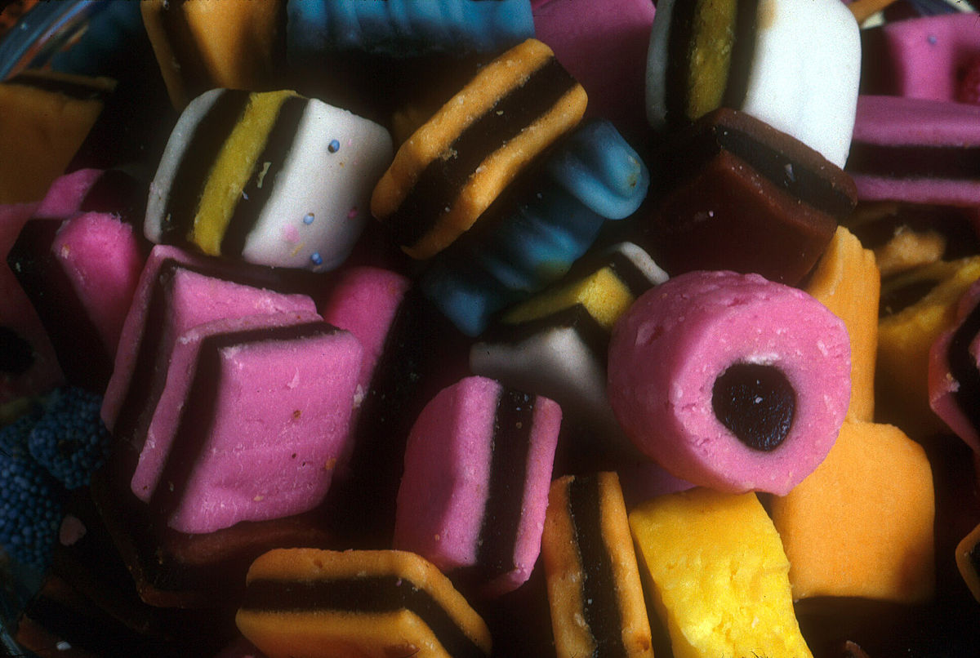
Building a QI team – Who?
Who can influence?
Who has connections?
Who has subject expertise?
Who has lived experience?
Who is good at communicating?
Who has done this before?
Who has an interest?
Who can challenge?
Who is seldom heard?

Slide 8
Building a QI Team – Avoid hierarchy!

Slide 9
Building a QI team – Involve patients
WHY? … Because it is the right thing to do
They bring a different set of skills and insights to the programme
A new and different way of working and thinking
Change of language in meetings – common ground
Bringing lived experience to the conversation – challenges some assumptions
Filter into practice in units – patients as assets
A new experience for patients – translates to improved Quality of Life
| 9
Notes:
Note the last point – these are big statements
This is where leadership comes in

Slide 10
Stakeholder Grid

Slide 11
QI – How to process map
1. Define and agree the process to be mapped
The objective is to get everyone’s view of the issues and create:
Problem Statement
Target Statement
2. Identify and agree the metrics
Establish the Key Performance Indicators (measures) that will tell whether a process has improved
3. Identify a team and team leader
4. Map the current activities
Create a current state map, this is how the process currently runs. Record it as it is even if it is “not as it should be”
Notes:
Process Flow Analysis – What are your bottlenecks which are stopping people from getting on to a transplant list? What stops people having a transplant. Map every process step/where the patient interacts with the NHS/Service and ask whether that is a value adding step to enabling them to achieve the objective of receiving a transplant.

Slide 12
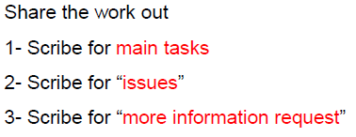
QI - How to build a map (2)

Slide 13
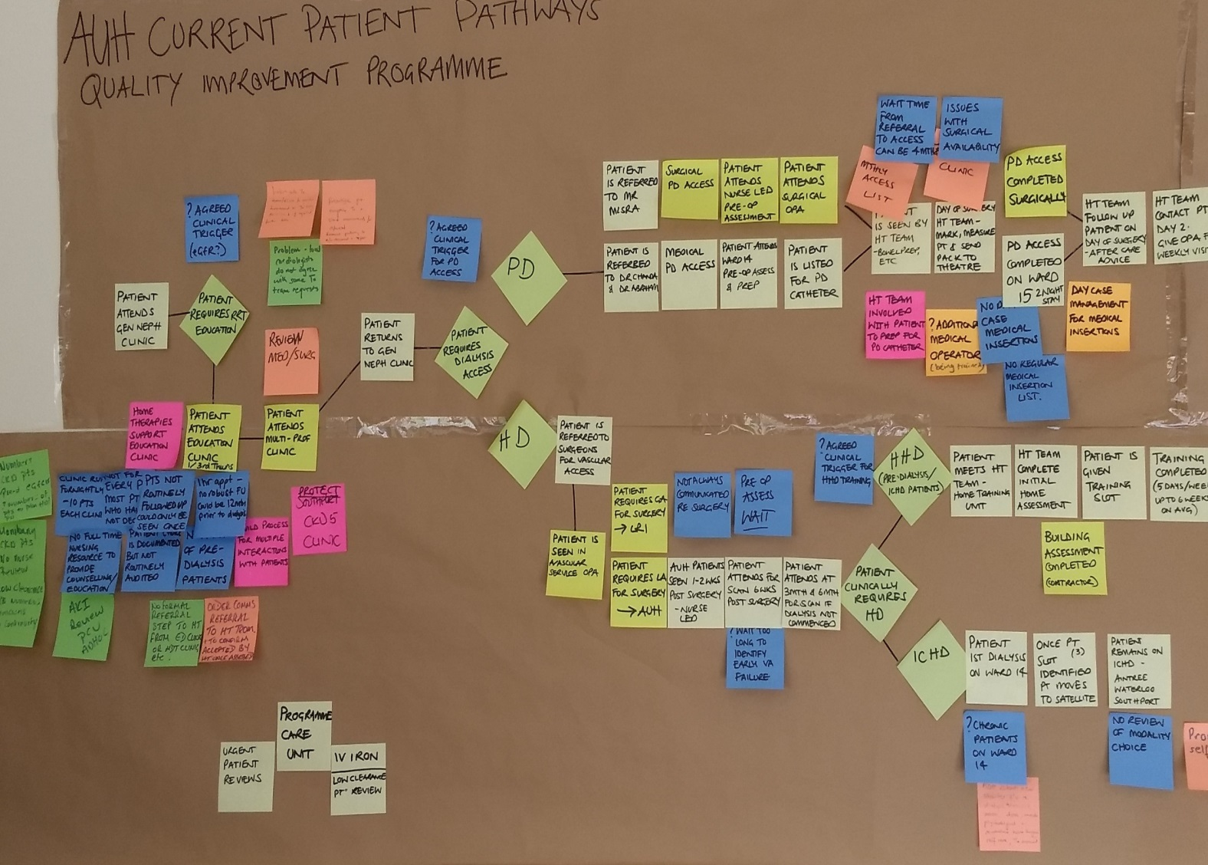
QI – process map

Slide 14
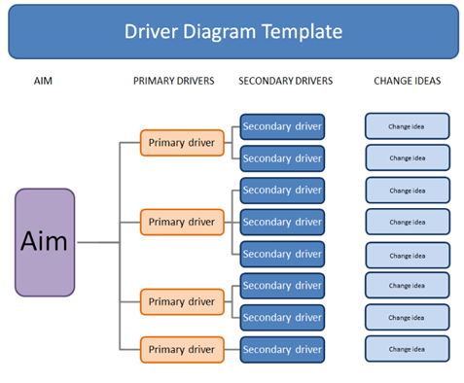
QI - Driver Diagram Template

Slide 15
COFFEE : 11.15-11.30

Slide 16
Kidney Quality Improvement Partnership | South West

Slide 17
10:30 – 11:30
Overall Aim – South West Team Transplant
‘As many people transplanted with as short a wait as possible and with the best experience’
[Unit presentations]

Slide 18
11:30 – 12:45
Your local strategy to enable measurement of suitability for transplant at EGFR <20
How many donors & recipients have started 18 week clock since May 1st
Discuss one aspect of involving patients you have done or plan to do
Discuss one method you have done or planning to do to raise profile of SWTT and its aims

Slide 19
Kidney Quality Improvement Partnership (KQuIP)
University Hospitals Plymouth NHS Trust
Leanne Savage, Transplant Liaison Nurse
Dr Richard Powell, Renal Registrar
Linda Boorer, Transplant Nurse Consultant
Dr Imran Saif, Consultant Nephrologist and Director of Transplantation

Slide 20
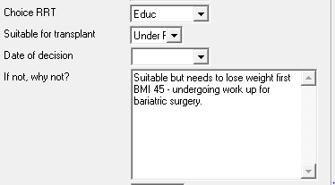
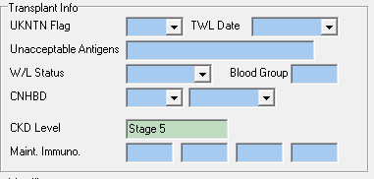
Local Strategy - Documented Transplant Decision
Current Practice
Currently transplant suitability is documented with 89% of all patients with an eGFR <20 having a documented decision either (Yes/No/Under Review)
However this is documented in two places – lacks consistency – often different consultants fill out different bits – some consultants not aware that the CKD screen existed

Slide 21
Local Strategy - Documented Transplant Decision
A report is pulled from vital data which identifies which patients have decisions or not. Currently used at the CKD/TWL review meetings with each consultlant.
Each CKD patient with a blank is reviewed approximately 6weekly to 2 months.
HD, PD patients not re-reviewed routinely in this way.
Plan
To discuss with admin manager whether we can auto populate the fields on vital data if one field is completed so that it shows in both places.
To get the drop down options to match the transplant first dashboard options for consistency (rather than Yes/No/Under Review)
Continue to pull off this report at each CKD/TWL meeting – updating the options once available
Revisit decisions periodically for HD/PD patients to ensure status hasn’t changed i.e those who may now be suitable
Audit on a quarterly basis?

Slide 22
Patients on 18 Week Pathway Since 1 May 2019
Recipients
9 referrals to transplant assessment across the three referrals centres (at the point of referral to MDT)
Donors
14 enquiries into living donation where we have sent out information out of these 14 - 4 have got back in touch
8 people have undergone compatibility testing
Where should the clock start for donors?
Should it be at the point of enquiry (although not registered sometimes at this stage? or at the point of an initial appointment with the LDC? Or at the point that they are proceeding to work up (following compatibility)?

Slide 23
How We Are Involving Patients
Donors
Looking at ways to make living donation more accessible
Currently down to an estimated three visits
Could the first visit be more convenient for the patient?
Want to ask patients who have gone through the process whether they would have preferred a late afternoon/evening appointment to fit better with work commitments?
Plan – to write a questionnaire and send out to all donors from the past year to find out their preferences

Slide 24
Raising Our Profile
Rich has written a piece about the KQuIP project which has been sent the communications team within the trust.
Linda and I met with the communications team who want to work with us to get a piece in the Herald talking about what the unit is doing.
KQuIP has been discussed within our transplant steering group to ensure the wider renal team is aware of the project.

Slide 27
13:15 – 13.45 + 15 mins questions
The Belfast Experience
Dr Aisling Courtney

Slide 28
14.00 – 14.30
Measurement for Improvement – what are we aiming for?
[Steve Dickinson]

Slide 29
Measurement for Improvement – do we want targets?
LKD rates of 16 pmp across SW
Deceased donors – reducing waiting times/turn down rates
Work up times – donor/recipient ( 18 weeks or 100 days?)
Talk Tx at 20
Kidney Quality Improvement Partnership | South West

Slide 30
14:30-14:45
Finalise shared purpose and scope

Slide 31
Overall Aim – South West Team Transplant
‘As many people transplanted with as short a wait as possible and with the best experience’
Do we want a more specific overall aim or more specific local aim?

Slide 32
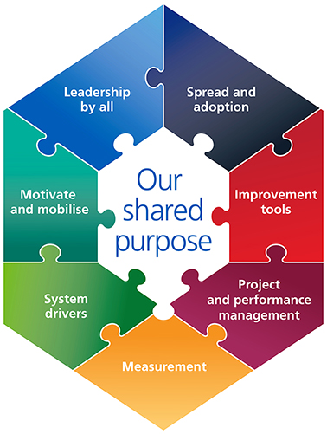
Our Shared Purpose
Leadership course for regional QI leads – expand this ( TP3)
Storytelling
Include patients at every level as leaders
Patient on delivery board
CD forum
Sharing & Learning events
Developing Regional networks
Sharing through projects across regions
IHI: model for improvement
This should be informing our training days
QI leads at unit/regional level
Website – keep updated
Abstracts/articles at national/international conferences
KPA’s – KCUK – newsletter
Local comms
Road map for change
Triggers for risk or barriers
Regional PM & leads
Delivery board holding to account
Agreed measures that are SMART and include PREM/PROM
Process as well as outcome measures at regional level
How do we measure success of KQuIP?
NHS 10 year plan
GIRFT
RA standards
CRG influence
Kidney Quality Improvement Partnership | South West

Slide 33
Scoping Exercise
What is in?
What is out?
Boundaries
Deliverables
List everything
OUT
IN

Slide 34
15.00-15.30
Measurement
Transplant dashboard – connect to it – agree to use and who will collect
Agree additional local simple measures if required
Transplant PREM
When to start
[Dr Steve Dickinson – Royal Cornwall Hospital, Truro]
[Rachel Gair - Quality Improvement Programme Manager]

Slide 35
15.30-16.00
30-60-90 day unit plans
Develop driver diagram
[Dr Steve Dickinson – Royal Cornwall Hospital, Truro]
[Rachel Gair - Quality Improvement Programme Manager]

Slide 36
Timeframes

Slide 37
16.00
Next steps and close
[Dr Steve Dickinson – Royal Cornwall Hospital, Truro]
[Rachel Gair - Quality Improvement Programme Manager]

Slide 38
Project phase
11th April 2019
11th June 2019
24th September 2019
December 2019
Launch event
Agree a project plan - Co-design outcomes and measures
Introduction to QI
1 day
Quality improvement and tools
Sharing and learning 1 day
Reflection on progress and overcoming challenges
Maintaining momentum
1 day
Review of progress
Launch project - Co-design methods
Measurement / Life QI
Project Model and NHS Change Model
PDSA
Peer assist (informal learning)
Sign posting to tools and information
Sustainability
Sustainability
Monthly support visits to units offered from KQuIP
P-D-S-A
Measure
Share learning
Collaborate
Peer assist
Kidney Quality Improvement Partnership | South West

Slide 39
Kidney Quality Improvement Partnership | South West

Slide 40
KQuIP Support…
Support to connect teams – collaboration
Assimilate and communicate learning between KQUIP collaboratives – action learning sets, webinars
Website resources and communications
Support for organising and providing training /meeting venues / sponsorship
Kidney Quality Improvement Partnership | South West

Slide 41
13:00– 13:30
Lunch and networking

Slide 43
13:30 – 15:30
QI leads

