Slide 1
Berkshire Kidney Unit KQUIP data – pre-emptive kidney transplantation
March 2020

Slide 2
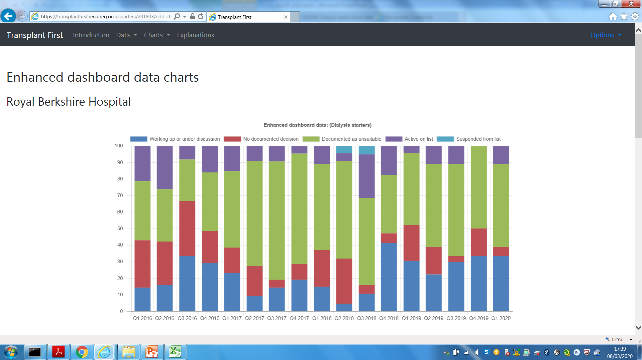
Transplant status at time of starting dialysis

Slide 3
March 2020 – transplant status of all dialysis and LCC patients
Notes:
12% overall active
29% PD; 9% HD
LCC heterogenous group – expect no decision higher as included EPO group

Slide 5
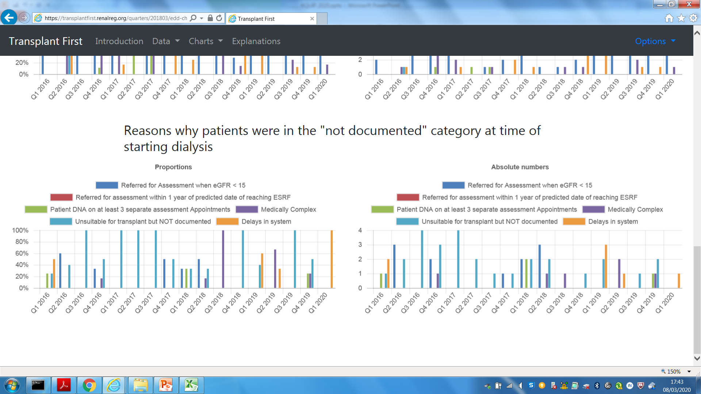

Slide 6
Narrative: Why?

Slide 7
Narrative: Why?
1/cr plot
Beliefs
Education focus on dialysis
Patient information
Investigate before referral
Non-standardised approaches
Cardiology process delays
Investigation/process momentum
Lack of documentation

Slide 8
Clinic letter
'I explained that in a young person like herself a staged approach making use of all available modalities over time is usable advisable and I recommended that she starts with peritoneal dialysis.'
She was referred as soon as started dialysis and is now transplanted

Slide 9
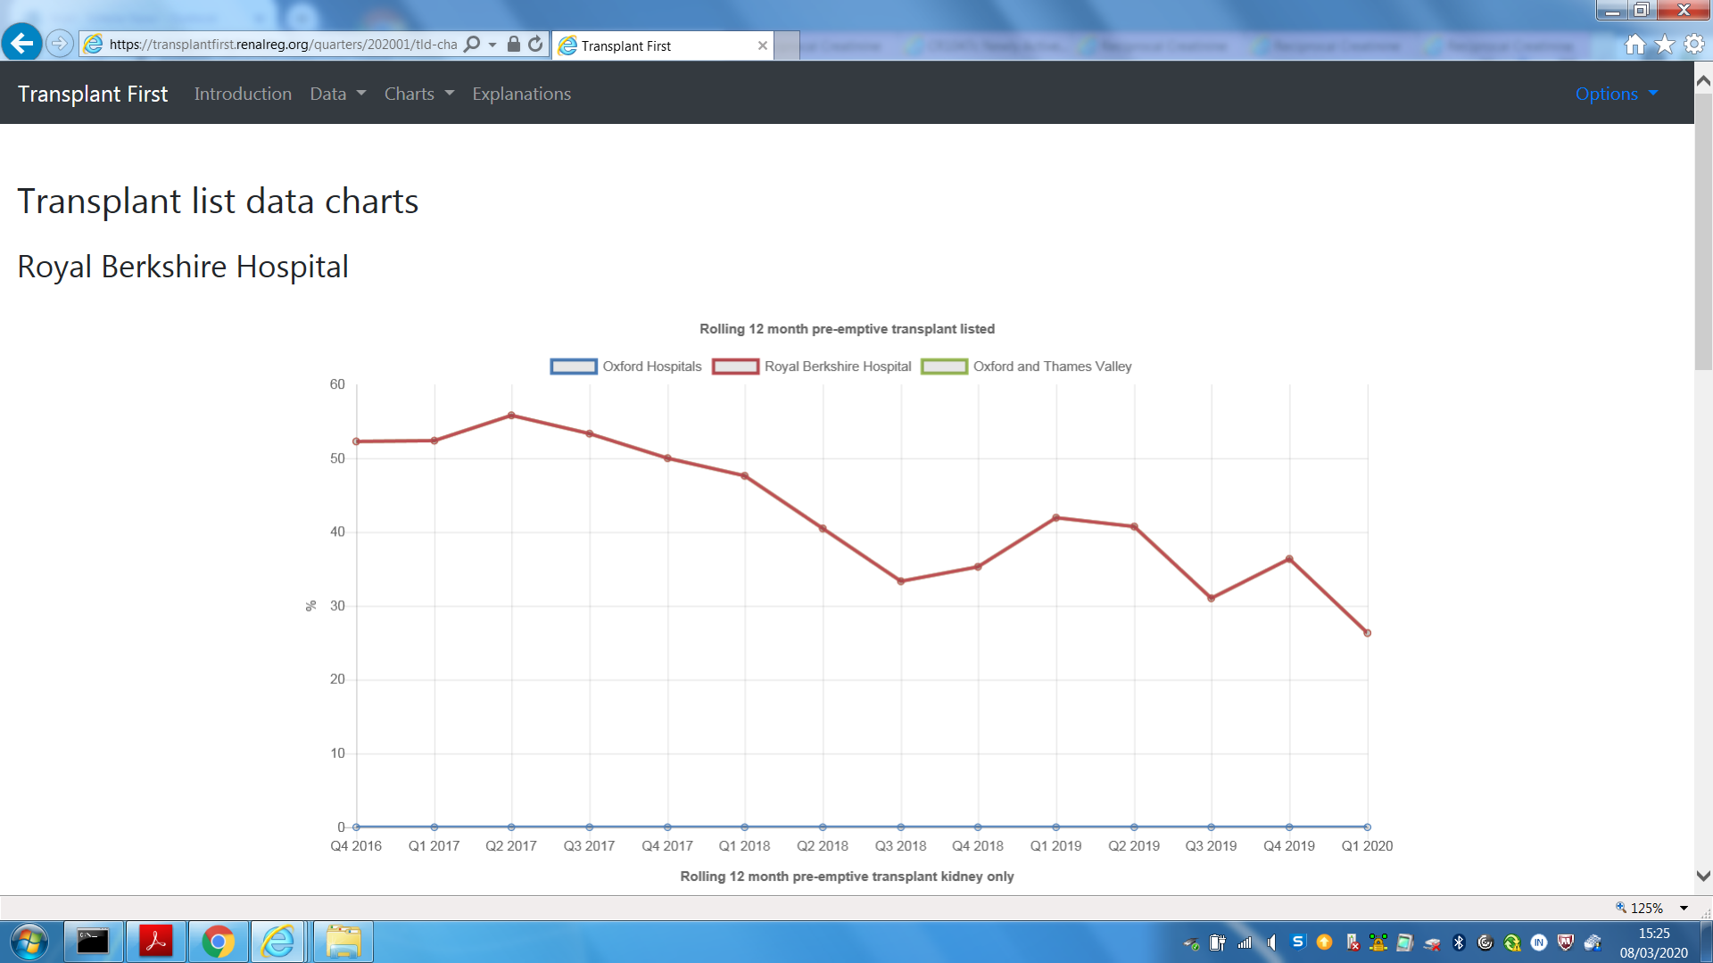
12 month pre-emptive transplant listed
Notes:
Fewer pre-emptive listing

Slide 10
Numbers listed each quarter: % pre-emptive
Range 40-71%
2016 Q1 to 2017 Q3
Range 0-67%
2017 Q4 to present day

Slide 11
Median/mean time to listing
Range 2016 Q1 to 2017 Q3
Median time: 0-147 days
Range 2017 Q4 to present day
Median time: 0-444 days
Notes:
Having started dialysis
Taking longer

Slide 12
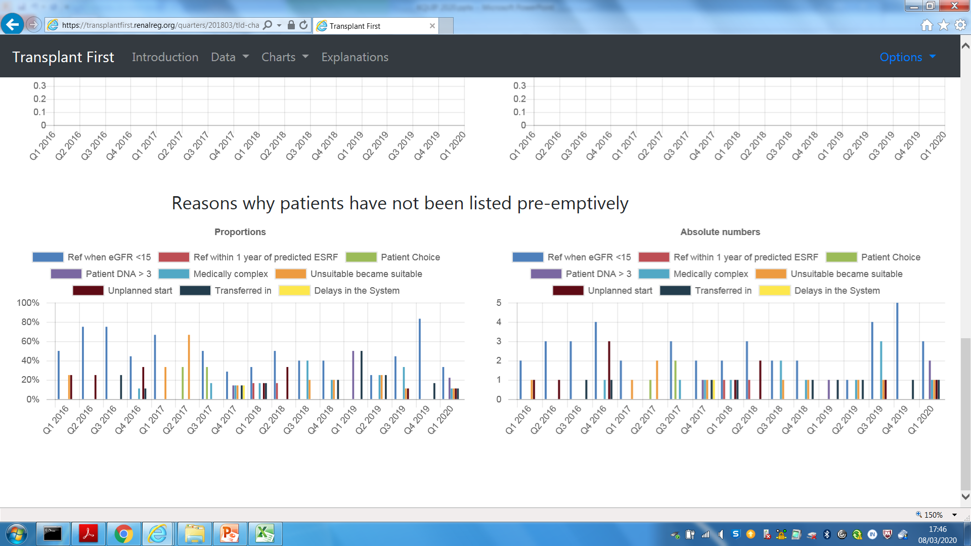

Slide 13
Narrative: Why?

Slide 14
Why?
Failing transplant re-listing delays
Refer eGFR <15
Despite predictable 1/cr plot
order investigations but not refer
Cardiology process delays
No-one chasing results
Transfers in from other units & not worked up
Patient DNAs
Medical complexity increasing
Waiting times/process delays for Reading patients

Slide 16
Possible solutions
Use reciprocal creatinine plot
Transplant audits
Standardise referral process
Clarify investigation process prior to referral
Reinvigorate RRT education
Patient information
Documentation
Already done – Tx MDT involve Reading; cardiology process reviewed

