Slide 1
KQUIP
Pre-Emptive Transplant Meeting Monday 9th March 2020
Streamlining the Living Donation Pathway

Slide 2
KQUIP OXFORD & THAMES VALLEY REGION LAUNCH DAY LD Programme- The Good/Not So Good/The Future Recommendations
THE GOOD | THE NOT SO GOOD | THE FUTURE
Single point of referral for donors | Waiting time for initial appointment too long | Patient LD Seminars
Great to have a named nurse | More help for recipients to ask family/friends to consider living donation | Nurse LD seminars at referring centres
Remote/overseas donors- not a problem (appointments consolidated) | A need for donor forums/seminar or LD website | Online video’s to include patient stories
Staff have a good knowledge | A need for more info to be available for Nephrologist to give to donors | Weekend/out of hours appointments
Comprehensive and thorough information given to donors | A point of contact for sharing knowledge or information giving | Outreach/peripheral LD clinics
Face to face meetings | Need for more information pre-emptively and in advance for recipients, about the possibility of living donation | More press and publicity nationally
Efficient process for donors

Slide 3
Old Pathway Versus New Pathway
New pathway
Old Pathway
LD initial assessment clinic every Tuesday and Wednesday
1 family or altruistic donor seen per LD coordinator, or one large family divided by 2-3 coordinators (4-8 week waiting list)
Each initial assessment clinic takes the coordinator on average 2-3 hours.
Crossmatch takes up to 2 weeks to process, then coordinator sends compatibility test results to the donor (2-3 weeks)
Clinical Immunology team can only process 8 cells a day (formal XM) therefore a limit to the number of formal crossmatches that can be processed.
Coordinator commences donor work up (4- 6 weeks minimum)
Donors complete the donor questionnaire prior to the seminar & GP summary obtained
One coordinator presents the LD seminar for all donors and their recipients as a group
Powerpoint presentation to aid education
Virtual crossmatches - No limit to the number of virtual crossmatches that can be processed.
Coordinators split donors to be seen for history taking consultation (coordinator already has background PMH)
LD presentations can contain a mix of donors and recipients who wish to get compatibility tested and those who are only attending for educational reasons
Internal or external healthcare professionals can attend the seminars
Donors requiring an interpreter – have one to one initial assessment

Slide 4
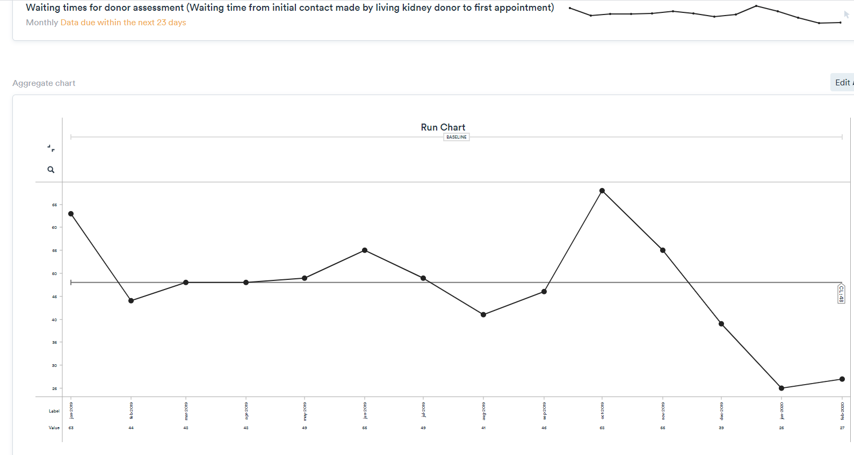
Secretary starts booking seminar appointments to commence January 2020
Seminars begin

Slide 5
Seminars Begin

Slide 6
More nephrologist slots

Slide 7
Coordinator on sick leave /
Summer annual leave
Seminars begin

Slide 8
Donor Screening Outcomes
3 donors ruled out/on hold since January 2020 – donor BMI >38, severe COPD- deemed unfit to proceed following anaesthetic assessment
1 donors referred back to GP – high HBA1C
11 donors sent questionnaire’s, but never returned them
= 15 donors that would have been booked into seminar appointments who were unsuitable or may have DNA’d

Slide 9
Other Points to Mention
Doctors/Nurses/HCA’s have attended LD seminars on a weekly basis to improve understanding of the LD process
Donor feedback has been excellent
Preferred group setting- felt “less alone”, lots of question’s asked by people that others may not have thought of
More efficient time management for coordinators- saving 9 hours total time spent in initial assessment clinic per week (per team)
More convenient for donors who come forward at different time periods, due to work or location etc. (not all donors have to attend at the same time)

Slide 10
Future Plans
Nurse living donor seminars at referring centres
EPAT (Electronic psychosocial assessment tool) to go live
Work on a living donor website
? Home BP readings for donors rather than 24 hour BP
Encourage kidney recipient/potential donors to attend LD seminars for educational purposes.

