Slide 1
KQUIP
Transplant First Meeting Monday 9th March 2020
Oxford

Slide 2
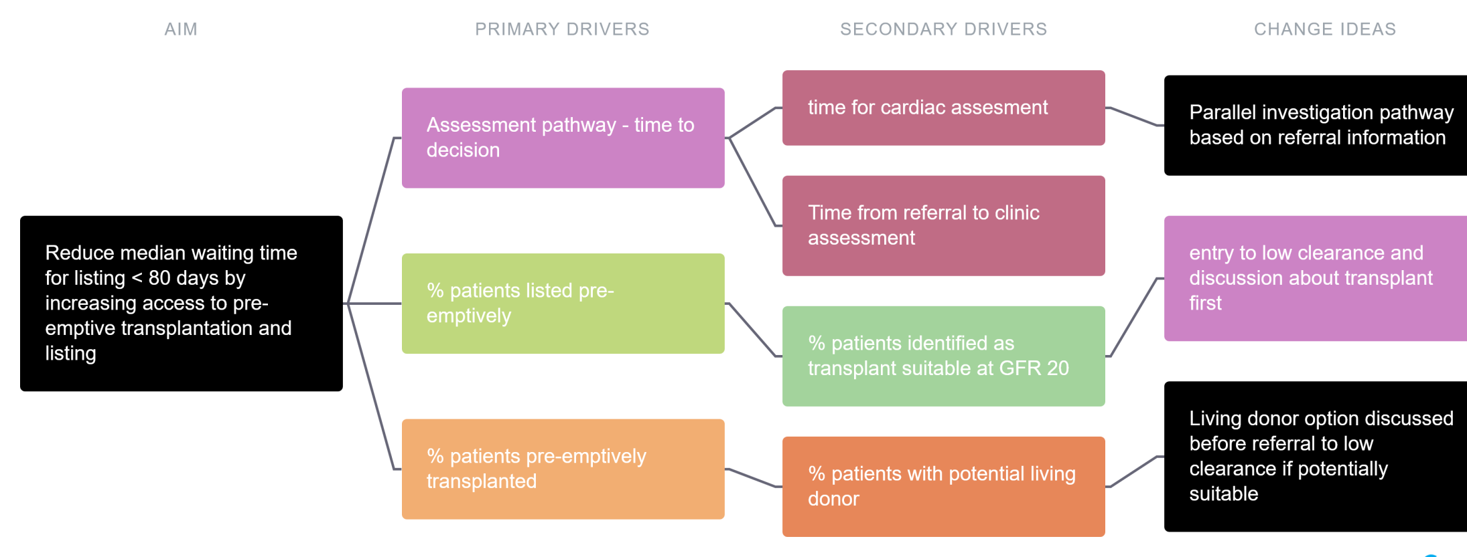

Slide 3
centre | N on RRT | % pre-em Tx | % LD pre-em TX | % WL at RRT start incl Tx | % WL @ 2 yrs | median time lisitng
Oxford | 268 | 19.4 | 6.3 | 41 | 66.4 | 140
Gloucester | 84 | 4.8 | 4.8 | 25 | 54.8 | 619
RBH | 133 | 8.3 | 5.3 | 22.6 | 54.9 | 292
Belfast | 112 | 40.2 | 32.1 | 53.6 | 69.6 | 0
Guys | 249 | 23.3 | 13.3 | 34.9 | 54.2 | 435
Birmingham | 357 | 10.60 | 7.6 | 28.6 | 51.3 | 616
Stoke | 122 | 2.5 | 0.8 | 20.5 | 52.5 | 505

Slide 4
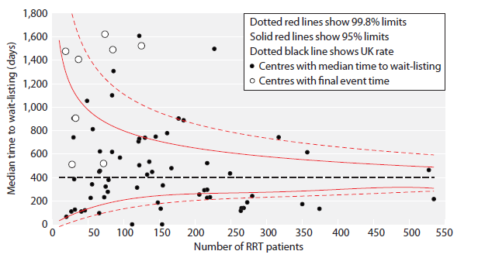

Slide 5
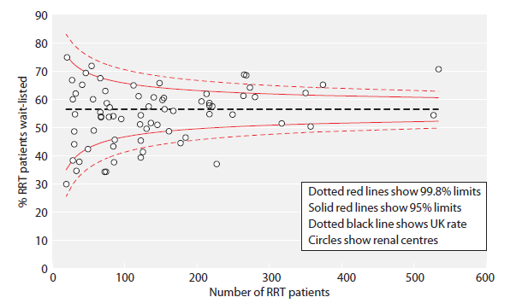
% adult RRT wait-listed prior to 2 years of starting RRT (adjusted)

Slide 6
KQUIP
Pre-Emptive Transplant Meeting Monday 9th March 2020
Improving the Recipient Assessment Pathway

Slide 7
KQUIP OXFORD & THAMES VALLEY REGION LAUNCH DAY Recipient Pathway- The Good/Not So Good/The Future Recommendations
THE GOOD | THE NOT SO GOOD | THE FUTURE
Quality of information and communication at clinic at face to face appointment | No agreed referral criteria | Standardised referral criteria and information
Great to have a named nurse, know who to communicate with | Long wait from referral to Tx assessment appointment | Peripheral clinics, can offer reassess if pts want this
Patient seminars | Long wait for cardiac tests | Direct cardiology referrals and link at peripheral hospitals
Staff have a good knowledge | No information in alternative languages | Timely and more standardised timing of referral for tx assessment
Comprehensive and thorough information given to donors | Repeated information at clinic appointment by nurse and surgeons | Explore information in other languages and on line videos
Communication between recipient and LD team | Too much information at a single appointment | Agreed work up tests for specific patient groups

Slide 8
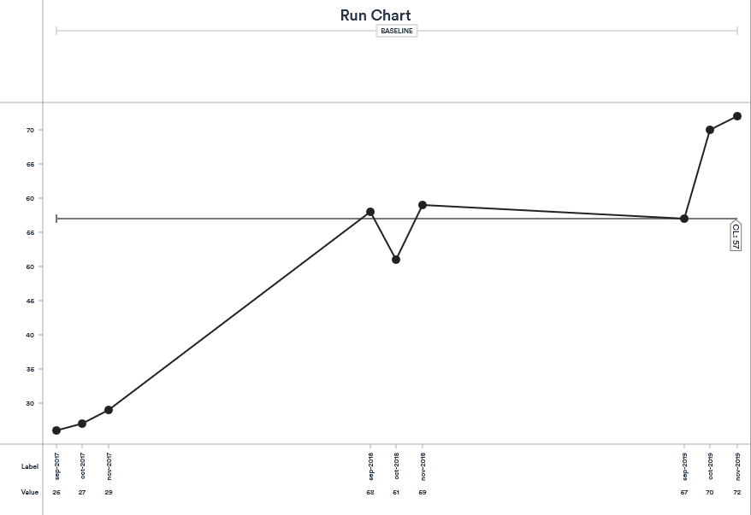
Waiting time from referral to assessment clinic appointment

Slide 9
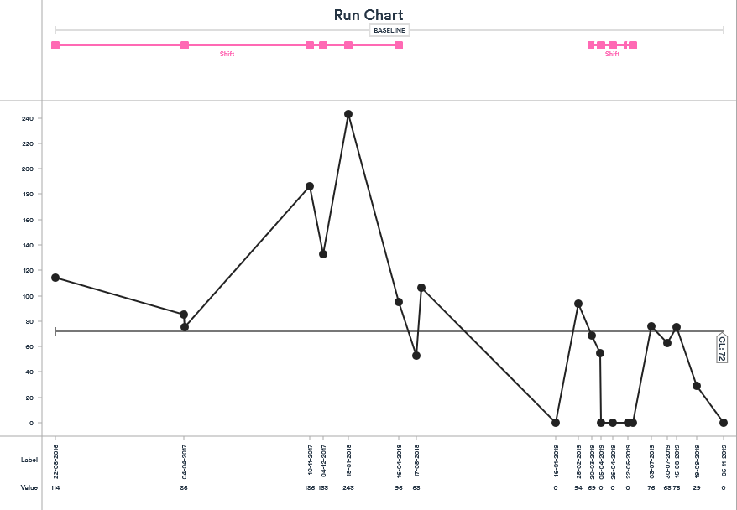
Waiting time from referral to cardiac investigation
Screening referral letters- MPS/ECHO

Slide 10
Future Plans
Standardised referral timing, information and criteria
Allow further screening and timely referral for further investigations
Ensures timely referral to allow sufficient time for potential pre-emptive transplant
Peripheral clinics
Reduce DNA’s
Improve links with referring hospitals
Cardiac link in referring hospitals may allow direct referrals

Slide 11
KQUIP
Pre-Emptive Transplant Meeting Monday 9th March 2020
Streamlining the Living Donation Pathway

Slide 12
KQUIP OXFORD & THAMES VALLEY REGION LAUNCH DAY LD Programme- The Good/Not So Good/The Future Recommendations
THE GOOD | THE NOT SO GOOD | THE FUTURE
Single point of referral for donors | Waiting time for initial appointment too long | Patient LD Seminars
Great to have a named nurse | More help for recipients to ask family/friends to consider living donation | Nurse LD seminars at referring centres
Remote/overseas donors- not a problem (appointments consolidated) | A need for donor forums/seminar or LD website | Online video’s to include patient stories
Staff have a good knowledge | A need for more info to be available for Nephrologist to give to donors | Weekend/out of hours appointments
Comprehensive and thorough information given to donors | A point of contact for sharing knowledge or information giving | Outreach/peripheral LD clinics
Face to face meetings | Need for more information pre-emptively and in advance for recipients, about the possibility of living donation | More press and publicity nationally
Efficient process for donors

Slide 13
Old Pathway Versus New Pathway
New pathway
Old Pathway
LD initial assessment clinic every Tuesday and Wednesday
1 family or altruistic donor seen per LD coordinator, or one large family divided by 2-3 coordinators (4-8 week waiting list)
Each initial assessment clinic takes the coordinator on average 2-3 hours.
Crossmatch takes up to 2 weeks to process, then coordinator sends compatibility test results to the donor (2-3 weeks)
Clinical Immunology team can only process 8 cells a day (formal XM) therefore a limit to the number of formal crossmatches that can be processed.
Coordinator commences donor work up (4- 6 weeks minimum)
Donors complete the donor questionnaire prior to the seminar & GP summary obtained
One coordinator presents the LD seminar for all donors and their recipients as a group
Powerpoint presentation to aid education
Virtual crossmatches - No limit to the number of virtual crossmatches that can be processed.
Coordinators split donors to be seen for history taking consultation (coordinator already has background PMH)
LD presentations can contain a mix of donors and recipients who wish to get compatibility tested and those who are only attending for educational reasons
Internal or external healthcare professionals can attend the seminars
Donors requiring an interpreter – have one to one initial assessment

Slide 14
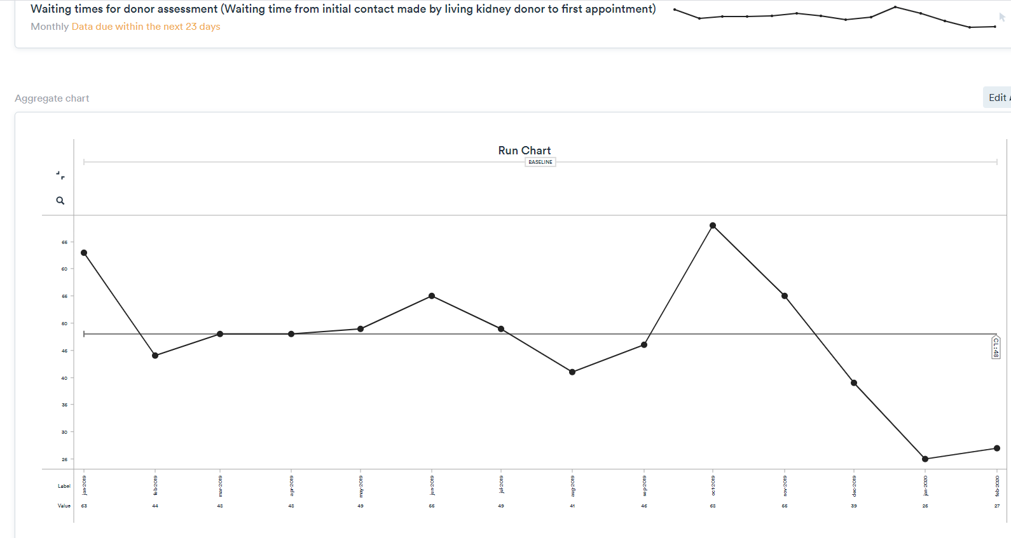
Secretary starts booking seminar appointments to commence January 2020
Seminars begin

Slide 15
Seminars Begin

Slide 16
More nephrologist slots

Slide 17
Coordinator on sick leave /
Summer annual leave
Seminars begin

Slide 18
Donor Screening Outcomes
3 donors ruled out/on hold since January 2020 – donor BMI >38, severe COPD- deemed unfit to proceed following anaesthetic assessment
1 donors referred back to GP – high HBA1C
11 donors sent questionnaire’s, but never returned them
= 15 donors that would have been booked into seminar appointments who were unsuitable or may have DNA’d

Slide 19
Other Points to Mention
Doctors/Nurses/HCA’s have attended LD seminars on a weekly basis to improve understanding of the LD process
Donor feedback has been excellent
Preferred group setting- felt “less alone”, lots of question’s asked by people that others may not have thought of
More efficient time management for coordinators- saving 9 hours total time spent in initial assessment clinic per week (per team)
More convenient for donors who come forward at different time periods, due to work or location etc. (not all donors have to attend at the same time).

