Slide 1
Working together to support people living with kidney disease
Olivia Johnson & Alison Dean

Slide 2
Benefits of our support
Royal Berkshire Hospital
Our ask today
Notes:
Alison

Slide 3
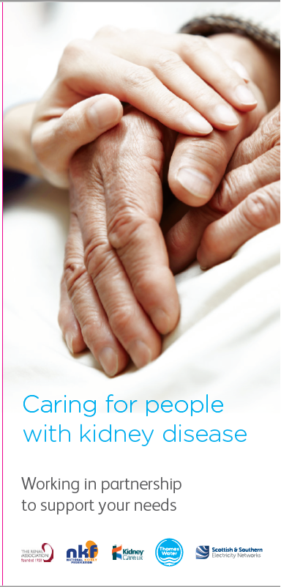
The benefit of our support
Based on:
Clinical insight
Need to add value / resilience & quality of care in and beyond hospital setting
Patient feedback
= Give patients the choice to review their finances and have added peace of mind in their home:
Reduce water and electricity bills via special tariffs, switching and energy saving.
Support navigating the benefit system with an income maximisation organisation.
Investigate eligibility for energy saving measures (grant/loans for home insultation).
In a power cut or water outage (unplanned or planned), we want to help kidney patients first, especially if they are a HD patient. Sitting alongside their care plan will mean we can give added peace of mind at home. This is called the Priority Services Register.
Notes:
Alison - Finance isn’t a need for everyone – but PSR is “uncertainty is the biggest thing that makes you vulnerable”

Slide 4
Royal Berkshire Hospital
Achieved:
Met and trained all staff in Home Therapies, low clearance clinics & 2 social workers
CAPD team have PSR embedded in their PD training
Lead sister managing 3 satellite centres – has opened her doors
Angela Clark and team on dialysis wards signpost via leaflets and posters
Still to come:
Design a process for on ward discharge
Waiting to speak to IT - online proformas
Benefits of registering:
“It’s hard to explain how much reassurance this gives me and my family – being informed gives me great peace of mind, I can’t fault it, it’s so helpful. I spend a lot of time at home by myself and being registered for priority services gives my partner peace of mind. He feels like I am safer because of it – there are no surprises – and if our water stopped or there was a power cut, the dedicated phone line means I can get the help I need. I have nothing but praise for that”
Donna Smith, HD patient, Reading.
Notes:
Liv

Slide 5
The ask
Our aim is to leave a legacy
We can’t always be on site to promote and sign people up
Unwavering respect for clinical time
By working with the Renal Association our aspiration is find relevant and timely opportunities to embed into a trusts BAU processes
patient proformas?
on-ward discharge?
supportive care patients programme?
quality improvement manager or programme?
resilience planning of satellite centres and their quality measures for their patients?
patient support groups do you promote?
wellbeing advice and information support?
training
patient facing events
Notes:
Liv

Slide 6
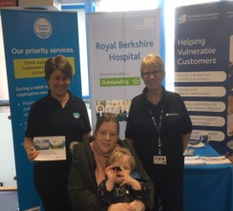
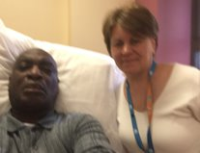
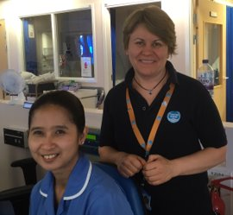
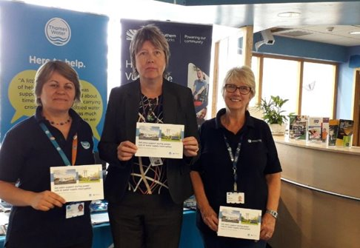
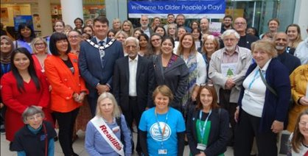
Our ask
Be aware
“This work improves our patients’ experiences inside the hospital and beyond – something the Royal Berkshire NHS Foundation Trust always aspires to achieve” Royal Berkshire Hospital
Share with colleagues
Ask how we can help/add value
Notes:
Liv

Slide 7
Thank you
Olivia Johnson – 07785 523624 Alison Dean – 07876 837283

