Slide 2
Driver Diagram
AIM
PRIMARY DRIVER
SECONDRY DRIVER
CHANGE IDEAS

Slide 3
FISHBONE DIAGRAM

Slide 4
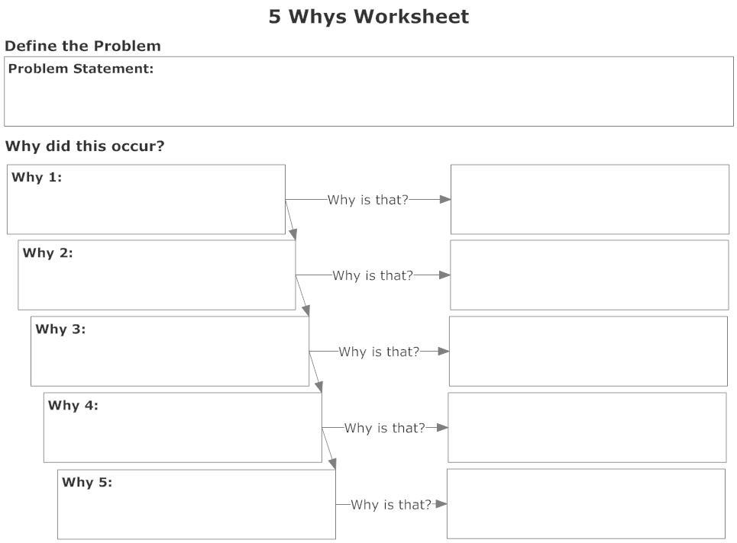

Slide 5
PDSA CYCLE
ACT
PLAN
STUDY
DO

