Slide 1
MAGIC
Katie Fielding, MAGIC Lead
Trainee ACP and Research Fellow,
University Hospitals of Derby and Burton NHS Foundation Trust
Margaret Aitken, MAGIC Co-Lead,
Vascular Access Clinical Nurse Specialist, Queen Elizabeth Hospital Glasgow

Slide 2
Timetable
Time | Session | Presenter / Facilitators
13.25-13.40 | Introduction to MAGIC | Katie Fielding
13.40-13.50 | NHS Improvement Model & MAGIC | Katie Fielding
13.50-14.00 | MAGIC Aims and Objectives | Margaret Aitken
14.00–14.20 | Group work – aims and objectives
14.20-14.35 | Feedback on group work | Margaret Aitken
14.35-14.40 | SMART objectives | Katie Fielding
14.40-14.55 | MAGIC’s measurement strategy | Katie Fielding
14.55-15.05 | Groupwork - measures
15.05-15.15 | Feedback on groupwork | Katie Fielding
15.15-15.20 | MAGIC Measurement Platform | Katie Fielding
15.20-15.25 | Next Steps | Katie Fielding

Slide 3
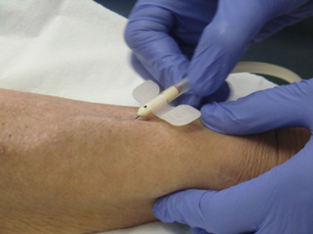
What is MAGIC?
‘Managing Access by Generating Improvements in Cannulation’
Quality improvement project
Structured by BRS VA and VASBI
Based on BRS and VASBI needling recommendations
  Defines best practice
Aim:
Improve cannulation
  Preserve AV access function
  Minimise complications
  Optimise patient experience
Make AV access a viable patient choice
To improve prevalent AV access rates
Notes:
If we make our access last longer and patients are more likely to choose AV access then we will increase prevalent rates – hopefully without just thowing lots of new AV access formation at it

Slide 4
Sections of the Recommendations
Principles of a Good Needling Technique
Technical Principles to aid Decision Making Prior to Needle Insertion
Procedural Principles for Good Needle Insertion
Assessment of AV Access Prior to Needling
Definitions of Needling Techniques
Choosing the Needling Technique and Planning Needling
Rope Ladder Needling Technique
Buttonhole Needling Technique
Area Puncture Needling Technique
Needling of New AV Access
Use of Nurse-Led Ultrasound to Assist with Needling
Managing Anxiety during Needling
Involving Patients in Care of their Vascular Access
Teaching Patient how to Self-Needle
Staff Training to Perform Needling of AV Access
Define Good Cannulation (3)
Assessment Pre-Cannulation (1)
Needling Techniques (5)
Needling new Access & US (2)
Managing Anxiety (1)
Involving Patients (2)
Staff Training (1)
Notes:
15 sections – Less time
First 3 look at how you needle general
Section on assessment
5 around what we mean by rope ladder, buttonhole and area puncture, how we choose which technique and which is the best way to perform these techniques
Also exmained other aspects including needling new AV access, use of US by nurses, managing anxiety
2 sections on involving your patient – felt this was critical
1 section on staff training.
Not going to go through all but look at few sections in detail

Slide 5
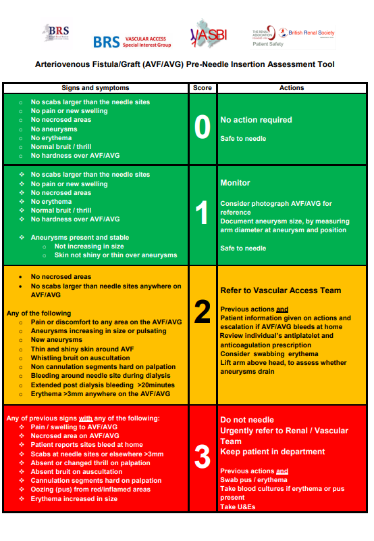
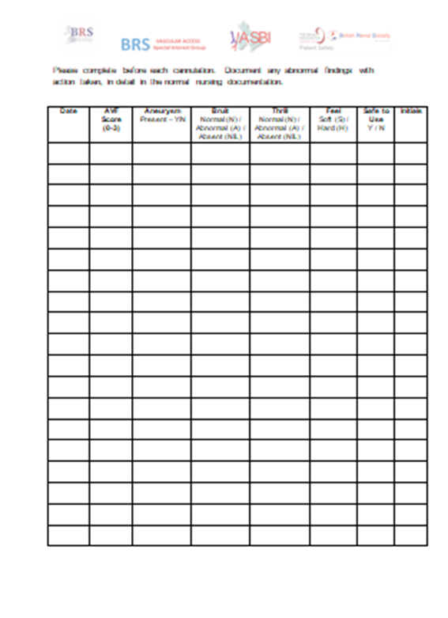
Pre-Cannulation Assessment
Notes:
One of the aspects that is critical to achieving a good needle insertion is
History – what have previous cannulations been like - help guide this one
Developed a tool to assess AV access prior to cannulation – very similar to VIP type scores

Slide 6
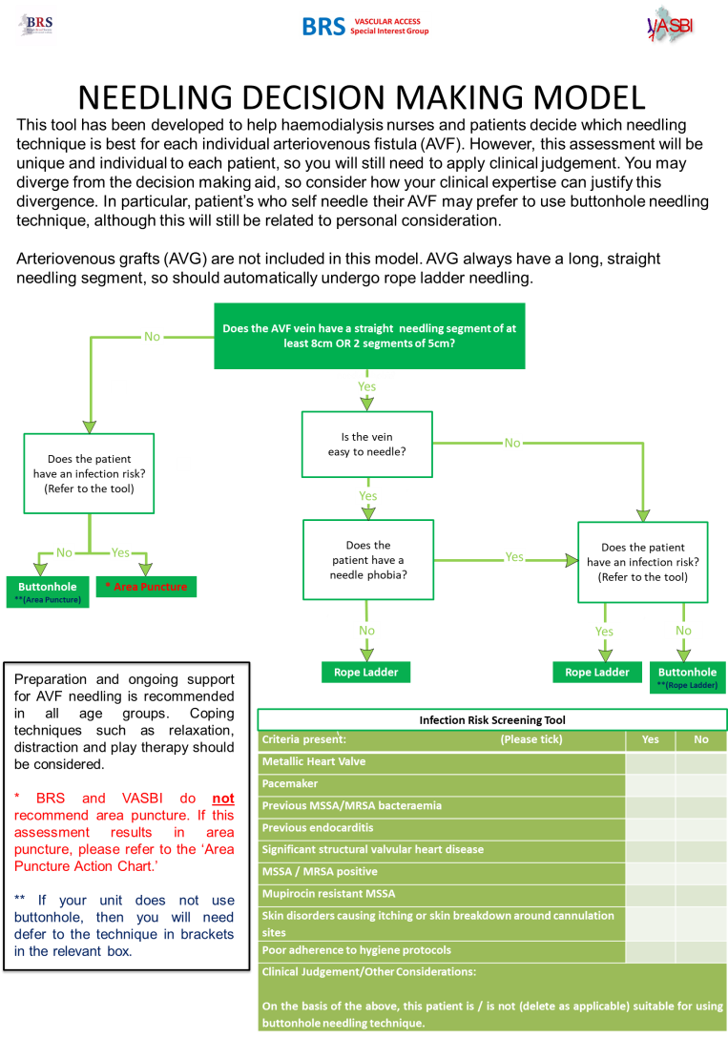
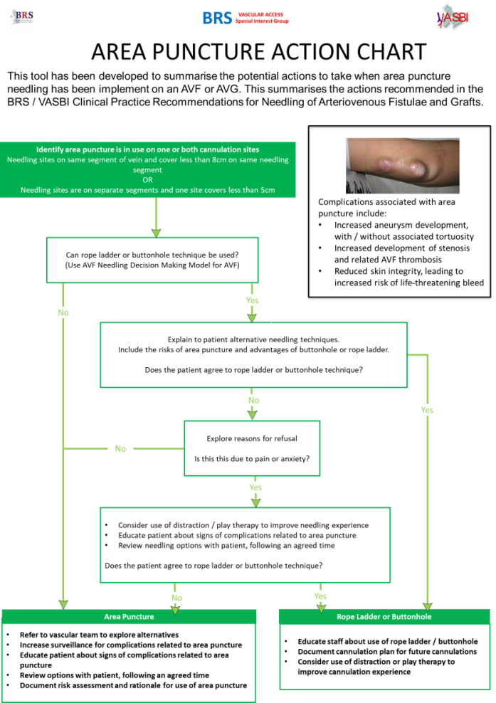
Choosing your Cannulation Techniques
How to Avoid Area Puncture

Slide 7
Implementing MAGIC
Develop QI capability
Monthly Measures
Phase 1
Staff Education
Phase 2
Patient Awareness
Phase 3
Region Designed
Baseline Measures
Notes:
3 monthly phases
Talk about ELearning in Phase 1 and patient awareness materials in Phase 2
Eventually left with measurement strategy and own network

Slide 8

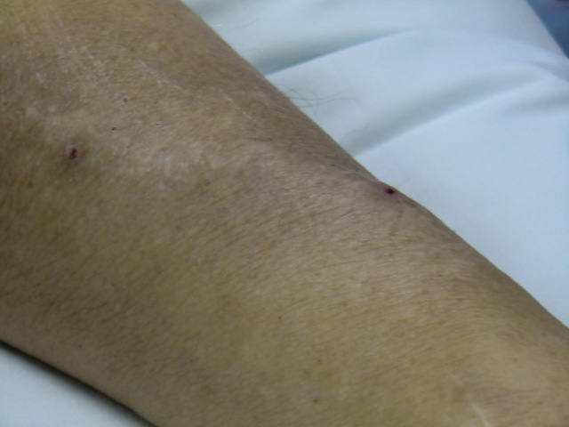
What does success look like?
AV access used for all HD patients, who it is suitable for
Achieve 80% + RA standards
Notes:
In theory success is every patient who it is suitable for using a fistula or graft for HD …
Included a picture of this being needled, as we are talking about being used for HD
RA standards promote this aim ….
However, this is a very grand aim, with a very unclear path to achieve success that in reality many units have worked on for years without success.
Animated 1 - So what we also want is AV access that looks like this – nice and flat with no signs of complications from needle insertion
Would they agree this is what our patients want?
However we have a number of steps to achieve this – one QI project not going to solve all the problems
So what might succes in those steps look like?

Slide 9
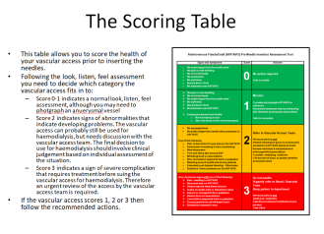
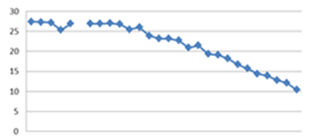
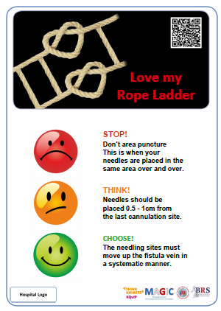
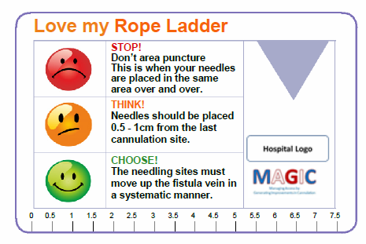

Complete MAGIC
ELearning:-
  A&P
  AV access assessment
  Cannulation
  Access complications
  Quiz to assess learning & certificate
Notes:
Animated Collect measures and embed regular collection in practice – measures mean something to you and affect practice
Animated Implement and use ELearning package – that it helps improve your cannulation practice
Animated Implement and use awareness materials and that patients find these useful
- No image for this one as we don’t know what this is going to be - Design their own intervention for Phase 3
Animated - Do this collectively as a region
Create a sustainable regional network to do QI within

Slide 10
Optimise clinical outcomes related to cannulation
Minimise ….
Promote ….
Area Puncture
Missed Cannulation
Infection
AV access failure
CVC use
Good cannulation technique
  Accurate and gentle
  Rope ladder & / or buttonhole
Good patient experience
Patients choose AV access
Longevity of access
AV access use
Notes:
Optimise – improve or sustain …..

Slide 11

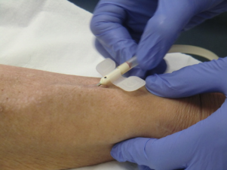

Your journey after MAGIC ….
Surveillance
VA MDT
Vascular Access QI
Patient Education
CVC use:
Minimise complications
Cannulation
Notes:
Whilst MAGIC is major part of promoting AV access use – there is actually more to VA QI than just this
We need you to carry on solving your problems – so success will also look like future QI

Slide 12
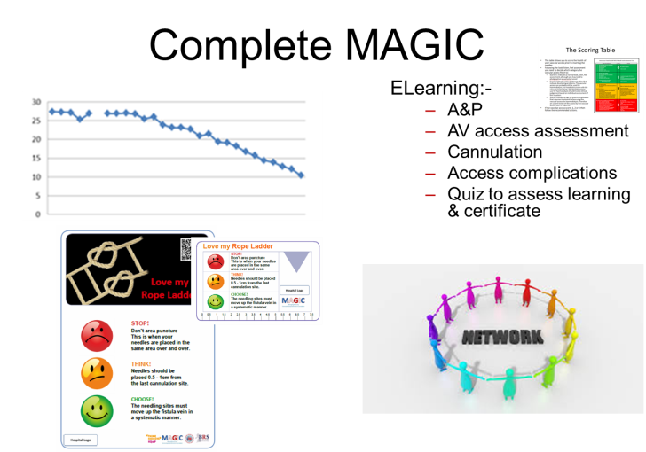
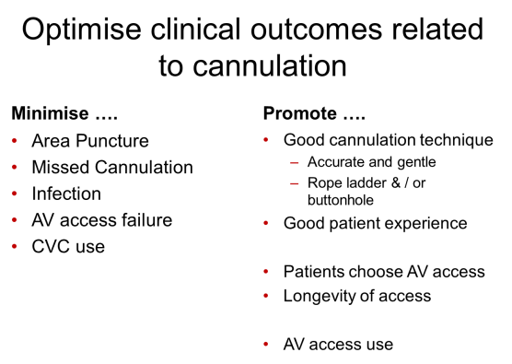
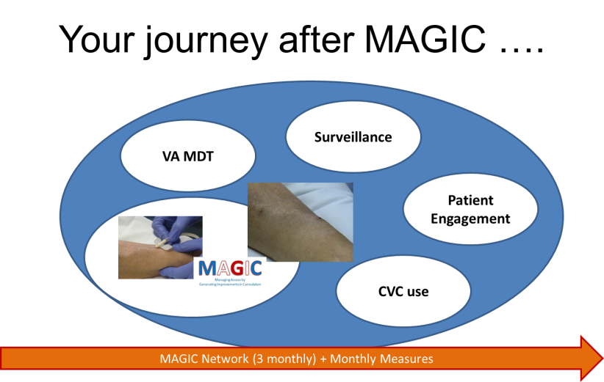
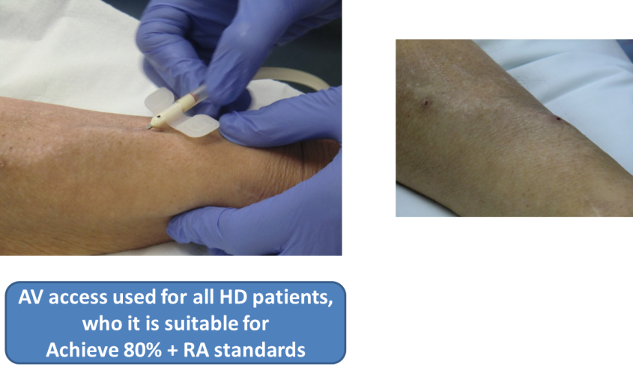
What does success look like?
Notes:
So what does success look like – yes it looks like this picture
Animated - But if we break is done, success also looks like all of these elements

Slide 13

Improvement Tools

Slide 14
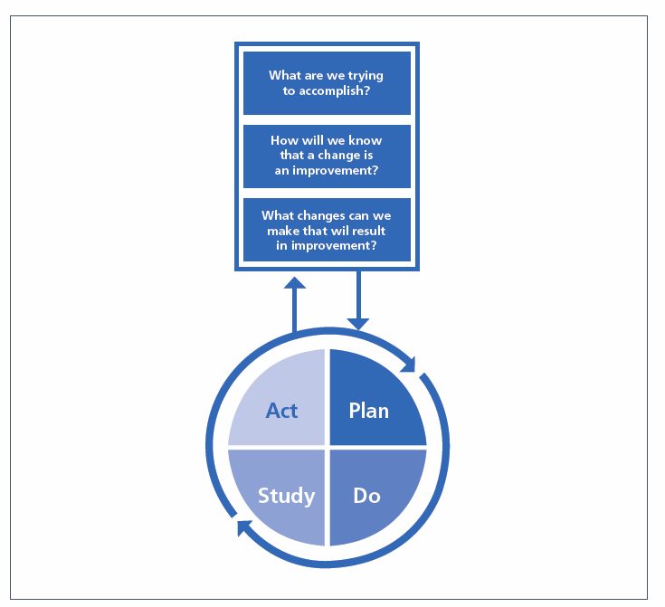
NHS Model for Improvement
‘The model for improvement provides a framework for developing, testing and
implementing changes leading to improvement. It is based in scientific method and moderates the impulse to take immediate action with the wisdom of careful study.’
(NHS Improvement)
Test out change on small scale
Learn from implementation
Identify what does and does not work
Minimises disruption from change
Simple and easy
Notes:
Animated – how many heard of the model for improvement
Not going to learn about it all today – going to focus on the first 2 questions and gradually learn as you need to know for implementation

Slide 15


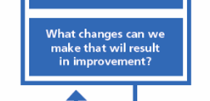
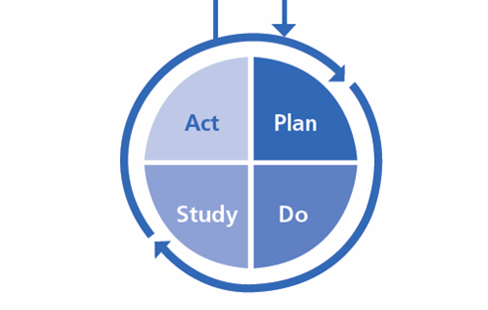
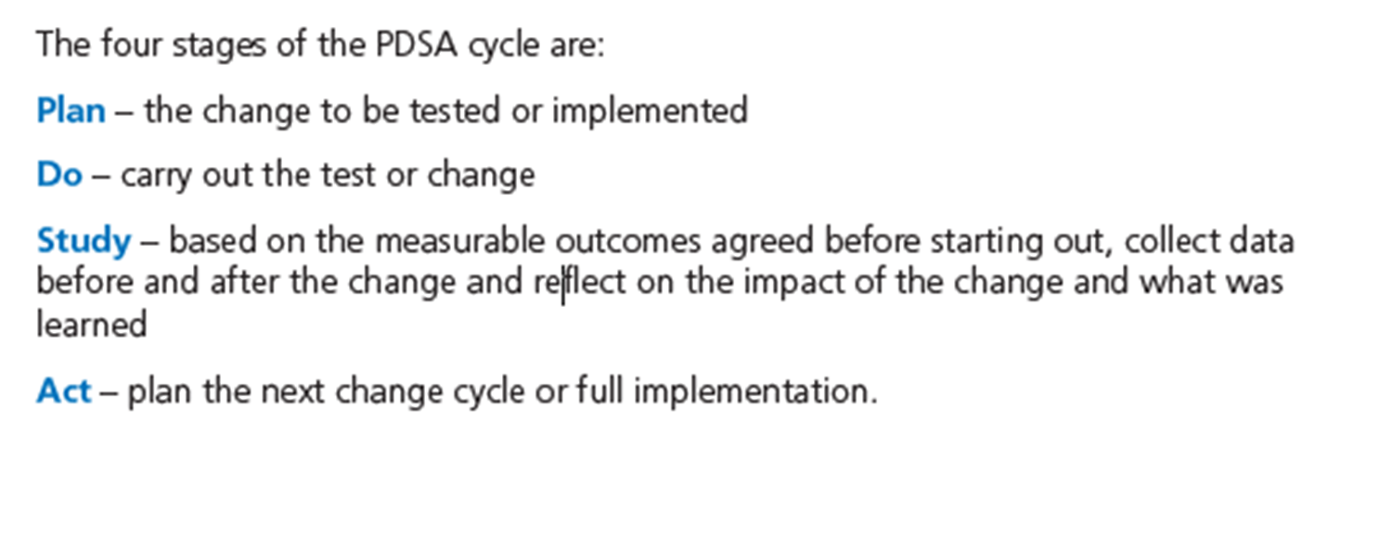
Aims and Objectives
Measurement
Intervention
Evaluates the change
Respond to success and challenges
Intrinsically linked with question 3
Notes:
Looks at model in more detail
Your intervention often driven by data and what you fin in your previous cycle
Contiuous cycle of improvement

Slide 16
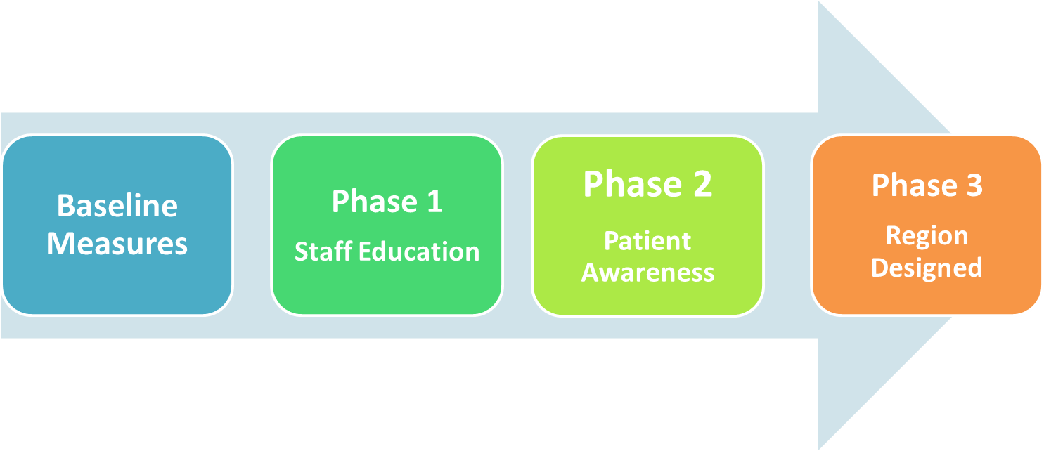
Application to MAGIC
What are we trying to accomplish – Aims and objectives
How we will know we’ve created an improvement – 7 outcome measures
What are we going to change – Staff Education … (then patient awareness, then region designed phase)
Baseline Measures
Plan – Staff Education Phase
Do – Take and implement the plan in your units
Study – how have you baseline measures changed
Act – Patient Awareness PDSA
….
Act – Region designed phase
Notes:
Animated – been learning about these today – this where they would fit – however MAGIC has done much of this.

Slide 17

MAGIC Aims and Objectives

Slide 18
Core Aims and Objectives
Short and long term objectives
Focussed on those affected by cannulation
MAGIC AIM: To promote good cannulation practice and improve the patient experience of cannulation
Notes:
Objectives break down the aim into manageable chunks – show objectives and go through
Is about what is important to both clinicians and patients – the latter is important but often missed
Looks at cannulation technique, missed cannulation, pain, infection, AV access use, loss and gain and evaluating MAGIC materials

Slide 19
Objectives
Short Term
Maximise RL and BH, minimise area puncture
Minimise missed cannulation
Minimise pain
Minimise infection
Long Term
Increase rates of AV access
Reduce AV access loss
Minimise CVC use

Slide 20
Groupwork
Is there anything you would want to add to the objectives?
Is there anything you would like to change in the objectives?
Notes:
Split into to 2 groups – myself and Margaret facilitate one group each
10 mins discussion and 15 mins feedback and finalise

Slide 21
SMART Objectives
Specific
Measurable
Achievable
Realistic
Timely
Once you have your baseline data, set your SMART objectives
Notes:
Show on measurement objectives

Slide 22
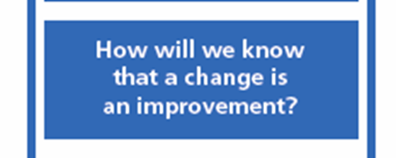
MAGIC Measurement

Slide 23
Why do we need to measure?
Know….
…we have achieved change
.. the change has had the correct effect
.. we are maintaining the change
…. what we need to focus on next
Notes:
Animated

Slide 24
What do you do with your data?
Interpret
  What does it tell you about your practice?
  Has something worked?
  What else needs to change?
Share
  Nursing staff
  Patients
  Wider team
DATA
CHANGE
Notes:
Animated
Important to use your data – not just a trick box exercise – this is the important part of QI, but all data
It is a privelage to get this data from patients – need to not waste their data and not waste our resources

Slide 25
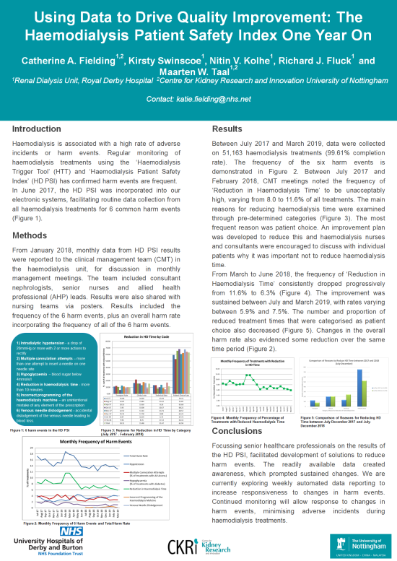
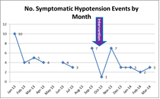
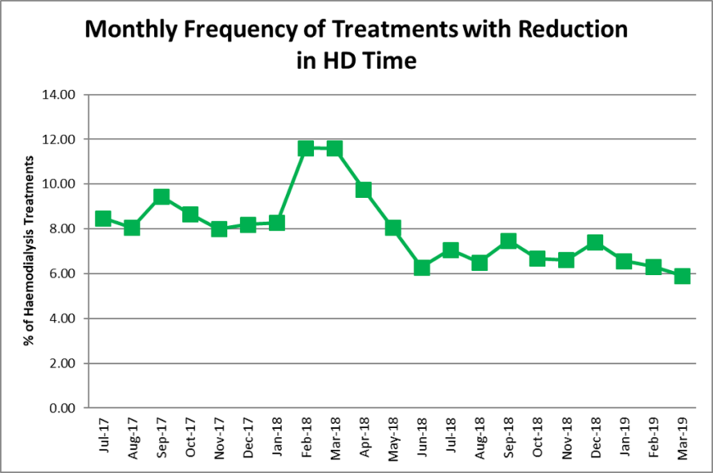
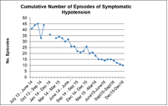
The Power of Data
Notes:
Example of a project I did
First 2 graphs – showed we had an issue, we implemented a change, we achieved a sustained decrease in events
Second 2 images – following on from this we didn’t need change, just neede data – this happened without an actual specific targeted change

Slide 26
Level 4: Clinical Outcome Measures
Mandatory patient measures
Mandatory unit measures
Needling technique
Missed cannulation
Patient experience of needling
Rates of AVF/AVG/CVC use
Infections
Number of AVF/AVG lost
Number of new AVF / AVG
Notes:
Going to focus on L4 measures – what you will be collecting initially and what will drive your practice – is open to adaption but will look at in more detail on 05/02

Slide 27
Patient Level Measures
Collect on sample of patients regularly
  Does not need to be same patients – better if it is not
  Snap shot of practice
Definitions
Needling technique
Missed cannulation
Patient satisfaction with needling

Slide 28
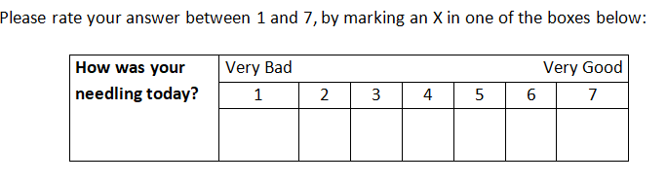
Patients Satisfaction with Needling
Mean score of your sample

Slide 29
Unit Level Measures
% of your HD population ….
… undergoing HD on a set day (including day before or after, to include all HD patients)
i.e. % of your population as it is today
Taken monthly
Rates of AV access used
Rates of new AV access
Rates of lost AV access
Infection

Slide 30
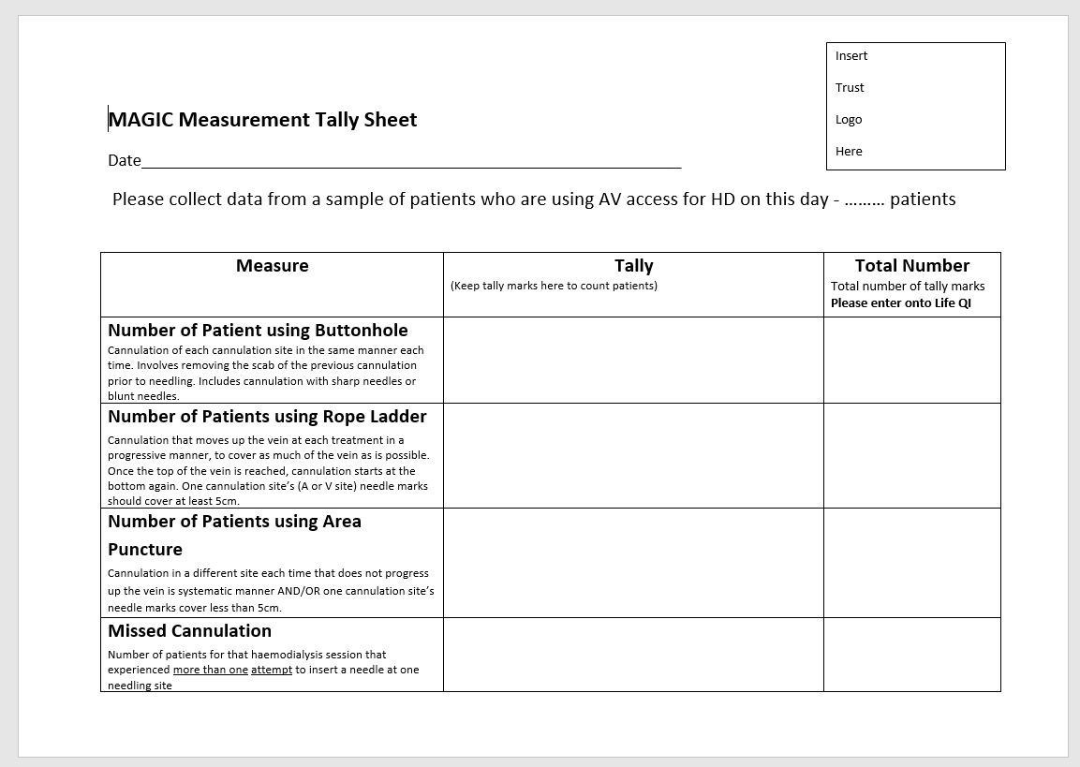

Slide 31
Groupwork
How often do you want to sample?
How many patients?
How do you want to set your unit?
- One only?
- All?
- Amalgamated or separately?
Notes:
Split into to 2 groups – myself and Margaret facilitate one group each
10 mins discussion and 15 mins feedback and finalise

Slide 32
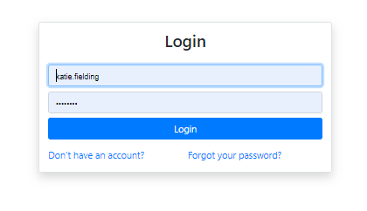
MAGIC’s Measurement Platform

Slide 33
Why?
Online platform
  magic.renalreg.org/accounts/login/?next=/
Allow you to collect your data
Converts into line charts (run charts … ish)
Can allow your whole team to have access
Share data in region / unit
Staff User
  Add staff
  See data for all units

Slide 34
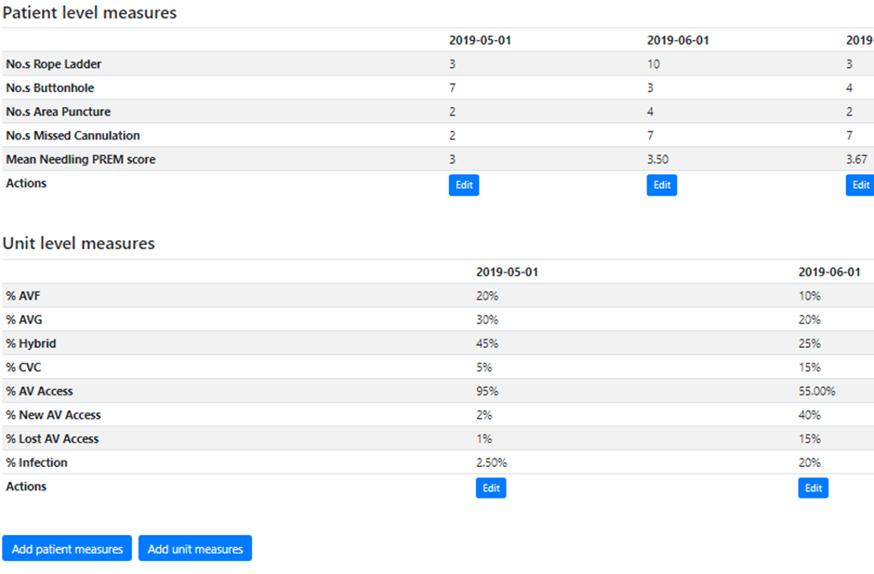

Slide 35
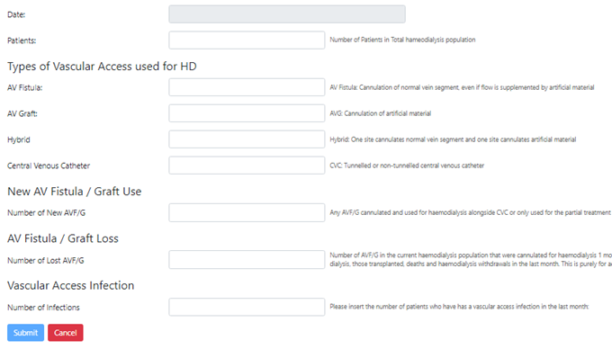
Notes:
Have unit level measures – so canput in exact number of HD patients (will work out % later for graphs)

Slide 36
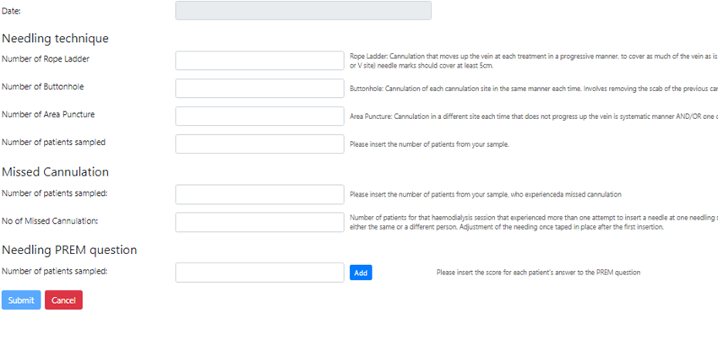

Slide 37
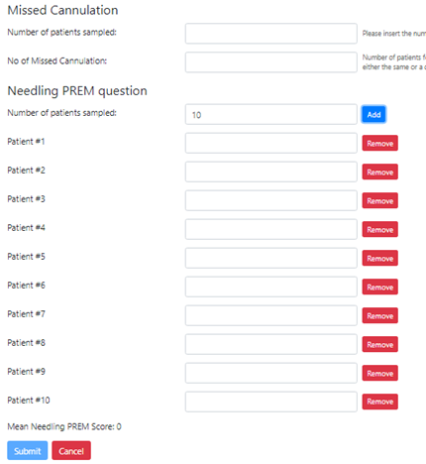

Slide 38
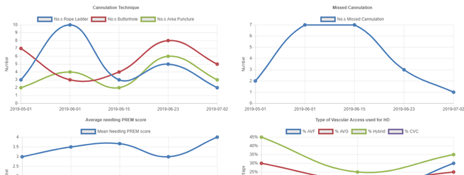

Slide 39
Practicalities
Identify how you want to structure your unit
  Satellites and main separate or together?
Identify how many patients and how often you are going to sample your patient level data
Identify ‘Staff User’ (s)
Let Leeanne and Ranjit know
Written instructions

Slide 40
Next Steps

Slide 41
Summary
What MAGIC is
  NHS Model for Improvement
Aims and Objectives
Measurement
Notes:
QI methodology throughout

Slide 42
Application to MAGIC
What are we trying to accomplish – Aims and objectives
How we will know we’ve created an improvement – 7 outcome measures
What are we going to change – Staff Education … (then patient awareness, then region designed phase)
Baseline Measures
Plan – Staff Education Phase
Do – Take and implement the plan in your units
Study – how have you baseline measures changed
Act – Patient Awareness PDSA
….
Act – Region designed phase
Notes:
Animated – been learning about these today – this where they would fit – however MAGIC has done much of this.

Slide 43
Month 1
Choose needling champion
Month 1-3
Collect clinical outcome data and input into measurement platform - ideally at least 6 sets of measures to obtain a baseline
Agree aims, objectives and clinical outcome measures – consider what, when, who, how
End of Month 3
Review clinical outcomes data collected to set SMART objectives
Month 4 - 6
Launch MAGIC ELearning
Continue collecting, inputting and reviewing clinical outcome data
End of Month 6
Collect and review MAGIC ELearning process data, including MAGIC ELearning evaluation forms
Month 7-9
Order patient awareness materials for printing
Launch patient awareness materials
Ask 10 random patients (per unit) to complete pre questions for patient awareness phase
End of Month 9
Ask 10 random patients (per unit) to complete post questions for patient awareness phase
Continue collecting, inputting and reviewing clinical outcome data
Month 10-12
Review patient awareness process data
Implement region designed phase
Continue collecting, inputting and reviewing clinical outcome data
End of Month 12
Review clinical outcomes and process data to:
Identify impact of MAGIC
Plan next PDSA cycle
Month 13 onwards
Continue vascular access QI independently
Identify and agree sites for inclusion – consider satellite units
Review MAGIC ELearning process data
Meet with MAGIC steering group to identify and map out the region designed phase

Slide 44
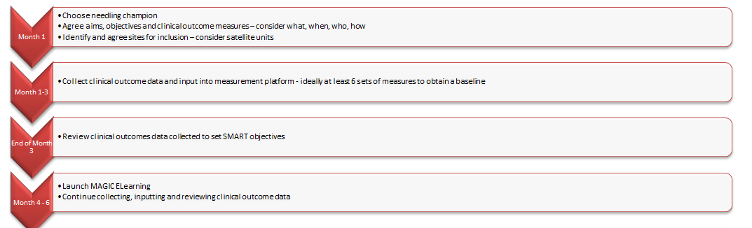
What do you need to get started?
Choose needling champion
Access to measurement platform
  How set up units
  Sample size
  Frequency
Start collecting data
  Who
  How
  Set deadlines
  Input into measurement platform
6 measurement sets then set SMART objectives
Next phase ….
  Staff education
Notes:
Help form us – we have full time jobs and no funding
Telephone conference calling account and the resources we have described

Slide 45
Expectations by Training Day 1 (12/03/20)
Present baseline data
Be ready to move into the first PDSA
  Staff Education
  Continue with measures
MAGIC ELearning & Process Evaluation

