Slide 1
Carlisle
“MAGIC”

Slide 2
What Have we done!
Audited and recorded 2 data sets on the ‘MAGIC’ platform.
Adjusted our unit based AVF surveillance tool to accommodate some ‘MAGIC’ data set requirements.
Set up a ‘mini’ access team.
Set up an education file on unit computer for all to benefit from.
‘Spread the word’

Slide 3
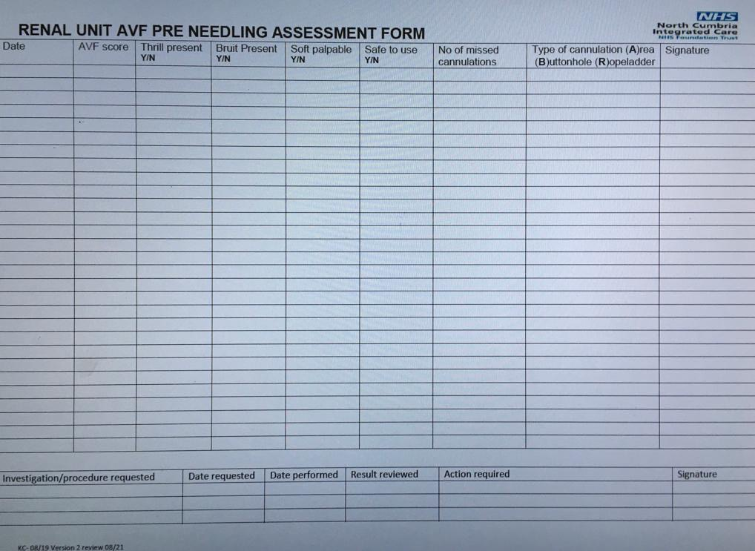
AVF Surveillance tool

Slide 4
What have we discovered so far!
Our definition of ‘missed cannulation’ has had to be redefined.
Dialogue has been promoted on the topic of access.
As a team a more considered approach is being used for the process of cannulation.

Slide 5
Any questions?

