Slide 1
Kidney Quality Improvement Partnership (KQuIP) #KQuIP
North East & Hull – Launch Event
28 January 2020

Slide 2
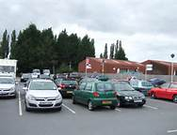
Housekeeping and survival
Fire alarms
and exits…
Car Park …
Toilet location…
Photos…
Mobiles
Breaks…

Slide 3
Kidney Quality Improvement Partnership (KQuIP) #KQuIP
Welcome and Introductions
Katy Jones, Regional Lead
Ranjit Klare, QI Programme Manager
Ron Cullen, CEO Renal Association

Slide 4
Kidney Quality Improvement Partnership (KQuIP) #KQuIP
What is MAGIC?
Jennifer Adam

Slide 5
Kidney Quality Improvement Partnership (KQuIP) #KQuIP
PREM Needling Data
Katy Jones

Slide 6
Kidney Quality Improvement Partnership (KQuIP) #KQuIP
Patient Experience
Vicky Harrison
Linda Pickering

Slide 7
Kidney Quality Improvement Partnership (KQuIP) #KQuIP
Complicated Fistula (Each Unit)
Facilitator: Nicole Williams

Slide 8
Kidney Quality Improvement Partnership (KQuIP) #KQuIP
What have we done since we last met?
(Each Unit)
Facilitator: Katy Jones

Slide 9
Back in 30 mins – Break/Networking

Slide 10
World Café Session
15 mins per table
5 mins topic discussion
10 mins discussion
Expert Nursing Group – VA
MAGIC
Patient Experience

Slide 11
Kidney Quality Improvement Partnership (KQuIP) #KQuIP
Next steps
Ranjit Klare

Slide 12
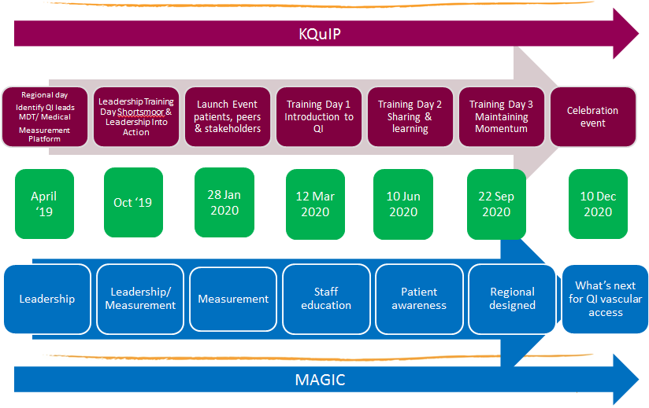
Seven steps in the North East KQuIP MAGIC Programme

Slide 14
Kidney Quality Improvement Partnership (KQuIP) #KQuIP
Thank you for coming today
and
have a safe journey home

