Slide 1
PREM needling data
NE and Hull

Slide 2
The Kidney Patient Reported Experience Measure (PREM)
Annual national survey of kidney patients
Help renal unit teams understand how patients feel about their experience of care
Show where improvement can be made
Give us a national picture of people’s experience of care
Survey in June, reports in the new year, so 2019 just out!

Slide 3
Kidney PREM 2019

Slide 4
Mean scores by theme 2019, 2018 and 2017

Slide 5
Needling scores raise concern nationally
Sharing decisions
Transport
Needling
Nationally these are the three consistent and unchanged lowest scoring areas of patient experience for the past 4 years.
There is a call to action from kidney patients and the wider community to address the aspects of kidney care that impact most negatively on their experience
Mean needling score nationally in 2019: 5.8
Unchanged over 3 years

Slide 6
Needling question
Please answer this question on your own without asking anyone to help you decide what to answer. We cannot identify you from this questionnaire, so please answer honestly.
How often do the renal team insert your needles with as little pain as possible? | Never |  |  |  |  |  | Always
 | 1 | 2 | 3 | 4 | 5 | 6 | 7

Slide 7
National responses
Needling mean score 5.8
Standard deviation of centre means 0.3
Lowest centre score 4.8
Highest centre score 6.6*
Change since 2018 0
Only transport has a wider range between the lowest and highest score

Slide 8
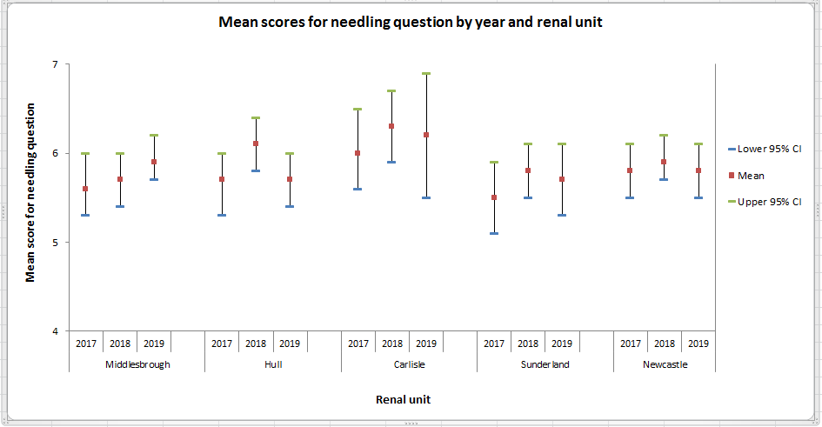

Slide 9
How often do the renal team insert your needles with as little pain as possible?
 |  | No of Patients | Lower 95% CI | Upper 95% CI | Mean
 | Unit
Middlesbrough | 2017 | 99 | 5.3 | 6 | 5.6
 | 2018 | 125 | 5.4 | 6 | 5.7
 | 2019 | 122 | 5.7 | 6.2 | 5.9
Hull | 2017 | 89 | 5.3 | 6 | 5.7
 | 2018 | 88 | 5.8 | 6.4 | 6.1
 | 2019 | 97 | 5.4 | 6 | 5.7
Carlisle | 2017 | 40 | 5.6 | 6.5 | 6
 | 2018 | 23 | 5.9 | 6.7 | 6.3
 | 2019 | 21 | 5.5 | 6.9 | 6.2
Sunderland | 2017 | 72 | 5.1 | 5.9 | 5.5
 | 2018 | 72 | 5.5 | 6.1 | 5.8
 | 2019 | 60 | 5.3 | 6.1 | 5.7
Newcastle | 2017 | 144 | 5.5 | 6.1 | 5.8
 | 2018 | 145 | 5.7 | 6.2 | 5.9
 | 2019 | 136 | 5.5 | 6.1 | 5.8
 | North East (2017) | 444 | 5.5 | 5.9 | 5.7
 | North East (2018) | 453 | 5.8 | 6 | 5.9
 | North East (2019) | 436 | 5.7 | 6 | 5.8

