Slide 1
WHO? WHAT? WHY? HOW?
Jen Adam, Consultant Nephrologist
North Cumbria Integrated Care Trust

Slide 2
What does a good vascular access service look like?
Patient
Haemodialysis
Nurses
Vascular Surgeons
Interventional Radiology
Nephrologist
Shared vision:
Timely access creation
Best cannulation
Robust monitoring processes
Early Identification of problems
Prompt access to intervention
Optimal patient experience

Slide 3
Cannulation
PLANNING
What is good cannulation?
NEEDLING
TECHNIQUE
PATIENT
INVOLVEMENT

Slide 4
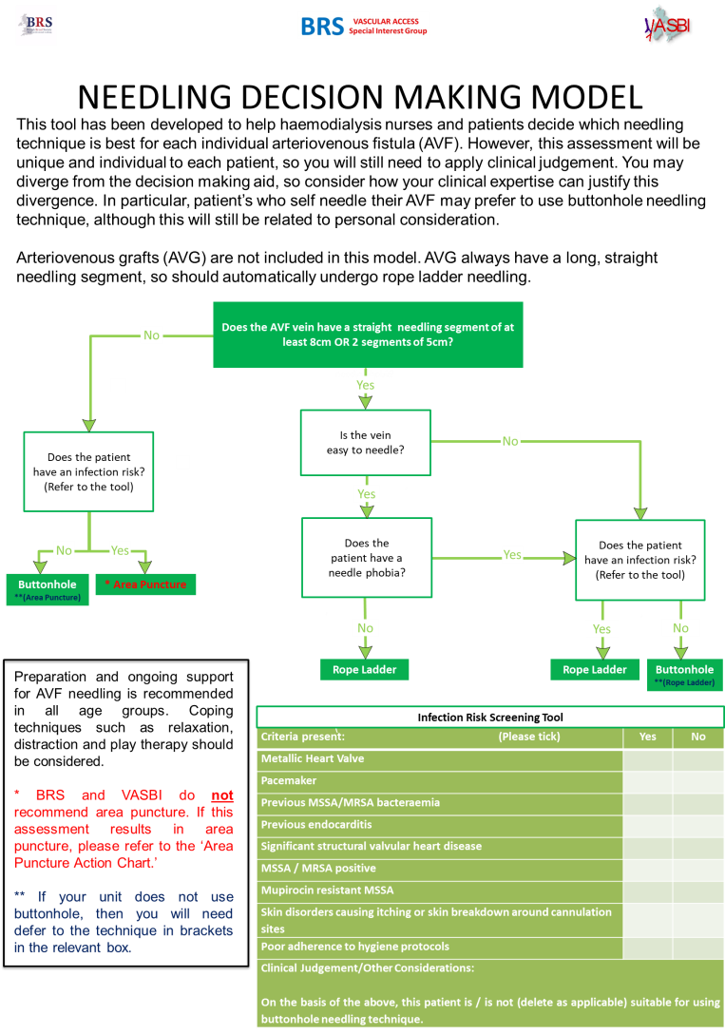
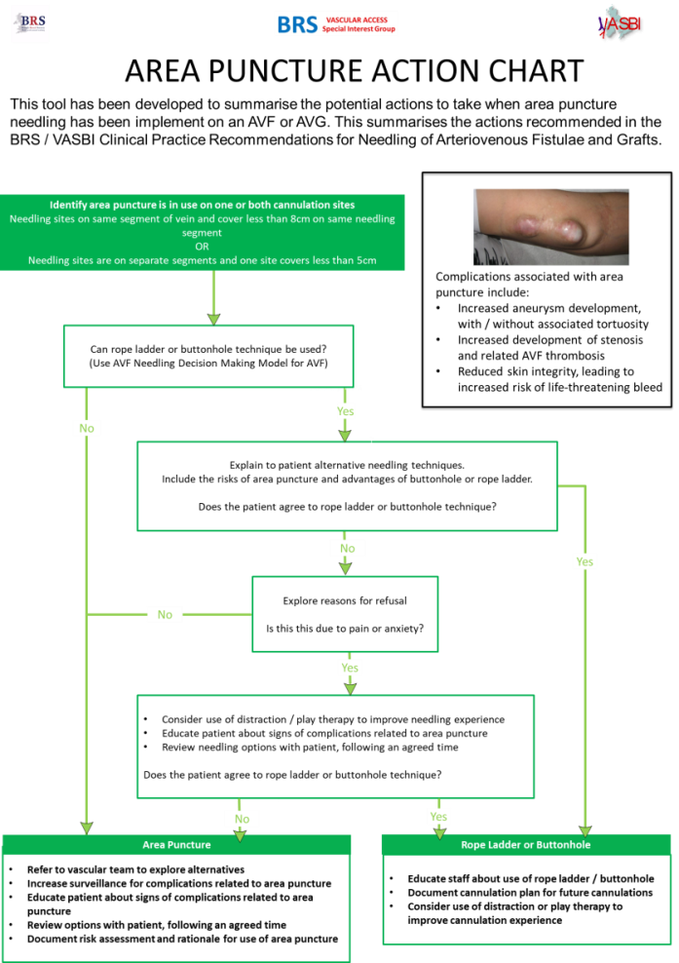
What tools exist?

Slide 5
Consequences of Poor Cannulation
Causes:
Education
Monitoring
Documentation
Ownership
Primary Consequences:
Pain
Bleeding
Haematoma
Stenoses
Aneurisms
Secondary Consequences:
Poor patient experience
Premature Access Failure

Slide 6
What is KQuIP?
MAGIC
Dialysis at Yours
Transplant
First
Kidney Quality Improvement Partnership
Formalised QI Structure
Embed Best Practice
Reduce Variability

Slide 7
What is Magic?
PRESERVE Vascular Access
EMBED
Quality Improvement
IMPROVE
Patient Experience
Managing
Access by
Generating
Improvements in
Cannulation

Slide 9
HOW
PLAN
INTERVENE
EVALUATE
MAINTAIN
Phase 1
Phase 2
MEASURE

Slide 10
PLAN
Phase 1
Staff Education
Phase 2
Patient Awareness
Phase 3
Region Designed
Baseline Measures
Timeline
Teams
Medical and Nursing Lead from each unit
Establish definitions and baseline measurement
Cannulation
Type missed
Unit
Native access rates
Infection rates
Access failure rates

Slide 11
TIMELINE
KQuIP
Training Day 1 Introduction to QI
Training Day 3 Maintaining Momentum
Celebration event
Regional day
Identify QI leads MDT/ Medical
Measurement Platform
Leadership Training Day Shortsmoor & Leadership Into Action
Launch Event patients, peers & stakeholders
Training Day 2 Sharing & learning
April ‘19
Oct ‘19
28 Jan 2020
12 Mar 2020
10 Jun 2020
22 Sep 2020
10 Dec 2020
Leadership
Leadership/ Measurement
Staff education
Regional designed
Patient awareness
What’s next for QI vascular access
Measurement
MAGIC

Slide 12
MEASUREMENT: Metrics
Unit Measures
New Access
Native Access Rates
Bacteraemia Rates
Access Failure
Patient Measures
Cannulation Type
Missed Cannulation
PREM Needling Scores

Slide 13
Measurement: MAGIC Data Platform

Slide 14
Measurement: MAGIC Data Platform

Slide 15
INTERVENTION
Promotion
Raise profile of AVF/G cannulation
Raise expectations and awareness
PHASE 1: Staff education
eLearning module based on BRS/VASBI Best Practice Guideline on cannulation
IMPROVE
Site preparation
Rope Ladder
Buttonholing
Monitoring
REDUCE
Area puncture
Missed cannulation
Pain and anxiety for patients

Slide 16
INTERVENTION
PHASE 2: Patient Education and empowerment
Encourage dialogue between patient and cannulating staff
Improve knowledge and understanding through visual cues

Slide 17
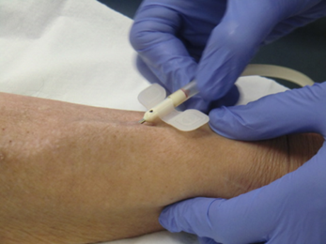
EVALUATION
Phase 1 + 2
Implementation of Intervention
eLearning
Patient Education
Impact of intervention on:
Cannulation type
Missed cannulation
Access rates
Infection rates
Access failure

Slide 18
MAINTENANCE…… TBC!
Embed good practice
Maintain awareness, knowledge, technique
Educate and assess new staff
Ongoing engagement of patients with cannulation
Future planning….

Slide 19
Making Best Practice Usual Practice

Slide 20
QUESTIONS?

