Slide 1
What we have done since we last met
Freeman team

Slide 2
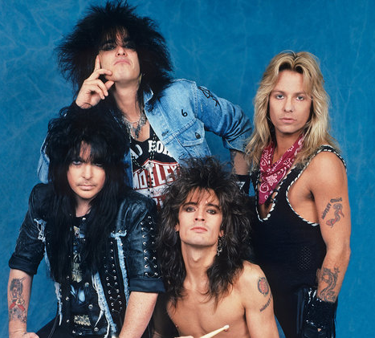
Formed our motley crew

Slide 3
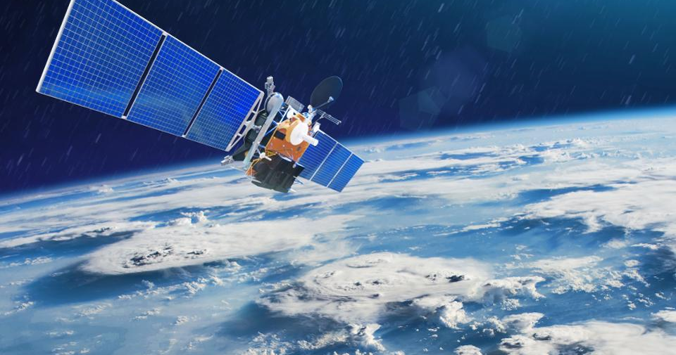
In centre and satellite

Slide 4
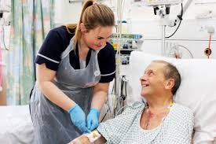
Patient input

Slide 5
Data

Slide 6
Ways to make things easier

Slide 7
MAGIC

